Slide 1
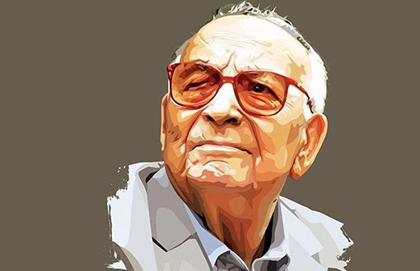
C
«İNCE MEMED»
NOVEL
B
WORKS AND LITERARY PERSONALITY
WHO IS YASAR KEMAL?
A

Slide 2
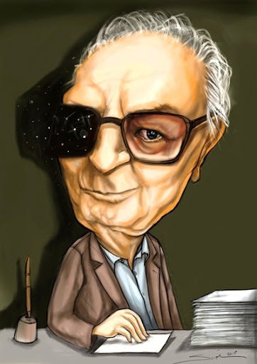
YAŞAR KEMAL
He was born in October 1923 in Van. He had to immigrate with his family from Van to Osmaniye due to the Russian occupation. (He described his experiences during this migration in his works.)
They were the only Kurdish family in Osmaniye. They were forbidden to speak Turkish at home. Her mother only allowed them to speak Kurdish.
He had a difficult childhood.
When he was only 4 years old, he accidentally lost one eye during the sacrifice. When he was 5-6 years old, his father was killed before his eyes. The day after this incident, he began to stutter. (He says he overcame it by singing and singing.)
.

Slide 3
Yasar Kemal; He also talked about the fear of death in his works.
After secondary school, he worked as a farmer and for a certain period of time as a scubaman. He worked in libraries and newsstands.
He moved to Istanbul in the 1950s. He only had a few pages of "İnce Memed" written in his pocket. He slept in the parks for a week.
He knocked on Abidin Dino's door first. supported, encouraged and put him to work in the newspaper Cumhuriyet.
Doing interviews; he was writing articles. He had to change his name because he had caught the attention of the police since Osmaniye.
His interviews with Southeasterners and smugglers attracted a lot of attention. These interviews played a big role in his recognition. He also gained a political identity. He quit journalism and turned to writing novels.

Slide 4
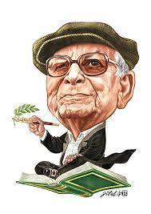
He met a woman named Tilda and they fell in love with each other very much. Tilda played the biggest role in the worldwide recognition of Yaşar Kemal; translated his works. His works were loved by the world. He was now a world writer.
The people embraced Yaşar Kemal because he fearlessly talked about the problems of the people, about being exploited and exploited.
In order to preserve the culture, he traveled from village to village and compiled lullabies, laments and folk songs. (All of these collections were burned in the raid by the police.)
He produced more than forty works. He passed away on February 28, 2015. Before he died, he wanted to tell his life from his own mouth, but he passed away before this wish could be fulfilled.

Slide 5
WORKS AND LITERARY
PERSONALITY

Slide 6








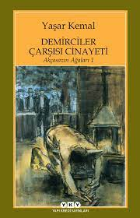


WORKS:

Slide 7
LITERARY PERSONALITY:
He is one of the social realists of the republican period writers.
He handled themes such as nature and village. While the villagers in other authors generally migrated to the city, he described the villager as someone who lived next to the village people. In his works, especially Taurus villagers, Çukurova people have dealt with their lives.
He wrote about the troubles, poverty, labor and the relations of the landlords and the landlords. He made short sentences with a rich vocabulary and preferred a plain and unpretentious language.
In Yaşar Kemal's literary works, a public opinion dominated and he carried out this by combining it with political thought.
In his works; In folk poetry, he tried not to break away from human values, as in epopees. Yaşar Kemal stated that his political views and art are parallel, that he believes in "the people and nature", and that his art is at the disposal of the interests of the proletariat.

Slide 8
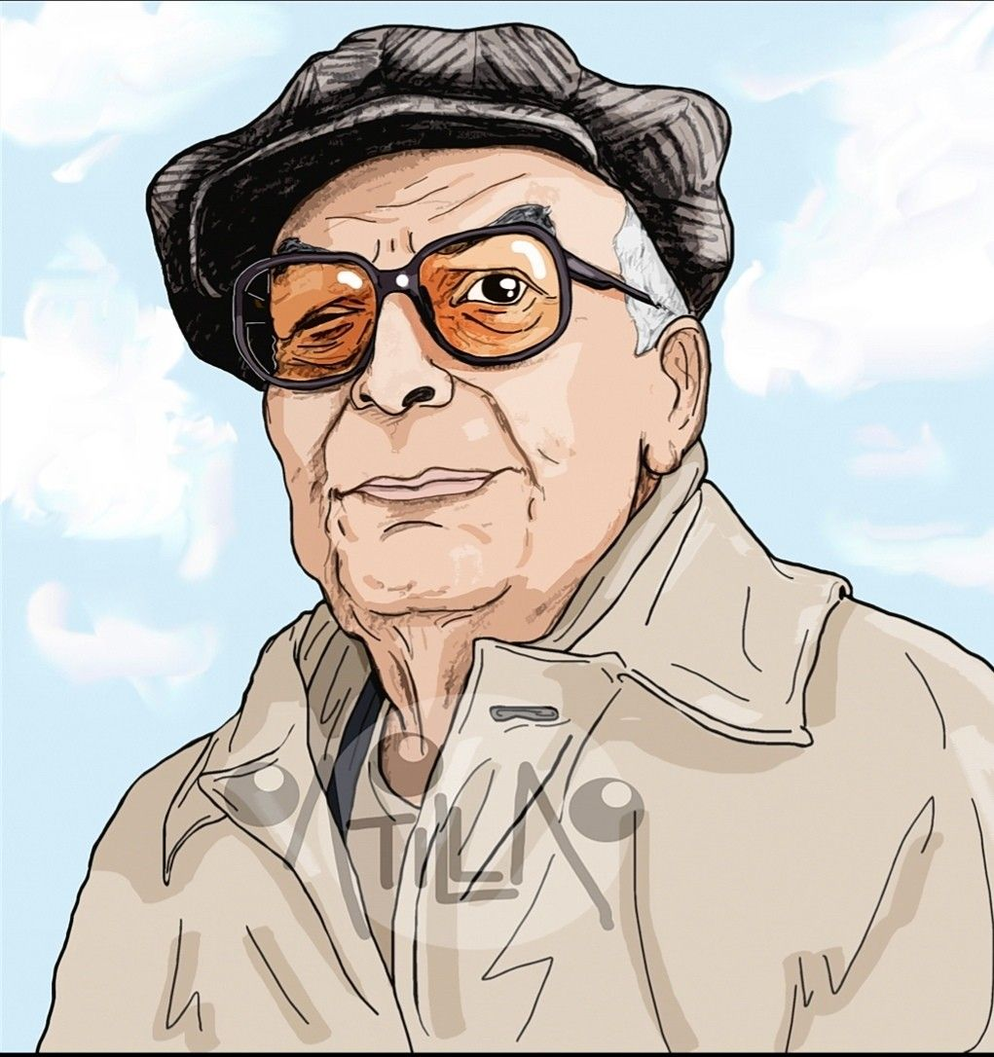
Yaşar Kemal describes himself as a witness of a transitional period:
"I experienced one of the extraordinary events of this century. I had the opportunity to experience the great changes Çukurova went through, and then to observe and write about them. I can happily describe myself as a witness of a transition period in which the old and the new coexist, with all the problems it brings."
He does not hesitate to reflect his socialist stance in his works. Yaşar Kemal explains his struggle as follows:
"This is a whole war, a war to save a world. While we are trying to save the sweat of human beings, we are trying to save the humanity of human beings, and the human values ​​of human beings, while we are trying to save the nature on which human beings live."

Slide 9
İNCE MEMED
BOOK SUMMARY

Slide 10



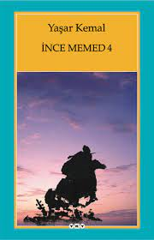
TIME: EARLY YEARS OF THE REPUBLIC
Ince Memed was tired of Abdi Aga's cruelty when he was still a child. Ince Memed, who is constantly beaten mercilessly; Unable to withstand the beatings he received, he decides to flee the village and flees to a nearby village. He took refuge in Kara Osman, who lived in this village, and worked as a shepherd there for a certain period of time. He is happy with his life and the decision he has taken, but things did not go smoothly, Abdi Aga had İnce Memed bring back to the village. The tortured life begins again and the persecution continues to increase. The character named Abdi Aga is a landlord of 5 villages and lives in Değirmen Oluk village. It starves the villagers and steals their rights. İnce Memed, whose father died in his time; with his mother; is scarce. While he can't even imagine a village without an Agha, a spark comes to his mind and when İnce Memed turns 18, he goes to Çukurova with a friend. İnce Memed is in love with his villager Hatce, but Abdi Aga has engaged Hatce to his niece.

Slide 11
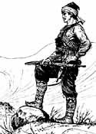
Learning about this love, Abdi Aga follows İnce Memed and Hatce.
Here, a character named Topal Ali is included in the story. Topal Ali is a great scout and is known all over Çukurova.
Abdi Aga makes Topal Ali find Hatce and Memed. Abdi Aga and Memed come face to face. Ince Memed draws his gun and shoots Kel Veli, Abdi Aga's nephew. Veli dies, Abdi Aga is injured.
After this incident, İnce Memed arrives at Koca Süleyman. Koca Süleyman offers to make him a bandit and Memed joins the Deli Durdu Gang.
Memed is a noble bandit type. He takes from the rich and gives to the poor. It protects the people and the peasantry. It is against oppression. All he cares about is getting revenge on those who oppress him. On the contrary, Deli Durdu is a grouping that aims to rob the whole people.
Memed leaves Deli Durdu with 2 of his friends and the adventure of Deli Durdu ends here.

Slide 12
Ince Memed learns that Abdi Aga is not dead. He wanders in the mountains. Amnesty is issued for the 10th anniversary of the Republic. Bandits come down from the mountain. Naturally, İnce Memed also goes to his village and Hürü mother İnce Memed scolds him not to surrender. Memed goes and kills Abdi Aga.
İnce Memed became a legend and became famous in other villages. He also begins to deal with the troubles of other villagers. Besides his own village, he also deals with the village of Vay Vay. There is a tyrant named Ali Safa here. İnce Memed stands with the Vay Vay villagers and kills Ali Safa Bey. However, he also kills Hamza. He is the brother of Hamza Aga. Hamza Değirmen has caused great troubles to the village of Oluk.
He became famous all over Çukurova, but one day he was shot by the gendarmes while escaping, and he was found and healed by the Yörüks. He has some good friends with him. Anacik Sultan steps in. (The head of Tekice) Anacık, who is very respected, gives a ring to Sultan Memed. The one who wears this ring says that lead does not work, Anacik Sultan says. Anacik Sultan is a woman who resurrects even the dead with her medicines. Reliable on its own terms.
Ince Memed comes to his senses. Everyone in Çukurova is now afraid of İnce Memed. Hearing Memed's name from the other village, Mahmut Aga follows İnce Memed. Ince Memed also kills Mahmut Aga and leaves Murtaza Aga.

Slide 13
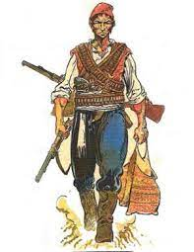
Ince Memed decides to quit banditry. Ferhat Hoca is a person whom he met and loved very much in the village of Vay Vay. Ferhat Hoca is now with Ince Memed. Ferhat Hoca sends Ince Memed to Abdulselam Hoca. He pretends to be his nephew. He buys a house, he buys a garden… He takes his beloved Seyran with his mother Hürü (Hatce is dead); Seyran is from Vay Vay village.
Even though the bandit seems like a normal citizen who has left his life, he is faced with cruel people wherever he goes. Here, too, he meets Mr. Şakir. Mr. Şakir caused people to die of malaria. Finally, he kills Mr. Şakir and goes back to the mountain next to Ferhat Hoca.
The breast is slandered. Azmi Bey searches for him and beats anyone who gets in his way, but he cannot kill Memed and dies. Ince Memed kills Raif Saim Bey. He goes to his village and says goodbye to everyone and says he will come again.
Ince Memed is lost with death.

