Slide 1
THE COMMON POINTS
OF HUNGARY-TURKS
ERASMUS 2021 PROJECT

Slide 2
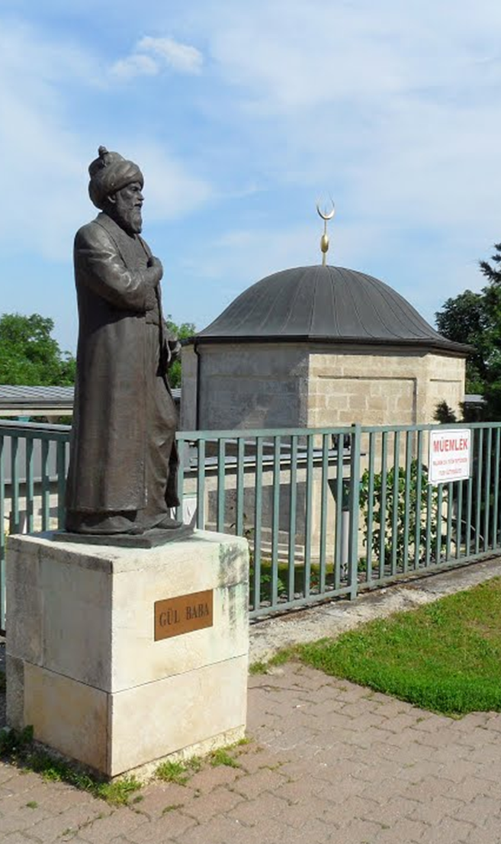
GÜL BABA TOMB
Gül Baba Tomb is the tomb of Gül Baba located in Budapest, the capital of Hungary.
Gül Baba is buried on a high hill in Budapest and the hill is called "Gültepe"

Slide 3
Gül Baba died on September 2, 1541, during the Budin expedition of Suleiman the Magnificent.According to historical records, Suleiman the Magnificent personally attended the funeral prayer of Gul Baba.
Gül Baba Tomb was built by Yahya Paşazade Mehmet Pasha, who was the 3rd Governor of Budin during the period of 1543-1548.
Gül Baba Tomb, which is considered the symbol of Turkish-Hungarian friendship, is located in the region known as Rose Hill (Rozsadomb) in the capital Budapest.

Slide 4
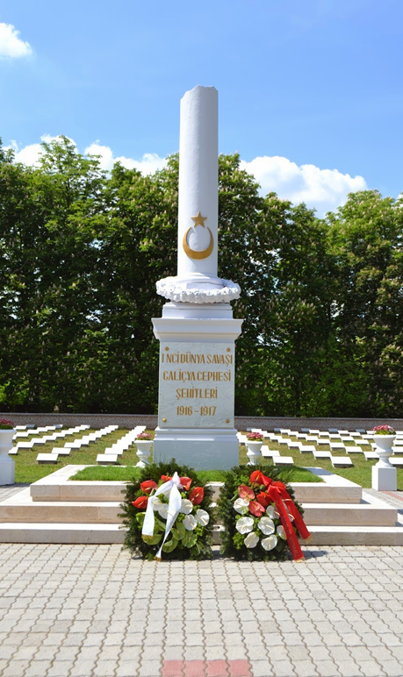
BUDAPEST MARTYRY
During the First World War, the 15th Turkish Army Corps, which served under the German South Army between 1916-1917 on the Galician front, lost many martyrs.The bodies of some of our soldiers who were martyred on the Galician front, as well as in various regions of Hungary, were transferred to the Turkish Martyrdom of Budapest, established in 1926.

Slide 5
There are 480 martyrs in the Turkish Martyrdom of Budapest, 11 of whom are unknown soldiers. The total area of the martyrdom is 4598 m2, and the section with the graves of martyrs covers an area of 1718 m2.
Budapest City Cemetery and in the middle of which there is a Monument to the Galician Martyrs with a moon-star, and the Turkish Flag is hoisted to the post.
Every year, scheduled commemorations are held by us on March 18, Martyrs' Day, and by the Hungarian side on November 1, "Day of the Dead".

Slide 6
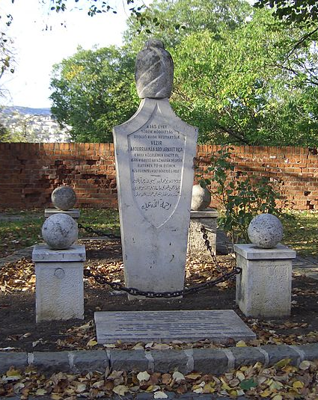
ABDURRAHMAN ABDİ PASA TOMB
The tomb of the last Budin Governor, Albanian Abdurrahman Abdi Pasha, is located just inside the walls of Budin Castle, in front of the Military History Museum. Despite his advanced age, he was martyred while protecting the Castle until his last breath with a sword in his hand. His body was found by a Hungarian looking for his son and buried in the same place. It is estimated that the Pasha died in the place where the tomb was made.

Slide 7
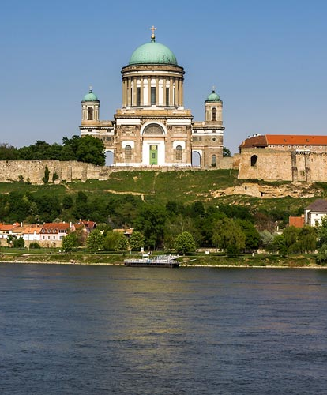
ESTERGON CASTLE
Esztergom Castle, which was the administrative and religious center of the Hungarian Kingdom, where the Ottoman Empire ruled for a total of 130 years between 1543-1595 and 1605-1683, continues to stand with all its glory.
Esztergom Castle, which is the first capital and a sacred religious center for the Hungarians and the subject of folk songs and marches for the Turks, is located on the banks of the Danube, about 60 kilometers from the capital Budapest.

Slide 8
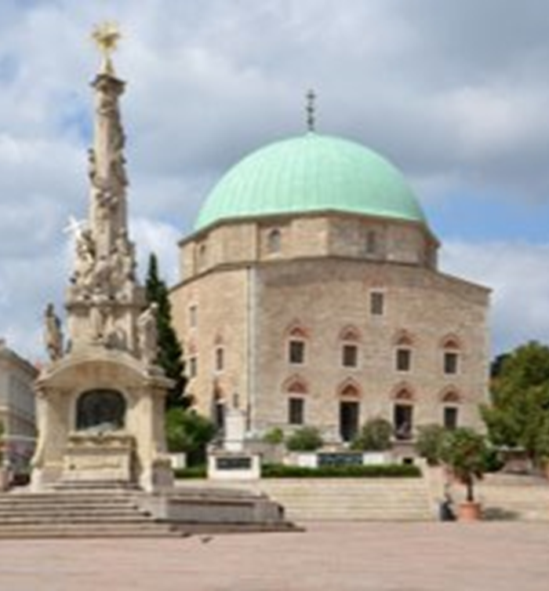
GAZİ KASIM PAŞA MOSQUE
It is a historical Ottoman mosque located in the Hungarian city of Pechuy.
The mosque, which was started to be built after conquest of Suleiman the Magnificent, was demolished and turned into a church when the Muslims left the area.
The building, located in Széchenyi, one of the crowded squares of the city, attracts the attention of those who see it. The interior of the mosque is just as interesting.

Slide 9
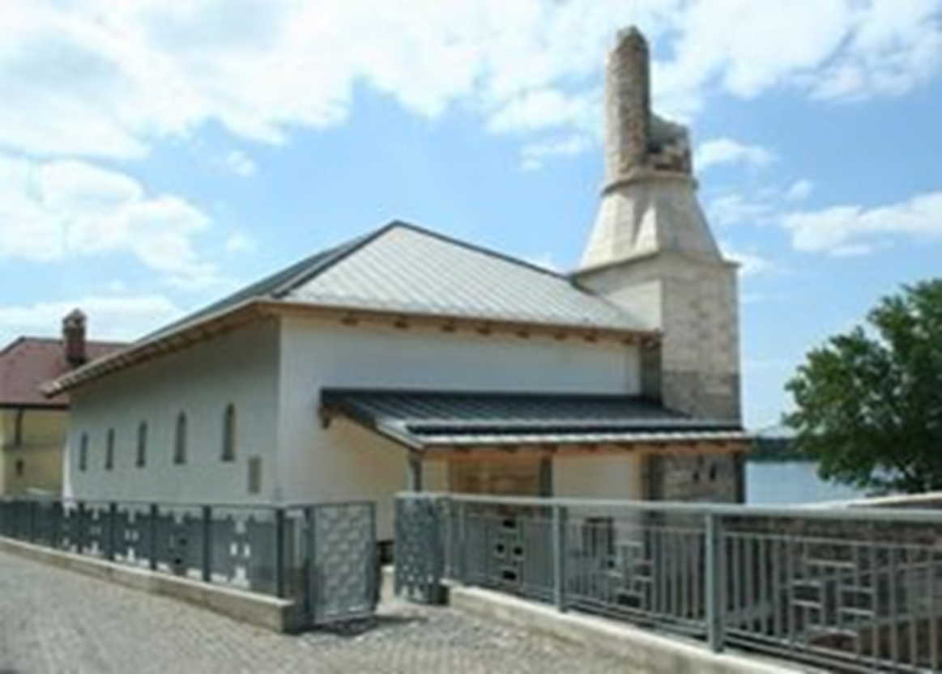
ÖZİÇELİ HACI İBRAHİM MOSQUE
Built in 1605 in Estergon, Hungary, the 4 centuries-old historical Öziçeli Hacı İbrahim Mosque was flooded due to the rising water level of the Danube River.​ ​
Öziçeli Hacı İbrahim Mosque, which was built during the Estergon rule of the Ottoman Empire between 1543 and 1683, but only remained underground until 2006 and was rebuilt in accordance
with the original, is located in the Zigmond Berenyi street of the city of Estergon, in front of the Estergon Castle and on the banks of the Danube River. It is right on the coast.

Slide 10
TURKİSH CEMETERY İN BUDAPEST CASTLE
In the southern corner of Buda Castle facing the Danube River, there are the graves of Ottoman soldiers who are understood to have been martyred during the loss of Budin. The cemetery, which has as many as 15 tombstones left, is enclosed in a fence. Hungarian Turkish inscriptions, which are estimated to have been placed in the cemetery around the year 1900, contain the inscriptions “Török Temetö - Türk Cemetery” and an engraved sketch of the castle area on the stone related to muhasara, where Budin was lost.

Slide 11
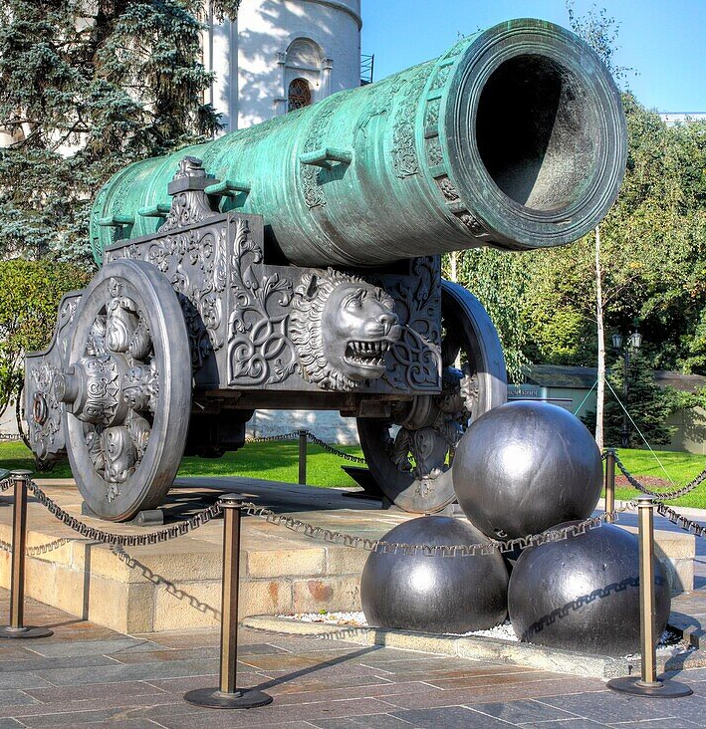
ŞAHİ-MACAR URBAN
The Shahi is the largest and special cannon of the period, which was made during the Ottoman Empire and used in the conquest of Istanbul.
The construction of the ball, which took three months, was made by Turkish engineers under the leadership of Fatih Sultan Mehmet, and the casting of the ball was done by a foundryman named Hungarian Urban, whom the Byzantines had previously deported.

Slide 12
SIMILARITIES IN LANGUAGE
Even if the language changes over the years, there are similar words left over from the past.
Elma – Alma
Keçi - Kescke
Kapı - Kapu
Deve - Teve
Amin - Amen
Bıçak - Bicska
Çizme - Csizma
Otel - Hotel
Koç - Kos
Kumpir - Krumpli
Kapak - Kupak
Asya - Ǻzsia
Şapka - Sapka
Şal - Sa'l
Patlıcan - Padlizsan

Slide 13
CULINARY CULTURE SIMILARITIES
Spices are used a lot in Hungarian dishes and Turkish cuisine.
Paprika is frequently used in both cuisines.
Meat and fish consumption is high in both cuisines.
Pickles are among the most commonly consumed foods in both cultures.

Slide 14
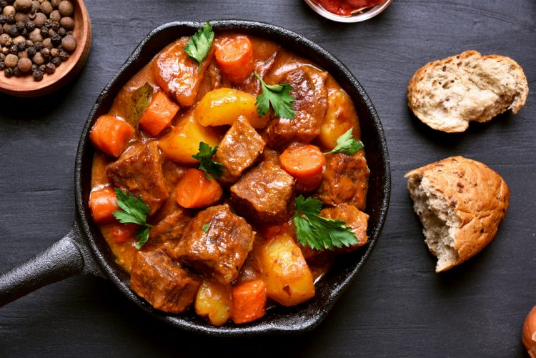
GULAŞ FOOD
Goulash, one of the traditional dishes of Hungary, is usually made from beef, onions and red peppers.
It is a dish that is frequently preferred in Central and Eastern Europe and is likened to tas kebab.
Goulash, whose origin dates back to the 9th century and means "shepherd", is actually a boiled dish eaten by Hungarian shepherds.

Slide 15
ARE HUNGARY AND
TURKS FROM THE SAME GENE?
In the years when the Hungarians came to Central Europe, III. According to the DNA sample taken from Bela's bone samples, it revealed that the genes of Hungarians at that time were of Asian origin.
The same research was carried out on the remains of the newly found tombs of a group of people from the first Hungarian tribes who settled on these lands a thousand years ago. The result was the same: The first Hungarians were of Asian descent, and their genes were even 25-30 percent similar to those of Asian Turks.

Slide 16
WE HAVE COMMON THİNGS AND
THERE WILL ALWAYS BE
Turks and Hungarians lived in a common geography for 150 years.
Accordingly, there are cultural interactions from the past.

Slide 17
Thank you for listening to us.

