Slide 1
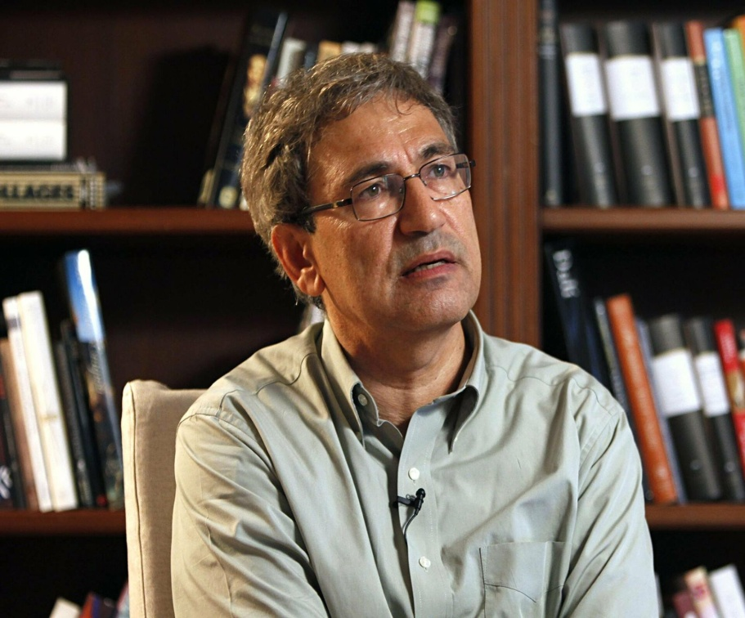
the life of Orhan Pamuk
Orhan Pamuk was born in Istanbul in 1952. He grew up in a crowded and wealthy district of Nişantaşı. Although the generation before his father was rich and wealthy, he says in an interview: Two generations before me, when the world was a brighter and rich family, they lost their money and dispersed, starting with my father's generation. So we broke up. As for Istanbul, it was one of the most important cities of Europe and the world in the 1800s, but in the mid-1900s, it was too late. When I was born in 52, that wealth and splendor had already ended.
ORHAN PAMUK
1952/ISTANBUL

Slide 2
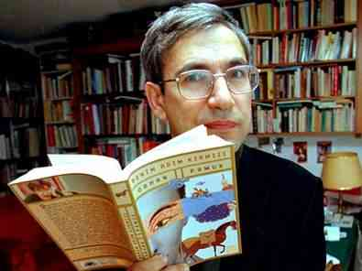
He completed his high school education at Robert College in Istanbul. After studying architecture at Istanbul Technical University for three years, he decided that he would not be an architect and painter and left school. He studied journalism at Istanbul University. But he didn't do journalism either. He had a love and hate
relationship with music. Music was a consolation tool for him. When things didn't go the way he wanted in life, music would distract him from his troubles. He has a very conservative understanding of music. He kept music out of his life because he thinks that what he needs for writing is not consolation.

Slide 3
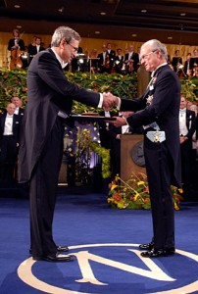
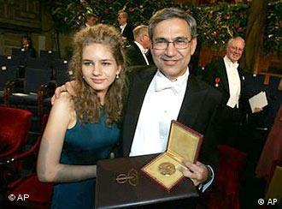
LITERATY PERSONALITY
He is the first and only Turkish writer to be awarded the Nobel Prize in literature. Orhan Pamuk is a writer who researches and reads a lot and writes his novels meticulously without haste. He is a writer whose name is identified with novel as he prefers to write only novels. He values ​​inner conversations very much. He also quoted a lot from different texts such as history, philosophy, newspapers, and poetry. In order not to follow the West, he turned to Turkish culture, and directed our culture and beliefs in his works, our motifs from old books. The "information" among the technical errors of the Tanzimat also shows itself in Orhan Pamuk's novels. Narration techniques and postmodernist approach in his novels attract attention. Orhan Pamuk did not like shallow and simple sentences, so he used long sentences a lot.

Slide 4
AVARDS WON
1979 Milliyet Novel Competition Award Dark and Light (shared between two authors)
1983 Orhan Kemal Novel Award Cevdet Bey and His Sons
1984 Madarali Novel Award Silent House
1990 Independent Foreign Fiction Award (UK) Beyaz Kale
1991 Prix de la Découverte Européene (France) Quiet House (dueto the French translation)
1991 Antalya Golden Orange film festival best screenplay Hidden Face
2002 Prix du Meilleur Livre Etranger (France) My Name Is Red
2003 Premio rinzane Cavour (Italy) My Name Is Red
2003 International Impac-Dublin Literary Award (Ireland)
2005 Prix Médicis Etranger (France) Snow
2005 Peace Prize of the German Publishers Association (Germany)
2005 Richarda Huch Award (Germany)
2006 Le Prix Méditerranée étranger Prize (France) Profit
2006 Nobel Prize in Literature
2008 Ovid Award (Romania)
2010 Norman Mailer Lifetime Achievement Award (USA)
2012 Sonning Award

Slide 5
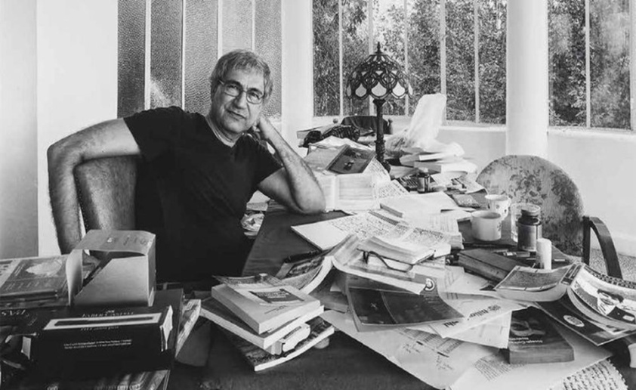
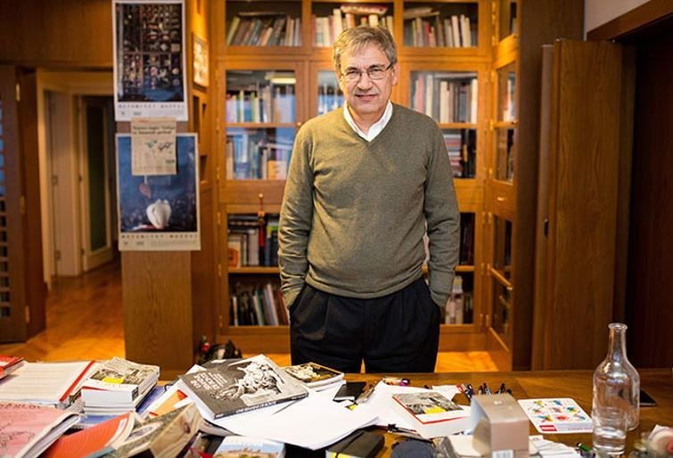
SOME OF HIS WORKS
Cevdet Bey and His Sons
Quiet House
White Castle
The Black Book
New Life
My Name Is Red
Snow
Museum of Innocence
A Strangeness In My Mind
Black Book 25 Years Old
Red Haired Woman

Slide 6
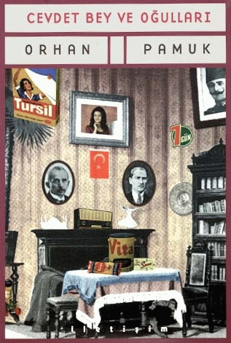
FIRST NOVEL
Orhan Pamuk started writing in 1974. In 1979, he shared the first prize with Mehmet Eroğlu in the Milliyet Novel Competition, which he participated in with his first novel "Darkness and Light". This novel was published in 1982 as Cevdet Bey and His Sons. In 1983, he was awarded the Orhan Kemal Novel Award with this book.
Cevdet Bey and His Sons is Orhan Pamuk's first novel, published in 1982, in which the life of a merchant family from 1905 to 1970 and the social, economic and cultural history of the Republic of Turkey are told around this story.
1979

Slide 7
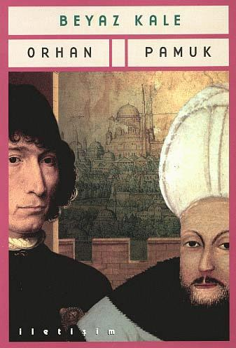
Beyaz Kale (White Castle)
The events of this story take
place in 17th century Istanbul.
The story is about a young Italian scholar sailing from Venice to Naples who is taken prisoner by the Ottoman Empire. Soon after, he becomes the slave of a scholar known as Hoja, a man who is about his own age, and with whom he shares a strong physical resemblance.

Slide 8
Hoja reports to the Pasha, who asks him many questions about science and the world. Gradually Hoja and the narrator are introduced to the Sultan, for whom they eventually design an enormous iron weapon.
The slave is told to instruct the master in Western science and technology, from medicine to astronomy. But Hoja wonders why he and his slave are the persons they are and whether given knowledge of each other's most intimate secrets, they could actually exchange identities

Slide 9
THANKS FOR
LISTENING
Prepared by :
Kerem Can Karadağ
Utku Batu Kurt

