Slide 1

Stephen King
The Master Of Horror
and his creepy creations
By Zsombor
Stephen Edwin King is an American writer and one of the most widely read authors of our time. His works have been translated into more than 40 languages and have sold more than 400 million copies worldwide.

Slide 2
Stephen King
The Master Of Horror
Stephen Edwin King is an American writer and one of the most widely read authors of our time. His works have been translated into more than 40 languages and have sold more than 400 million copies worldwide.
He was born Stephen Edwin King on September 21, 1947, in Portland, Maine.
Stephen started writing stories at the age of 7 after finding a box full of horror and science fiction books in his aunt's house.

Slide 3
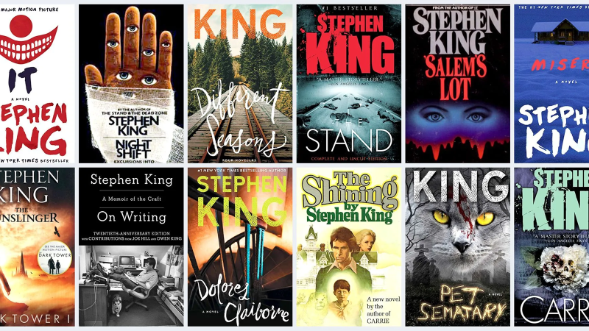
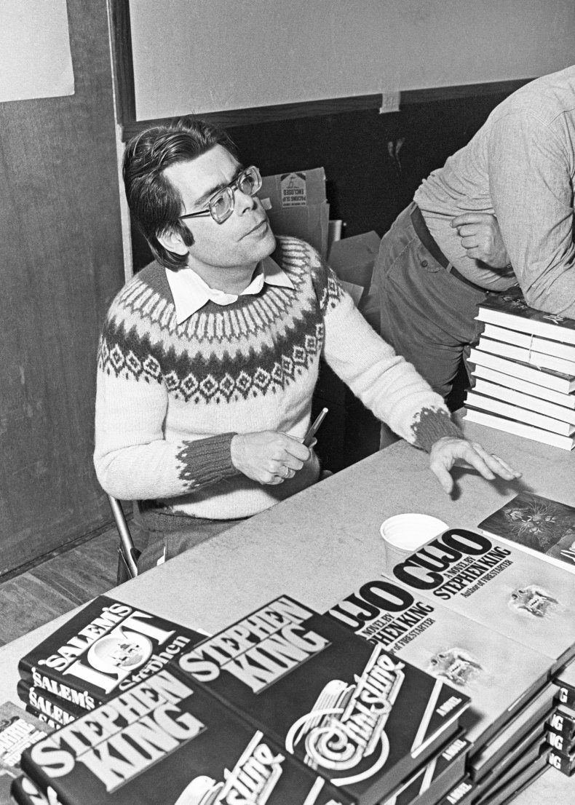
King supported himself while writing short stories by teaching and working as a janitor, among other jobs. His first published novel, Carrie, was released in 1974 (1976 and 2013 film) and was an instant hit.

Slide 4
King supported himself while writing short stories by teaching and working as a janitor, among other jobs. His first published novel, Carrie, was released in 1974 (1976 and 2013 film) and was an instant hit.

Slide 5

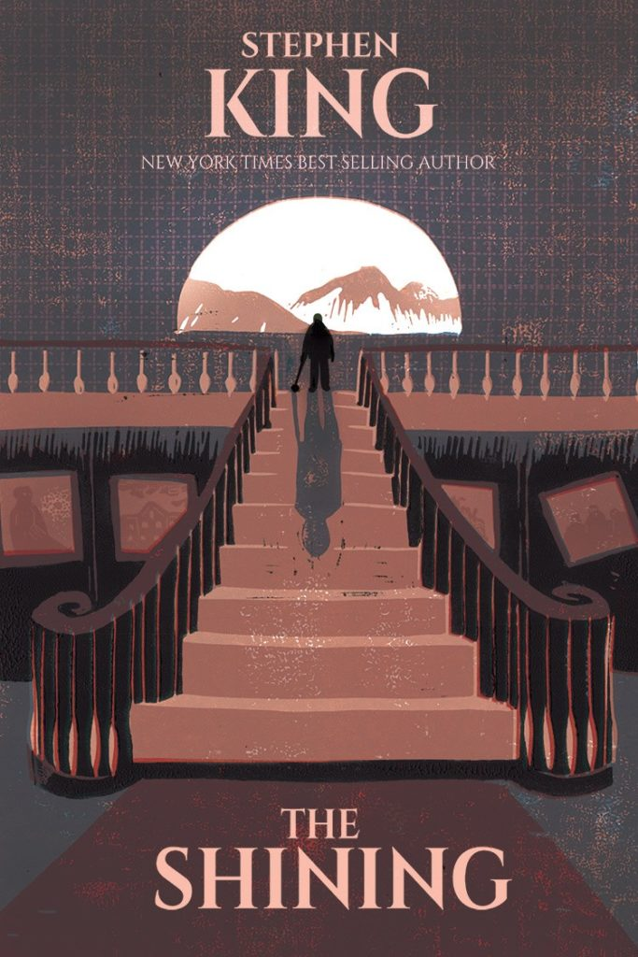

The biggest success stories
in order of publication

Slide 6
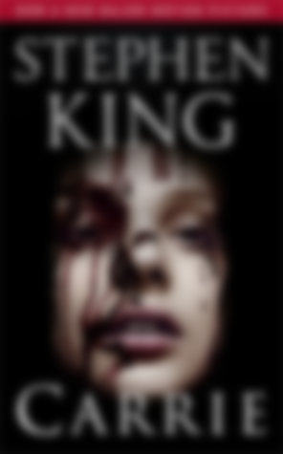
The biggest success stories
Carrie
is one of King's most mature, well-crafted works to date, and one that would surely end up on the podium for both rawness and eloquence.
1974
in order of publication

Slide 7
The biggest success stories
in order of publication

Slide 8

The biggest success stories
The Shining
The book is one of the author's early works, but even in this one, the pithy storytelling and the clever and exciting use of horror elements are crystal clear. King is incredibly good with his characters, giving them depth and bringing them so close to the reader.
1977
in order of publication

Slide 9
The biggest success stories
in order of publication

Slide 10

The biggest success stories
IT
One of King's magnum opus, almost his longest work, one of his most terrifying yet most beautifully written books is
IT . The novel is a combination of King's strengths
1986
in order of publication

Slide 11

LET’S LOOK AT OUR FAVOURITE

Slide 12




Slide 13
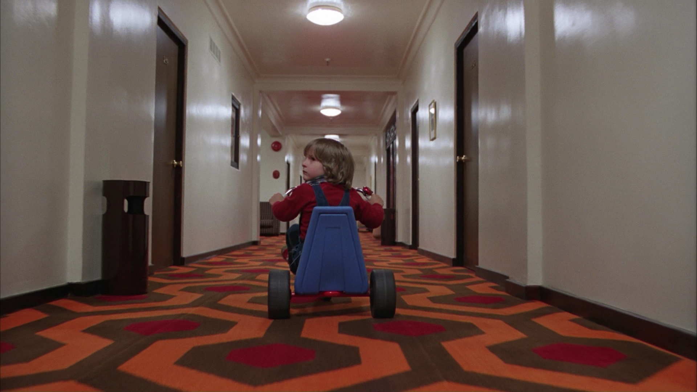
The setting and characters are influenced by King's personal experiences, including both his visit to The Stanley Hotel in 1974 and his struggle with alcoholism.
The novel was adapted into a 1980 film of the same name. The book was followed by a sequel, Doctor Sleep, published in 2013, which was adapted into a film of the same name.
ABOUT THE
BOOK

Slide 14
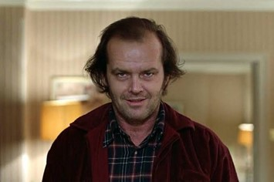

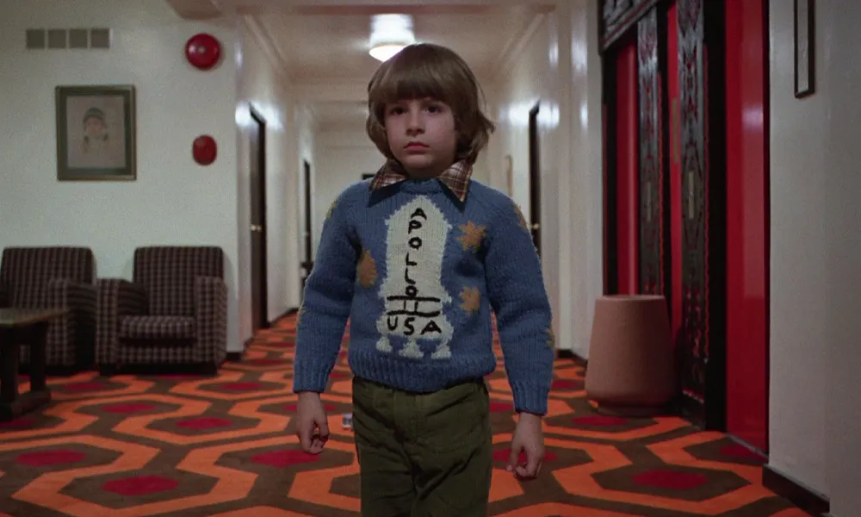
ABOUT THE
CHARACTERS
JACK
WENDY
DANNY
Jack is the husband of Wendy Torrance, the father of Danny Torrance and Lucy Stone; he was an author and former teacher. The evil spirits, which inhabit the hotel, drive him crazy and force him to attempt to murder his family with a roque mallet.
Wendy Torrance is drawn, like many of King’s female characters, as a traditional wife and mother. Wendy has some psychological problems of her own: She is always unconsciously competing with her mother, who resented Wendy for the death of a younger sister, and who has derided her choice of Jack as a husband.
The older half-brother of Lucy Stone and the uncle of Abra Stone. He has the "shining", which allows him to detect spirits, thus making him a prime target of the Overlook Hotel.

Slide 15

ABOUT THE
SCRIPT
The Shining centers on the life of Jack Torrance, a struggling writer and recovering alcoholic who accepts a position as the off-season caretaker of the historic Overlook Hotel in the Colorado Rockies
His family accompanies him on this job, including his young son Danny Torrance, who possesses "the shining", an array of psychic abilities that allow Danny to see the hotel's horrific past.
Soon, after a winter storm leaves them snowbound, the supernatural forces inhabiting the hotel influence Jack's sanity, leaving his wife and son in incredible danger.

Slide 16


THANK YOU FOR YOUR ATTENTION
https://theshining.fandom.com/wiki/The_Shining_(film)

