Slide 1
READING WEEK
PIARIST HIGH SCHOOL IN RZESZOW, POLAND

Slide 2
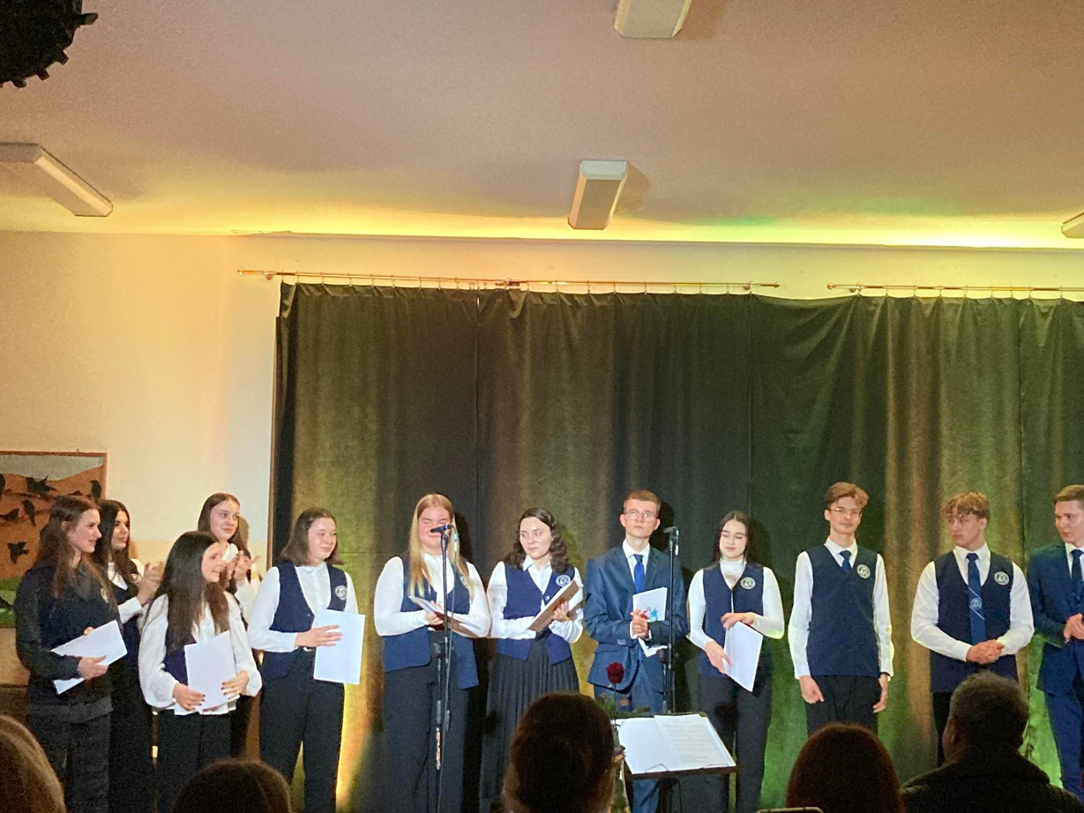
JANUARY 9-13
During 5 days in our school we organised the second edition of reading week connected with Erasmus plus project
We promoted reading through drama performances.

Slide 3
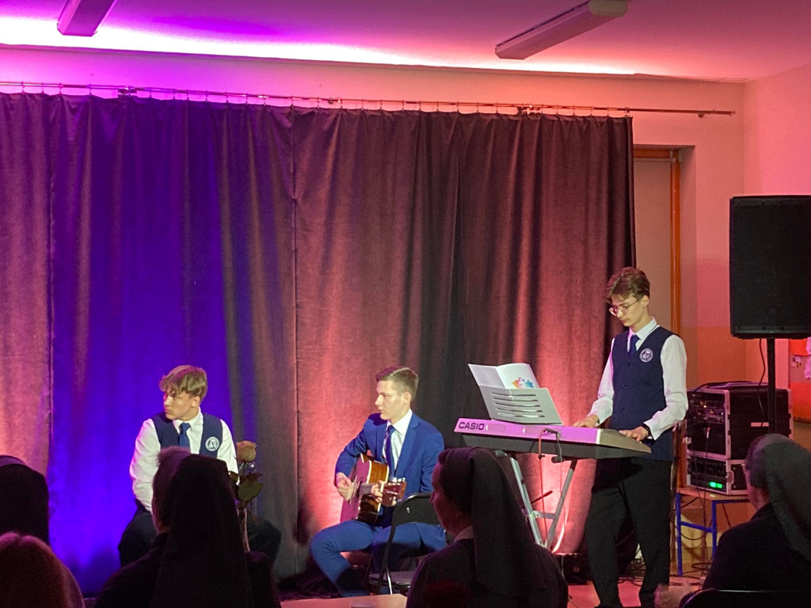
Evening with drama
We organized an evening both for students and parents during which we were reading our poems and short stories. The literature was combined with pieces of music.

Slide 4
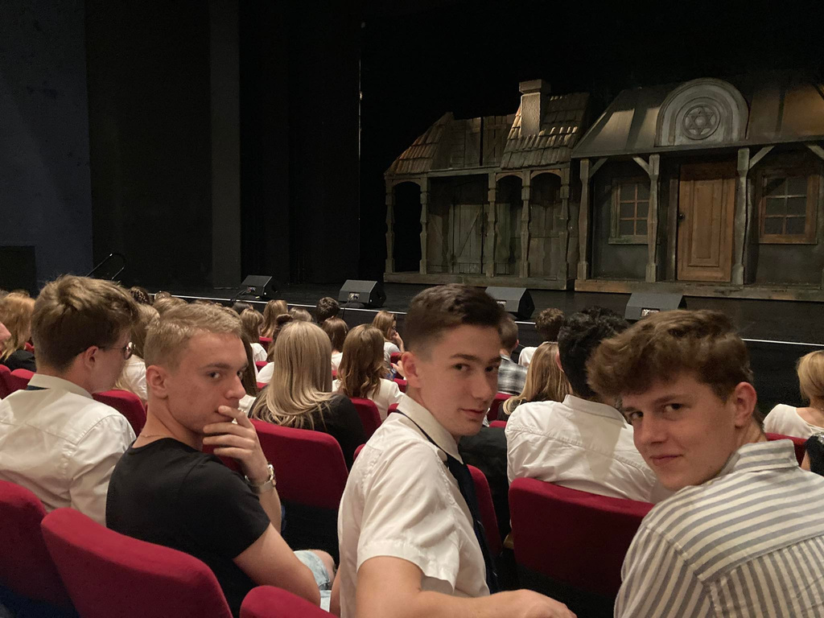
Visit at the theatre
As the next opart of the reading week we visited local theatre. We saw a musical called "Fiddler on the roof" based on "Fiddler on the Roof" by Sholom Aleichem's Stories

