Slide 1
My favourite books
Ania Szczepanik

Slide 2
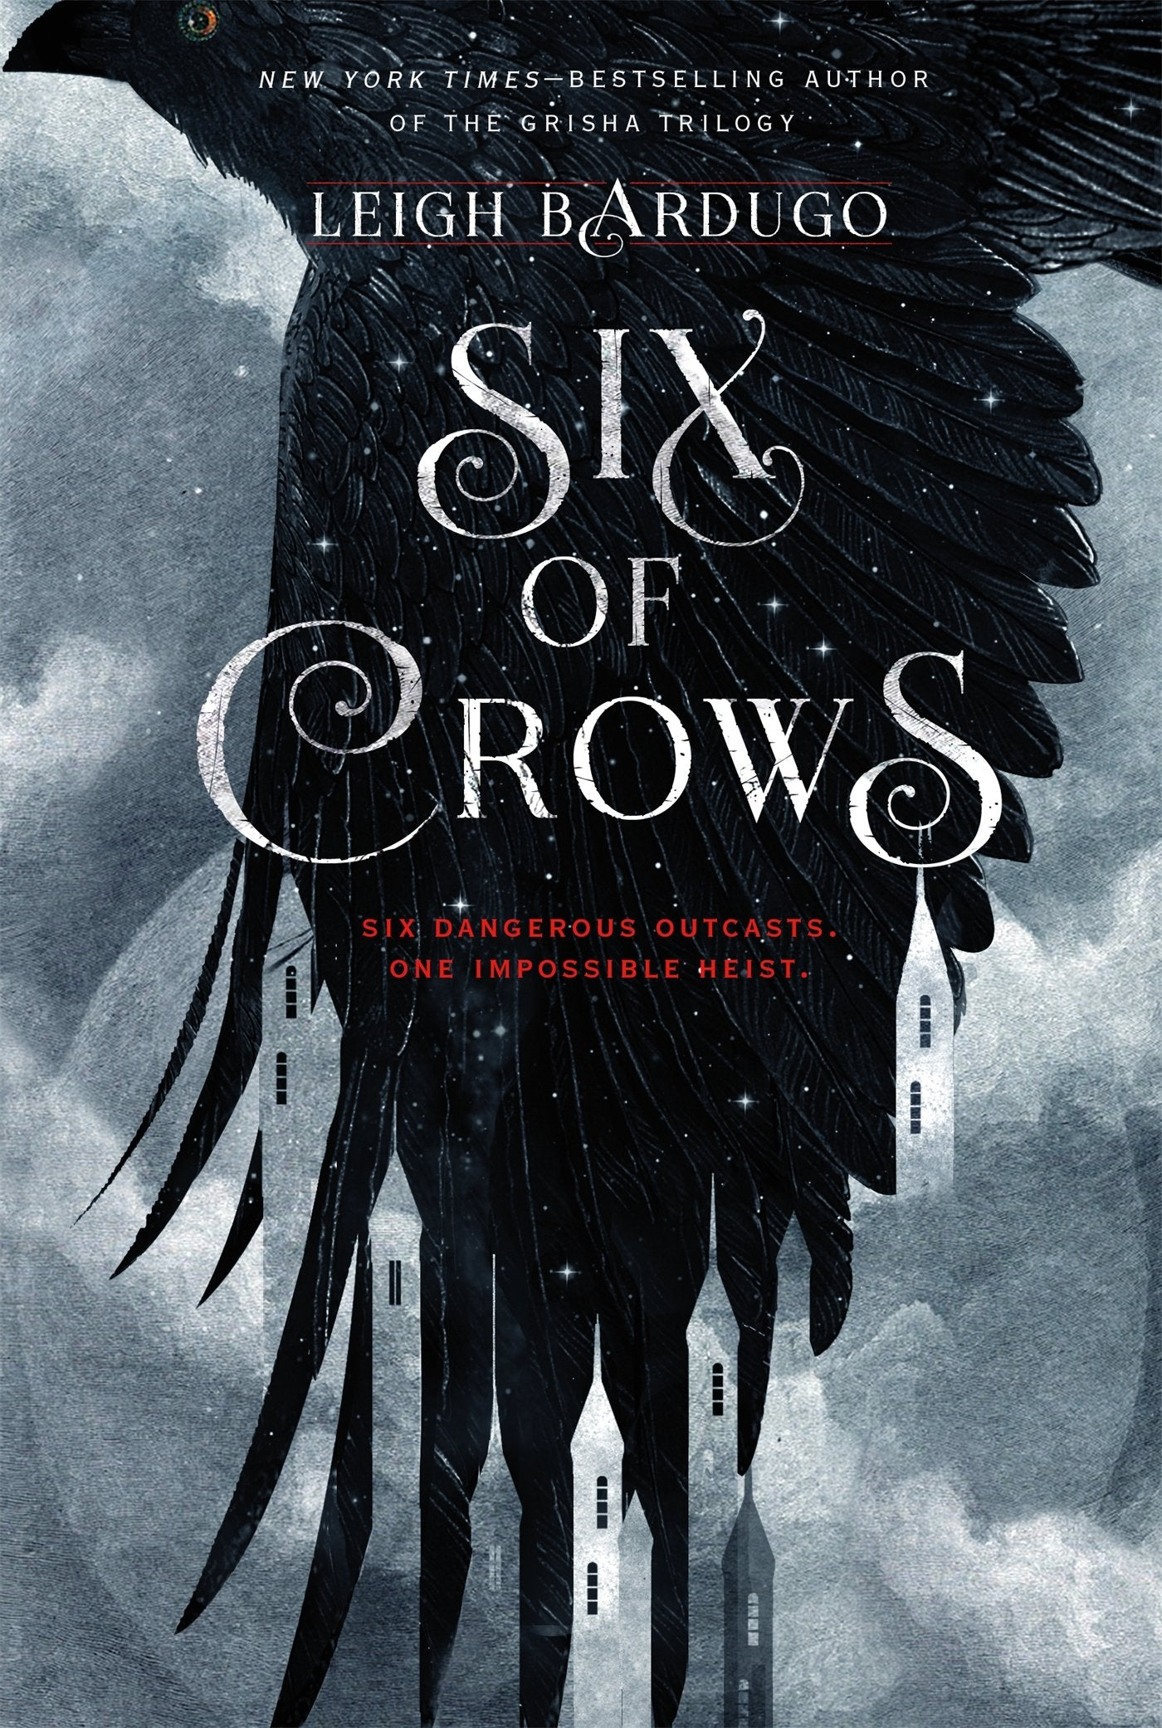
SIX OF CROWS
Author: Leigh Bardugo Country: Unitet States Genre: Fantasy, Young Adult

Slide 3
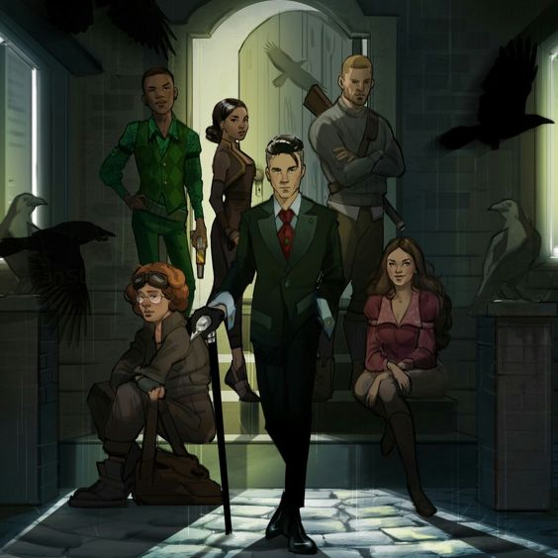
This book was recommended to me many times by my friend but I didn’t feel like reading it, but when I did, I fell in love with it.

Slide 4
PLOT
Action takes place in Ketterdam – the city of international trade in an imaginary world. The main character is Kaz Brekker, who belongs to the gang and is known for his ruthlessness. For the money he wants to carry out an almost imposible robbery, but he needs the right people to do the job.

Slide 5
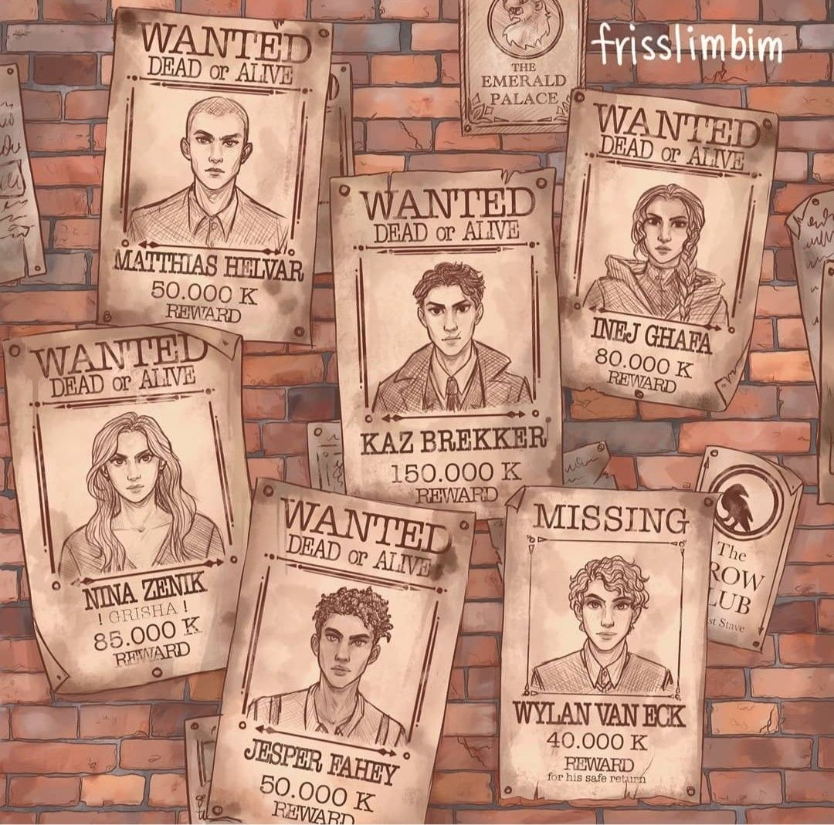
CHARACTERS
What I love about this book are characters. Each chapter is written from another character’s perspective, so we get to know them as the story progresses. Each of them is different, has a difficult life and some sort of trauma. Despite the fact that they are 16 or 17 years old, they have nothing to lose and money may help them build a better life.

Slide 6
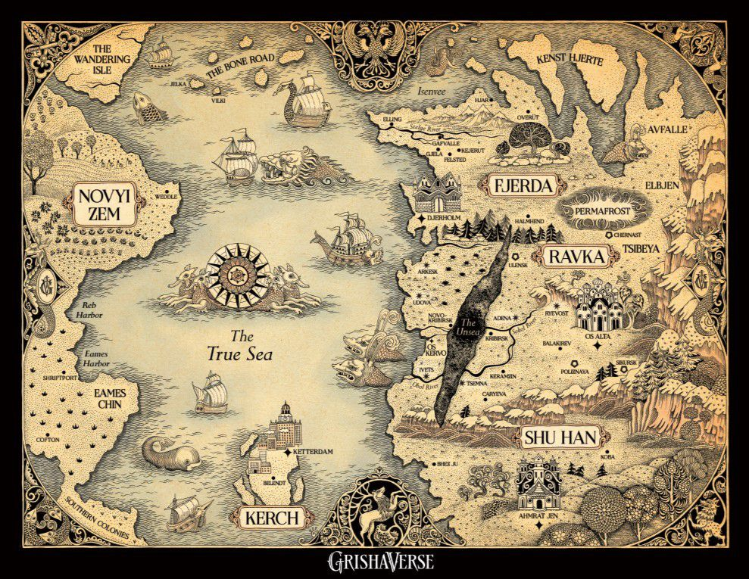
THE WORLD OF GRISHA
Another aspect I like about this book is the world created by the author. There are different cultures and countries. One of them is Ravka, where Grisha live. Grisha are humans who have some extraordinary abilities, but they don’t call it magic, they practice the Small Science. Their skills are based on the manipulation of matter, which Grisha must learn. Everything about it is described in more details in the Grishaverse trilogy by the same author as „Six of Crows”. I haven’t read these books yet.

Slide 7
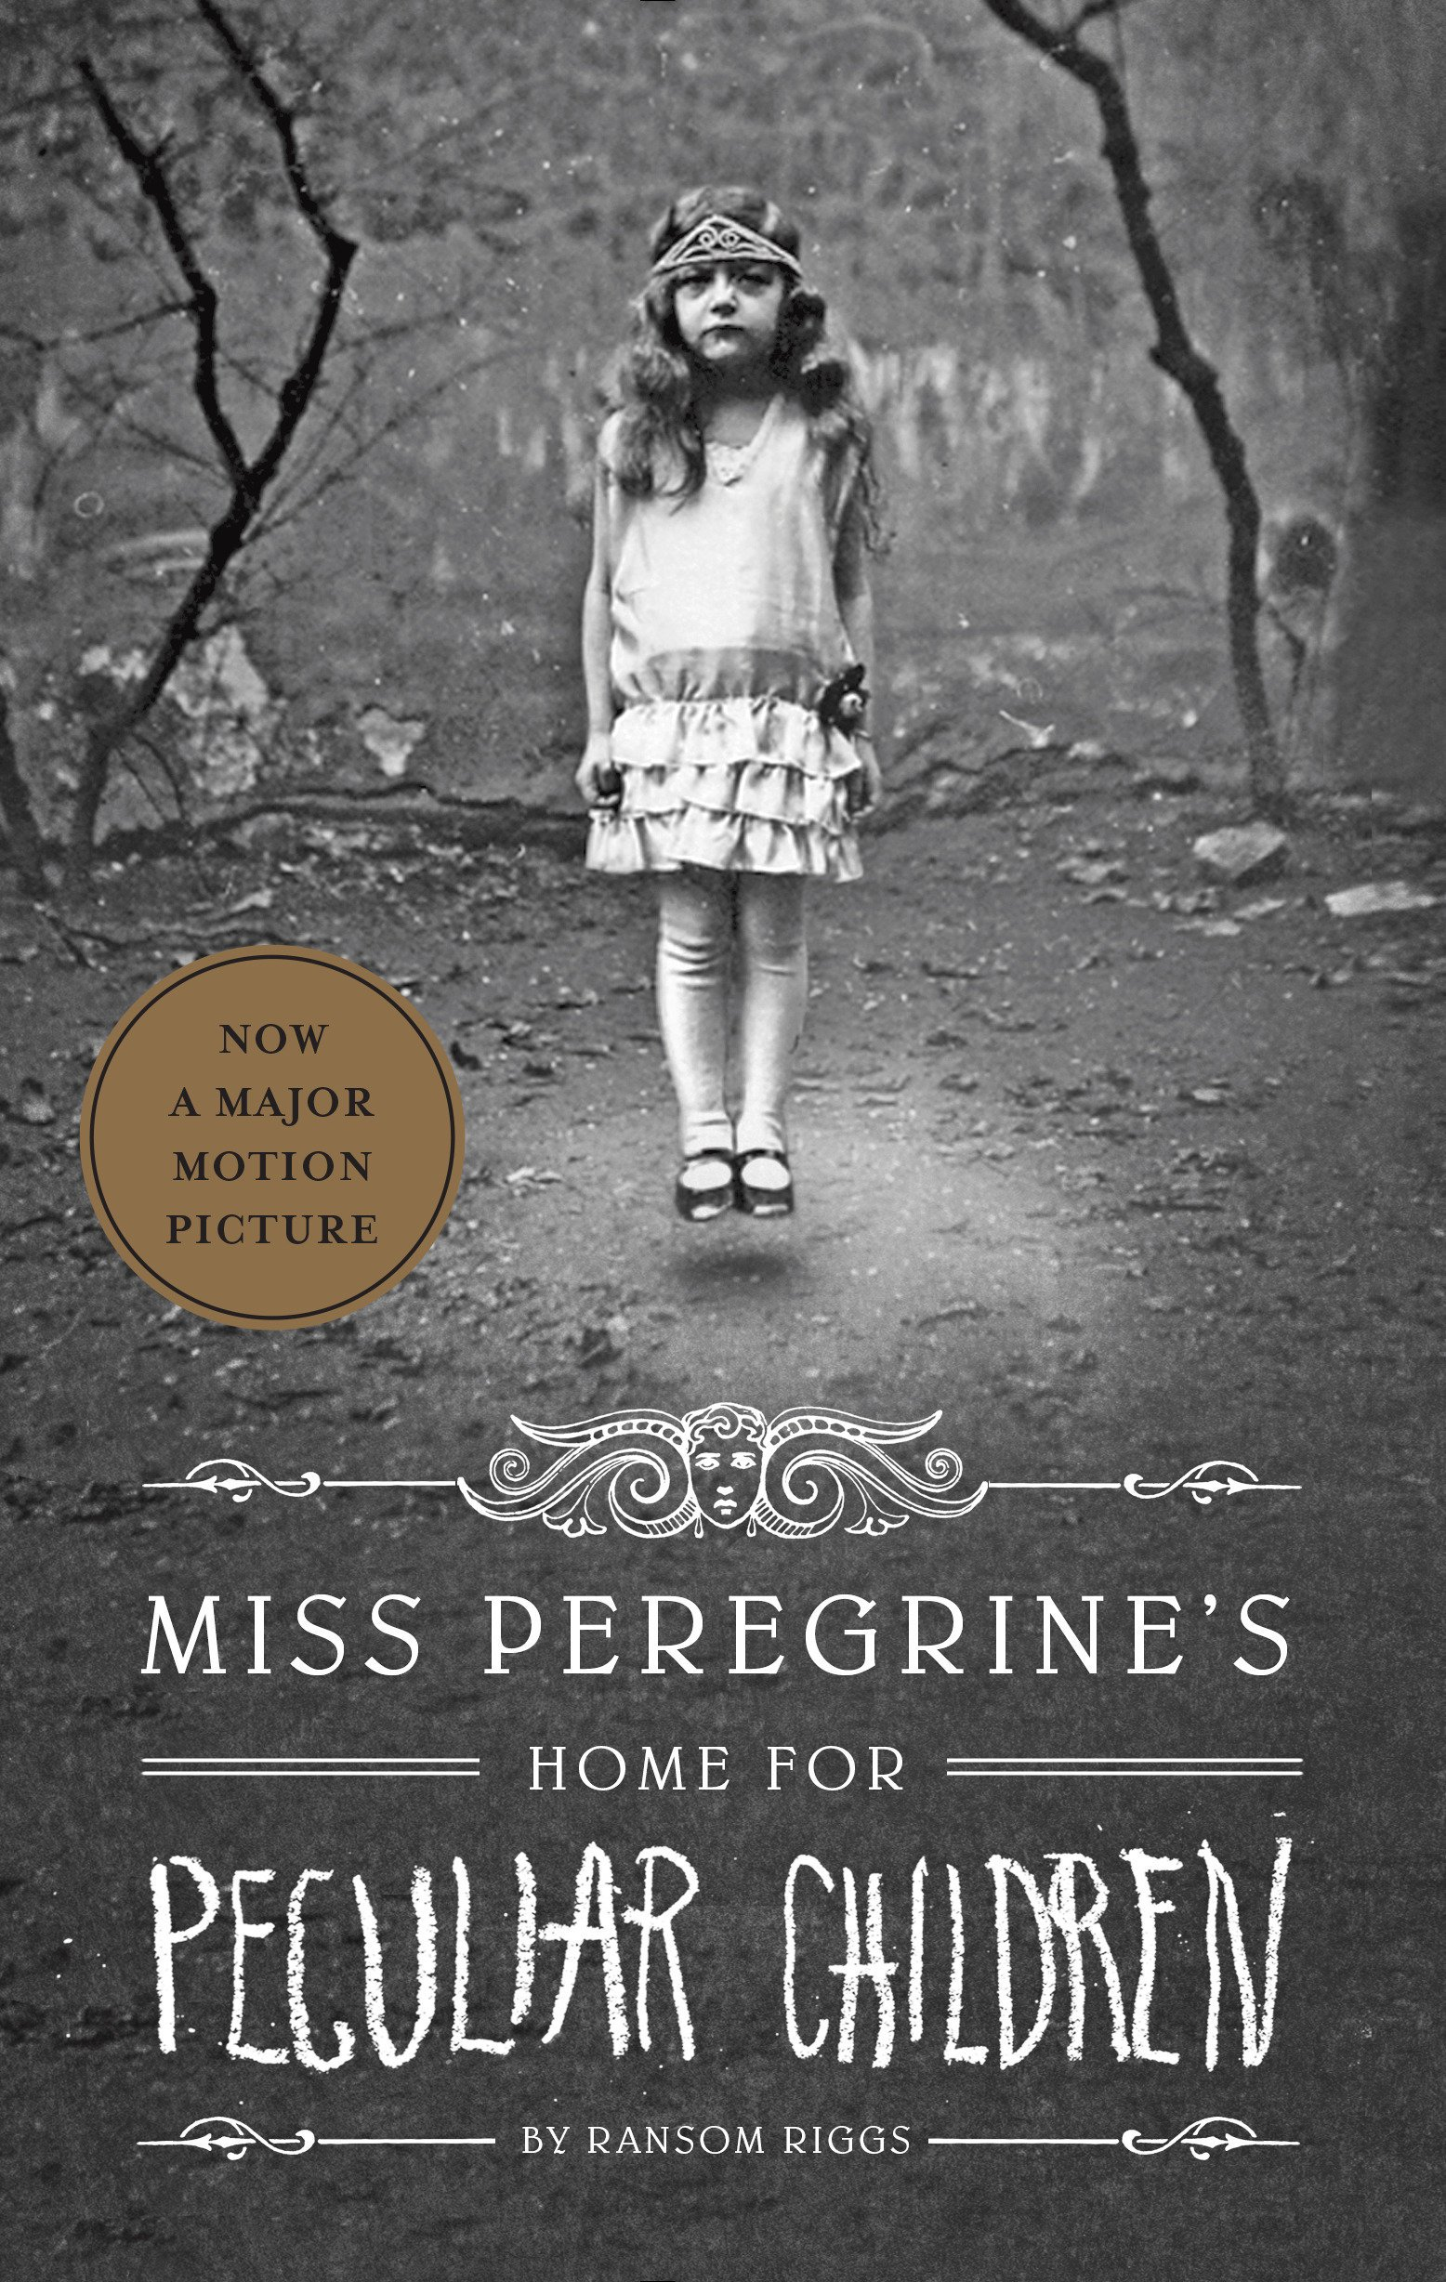
MISS PEREGRINE’s HOME FOR PECULIAR CHILDREN
Author: Ransom Riggs Country: Unitet States Genre: Fantasy, Young Adult

Slide 8
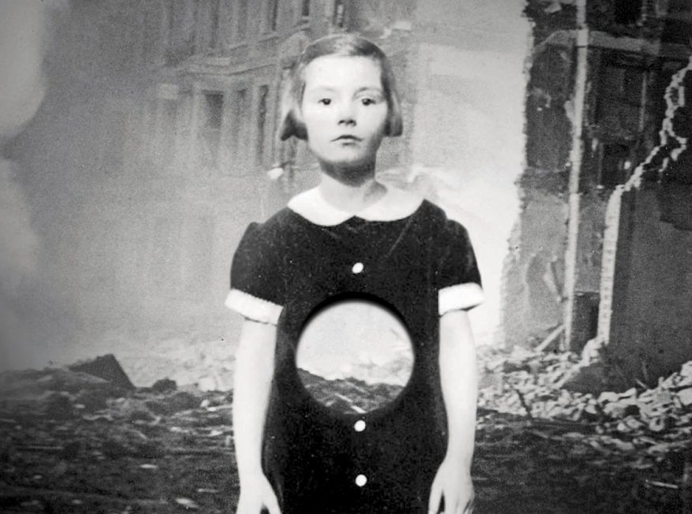
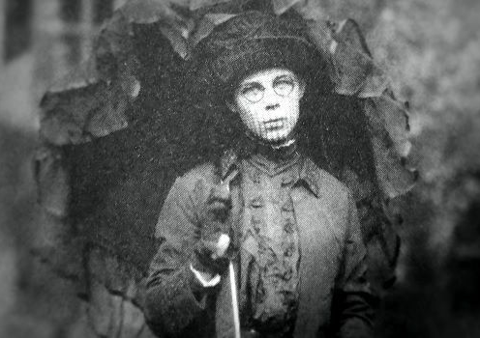
I picked this book in the library few years ago, when I was looking for something to read. I was attracted to the interesting cover and after reading I wasn’t disappointed with the plot.
What is interesting about this book is the fact that it was originally intended to be a picture book feathuring photographs the author had collected, but on the advice of his editor, he used the photographs as a guide from which to put together a narrative.

Slide 9
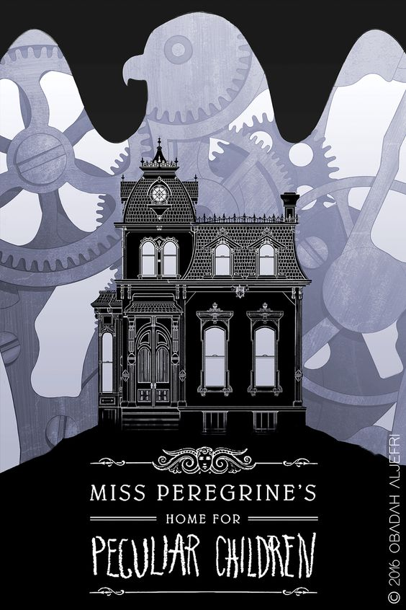
PLOT
„Miss Peregrine’s Home for Peculiar Children” is a story about very odd home for a selected group of young children. The main character is Jacob Portman. He has a boring life in Florida, when his grandfather dies under mysterious circumstances. Jacob wants to know more, so he finds a place from a postcard he found at his grandfather’s house. On the spot he’s found by the girl from photos that his grandfather once showed him and the girl took him to miss Peregrine’s home. It turns out that the inhabitants of this house are peculiar children who must hide from normal people and miss Peregrine is their guardian. Children are not really young, because they hide in a time loop, where they don’t age.

Slide 10
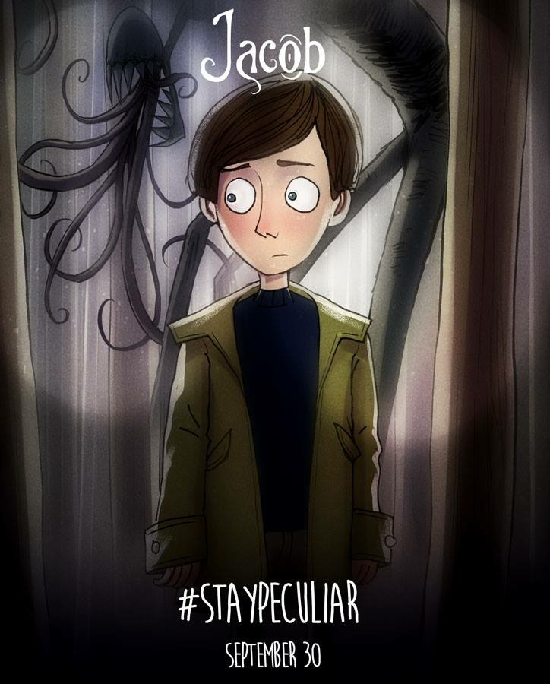
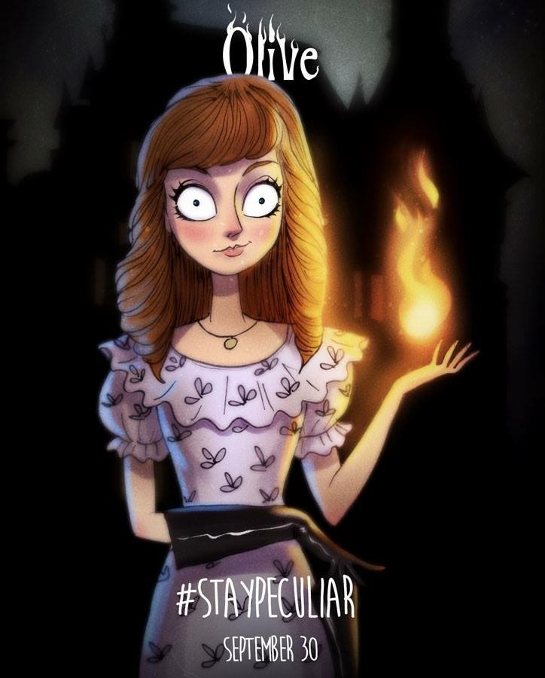
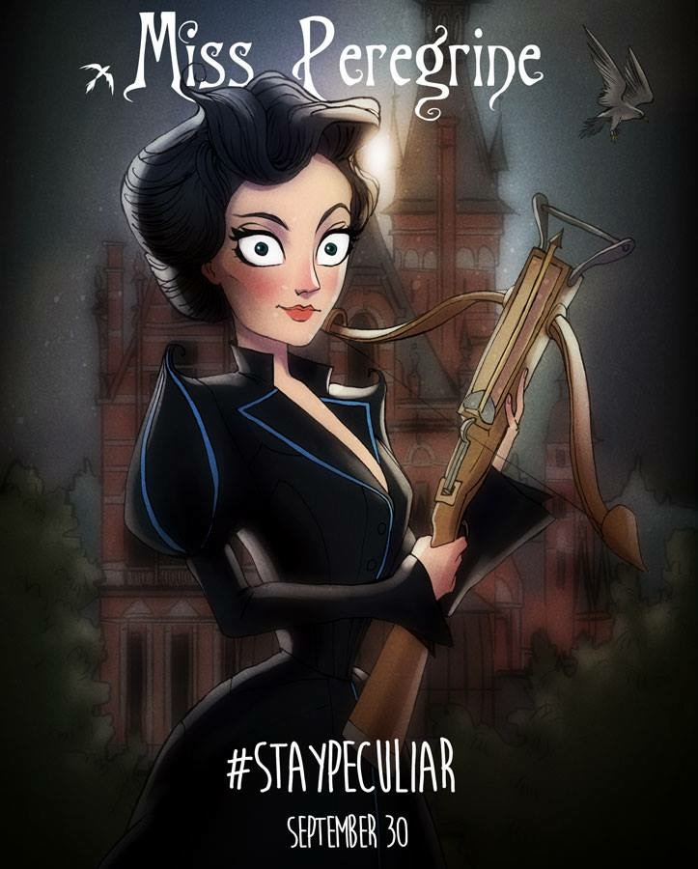
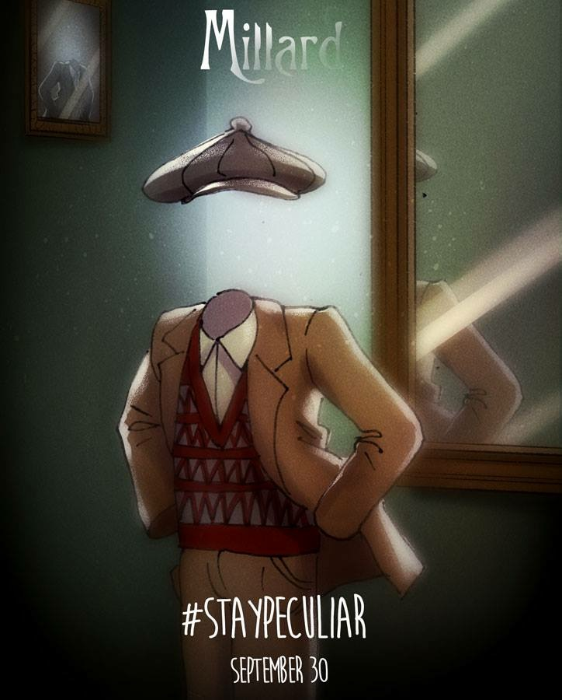
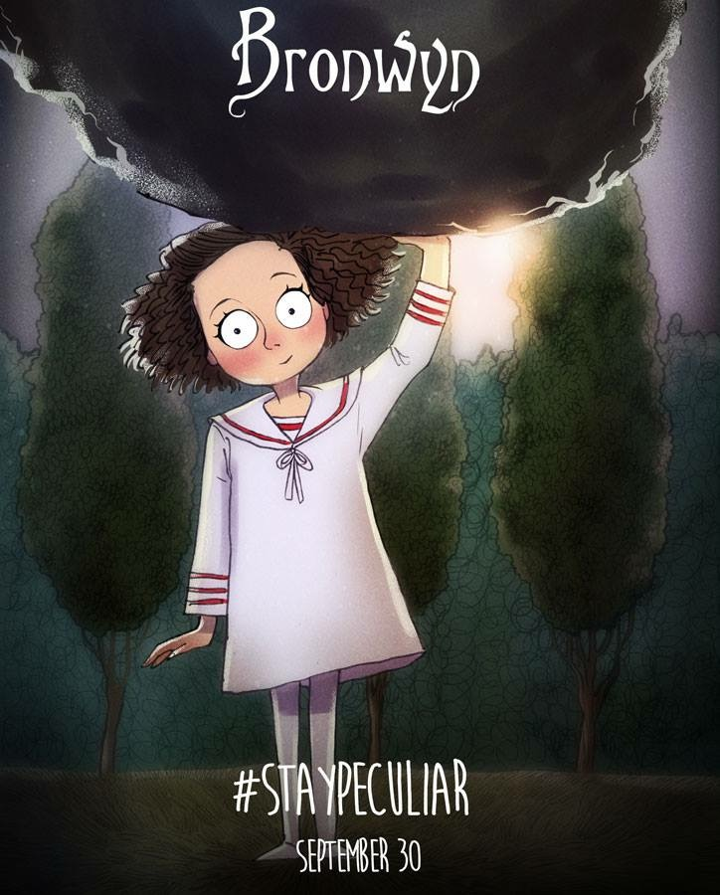
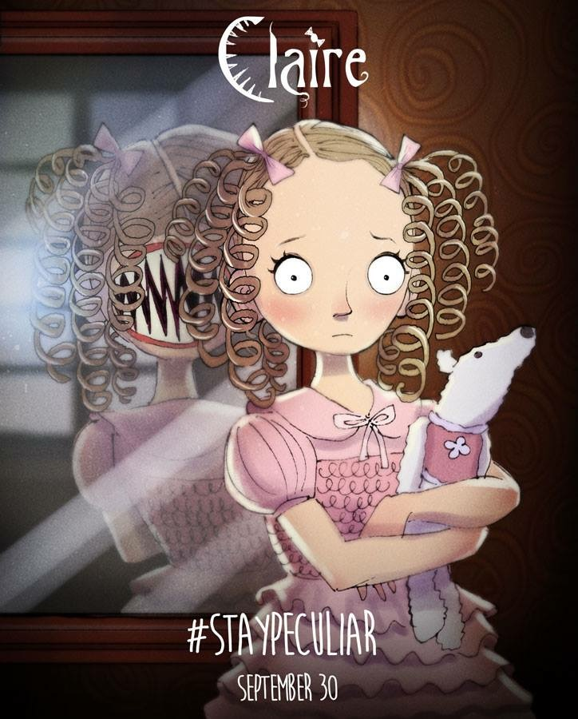
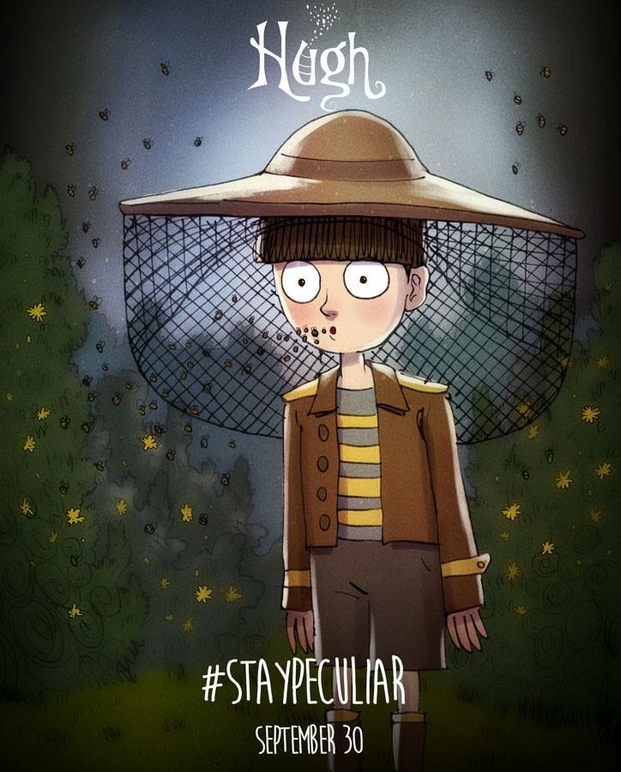
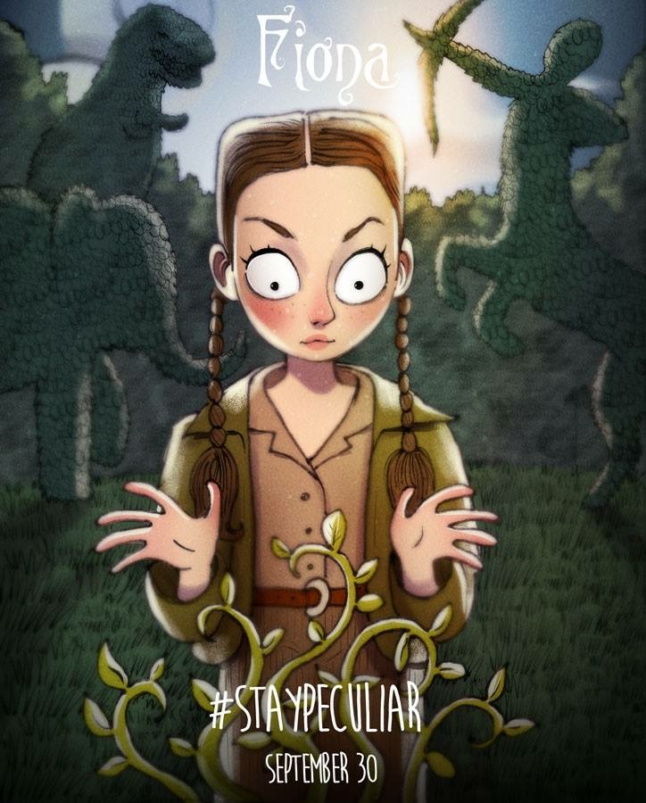
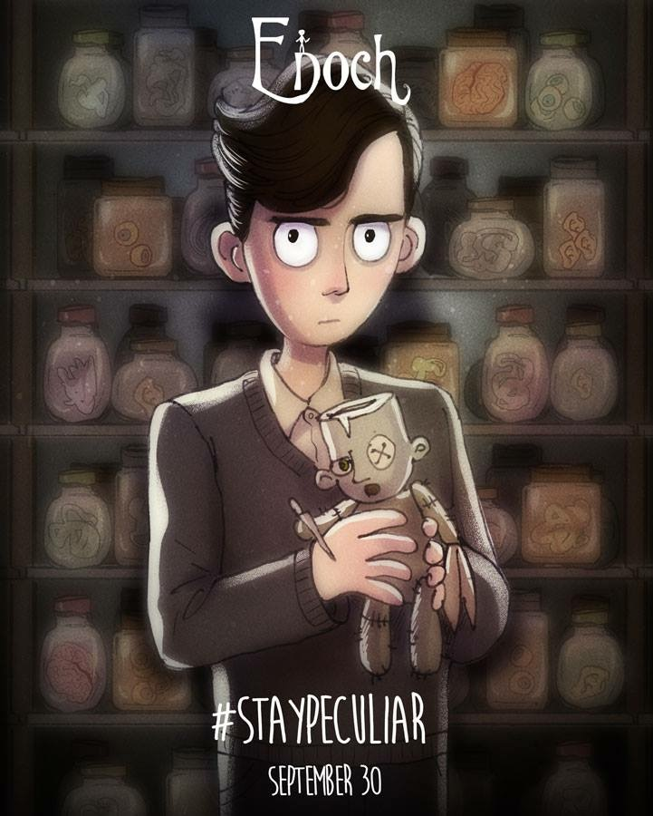
CHARACTERS
All the children living in miss Peregrine’s home are peculiar, so they have some extraordinary abilities. For example Millard is invisible, Bronwyn is super strong and Claire has two mouths.

Slide 11
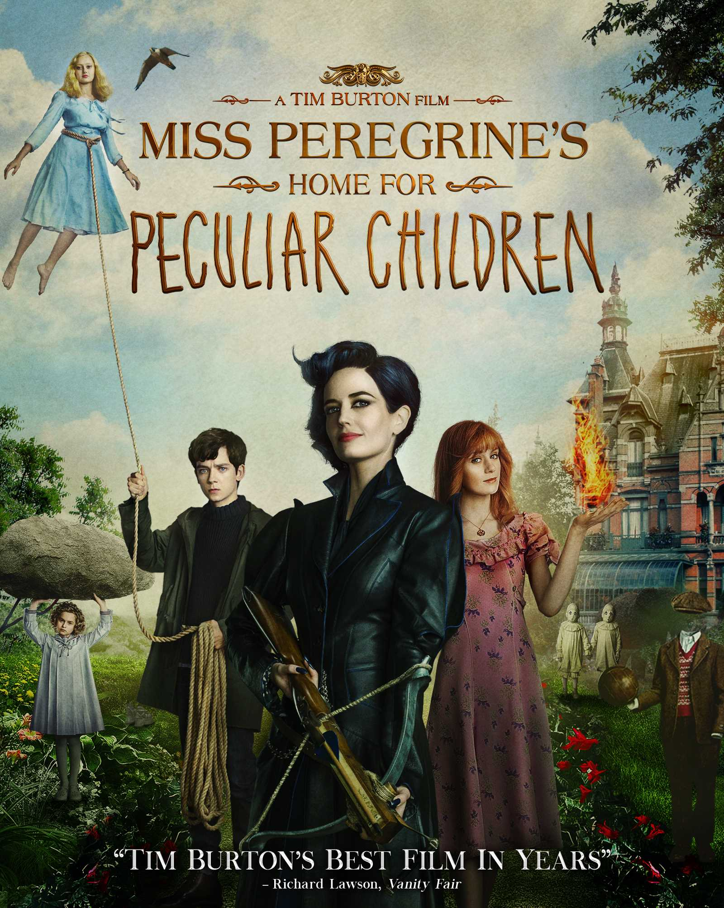
FILM ADAPTATION
In 2016 the book was adapted into a film of the same name. The film is directed by Tim Burton and the cast is inter alia Asa Butterfield, Eva Green and Samuel L. Jackson. In my opinion the movie is very good, but few facts, like characters’ peculiarities, were changed, so I recommend reading the book first.

Slide 12
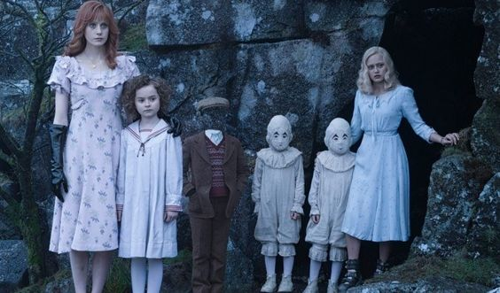
I enjoy Ransom Riggs’s writing style and I love seeing the photographs in between chapters. It helps convey the story realistically.
This book is kind of dark and weird, but also it’s a real page-turner about friendship, adventures and being different.

Slide 13
THANK YOU

