Slide 1
My favourite authors
Ania Szczepanik

Slide 2
Kerstin Gier
One of my favourite authors is Kerstin Gier. She is a Grman author of novels for adults and young adults.

Slide 3
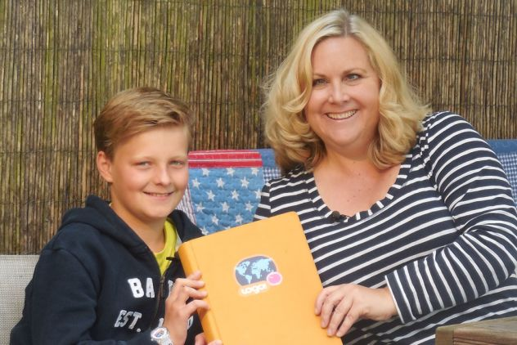
She studied business education and communication psychology. She has written over a dozen books. Her book „Immoral Super Offer” was awarded for the best female novel of the year. Currently she lives with her husband, son and cat in Bergische Land.

Slide 4
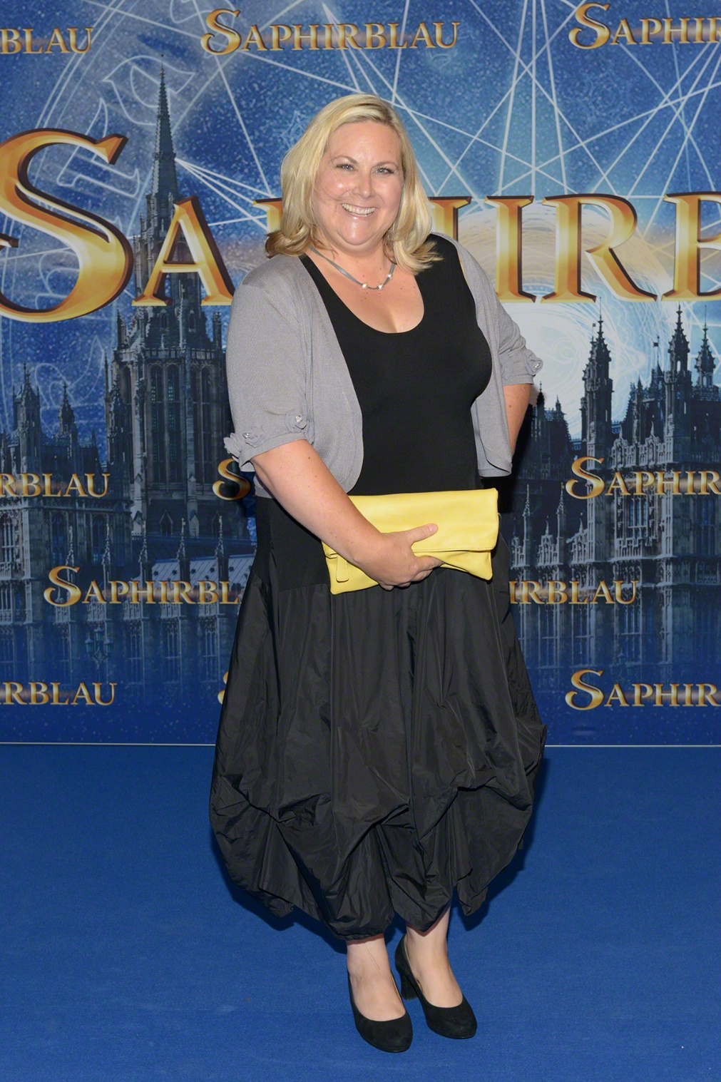
Kerstin Gier’s books
I have read 6 Kerstin Gier’s books so far – Ruby Red trilogy and Silver trilogy. I enjoy this author’s writing style. Books are funny and easy to read. Addittionaly, I am interested in the subject of these books.

Slide 5
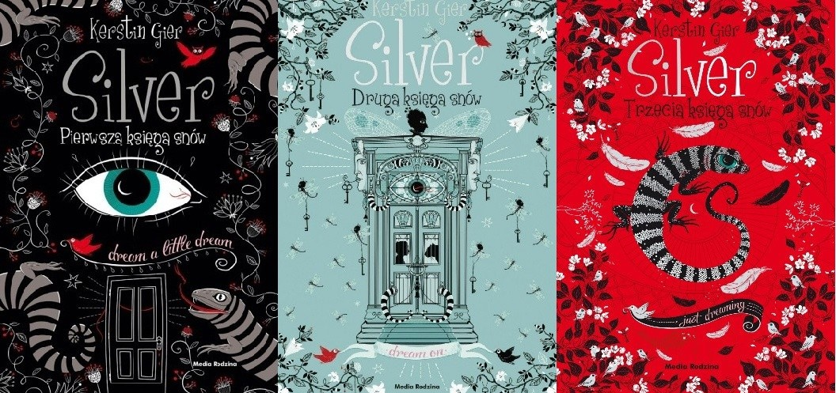
The Ruby Red trilogy
a series about time travels
The Silver trilogy
a series about dreams

Slide 6
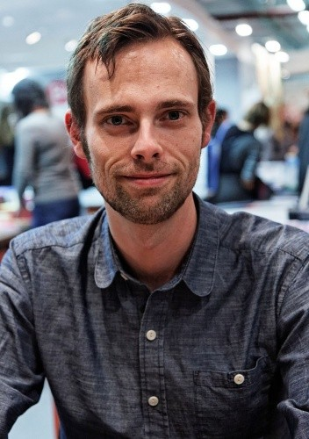
Ransom Riggs
Another author I really like is Ransom Riggs. He is an American writer and filmmaker best known for the book „Miss Peregrine’s Home for Peculiar Children”

Slide 7
Riggs was born in Maryland in 1979 and grew up in Florida. He studied English literature at Kenyon Collage and film studies at the University of Southern California.

Slide 8
Personal life
Riggs married author Tahereh Mafi in 2013 and they have a four-year-old daughter – Layla.

Slide 9
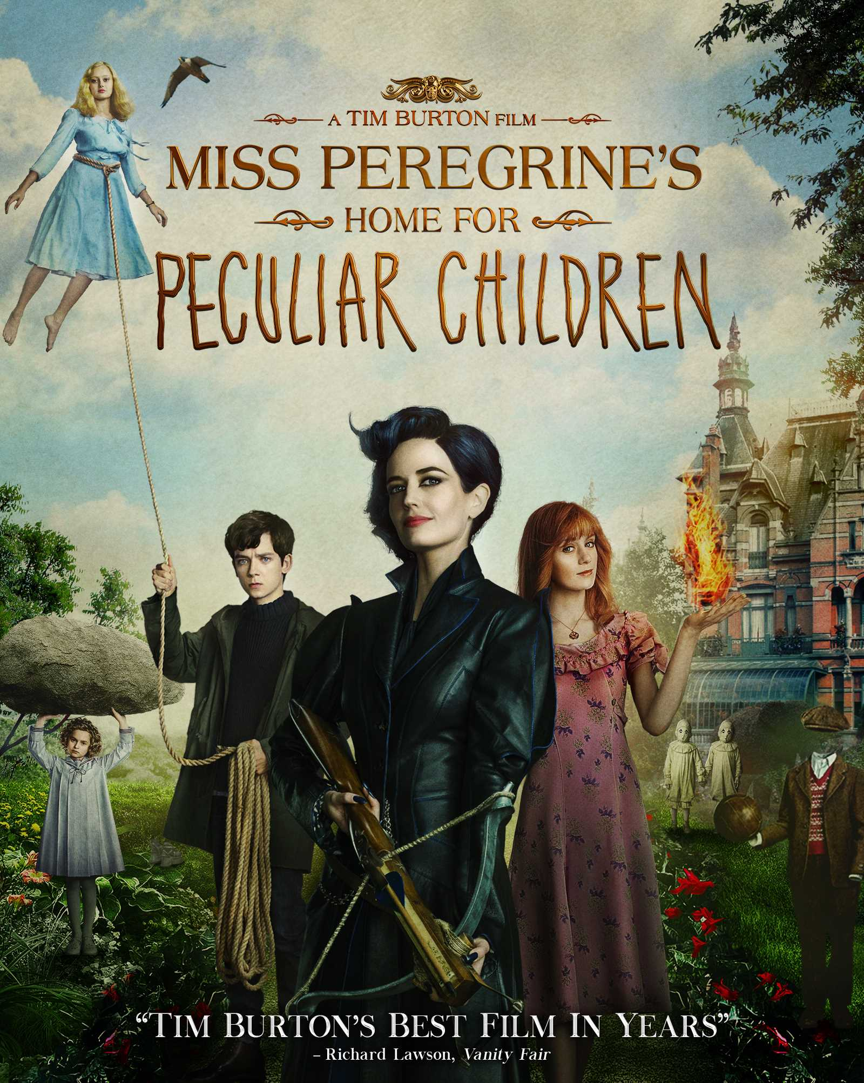
Miss Peregrine’s Home for Peculiar Children
Ransom Riggs also collected interesting photos that he wanted to publish as a book with pictures, but on the advise of his editor, he wrote a narrative for them. This is how „Miss Peregrine’s Home for Peculiar Children” was created and became a New York Times bestseller. In 2016 the book was adapted into a film of the same name.

Slide 10
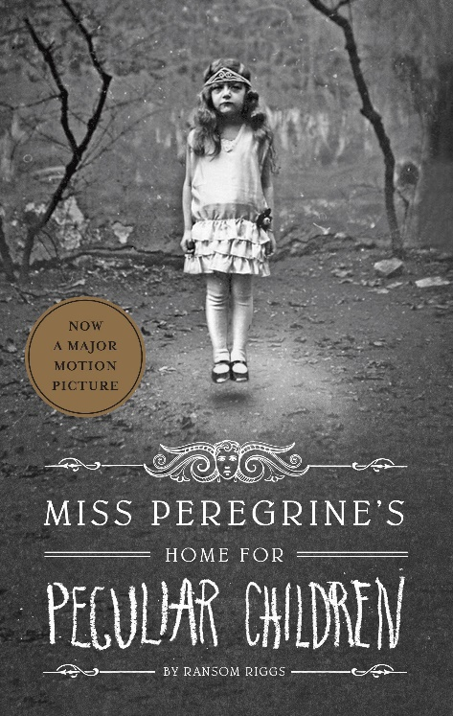
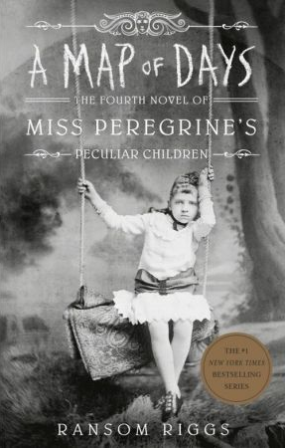
Continuation of the book
After the success of the first part, the author decided to continue the series. So far has been written 6 parts of the novel and „Tales of the Peculiar”

Slide 11
Thank you ☺

