Slide 1
Lithuanian books
Sigutė Amšiejūtė,
Elzė Remeikytė,
Taura Sabaliauskaitė

Slide 2
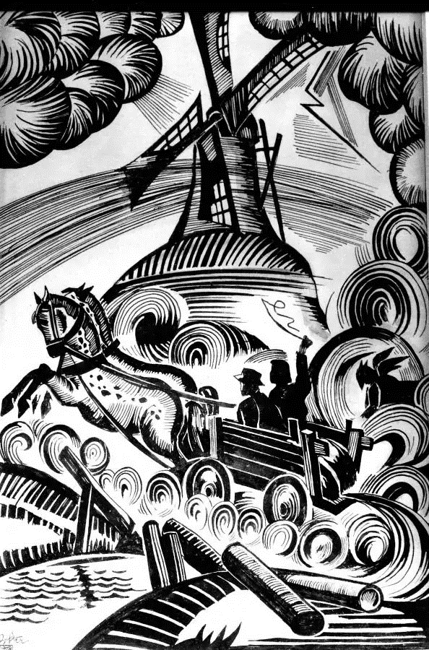
BALTARAGIO
MALŪNAS
“Baltaragis mill’’

Slide 3
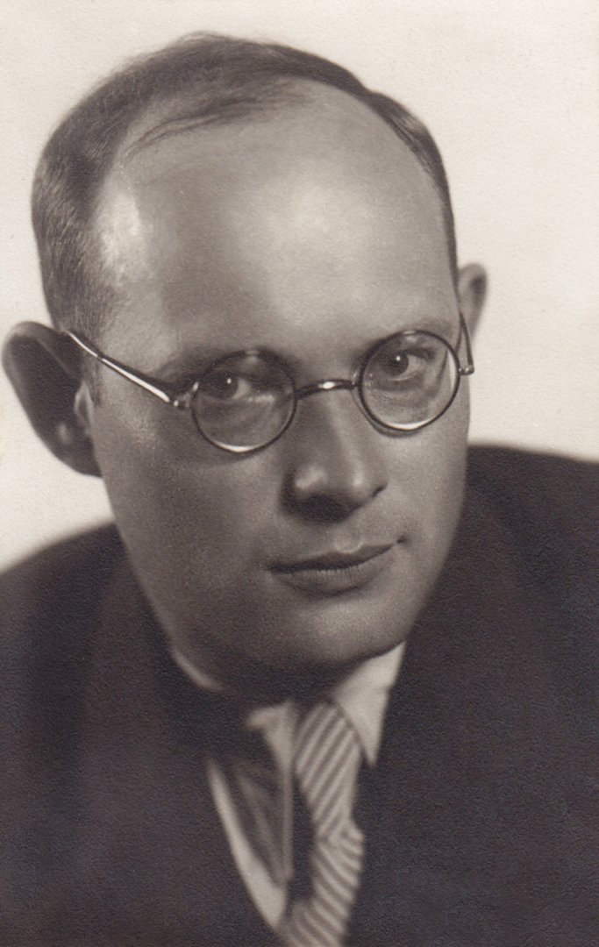
Kazys Boruta
Kazys Boruta wrote a novel “Baltaragio malūnas‘‘. He lived around the time that world war I started.
Many times, he was punished for illegal political work.

Slide 4
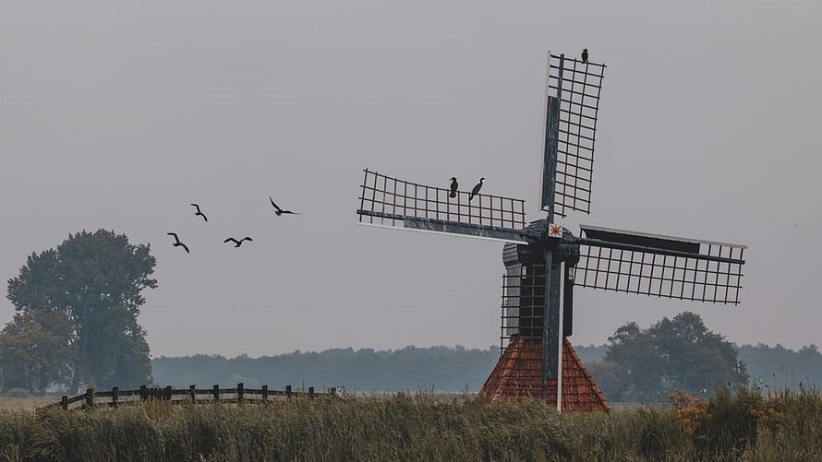
Plot

Slide 5
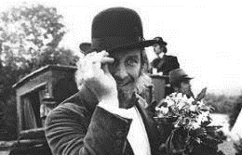
quotes
“Pinčukas was such a lazy, naughty devil that he never did anything good or bad to anyone. He was such a loser that he was not interested in anything, not even himself.”
“But what is there to want from the devil, when people also have plenty of everything, and the devil, as they say, is the embodiment of all evils.”
,,Pinčukas buvo toks netikęs velnias ir toks tinginys, kad niekam nepadarydavo nei blogo, nei gero. Toks iš jo buvo nevykėlis, kad jis nieku, net pačiu savimi nesidomėjo.”
,,Bet ko norėti iš velnio, jeigu ir žmonės to gero apsčiai turi, o juk velnias, kaip sako, visų blogybių įkūnijimas.”

Slide 6
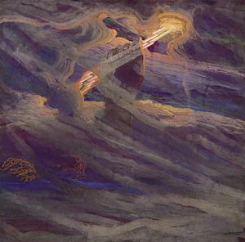
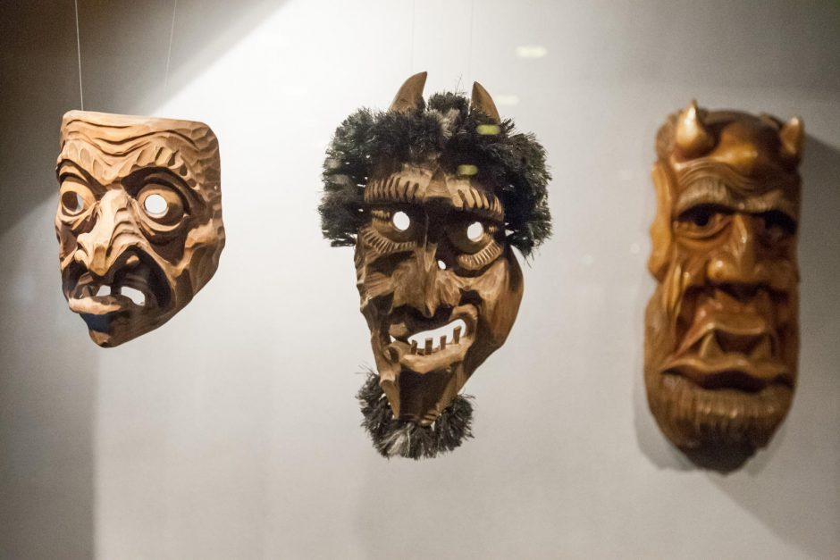
“Baltaragis mill” and folklore
Devil and Thunder

Slide 7
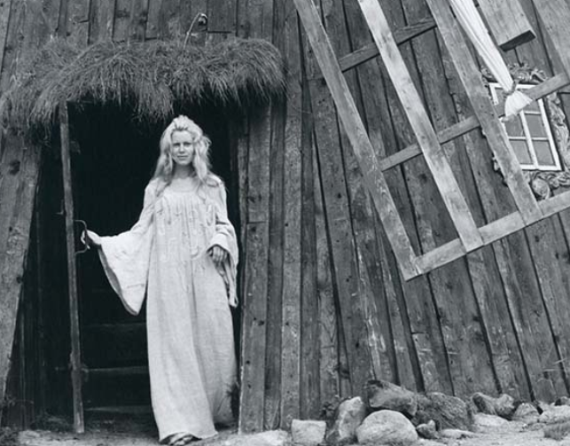
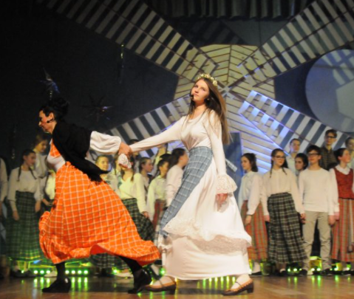
“Velnio nuotaka” (eng. “Devil’s Bride”) was made into a musical in 1973.Also, there were many theatre perforamances created.

Slide 8
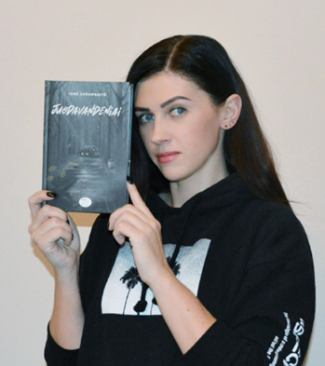
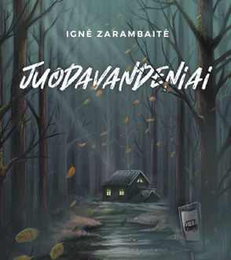
Juodavandeniai

Slide 9
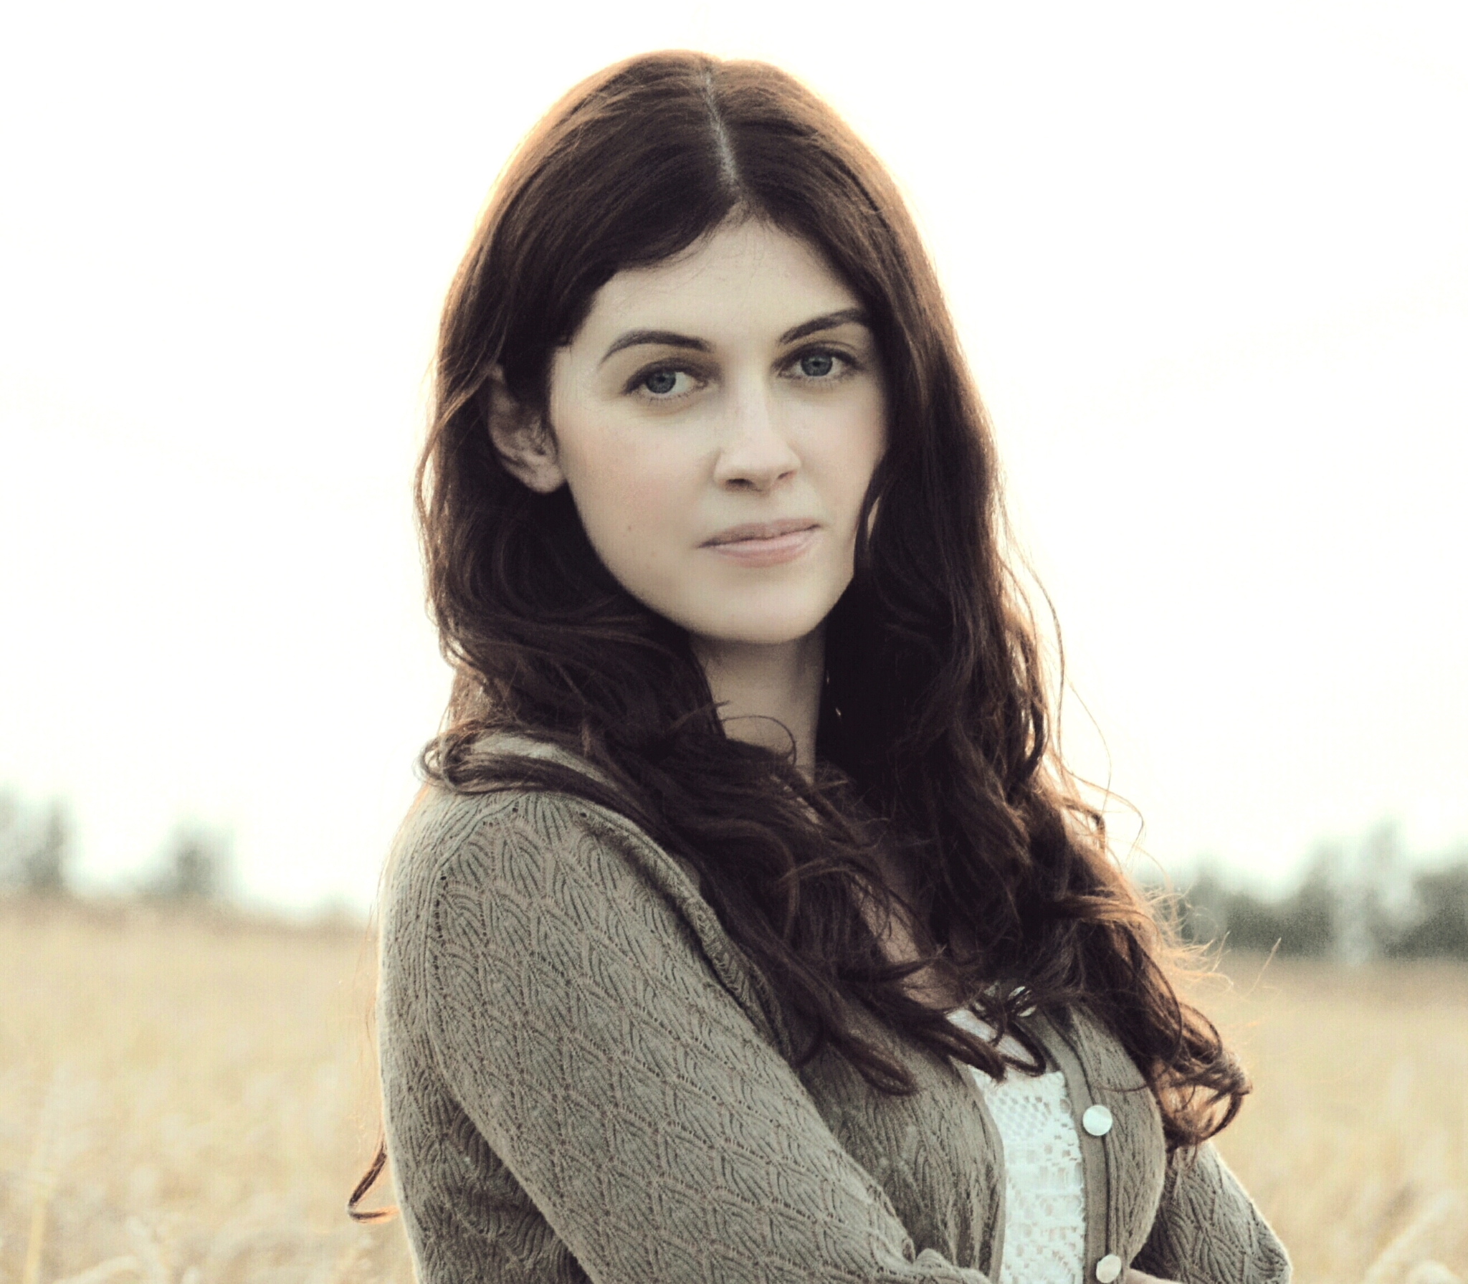
Ignė Zarambaitė
Ignė Zarambaitė is the author of the book ‘‘Juodavandeniai’’.
She writes books for teens and kids.

Slide 10
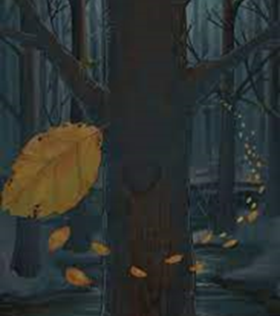
PLOT

Slide 11
QUOTES
“After all, stagnant water turns into a swamp ... Who wants to be a swamp? You, probably, don‘t. Water has both a surface and a bottom; but it is the most important what is between these two borders…”
,,Juk užsistovėjęs vanduo virsta pelke... Kas nori būti pelke? Tu, tikiu, nenori. Vanduo turi ir paviršių, ir dugną, tačiau visų svarbiausia - kas tarp šių dviejų ribų…”

Slide 12
Awards

Slide 13
This project has been funded with support from the European Commission under the Erasmus+ Programme. This publication reflects the views only of the author, and the Commission cannot be held responsible for any use which may be made of the information contained therein.

