Slide 1
Kristina Gudonytė „ Ida from the Shadows' Garden“

Slide 2
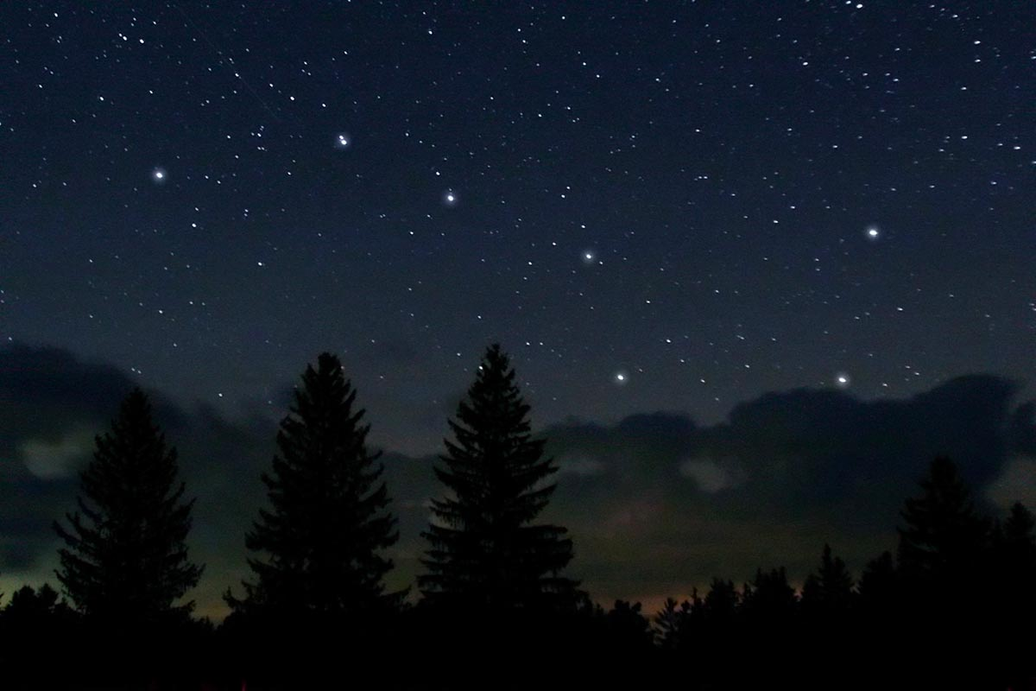
Creation of the book
The author came up with the idea of ​​the book while looking at the stars and having sad thoughts, such as "Can death destroy love?" Therefore, the author had to read a lot of philosophical books while writing this book. Only then the writer was able to freely describe love, intolerance and understanding of others.

Slide 3
The main idea of ​​the book
You can love another person; but you need to forgive, understand, sympathize and always think about the consequences. After all, each person is different and understands life in his own way.

Slide 4
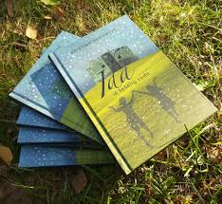
The subject of the book
A teenager Sofia dreams of becoming a writer. This book is Sofia's first work. This is a story about a peer Ida, who unexpectedly found herself in their home and disrupted the orderly life of the family. The book has a lot of everything: events, adventures, secrets, dreams, philosophy, poetics and so much more... But it's a book about love that lasts forever.

Slide 5
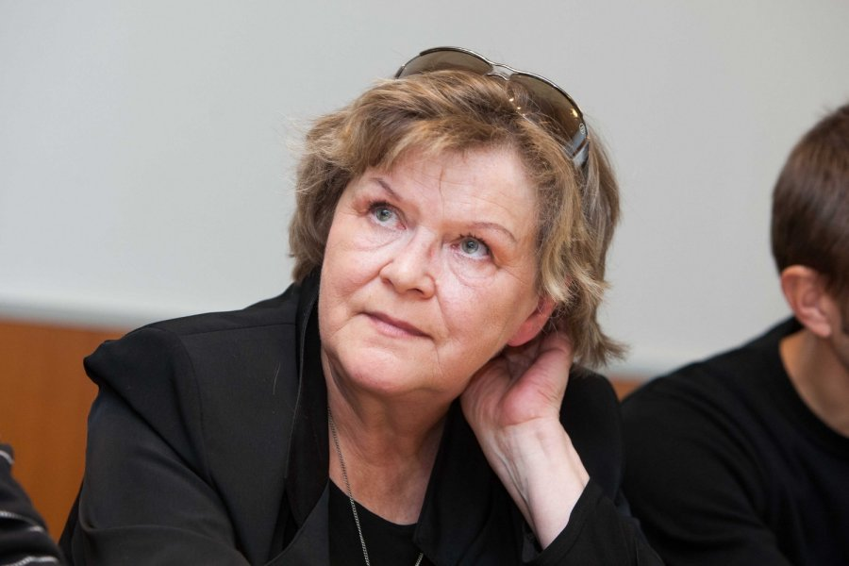
The author's thoughts about the book
But why does the writer write for teenagers? It is even difficult for the author herself to answer this question. But her answer would be that with them she feels herself, she doesn't need to put on any masks, think about how to communicate or what to say. Also, she is happy that she manages to touch the hearts of young people.

Slide 6
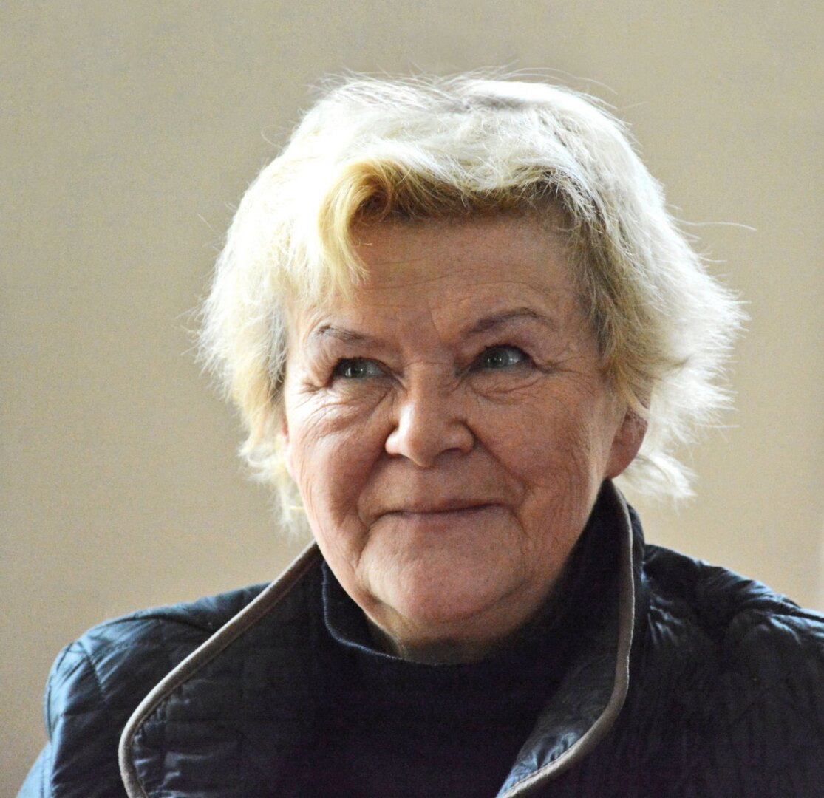
"This novel opens up many themes. For me, this is a book about the lack of tolerance: how we accept and understand a different person who thinks differently. And about human capabilities. A person is capable of much more than he imagines", - says author K. Gudonytė about the novel "Ida from the Shadow's Garden"

Slide 7
Fragment from „Ida from the garden of shadows“
„Gaila prarasto laiko... Laiko, kai dar buvo galima ką nors pakeisti...
Kai pasidaro sunku ir liūdna, kai naktį negaliu užmigti, nueinu prie lango ir ilgai žiūriu į žvaigždes... Bandau atspėti, kurioje iš jų savo nebūtyje Tedo laukia ilgesio iškamuota Idos siela... Myliu tave, Ida, kad ir kur tu būtum, myliu jus abu... – tada sakau mintyse“
"It's a shame about the lost time... Time, when something could have been changed...
When it gets hard and sad and when I can't sleep at night, I go to the window and look at the stars for a long time... I try to guess which of them Ida's longing soul is waiting for Ted in his absence... I love you, Ida, wherever you are, love you both... - then I say in my mind"

Slide 8
Fragment from „Ida from the garden of shadows“
„Kažkur labai toli, begalinėje visatos erdvėje, ten, kur žmogaus akis nesiekia ir net mintis negalini nuskrieti, raibuliuojančiame kosmoso dujų debesyje susikibę už rankų plaukioja du maži žiburėliai. Tai vienas kitą labai mylinčių dar negimusių žmonių sielos.“
"Somewhere very far, in the infinite space of the universe, where the human eye can't reach and even the mind can't fly away, in the rippling cloud of cosmic gas, two small lights are floating hand in hand. These are the souls of unborn people who love each other very much."

Slide 9
THANKS FOR LISTENING
This project has been funded with support from the European Commission under the Erasmus+ Programme. This publication reflects the views only of the author, and the Commission cannot be held responsible for any use which may be made of the information contained therein.

