Slide 1
Kristina Gudonytė
Smiltė, Leila, Eglė

Slide 2
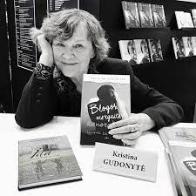
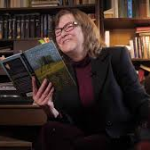
Kristina Gudonytė was born on 15th December 1949 in Vilnius. She is a Lithuanian writer, actor, producer and scenarist.

Slide 3
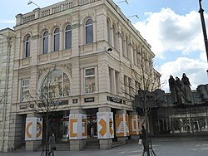
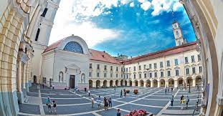
Kristina Gudonytė has studied at Vilnius University and graduated from acting studies. She Has worked at Lithuanian National Drama Theater for ten years.
Vilnius University Lithuanian National Drama Theater

Slide 4
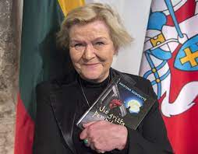
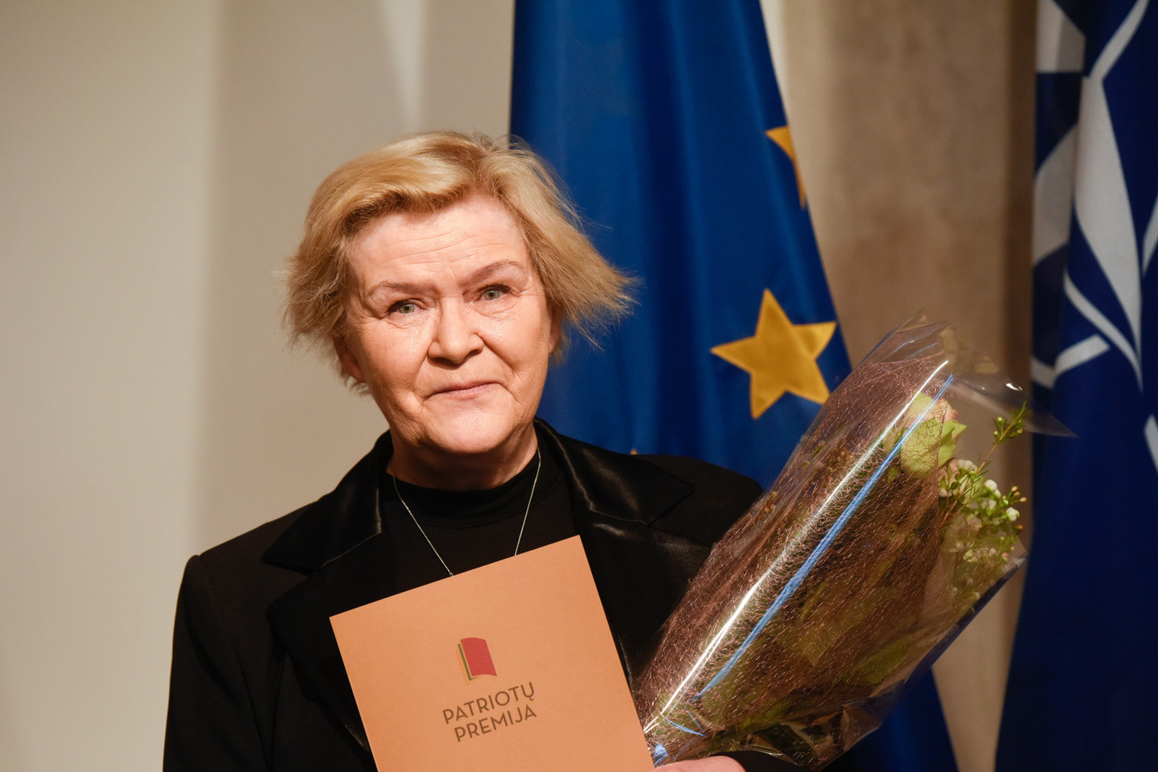
In 2014, Kristina Gudonytė was awarded the children's literature prize established by the Ministry of Education and science for her creativity for children and teenagers and for her sensitivity to the mother tongue

Slide 5
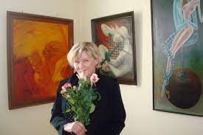
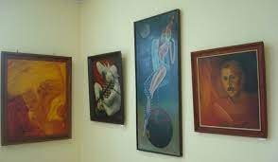
The writer has created many scripts and lyrics for performances, video films, TV shows, and has organized many painting exhibitions.

Slide 6
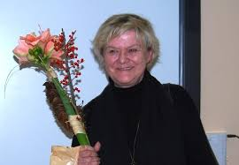
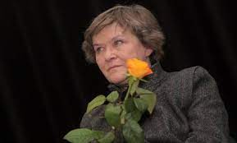
Became a member of Lithuanian writer's union in 2010

Slide 7
BOOKS

Slide 8
TOP 3 BOOKS
„Bad girl's diary” (LT. Blogos mergaitės dienoraštis)
„flower garden”( LT. Gėlių dvaras)
The best book of the year for teenagers 2009

Slide 9
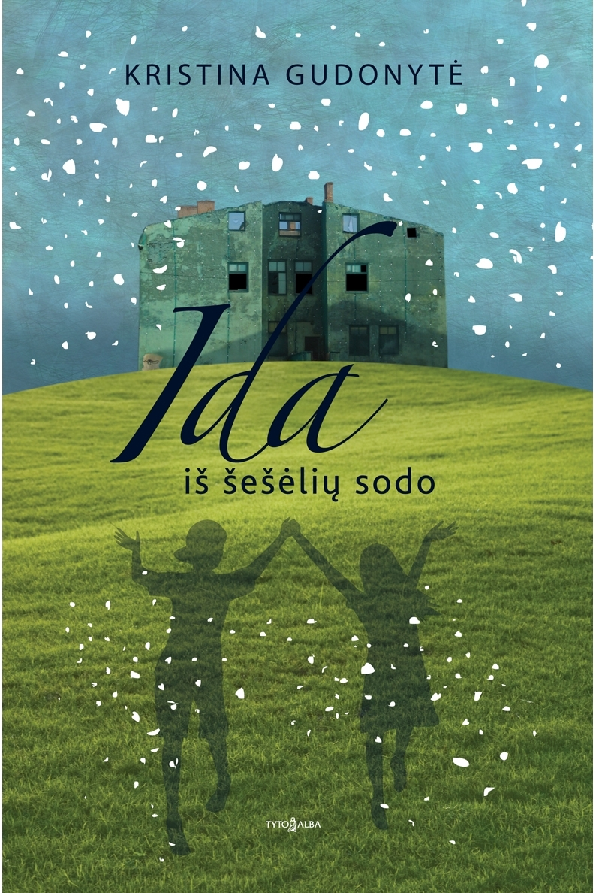
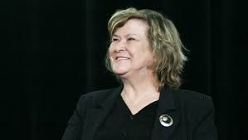
„Ida from the garden of shadows“ (LT. Ida iš šešėlių sodo)
The best book of the year for teenagers 2012

Slide 10
thank you for your attention
This project has been funded with support from the European Commission under the Erasmus+ Programme. This publication reflects the views only of the author, and the Commission cannot be held responsible for any use which may be made of the information contained therein.

