Slide 1
Lithuania writers
Justė Čiuderytė
Adrijus Dulskas
Simas Tiškevičius

Slide 2
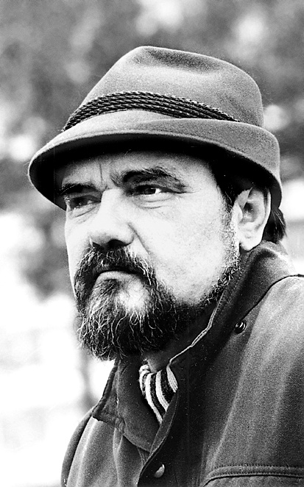
ROMUALDAS GRANAUSKAS
Was born in 1939 in Mažeikiai
Lithuania prose writer and dramatist
Died in 2014 in Vilnius
He graduated from high school in Seda. Served in the army, studied in maritime school, Kaunas university of technology. After studies he worked in a printing house, in construction sites and in a compressor’s factory. Later he had got a job in Seda culture department, Mosėdis school and in redaction of magazine “Nemunas”.

Slide 3
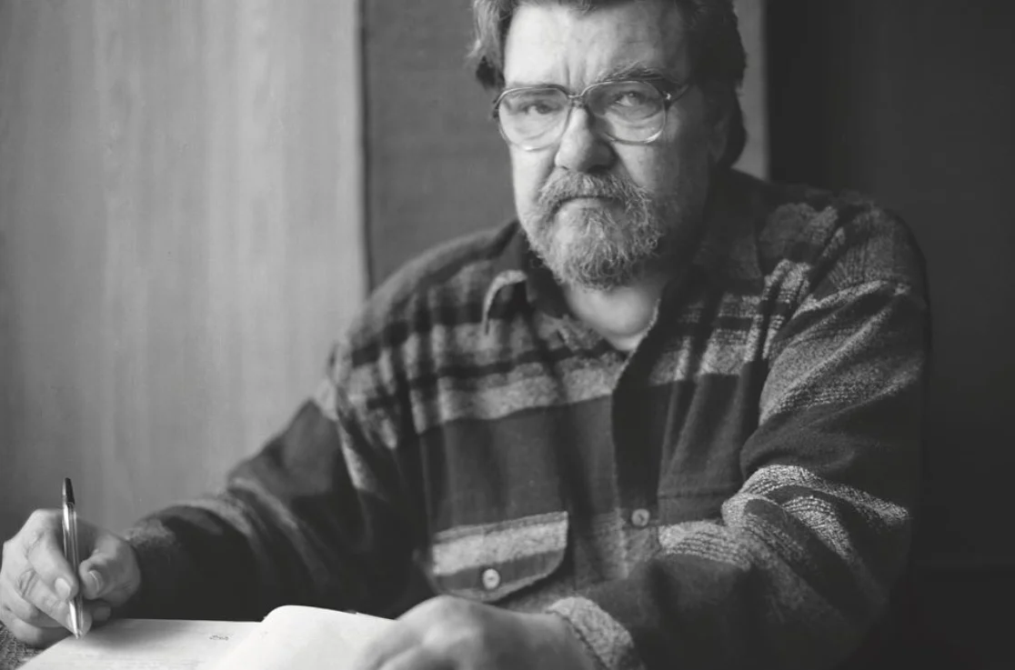
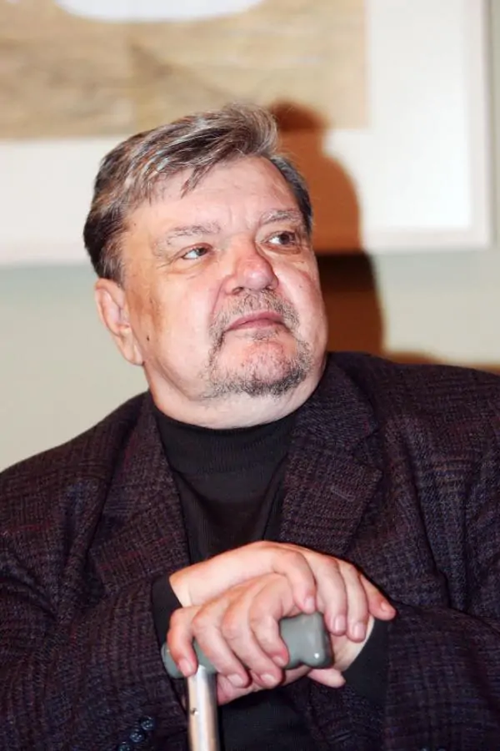
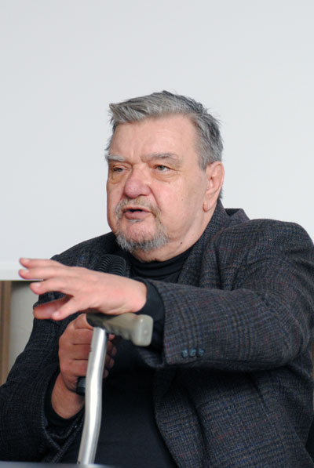
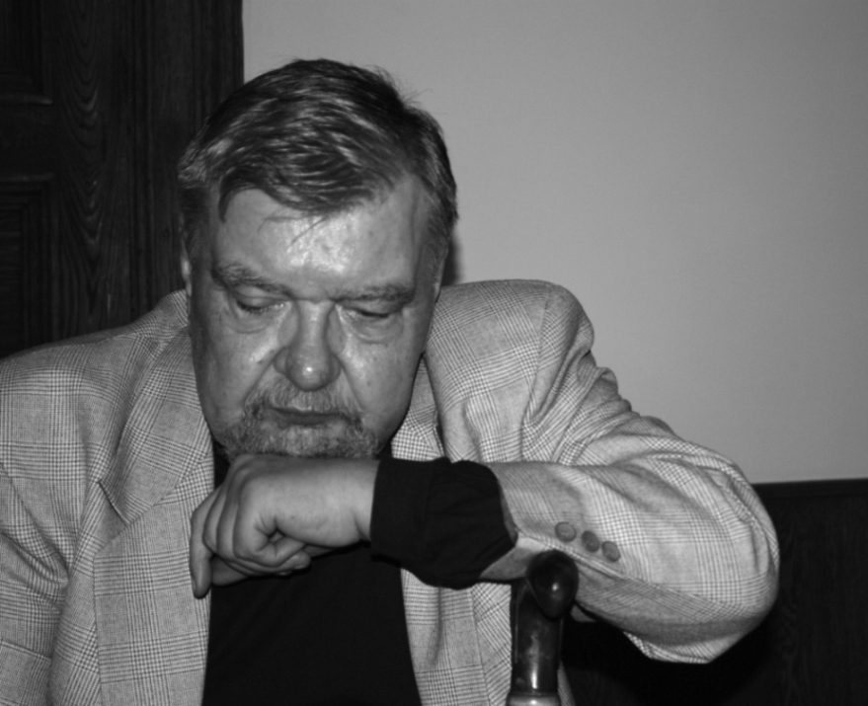
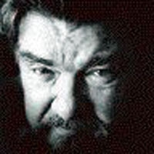
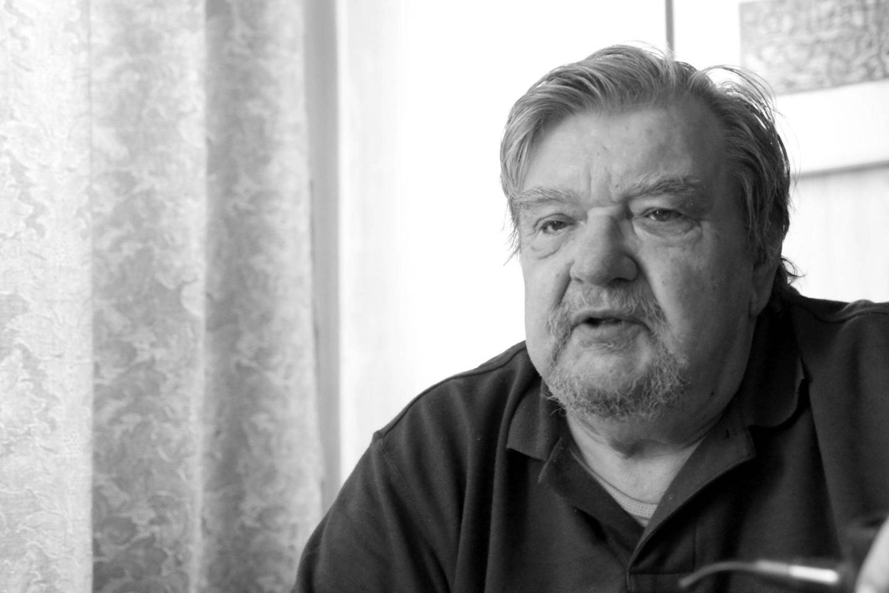
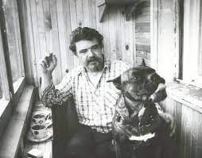

Slide 4
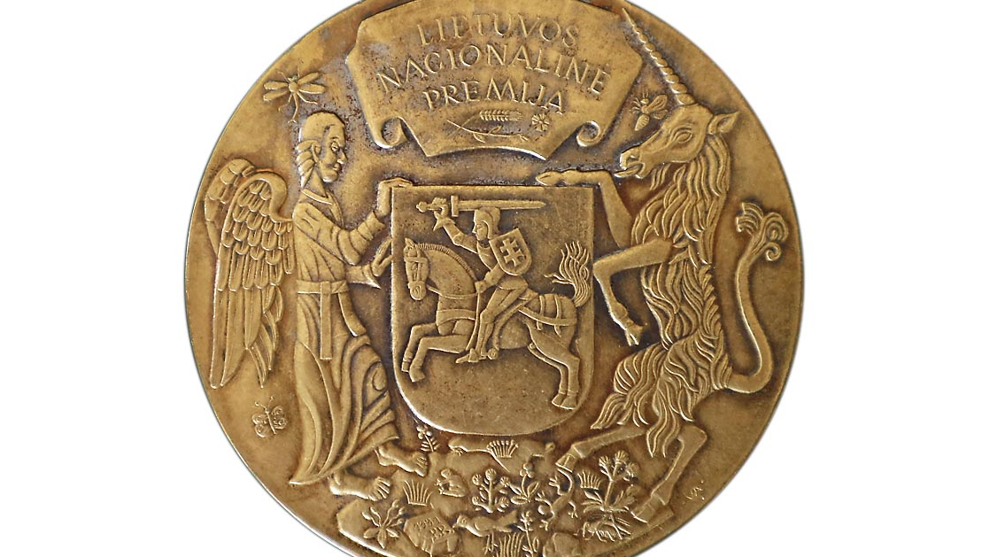
Creation

Slide 5
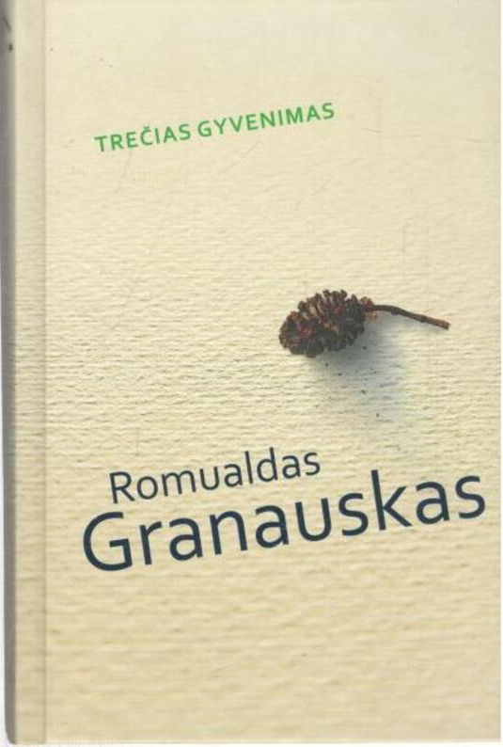
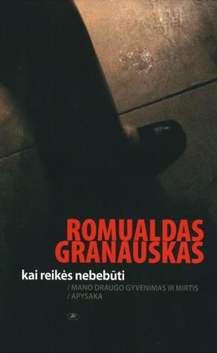
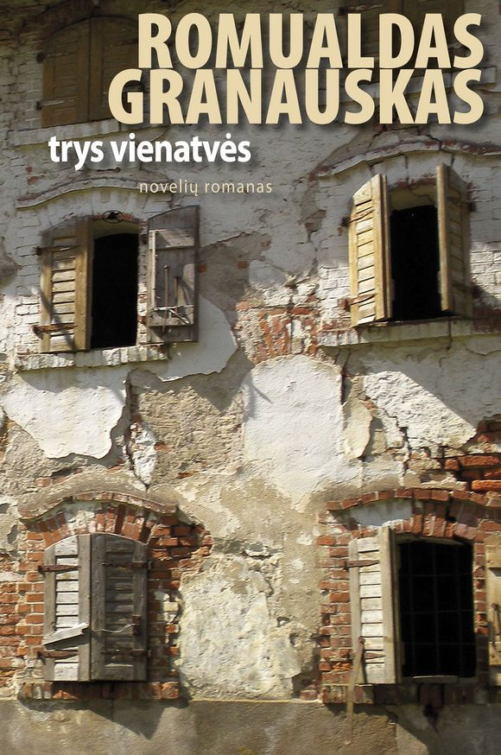
He created even 27 books.

Slide 6
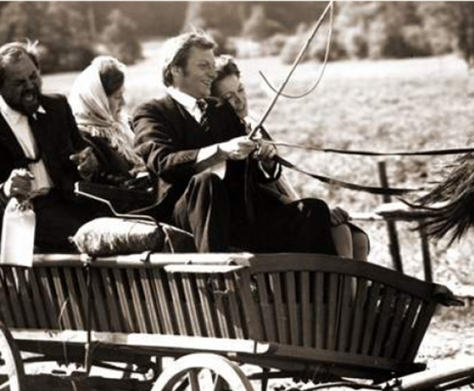
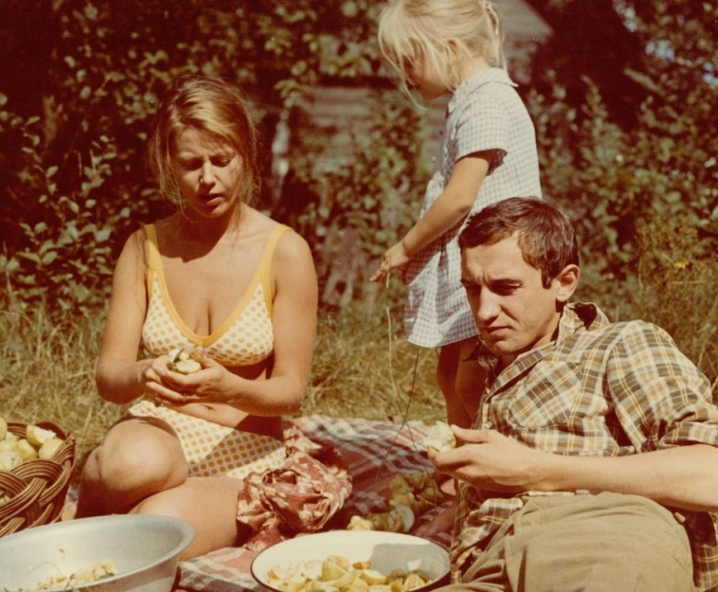
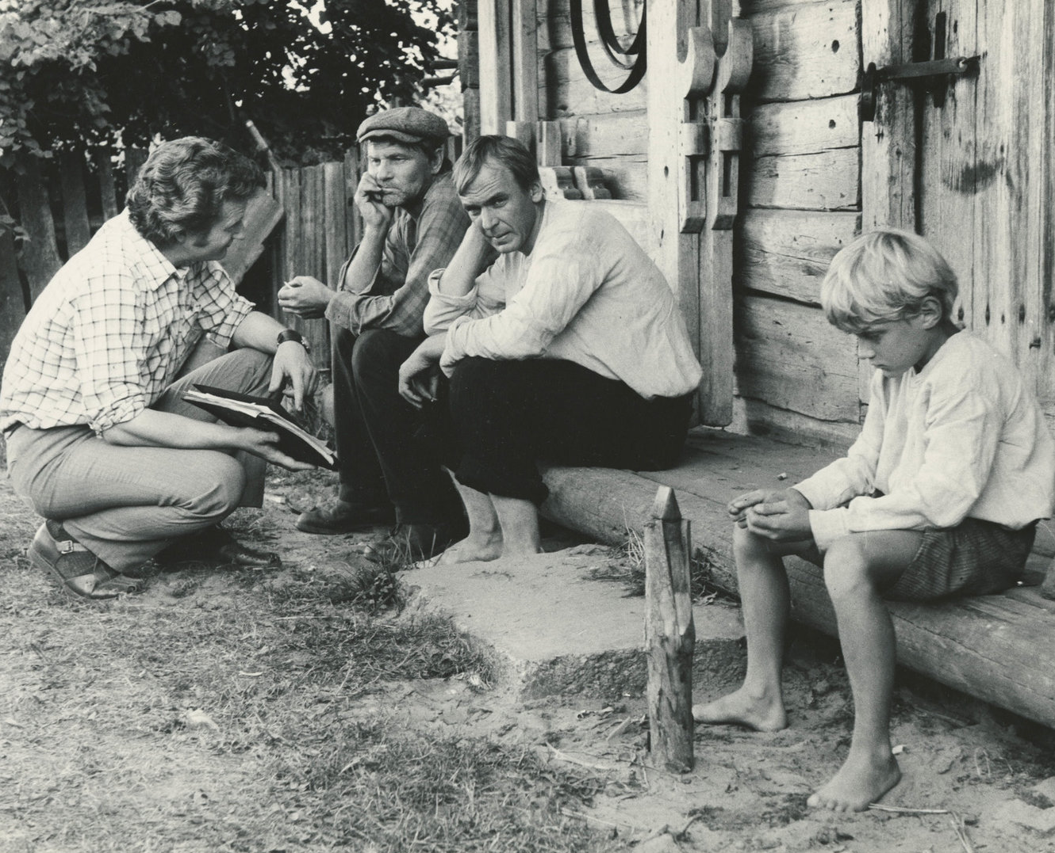
Wrote scenarios for five films.​
,,Sodybų tuštėjimo metas'' 1976
(Homesteads emptying time)
,,Vasara baigiasi rudenį'' 1981
(Summer ends at autumn)
,,Neapykantos pamokos'' 1983
(Lessons of hate)

Slide 7
Sources
https://www.vle.lt/straipsnis/romualdas-granauskas/
https://rasytojai.lt/rasytojai/granauskas-romualdas/
https://www.knygos.lt/lt/knygos/gyvenimas-po-klevu/
https://www.kinofondas.lt/filmas/sodybu-tustejimo-metas-1-serija/
http://www.yrasalis.lt/desimt/menininkai/romualdas-granauskas/

Slide 8
This project has been funded with support from the European Commission under the Erasmus+ Programme. This publication reflects the views only of the author, and the Commission cannot be held responsible for any use which may be made of the information contained therein.

