Slide 1
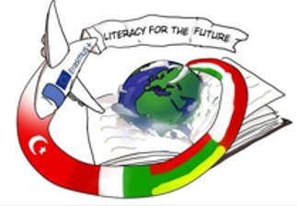
Romualdas Granauskas
Life under the Maple Tree
(,,Gyvenimas po klevu'‘)
Justė Čiuderytė
Adrijus Dulskas
Simas Tiškevičius

Slide 2
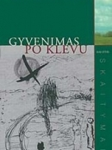
Life Under the Maple Tree (1988)

Slide 3
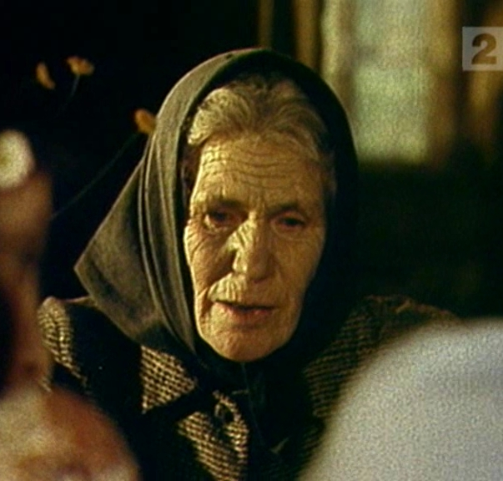
The work depicts the journey of the lonely and old woman Kairienė to a new town as she remembers her life and its slow collapse due to the collectivization that took place at the time. This leads to not only the loss of the farm, but also the disintegration of the family.

Slide 4
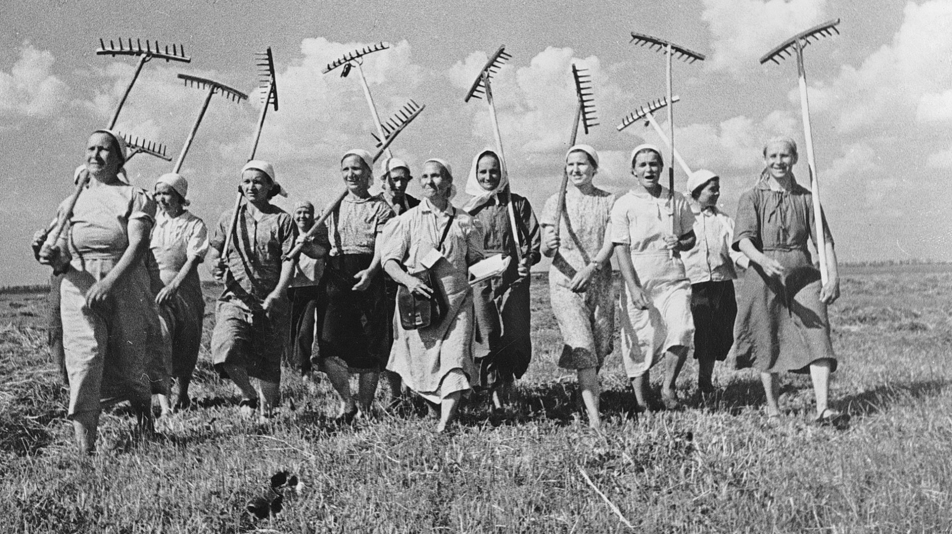
Collectivization. What is it?

Slide 5
Distance from the birthplace
Sūnus sėdėjo ant žemės, žiūrėjo į tolį, ir toks liūdnumas buvo jo akyse... Ne dėl to sakėsi pavargęs, kad visą savaite dirbo, kad net sekmadienį negalėjo pailsėti <...> ne dėl to. Ir tas jo sėdėjimas po klevu, tas vaikščiojimas po gimtąją sodybą, po kiemą.”
The son was sitting on the ground while looking into the distance, and there was such sadness in his eyes... He said he was tired not because that he had worked all week, that even on Sunday he struggled to rest <...> not for that. And him sitting under the maple tree, him walking around the homestead and around the yard.”

Slide 6
New life
,,Ji pati iš savęs žino, kaip ramina gamtos balsas, vėjo ūžavimas klevo viršūnėje, kapinaičių medžiuose''
,,Ji viena, sena ir nepagalinti, jai sunku gyventi vienatvėje, bet visa jos stiprybė - ramybėje''
"She knows herself how soothing the voice of nature, and the rustling of the wind on the top of the maple tree, in the trees of the cemetery is."
"She is alone, old and helpless, it is difficult for her to live alone, but all her strength is in peace."

Slide 7
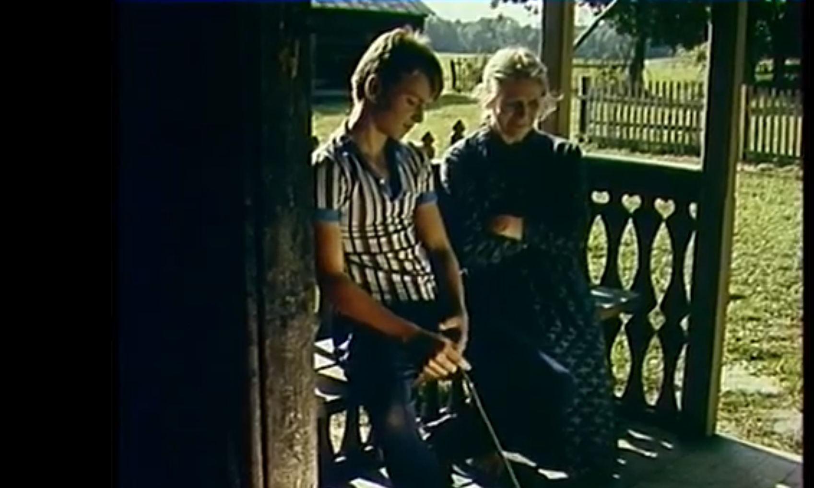
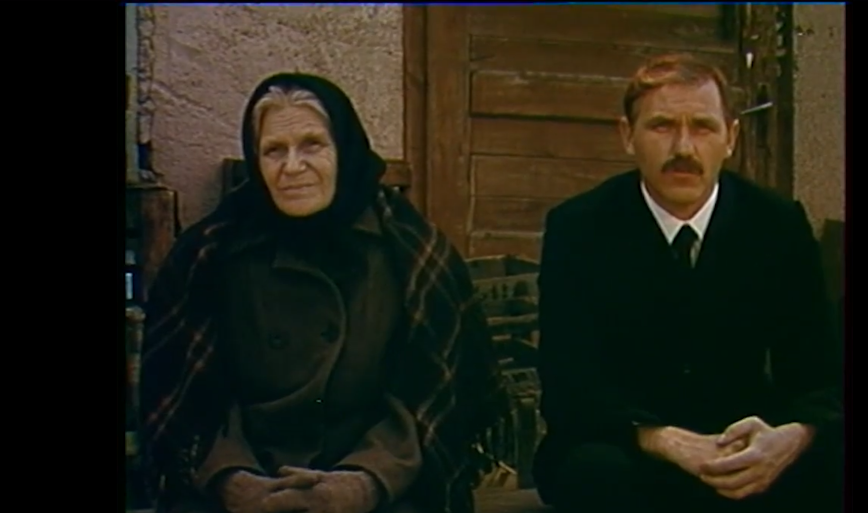
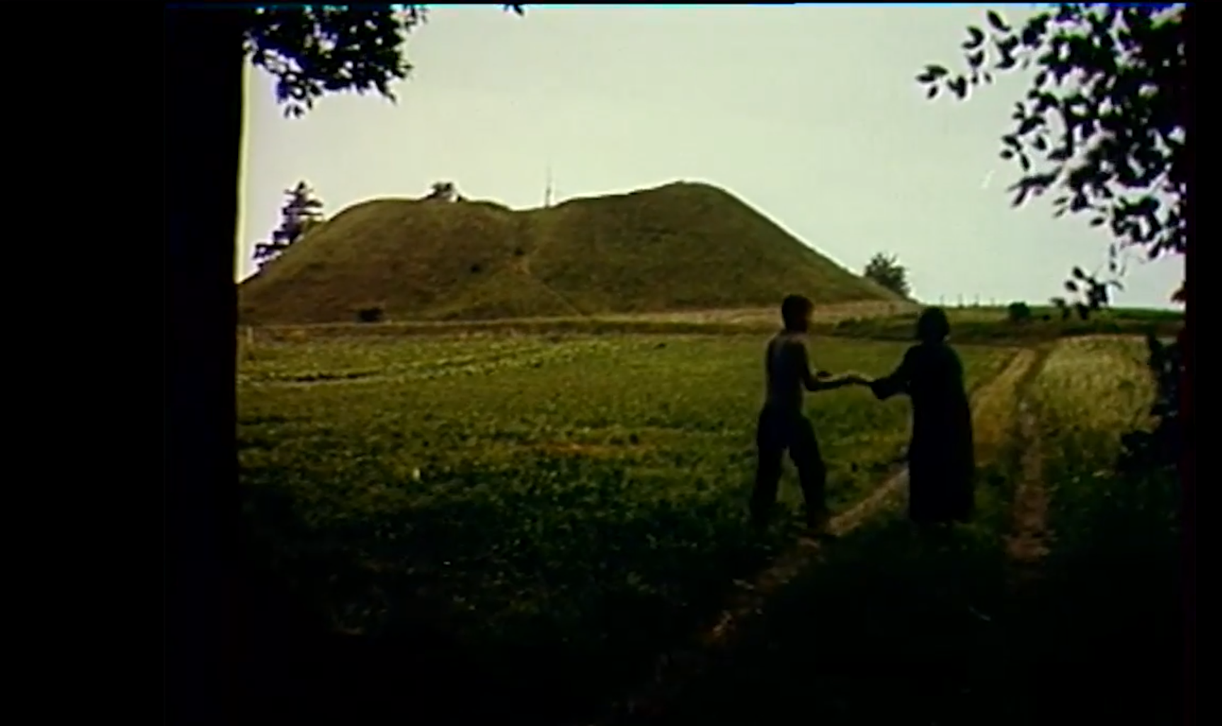
Film
https://www.facebook.com/watch/?v=1086119778502938

Slide 8
Resources
https://www.vle.lt/straipsnis/romualdas-granauskas/
https://rasytojai.lt/rasytojai/granauskas-romualdas/
https://www.knygos.lt/lt/knygos/gyvenimas-po-klevu/
https://www.kinofondas.lt/filmas/sodybu-tustejimo-metas-1-serija/
https://www.facebook.com/watch/?v=1086119778502938

Slide 9
This project has been funded with support from the European Commission under the Erasmus+ Programme. This publication reflects the views only of the author, and the Commission cannot be held responsible for any use which may be made of the information contained therein.

