Slide 1
If you get a second chance… Take it!
Goda, Miglė and paulina
VDU Ugnė Karvelis gymnasium

Slide 2
Where it ended…
”She has to go back to the point in her life where it all started. She gets a last chance to change everything, otherwise she will end up there again.”

Slide 3
Jessica decided to take this chance and start over. She made a pact with herself to stay away from bad things and live her truth.

Slide 4
The girl remembered what she really wanted and kept working hard to one day be able to pursue her career in medicine.

Slide 5
She remembered what was truly important and she took care of herself, spent time with her family and friends, played sports.

Slide 6
One day she was celebrating her friend’s birthday playing bowling where she saw him. All the bad things that happened to her came rushing back leaving her frozen. Once the haze has lifted from her, she saw him approaching her.

Slide 7
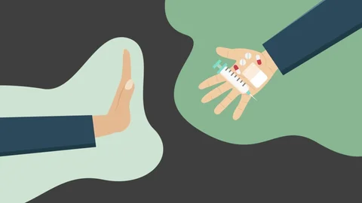
He tried to talk to her and secretly offered her drugs, but she had learned her lesson and said no. After some more convincing Jessica said no one last time and ran away.

Slide 8
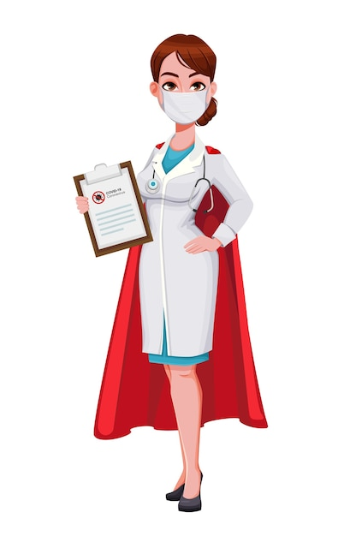
The End…
She never saw him again. Jessica was happy, she got everything she wanted. She grew into a beautiful successful woman and the best doctor specialising in substance abuse.

Slide 9
Let’s make good choices together!
„This project has been funded with support from the
European Commission under the Erasmus+ Programme. This
publication reflects the views only of the author, and the
Commission cannot be held responsible for any use which may
be made of the information contained therein.”

