Slide 1
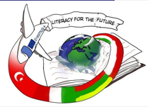

Lithuanian authors
Sigutė Amšiejūtė,
Elzė Remeikytė,
Taura Sabaliauskaitė

Slide 2
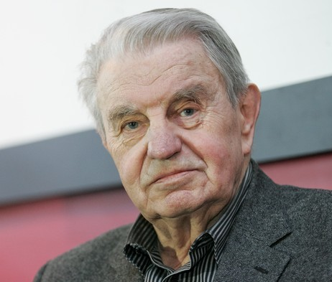
Justinas Marcinkevičius
Biography:
Lived XX-XXI century.
Poet, dramaturg, translator, academician, society member.
Most of Justinas Marcinkevičius creations were written in difficult times of Soviet occupation years, that’s why his work has a lot of (metaforų, užuominų ir nutylėjimų).
His most known work: ‘Mindaugas, ‘Katedra’,’Mažvydas. Books: ‘Grybų karas’, ‘Poemos’’.

Slide 3
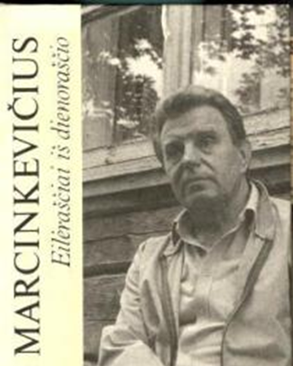



Poetry and poems
Very prolific poet
Published 23 books while he was alive
After his death, 3 more books were published

Slide 4
Du eilėraščiai
Two poems
Pakėliau raibą gegulės plunksną
– beržynas užkukavo.
Pakėliau pilką vieversio plunksną
– arimas užgiedojo.
O kai pakėliau vargų kryželį
– Lietuva atsiduso.
I picked up the cuckoo’s mottled
feather,
– the birch grove cuckooed.
I picked up the skylark's grey feather
– the tillage sang.
And when I picked up the cross of hardships–
– Lithuania sighed.

Slide 5
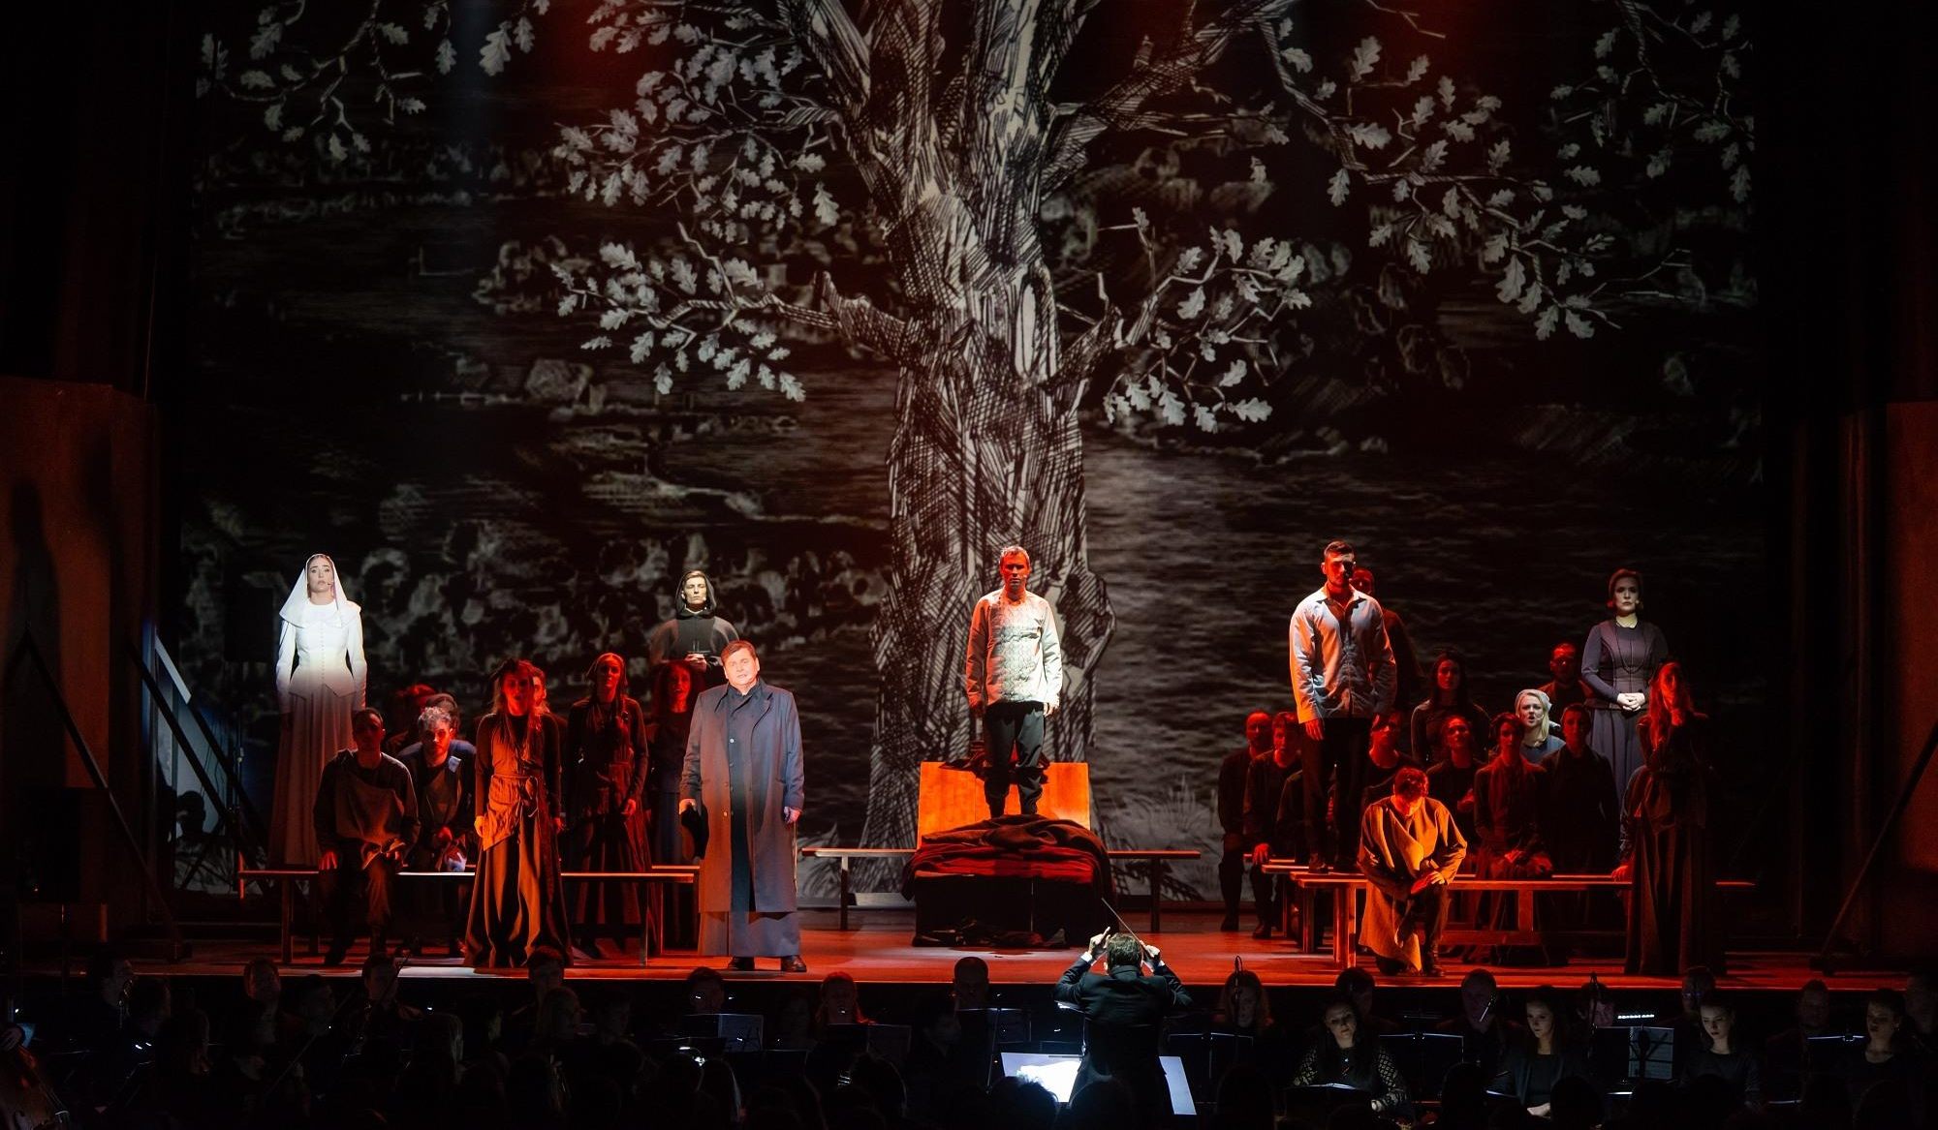
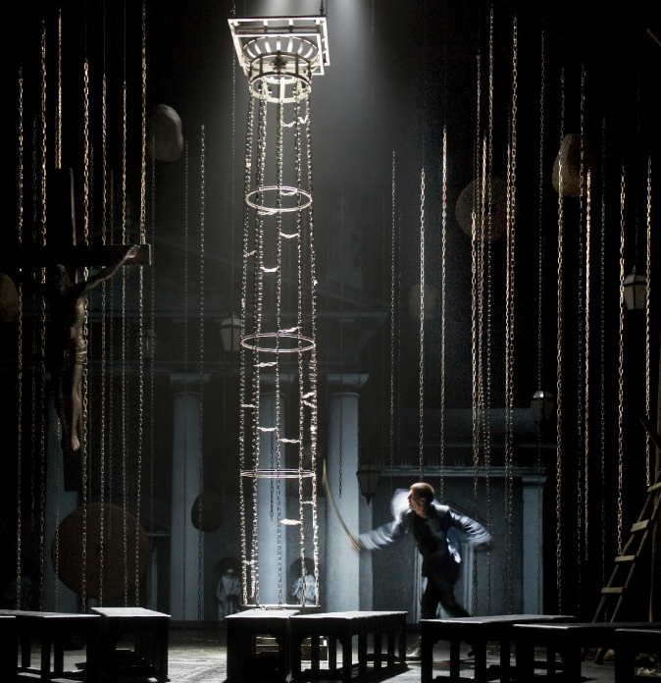
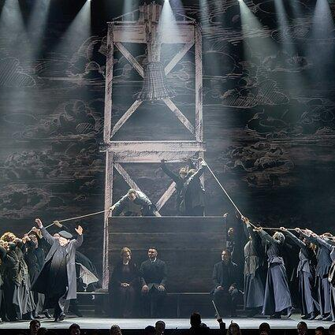
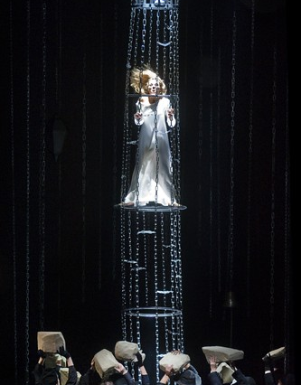
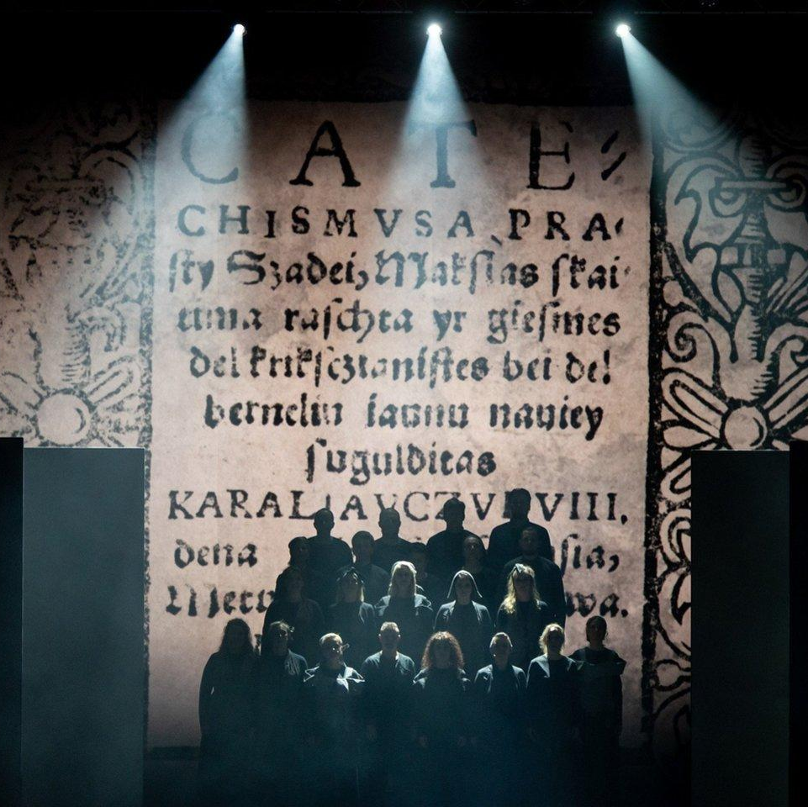
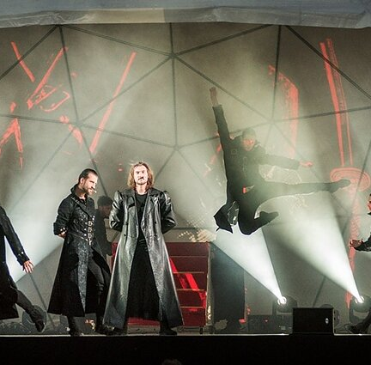
Plays

Slide 6
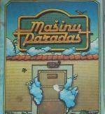
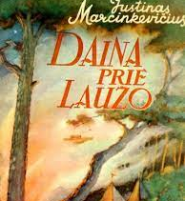
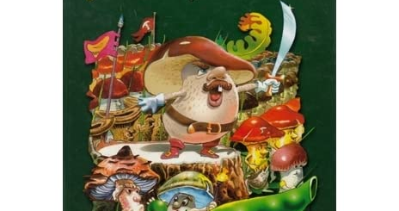


Books for children

Slide 7



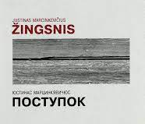
Translations
His books have been translated to 18 languages
He was also a translator

Slide 8
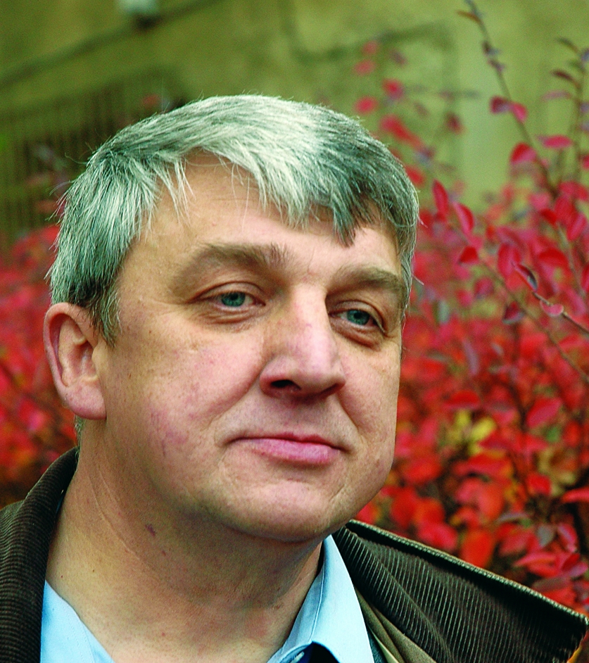
Gendrutis Morkūnas
Biography
Lived XX-XXI century.
Writer for kids, doctor of physical sciences.
Has done various researches, tried to find a way for people to protect from radiation, wrote scientific articles.
His most known work (books): ‘Vasara su katšuniu’, ‘Grįžimo istorija’, ‘Iš nuomšiko gyvenimo’.

Slide 9


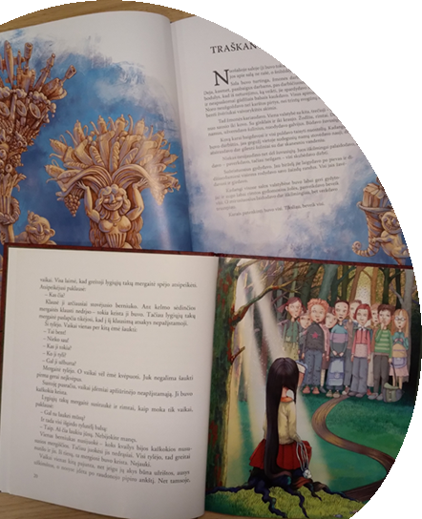
Gendrutis Morkūnas wrote 6 books for children.
‘’Children, - said their friend Gendrutis, - are the best readers: when they read, they settle in books, so they can forget everything. It is very interesting to talk to them. They always tell the truth about books. They also tell the truth about life. That’s why I write for kids.’’

Slide 10
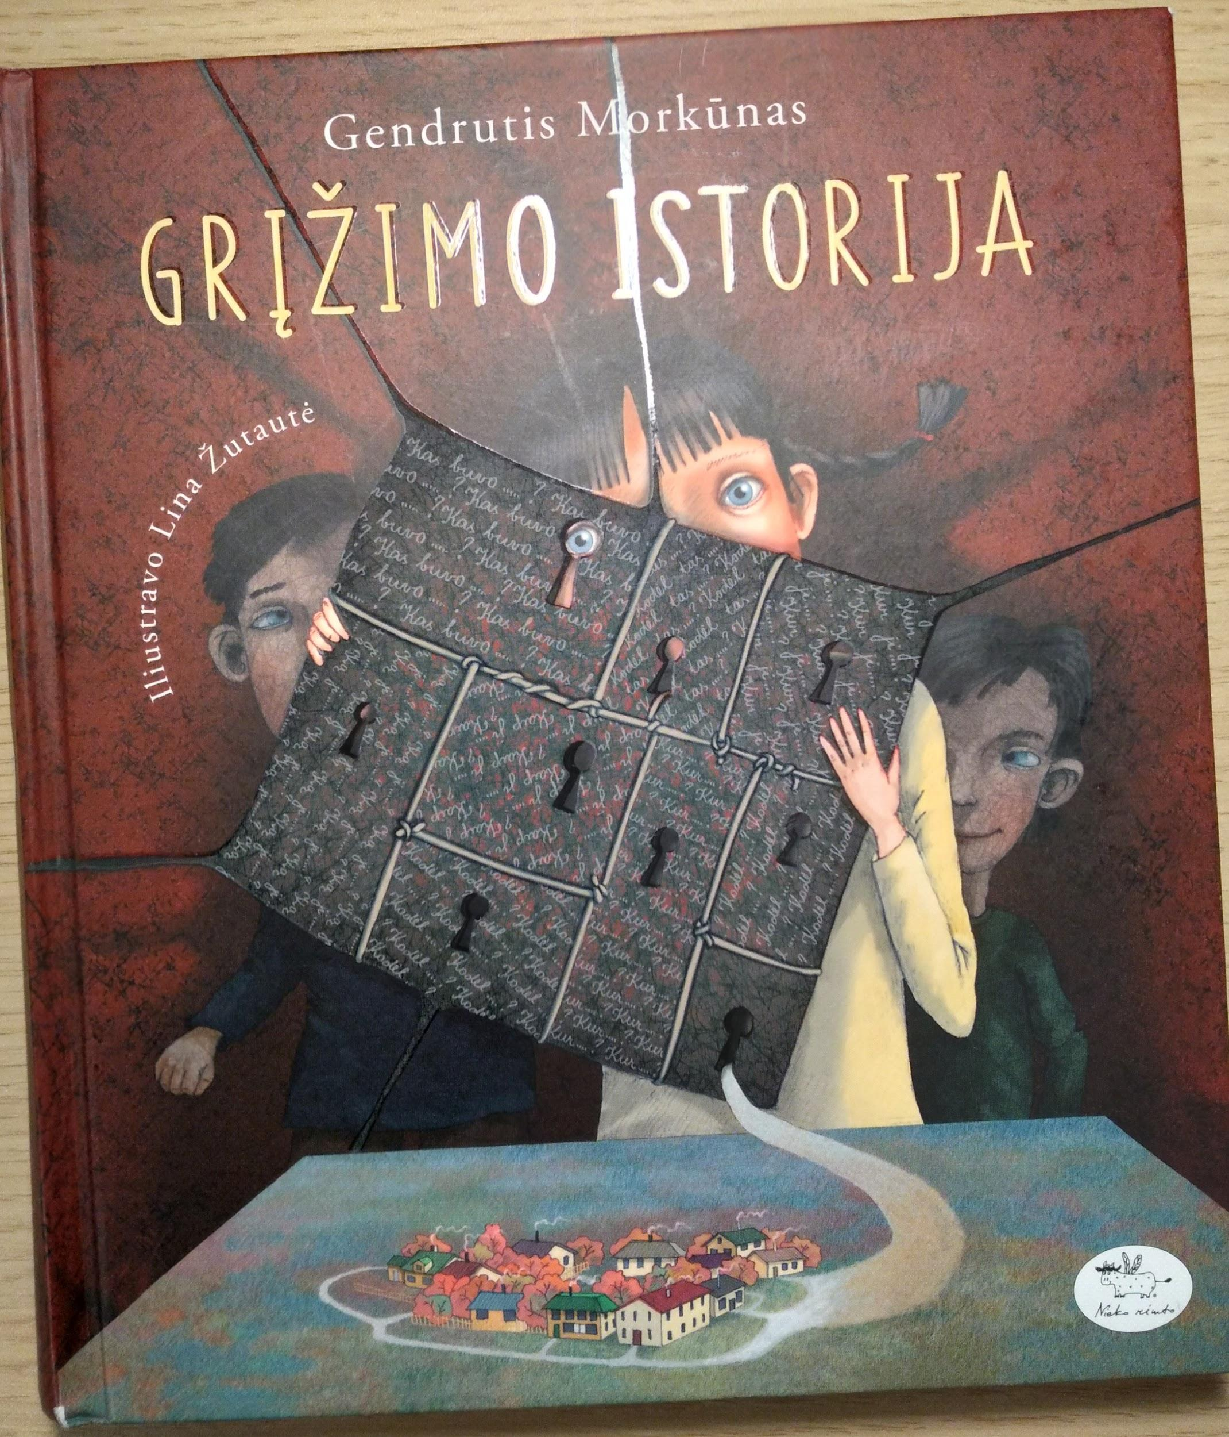
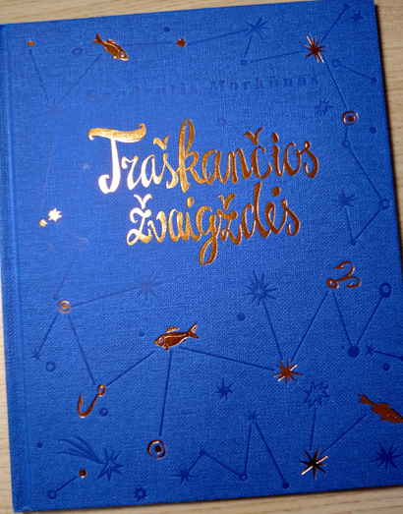
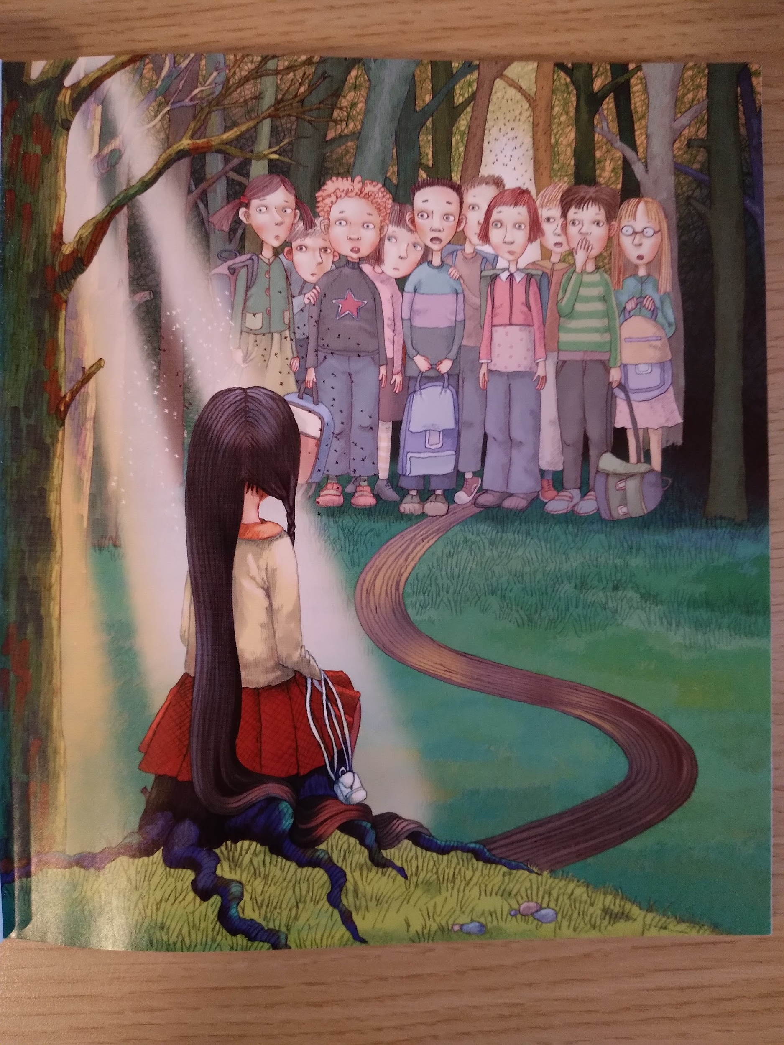
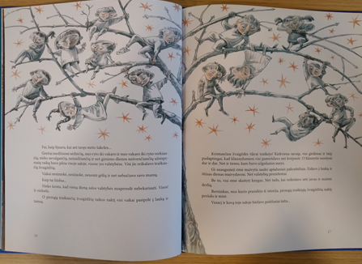
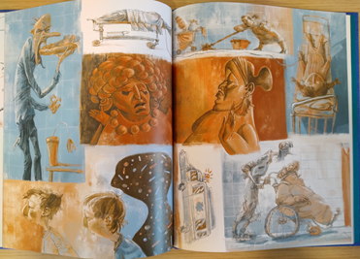
vvvvvvv

Slide 11

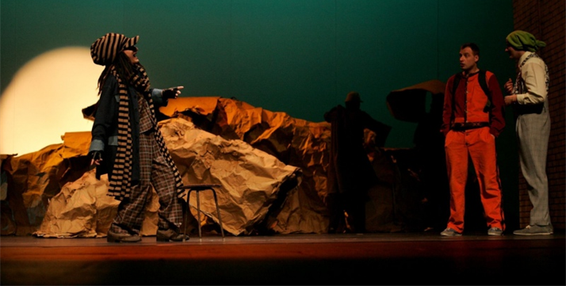
Performance
There is a performance in drama theatre created by G. Morkūnas book ‘’Iš nuomšiko gyvenimo”

Slide 12
This project has been funded with support from the European Commission under the Erasmus+ Programme. This publication reflects the views only of the author, and the Commission cannot be held responsible for any use which may be made of the information contained therein.

Slide 13
Sources
http://www.xn--altiniai-4wb.info/files/literatura/LH00/Justinas_Marcinkevi%C4%8Dius._Eil%C4%97ra%C5%A1%C4%8Diai.LHD800.pdf
http://www.lituanus.org/1984_4/84_4_03.htm
https://www.vle.lt/straipsnis/justinas-marcinkevicius/
https://www.bernardinai.lt/gendrutis-morkunas-amzinai-skolingas-vaikams/

