Slide 1
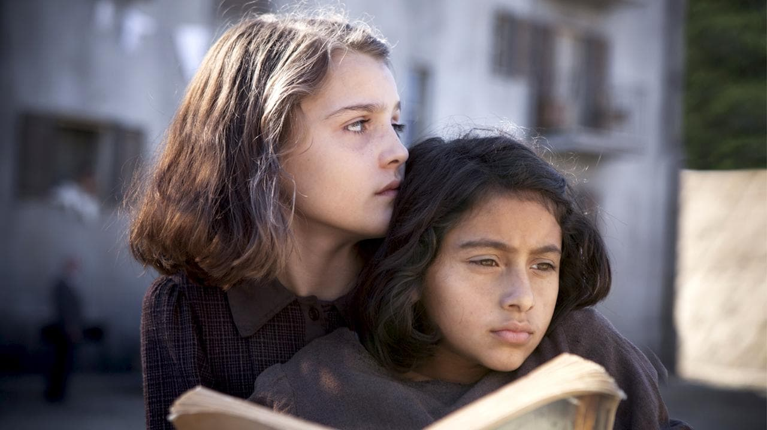
The brilliant friend
.
“The brilliant friend” is a quadrilogy of novels, written by Elena Ferrante from 2011 to 2014. The books tell the life of two women, different and at times similar, Lenù and Lila, who know each other since childhood they look for each other and find themselves in a succession of events until adulthood.

Slide 2
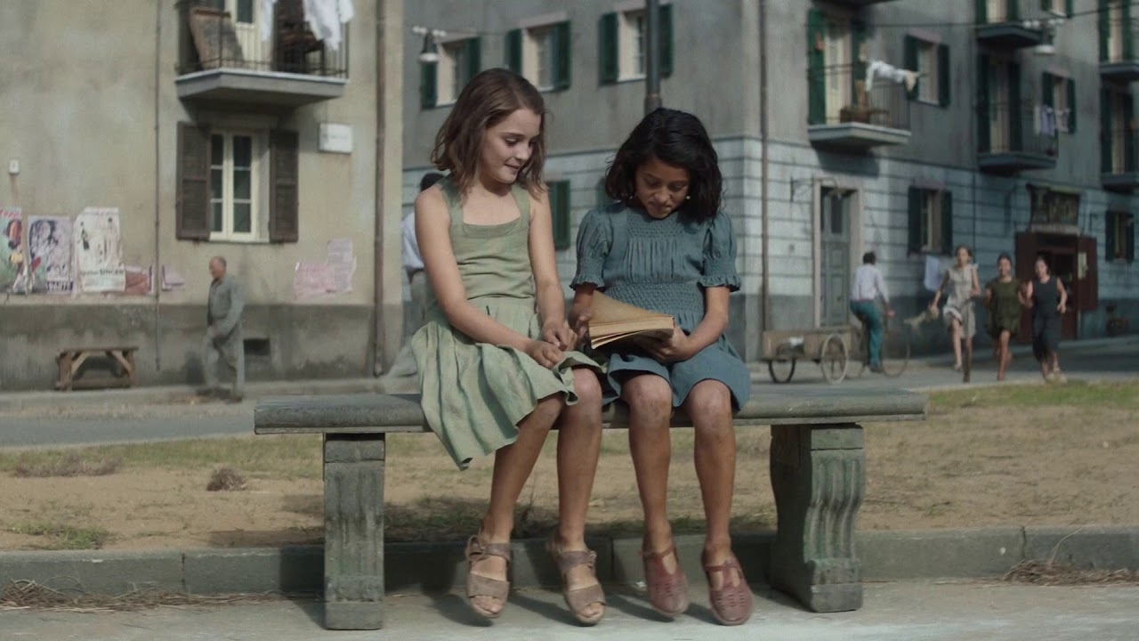
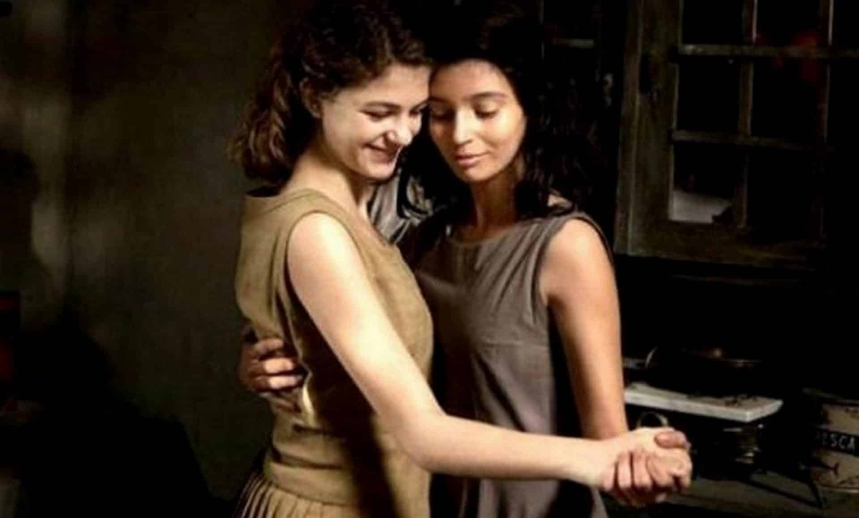
It is the story of a strong and controversial friendship, in which the roads meet and separate, against the backdrop of an Italy with different sides and different opportunities grappling with the arrival of progress. The most brilliant friend opens with a twist that opens the story of these girls and their families, who lived in a poor neighborhood, in an ancient Naples surrounded by stereotypes living among a great amount of contradictions.
The struggle to survive is tough and leads Lila and Lenù to become two different women who rush into opposite spheres, but tied by the same stormy past. Their pasts loom over their adult lives. This story tells of a shared passion for study and school, strong complicity between the two, but also means for social redemption.

Slide 3

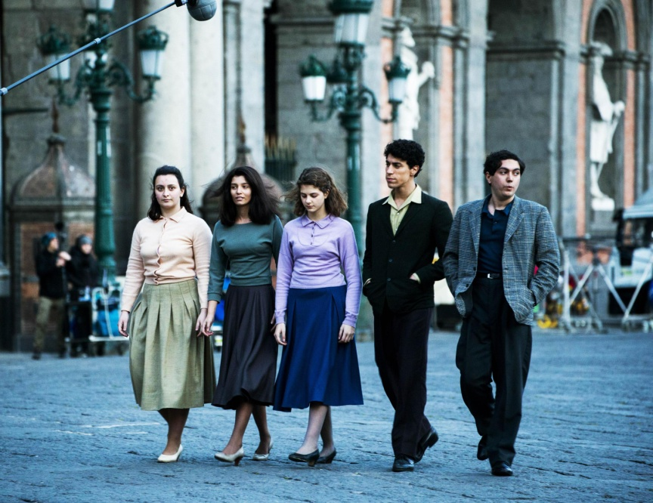
The first book opens with a glimpse into the present with all the difficulties of everyday life, and then there is the long narrative flashback told by Elena in first person as a narrator. It tells the part of the life of Lila and Lenù that goes from the first meeting of the two friends to the marriage of the first with Stefano Carracci, son of Don Achille, a powerful person in the neighborhood. As we have already said, Lila and Elena are two different and similar girls. Different because the first one one has a lively and instinctive (energetic) yet brilliant character, the other is devoted and quiet. One is small and dark, the other almost angelic and blonde.
They have the same destiny, they were born and live in the Rione, an autonomous and closed entity with respect to the city. Since childhood Lila and Lenù have lived in continuous competition between them for personal affirmation and establish a relationship of emotional dependence and mutual help, but also of continuous challenge: since elementary school Lila has won this particular competition, given her marked intelligence and his love for knowledge. But when they get to high school, the two girls split up because Lila's parents are too poor to let her study.

Slide 4


So Elena studies to improve her social condition, while Lila is swallowed up by the closed society of the neighborhood. The life of the two, now divided by school hours (one studies, the other works in her father's shoemaker shop) meets more and more rarely, in the evening, in the Rione. The two girls grow up starting to draw two different lives for themselves: Lila becomes the most admired in the neighborhood for her beauty, Elena instead pines for love for Nino Sarratore, a young man from the neighborhood. Back in Naples, she discovers that Lila is engaged, a love that will lead to Lila and Stefano's wedding. A wrong marriage. The story continues between wrong loves and betrayals, disappointments and estrangements, in the continuous search for emotional stability.

Slide 5
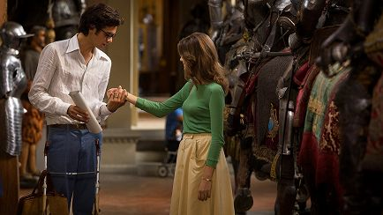

History of the new surname
The second book of the quadrilogy highlights that the marriage between Lila and Stefano immediately starts badly: the man turns out to be violent and hard towards Lila. Elena, on the other hand, wins a scholarship for the university at the Normale di Pisa, and gradually distances herself more and more from the neighborhood, from her old life, from her friend and from that Lenù that she was and nobody recognizes. After university he decides to write a book.
The goes on with those ones who flee and those ones who remain: against the backdrop of the lives of Lila and Lenù, a world of political battles and social clashes comes to life more and more. These are the years of riots, the years of street and factory clashes. In this frenzy, on one side and the other on the other, they watch the lives of the ward change. Lila sets up her own in the world of computers and information technology, in which she is interested. The book ends with Elena who, finally freed from her husband and daughters, can start her new life beside a new partner.

Slide 6


This is how The Brilliant Friend ends Elena is constantly on the road for her writing business. When Elena can finally stop, take back her daughters who in the meantime had lived with their in-laws to move to Naples from her Nino, Lila tells her what Antonio has discovered: Nino has never really left his wife, while Elena has thrown his life away. in the air to follow the dream of a childhood love. In this sad awareness, she will accept to remain the lover of this man. Thus opens the chapter that marks the end of the story of The brilliant friend. It opens with the pregnancy of the two, contemporaneous. The times of revolutions are over, and those of the dead have arrived with dangerous injections in their arms. Both the girl were born
The opportunity, the money, the success bring Elena and Lila back to live close together again, in the district, with their children, as in the past. But it is a brief interlude of joy: things between the two begin to crack, and everything explodes when Tina, Lila's daughter, mysteriously disappears in an afternoon. Tina disappears and with her part of Lila. Elena's Neapolitan parenthesis thus ends in tragedy: the woman decides to leave again, go to Milan, change her life. Elena receives a sad phone call: Lila has disappeared. So Elena decides to write their story. Life always makes us face with choices that will affect the rest of existence. Stay or go, surrender or fight, flee or stay

Slide 7
Moral teaching
The brilliant friend teaches us that speking is essential and vital to speak up, to express one's point of view in a decisive and sincere way in order to claim one's freedom of thought and action, and not to be suffocated by a patriarchal system dominated by violence and oppression. The author highlights a series of feelings lived in an intense way, capable of sustaining and also capable of tearing: friendship, love, bond with one's land and roots, the strong drive towards self-affirmation and the defense of their dignity, even in the face of deep disappointments, wounds and distances, detachments and pains.

