Slide 1
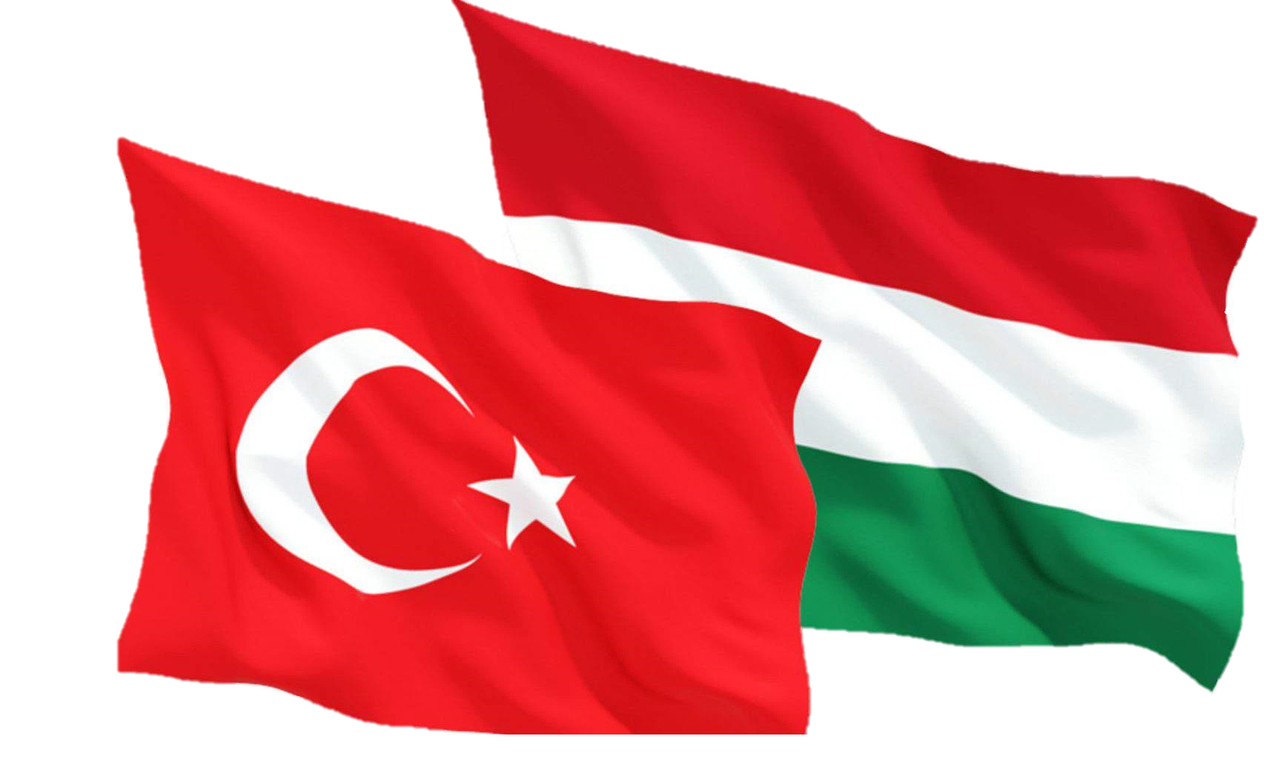
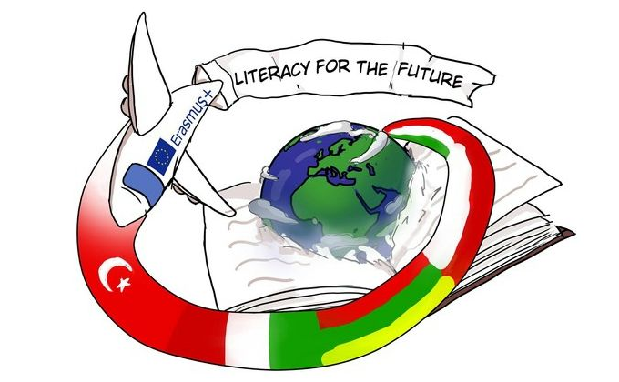
Turkish and Hungarian relations in history

Slide 2
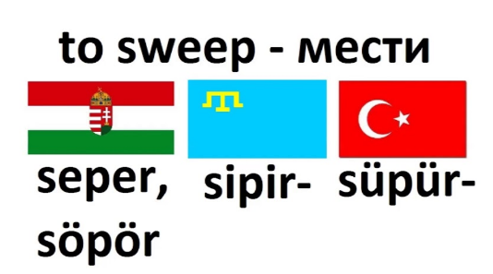
The origin of the relationship
The origin of the two nations
Cultural similarities
Language, fashion

Slide 3
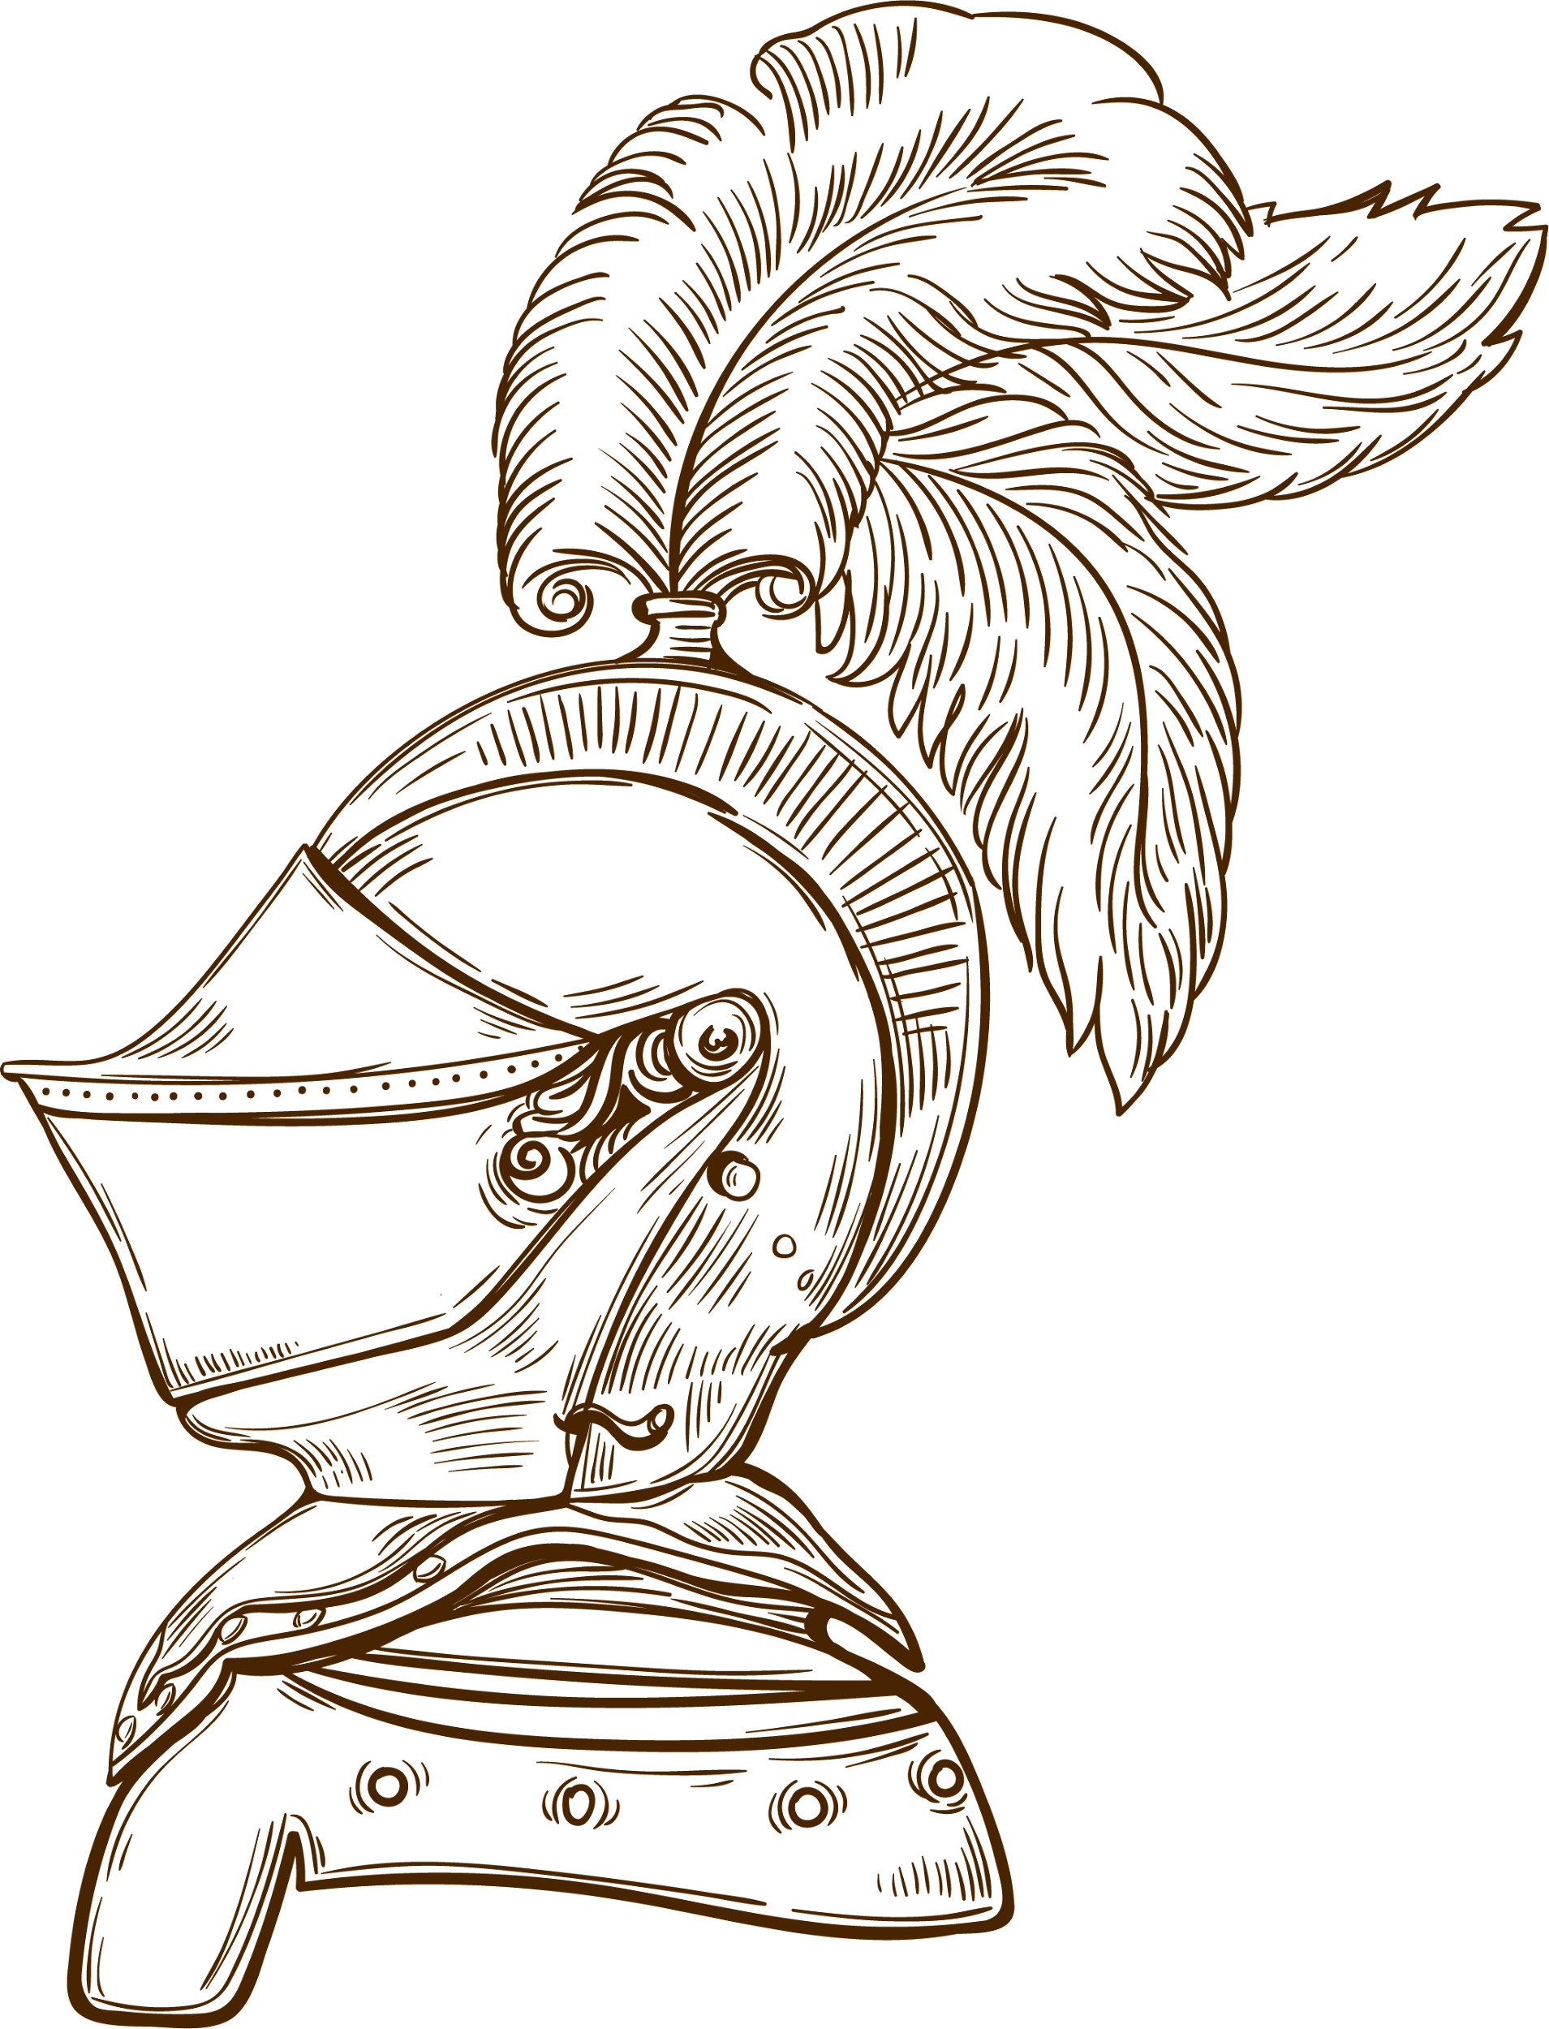
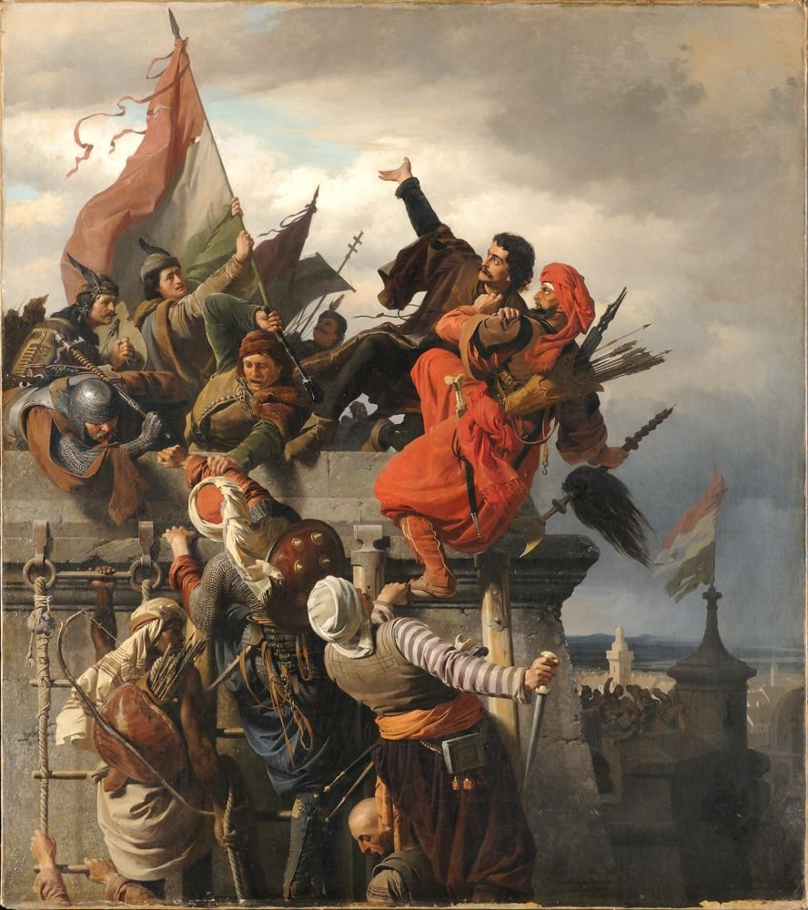
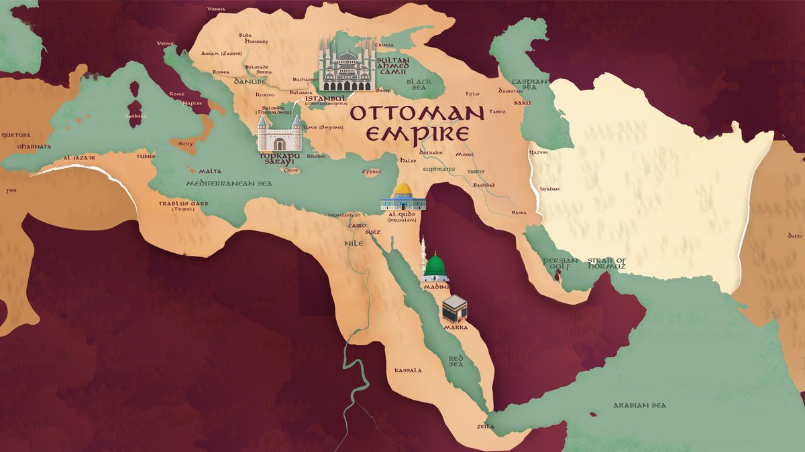
Medieval history
The European expansion of the Ottoman Empire
The border fortress system of King Sigismund of Hungary
Headquarters: Nandorfehevar

Slide 4
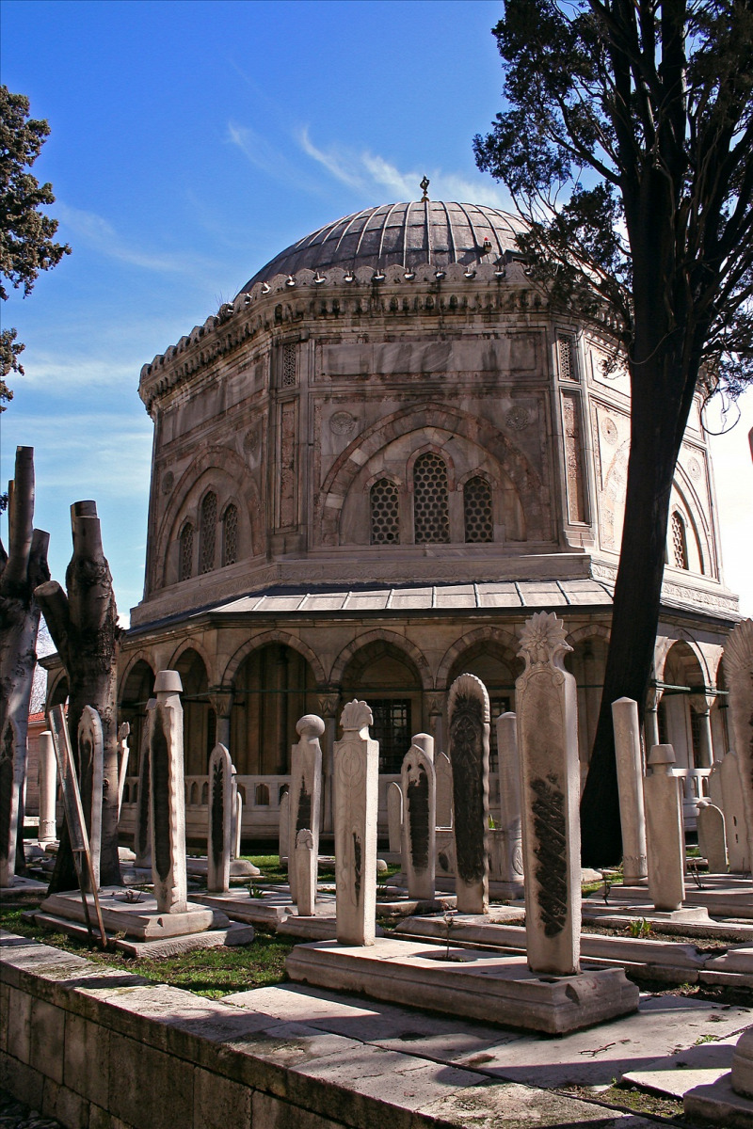
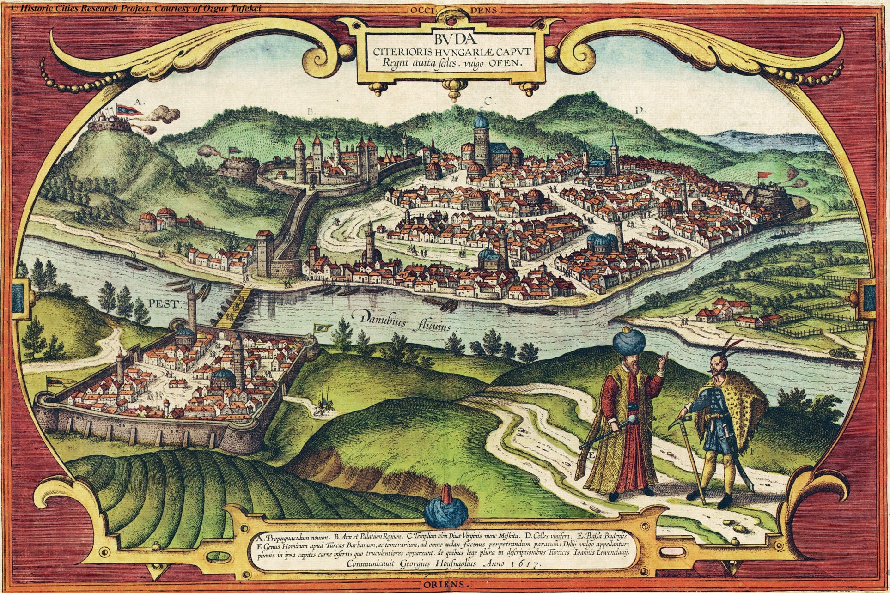
150 years of occupation
Battle of Mohács
Deviding the country into three parts
The appearance of Turkish culture in Hungary
Liberation in 1699

Slide 5
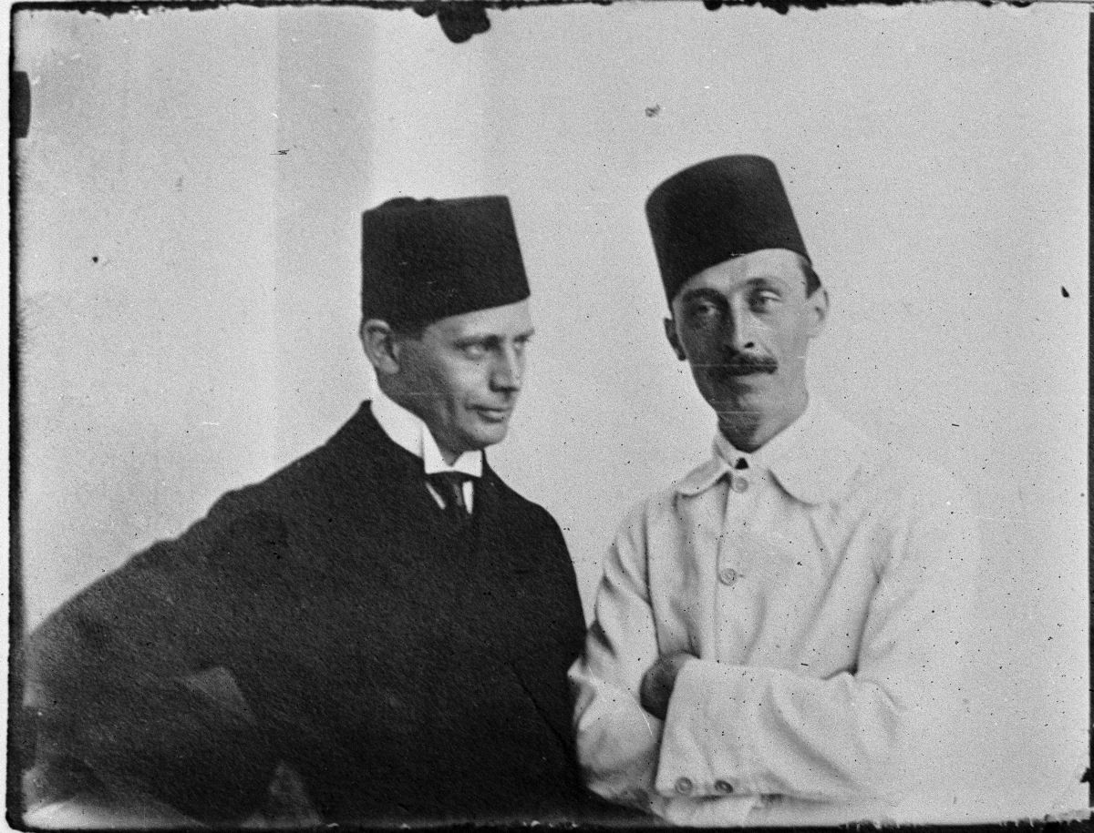
World War I relations
Good relations between the two countries
Turkology training
Hungarian Scientific Institute of Constantinople

Slide 6
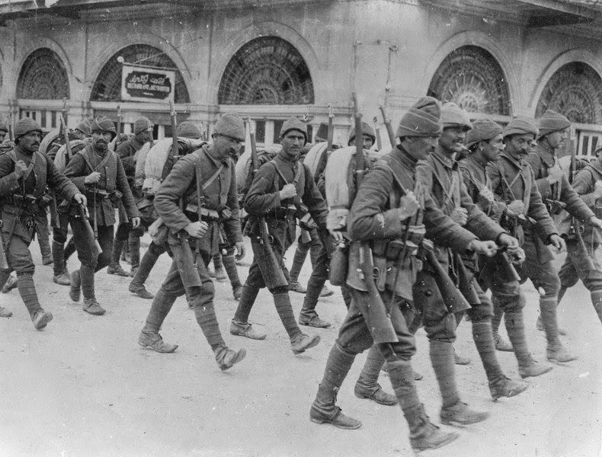
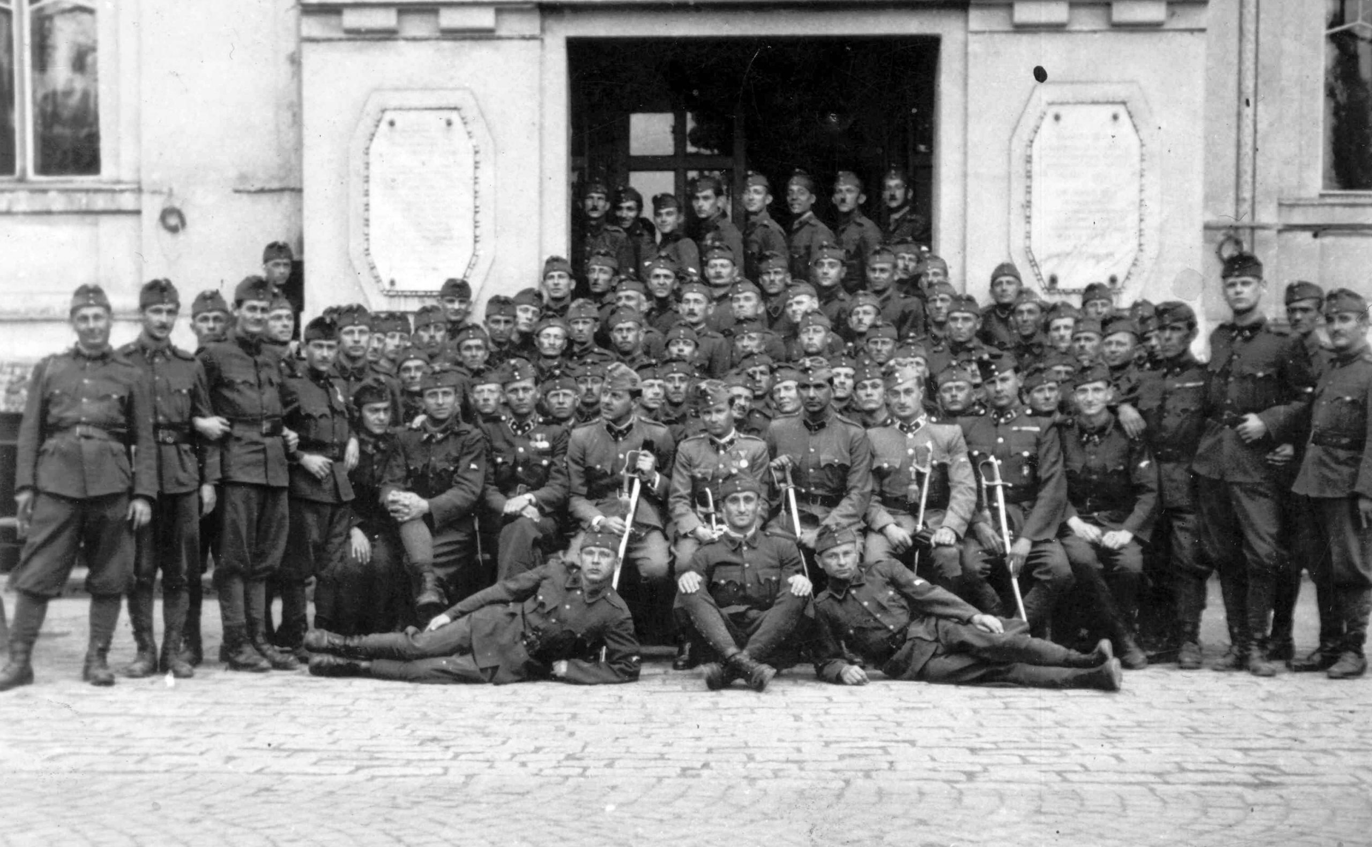
World War II and its consequences
Side-by-side battles
Republic of Turkey
Friendly contract
Local offices

Slide 7
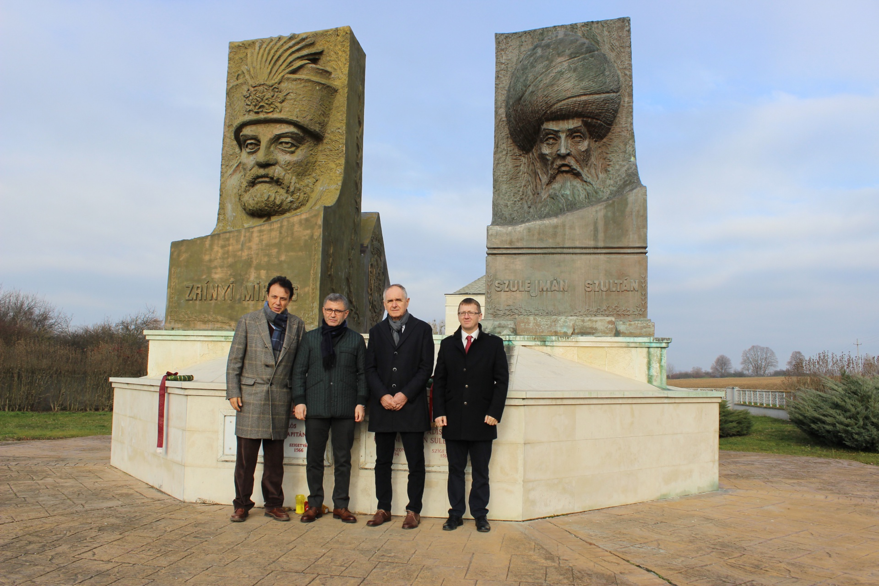
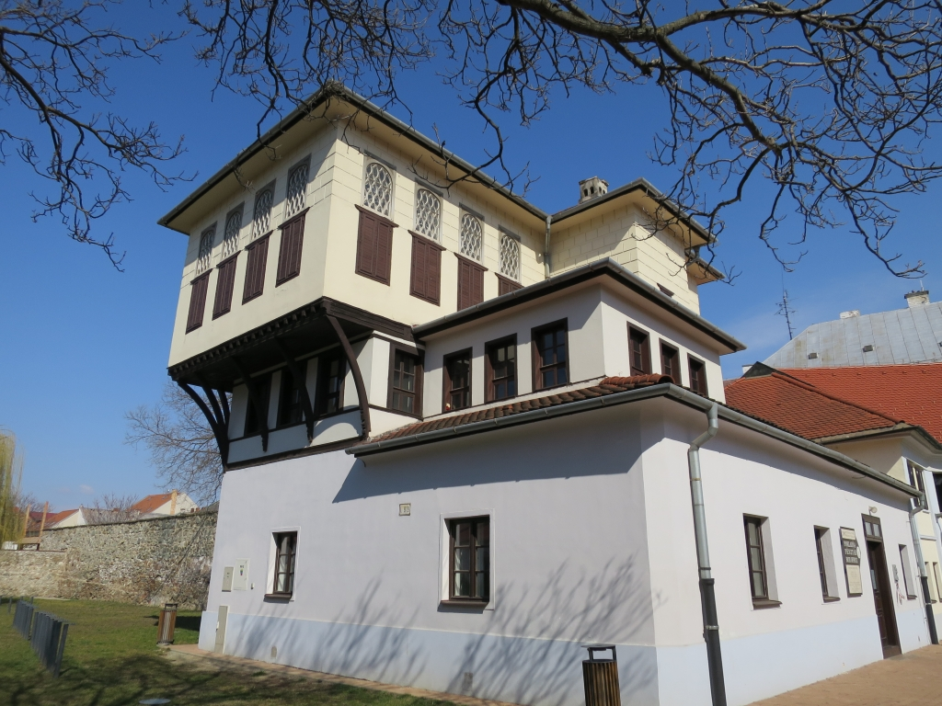
Cultural footprints
Hungarian memorials ​​in Turkey:
Lajos Kossuth Memorial Museum, statue of Imre Thököly and Ilona Zrínyi, II. Ferenc Rákóczi Memorial House and Museum
Turkish memorials ​​in Hungary :
Turkish architecture, Thermal baths, Tombs of Sami, Suleiman

Slide 8
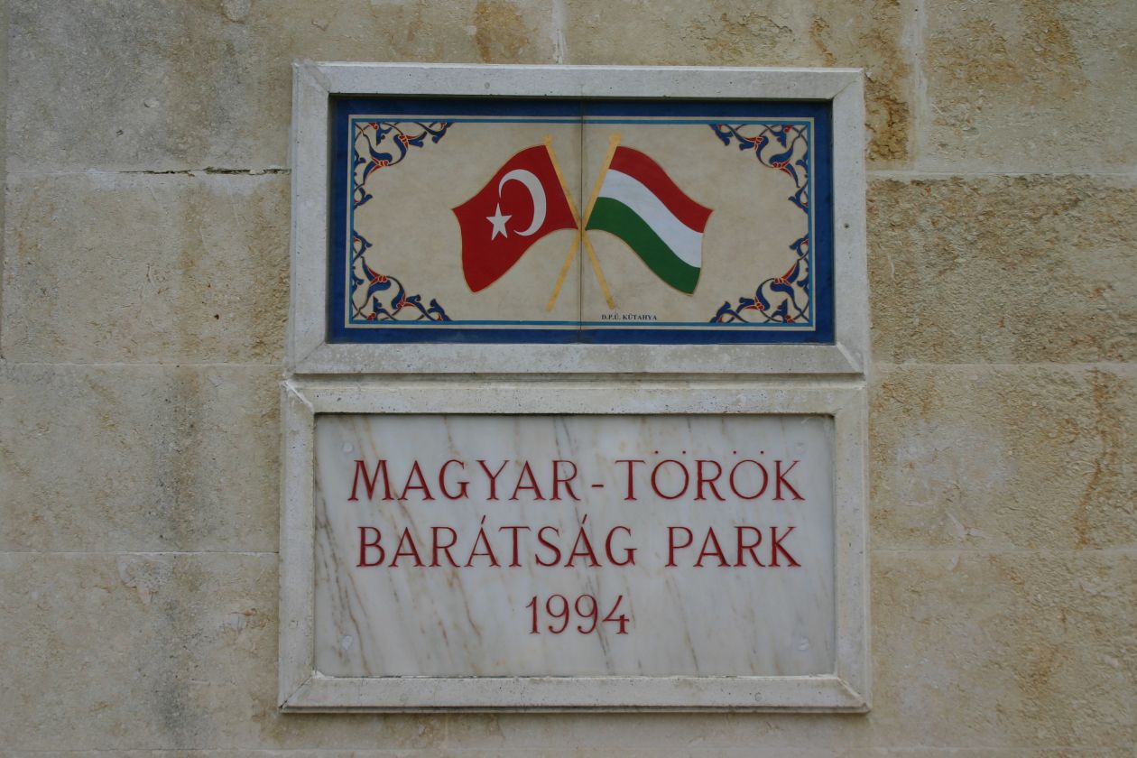
Thank you for your attention!
https://hu.m.wikipedia.org/wiki/T%C3%B6r%C3%B6k%E2%80%93magyar_kultur%C3%A1lis_kapcsolatok

