Slide 1
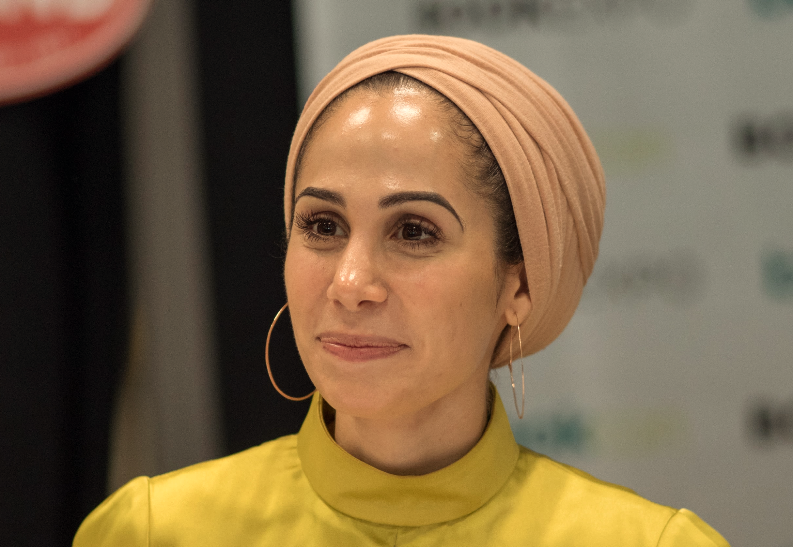
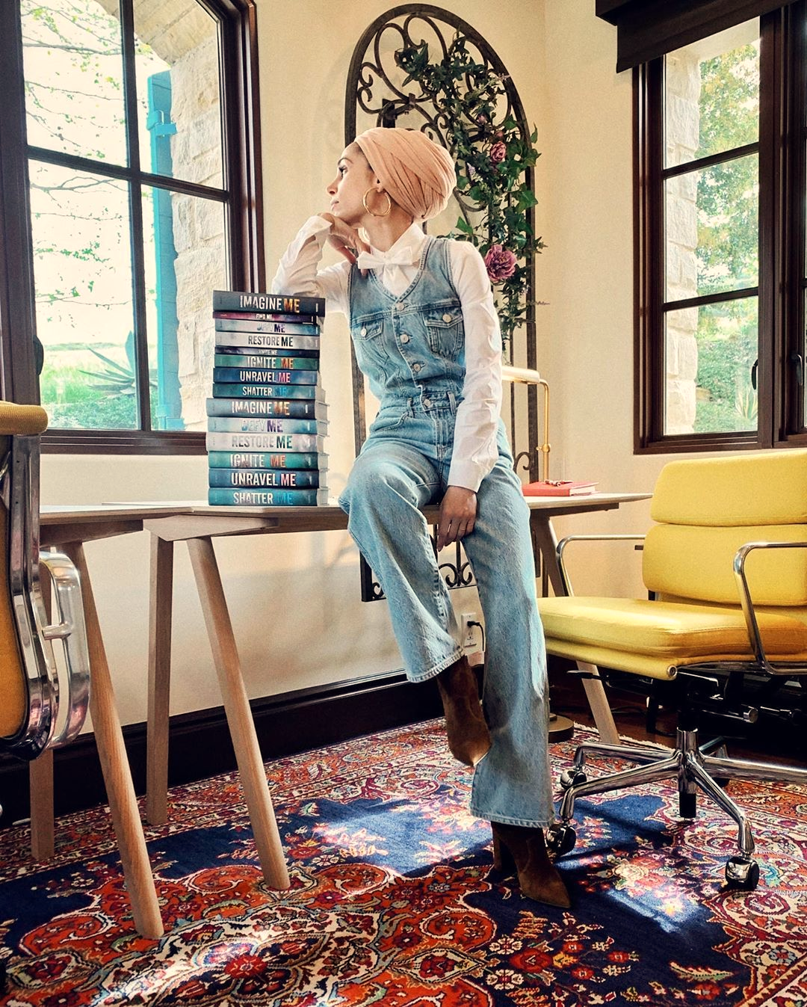
Tahereh Mafi
Tahereh Mafi is an American author who lives in Santa Monica, California. She is known for writing young adult fiction.

Slide 2
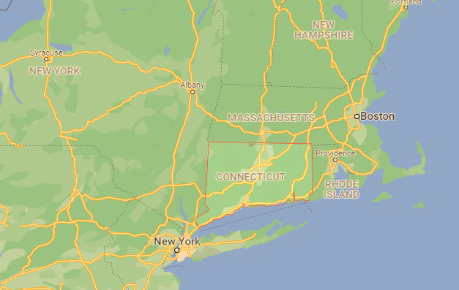
Her life
Mafi was born on November 9, 1988, in a small town in Connecticut. She is the youngest child of her family and has four older brothers. Mafi's parents are immigrants from Iran. At age 12 she moved with her family to Northern California and at age 14 they moved to Orange County.
Connecticut

Slide 3
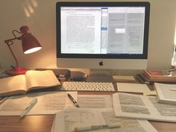
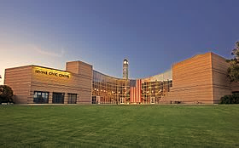
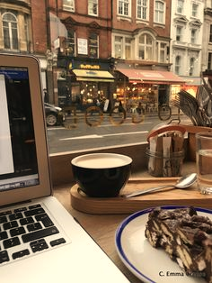
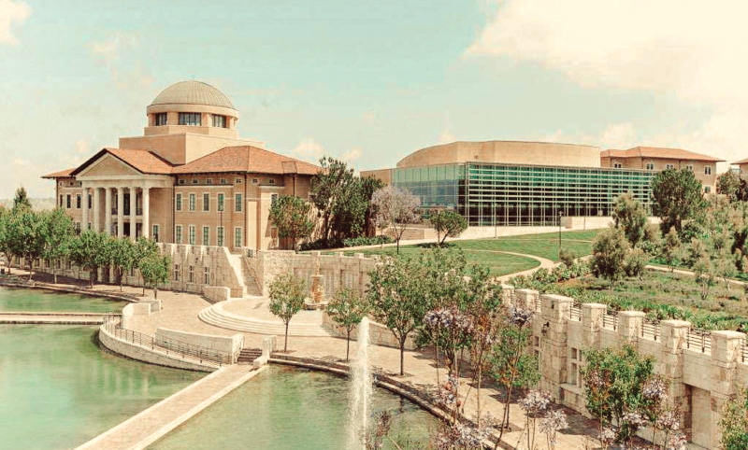
Mafi graduated from University High School in Irvine, California. She later graduated from Soka University of America, in California. She has varying levels of competency in eight different languages. She studied abroad in Barcelona, Spain for a semester in a college. During this trip she had the opportunity to be fully immersed in the Spanish language.

Slide 4
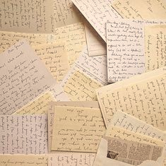
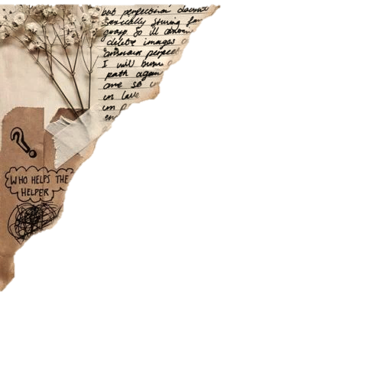
Career
Mafi stated that before writing her first novel, Shatter Me, she wrote five manuscripts in order to understand better how to write a book

Slide 5
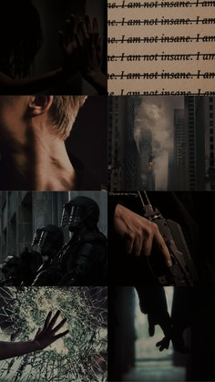
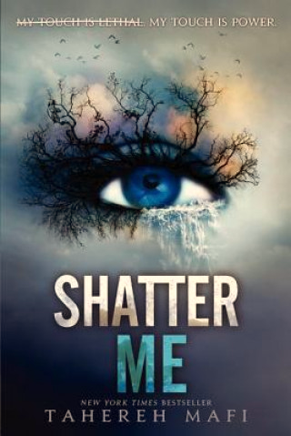
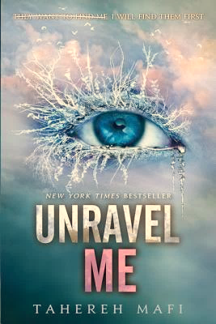
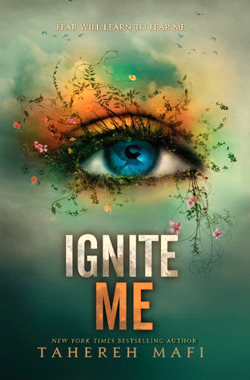
Shatter Me was published on November 15, 2011. Since then, Unravel Me and Ignite Me have been published. Mafi also has two novels that go with the Shatter Me series, Destroy Me and Fracture Me. Film rights to Shatter Me have been purchased by 20th Century Fox.

Slide 6
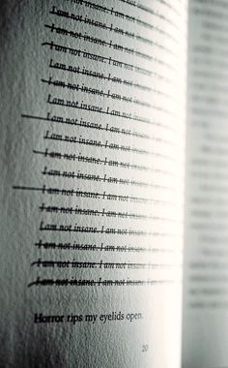
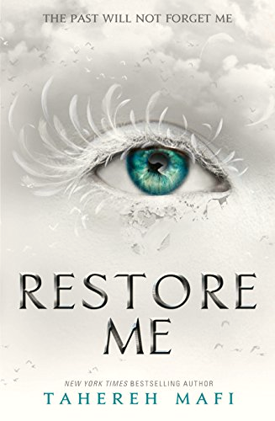
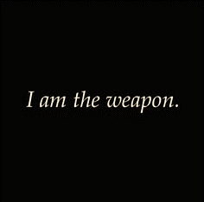
In April 2017, Mafi announced another trilogy in the Shatter Me universe following the same cast of characters. The first installment, Restore Me, is told from a dual-POV from Juliette Ferrars and Warner, the protagonist and antagonist, respectively, in the original trilogy. Restore Me was published on March 6, 2018.

Slide 7
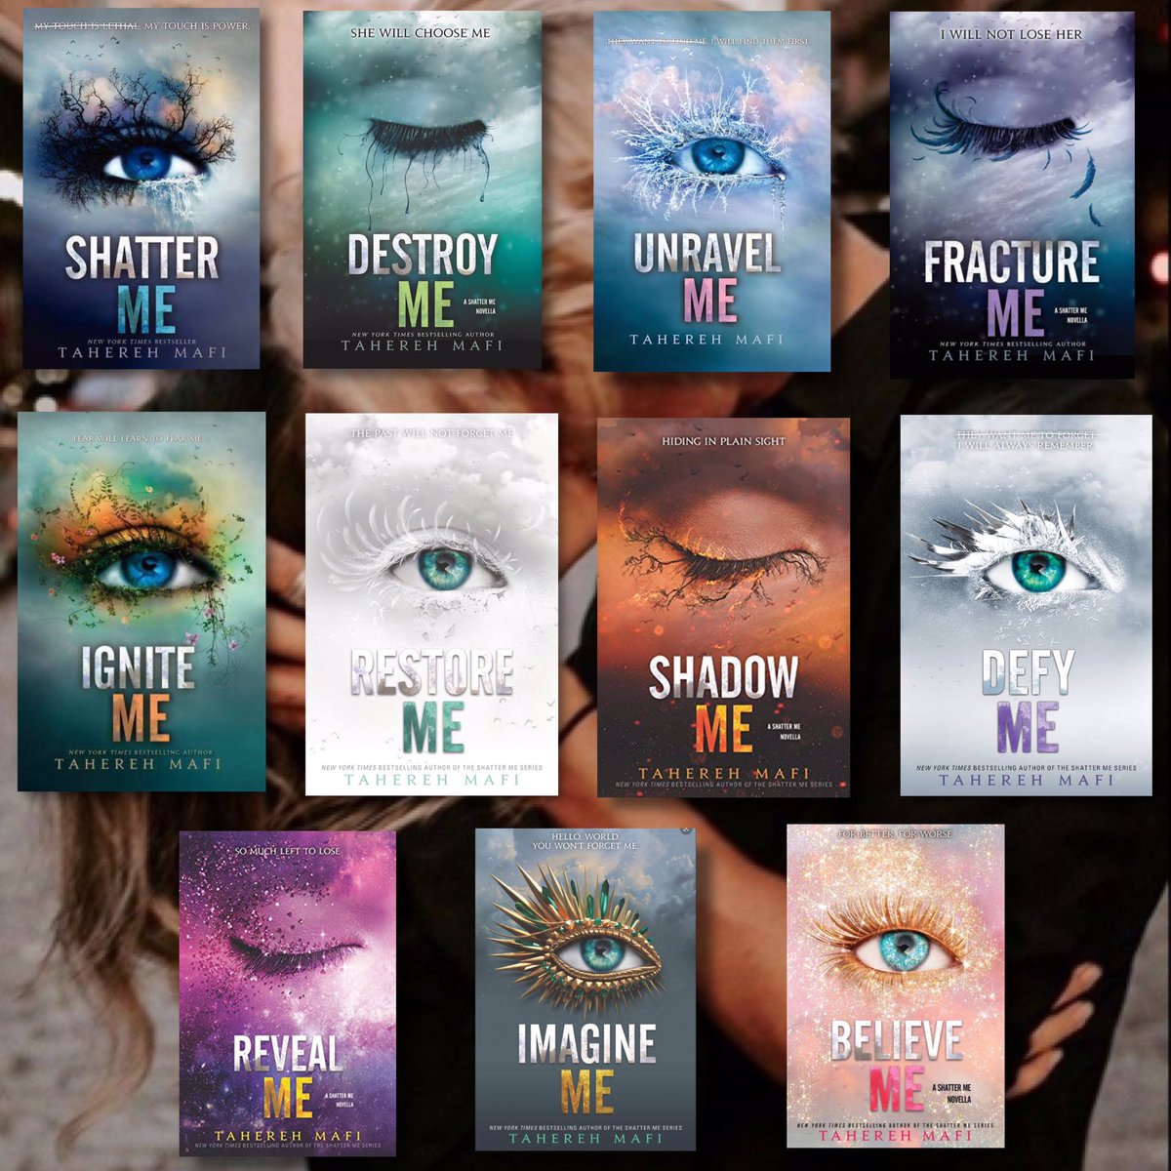
Here is the full series… You ask why is this is many books?
I made a little trailer about herfirst book and you can know the answer.
Juliette ​hasn't touched anyone in exactly 264 days. The last time she did, it was an accident, but The Reestablishment locked her up for murder. No one knows why Juliette's touch is fatal. As long as she doesn't hurt anyone else, no one really cares. The world is too busy crumbling to pieces to pay attention to a 17-year-old-girl. Diseases are destroying the population, food is hard to find, birds don't fly anymore, and the clouds are the wrong color.
The Reestablishment said their way was the only way to fix things, so they threw Juliette in a cell. Now so many people are dead that the survivors are whispering war- and The Reestablishment has changed its mind. Maybe Juliette is more than a tortured soul stuffed into a poisonous body. Maybe she's exactly what they need right now.
Juliette has to make a choice: Be a weapon. Or be a warrior.

Slide 8
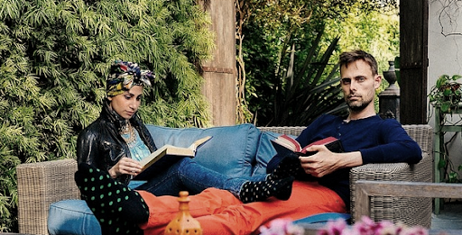
I’ve only read the first two parts of the series from her, but she grasped me and I want to read the whole series. I loved her writing and the story. She write a romantic and adventure category with a little „the world end” feeling.

Slide 9
Thank you for the attention.
Made by Renata Kis
https://www.goodreads.com/book/show/17331518-fracture-me
https://en.wikipedia.org/wiki/Tahereh_Mafi
https://azenkonyvtaram.blogspot.com/2017/02/tahereh-mafi-shatter-me-ne-erints.html

