Slide 1
Széchenyi István Roman Catholic Secondary School

Slide 2
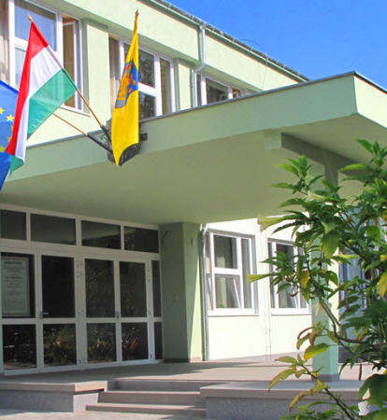
Introduction
located in Hatvan
more than 450 students
Several specializations

Slide 3
Specializations
Economics
Informatics
Management
High School
Health care

Slide 4
Foreign languages
English
German
Small groups
Pannon language exam

Slide 5
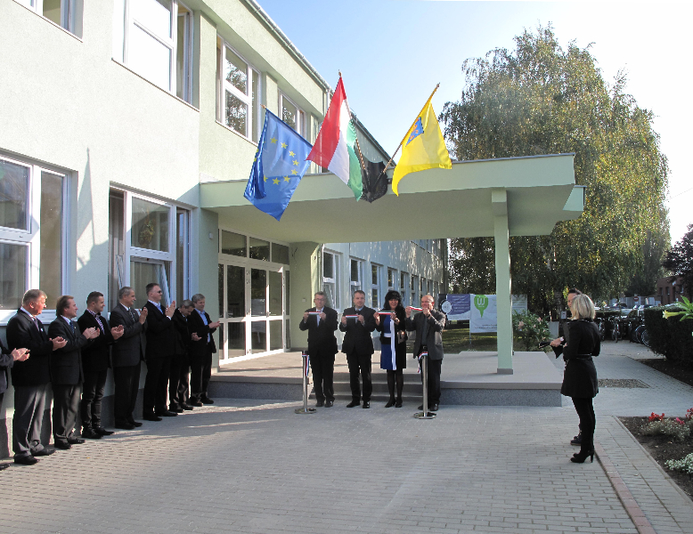
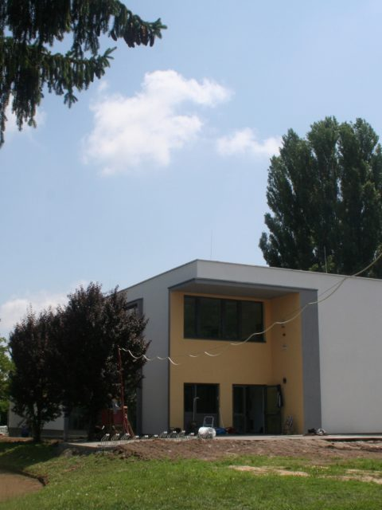
Our school today
2014-renovation
2018-new building

Slide 6
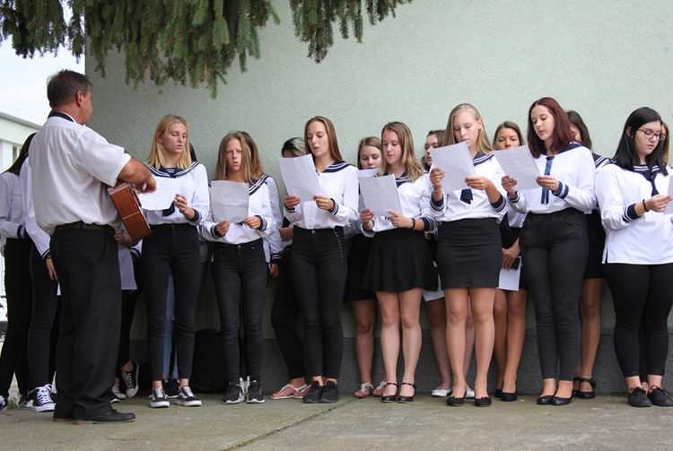
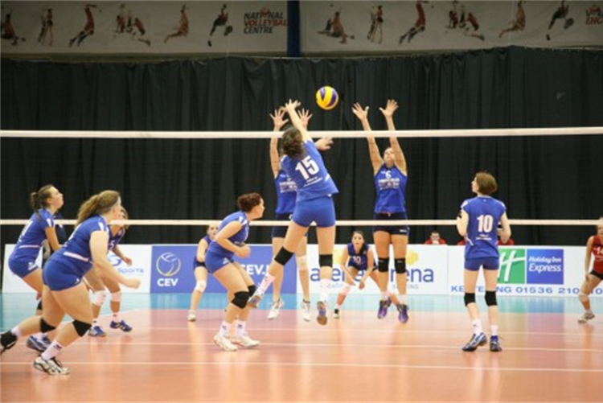
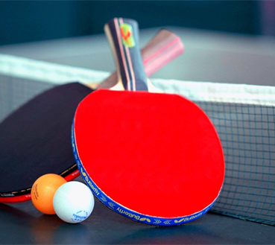
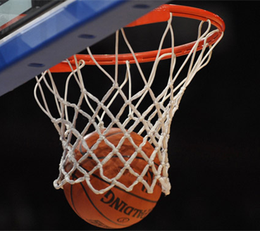
Community and sport activities
choir
volleyball
table tennis
basketball
football

Slide 7
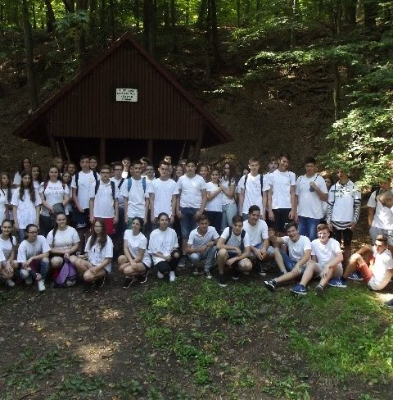
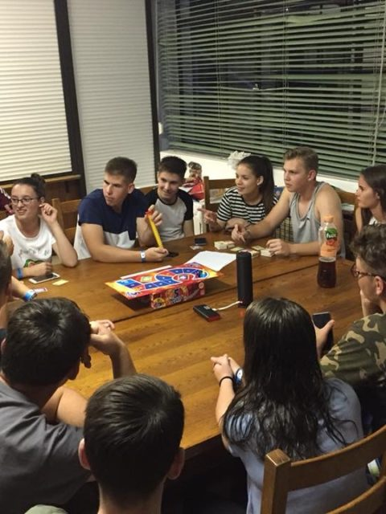
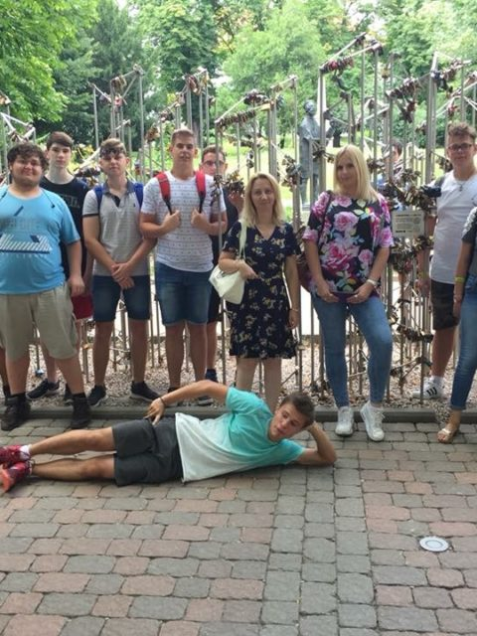
Camps
Freshers’ camp
English language camp

Slide 8
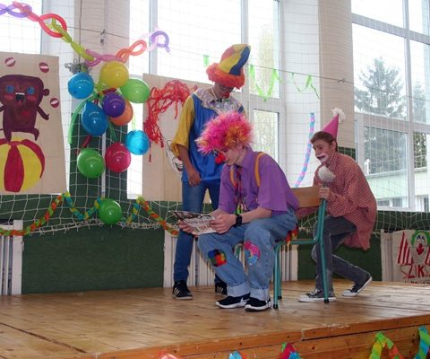
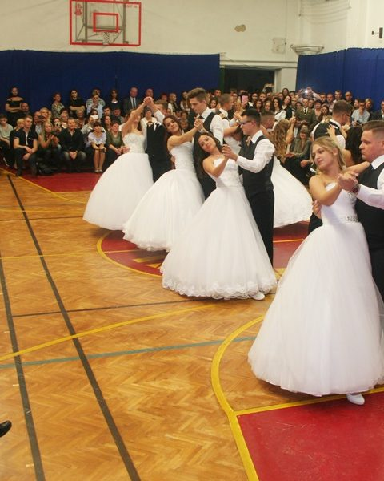
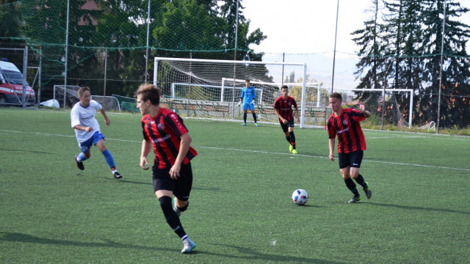
Annual events
Freshers’ day
School leavers’ ball
students’ day

Slide 9
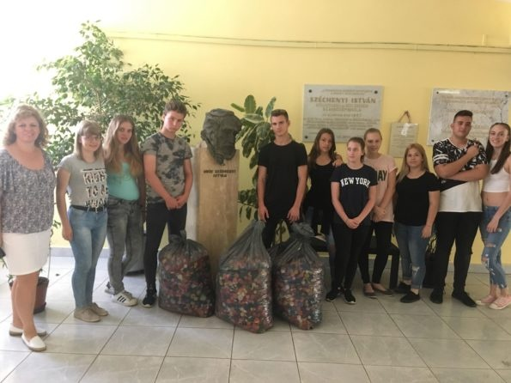
Competitions
wreath-making
Charity activities

Slide 10
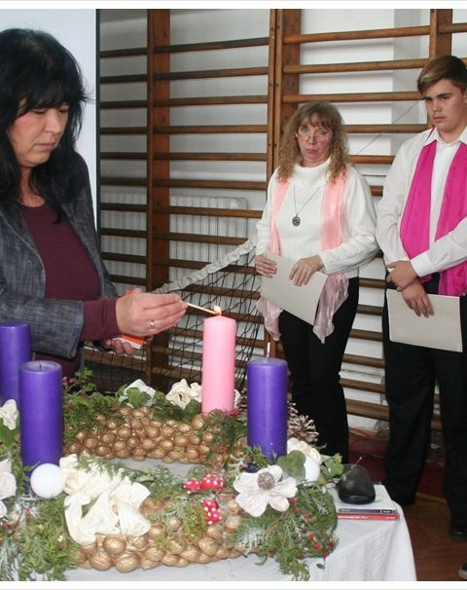
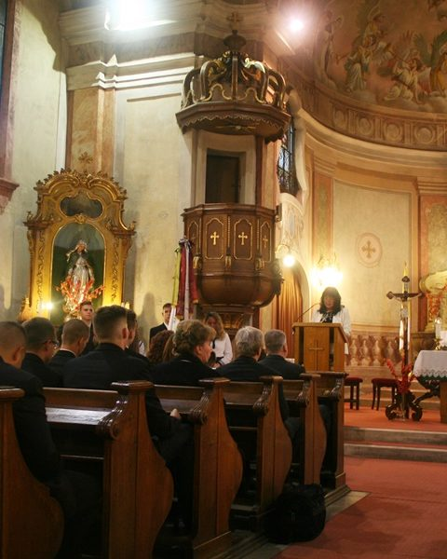
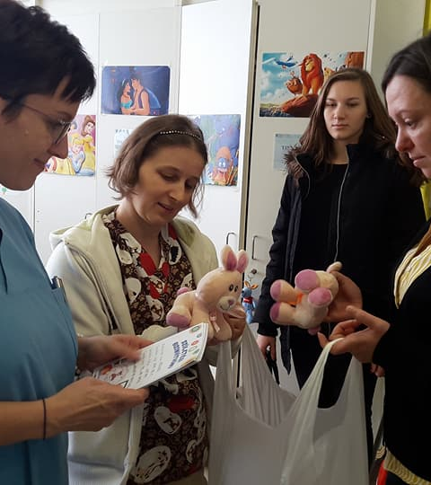
Religious life
Advent
attending a service
donations

Slide 11
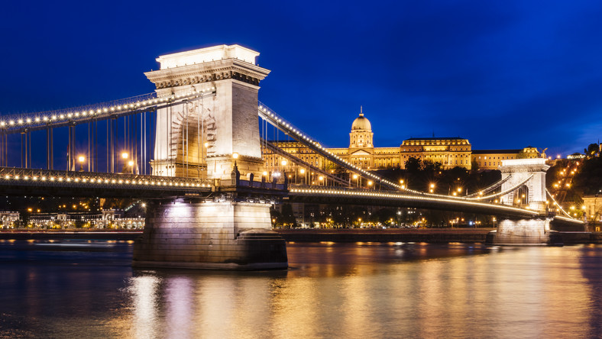
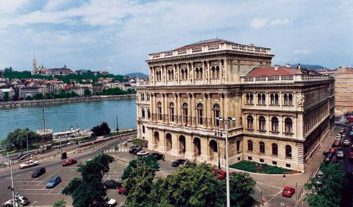
Széchenyi István
Chain Bridge
Hungarian Academy of Sciences

Slide 12
Thank you for your attention ☺

