Slide 1
The St. Johanna High school
Created by: Dorina Dobai, Zsanett Gulyás

Slide 2
Introduction
From Laura Leiner we would like to present the youth novel of St. Johanna High School.

Slide 3
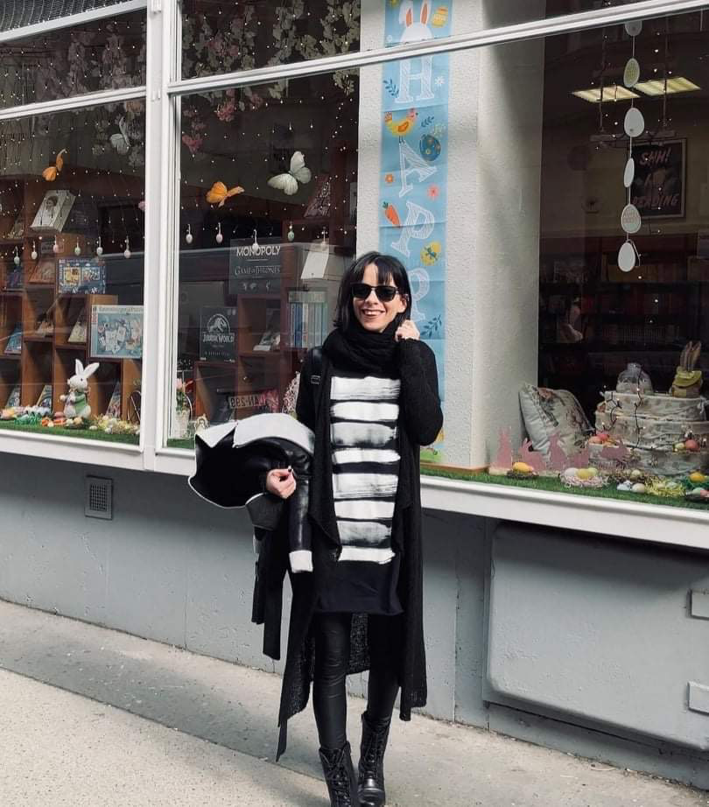
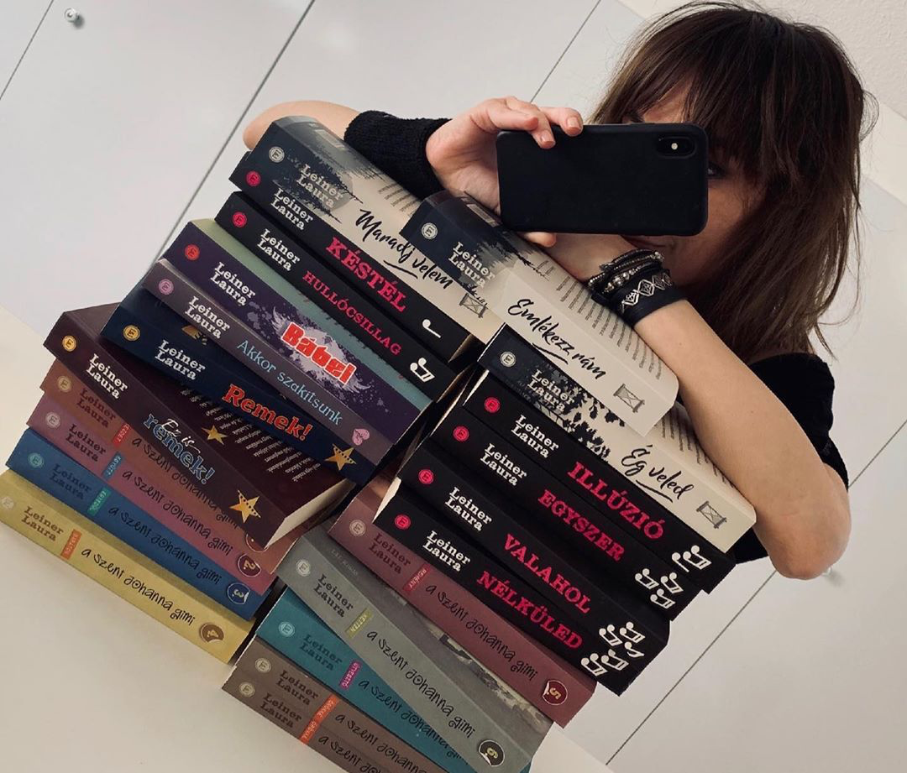
About the writer
Laura Leiner is a Hungarian writer who has been writing novels for young people since she was 18 years old. The success is due to the youth diary novel by St. Johanna High School. The story is fiction, not an experience of her own. She currently has 33 books published that can be purchased at her own bookstore.

Slide 4
THE CONTENT OF THE STORY
One of the main characters in the series is Renáta Rentai, a student of a French high school in Budapest, the Szent Johanna Foundation High School, and the book series was written from her point of view. The novel consists of 8 books, the last part is divided into two parts.
In the plot, we can follow the girl’s high school years. For the first time in her life, dhe finds friends and an inclusive community. Here she meets Antai-Kelemen Ádám- nicknamed Cortez - Reni falls in love at first sight. The girl and her best friend called AKÁ, which is his secret name.

Slide 5
The youth novel series has been a huge success, with thousands to read to this day. In our opinion, it was very exciting, fun and educational. It can be read soon if one is immersed. We recommend it to everyone!
OUR OPINION

Slide 6
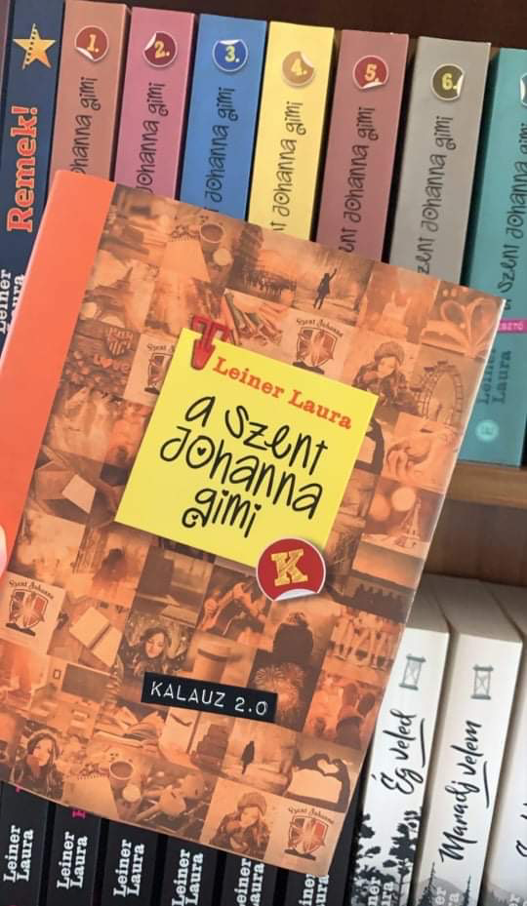
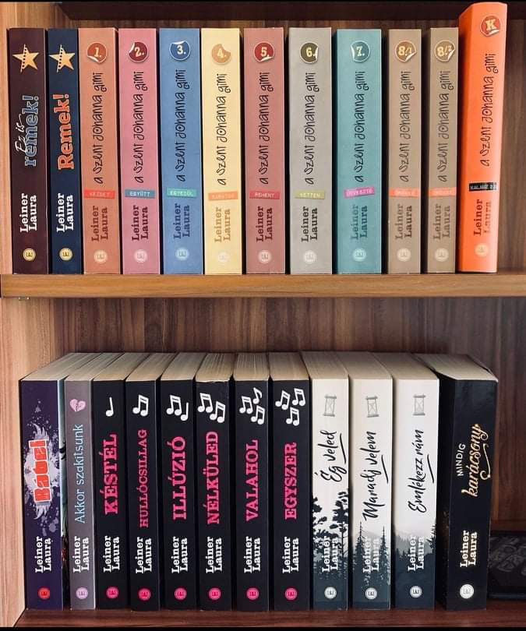
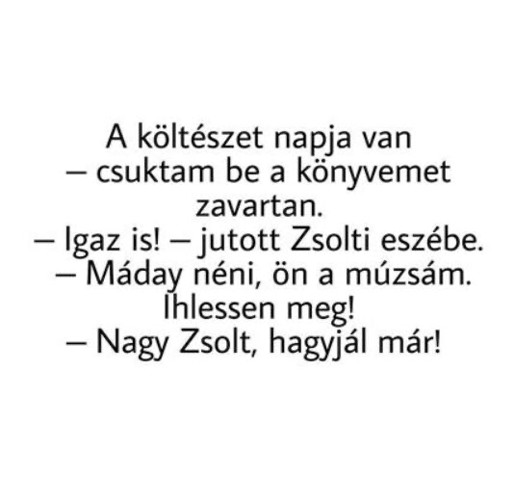
Thank you for your attention!☺

