Slide 1
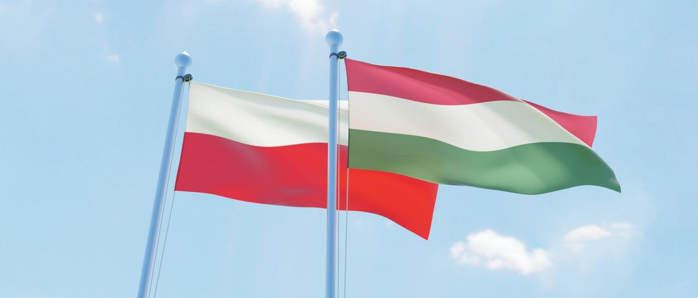
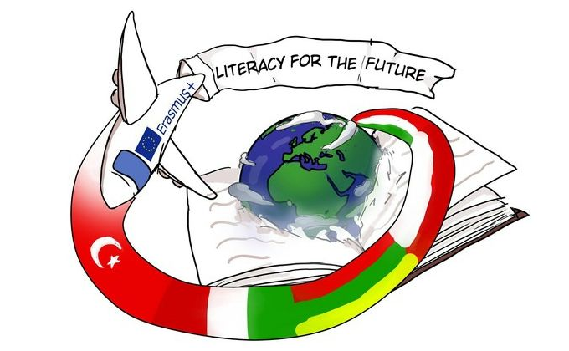
Polish and Hungarian relations in history

Slide 2
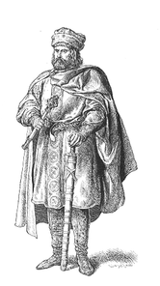
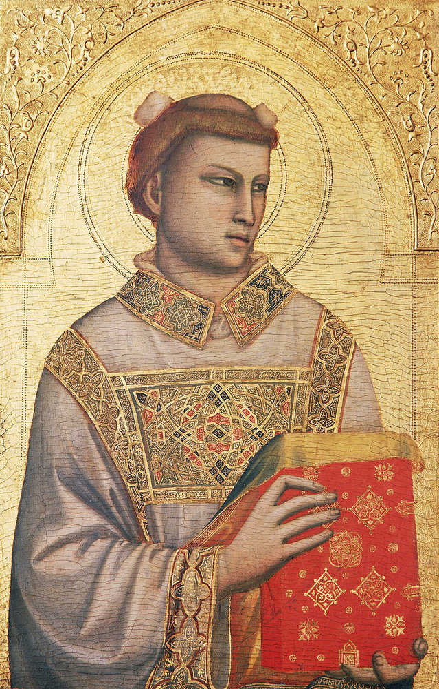
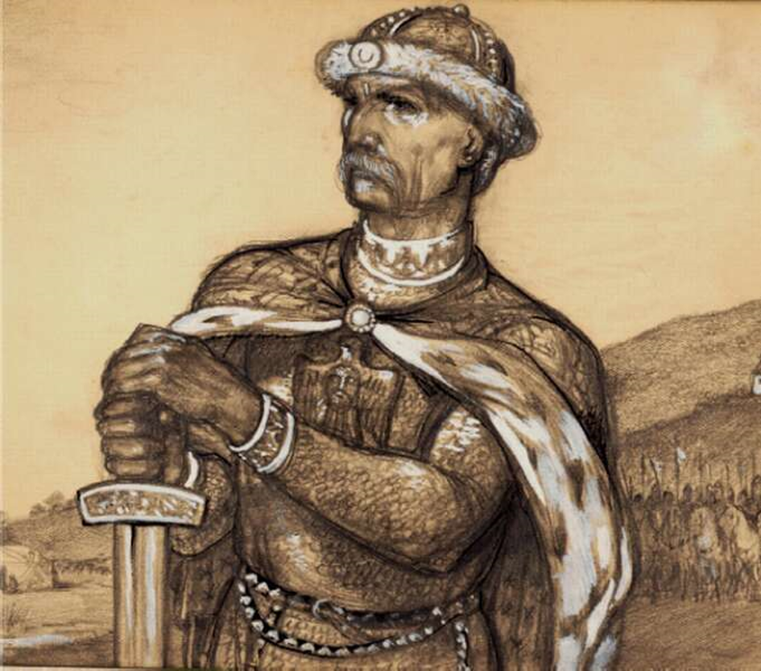
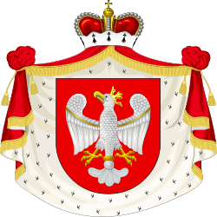
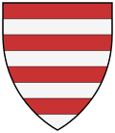
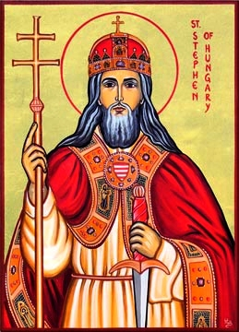
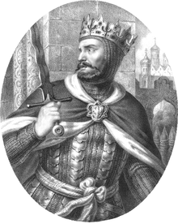
Árpád era
Siemomysł Polish Monarch
Sarolt Princess
Géza Hungarian Monarch
Era of the Árpád and Piast dynasties
Marriages are born between two houses
Adelajda
Judit
I. Saint Stephan
Knight Boleszláv
Piast dynasty
House Árpád

Slide 3
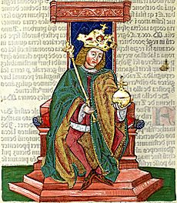
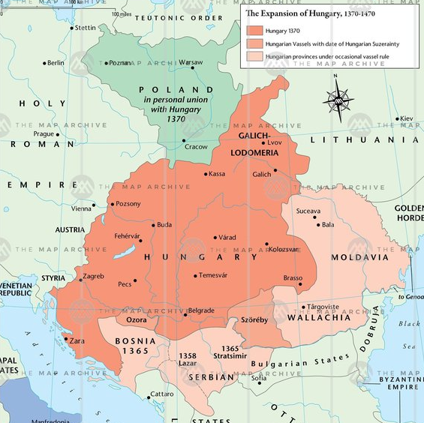
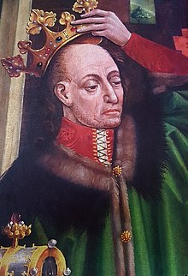
Age of Anjou
Ulászló
alliance
King’s meeting at Visegrád
Personal union between two countries
I. Károly Róbert
II. Ulászló Polish and Lithuanian king

Slide 4
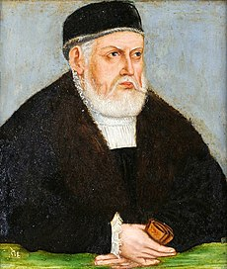
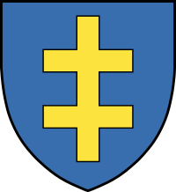
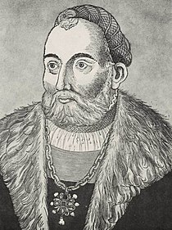
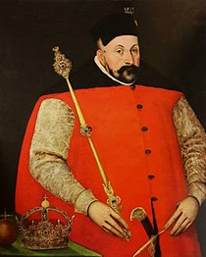
Era of Jagelló
I. Zsigmond last Jagiellonian on the Polish throne
Polish Lithuanian dynasty
Polish throne gets out of the Jagiellonian house
Izabella
Anna
Szapolyai János
Báthory István Monarch of Transylvania and King of Poland
Jagellonian dynasty

Slide 5
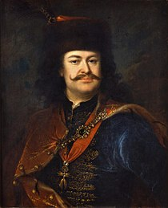
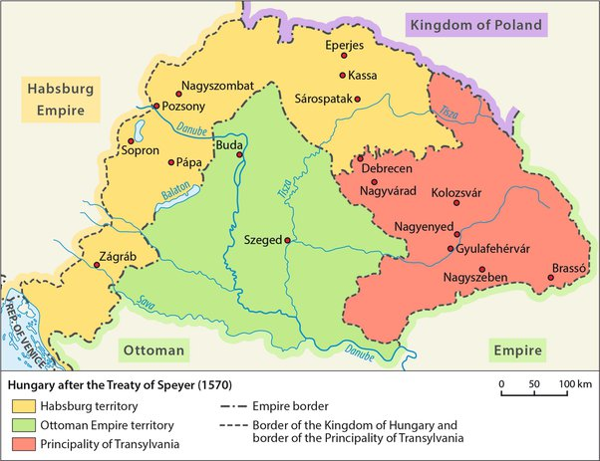
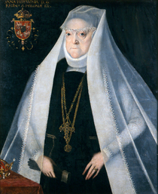
Ottoman Hungary
The reign of István Báthory
Assistance in the liberation of Hungary
Holy League
Reception of Rákóczi after the uprising
II. Rákóczi Ferenc
Jagelló Anna
Báthory István Monarch of Transylvania and King of Poland

Slide 6
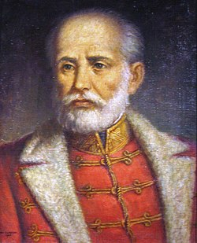
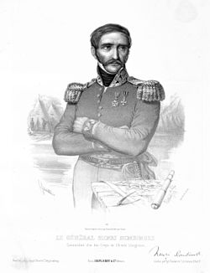
War of Independence of 1848–1849
Polish officers and soldiers in the war of independence
Battles:
Under Szolnok (March 5, 1849) Ulans of Władysław Poniński
At Hatvan the horsemen of Józef Jagmin
At the tapioca, the Ulans again distinguished themselves.
Retention of Russian forces
Association of Poles in Budapest
Józef Zachariasz Bem
Henryk Dembiński

Slide 7
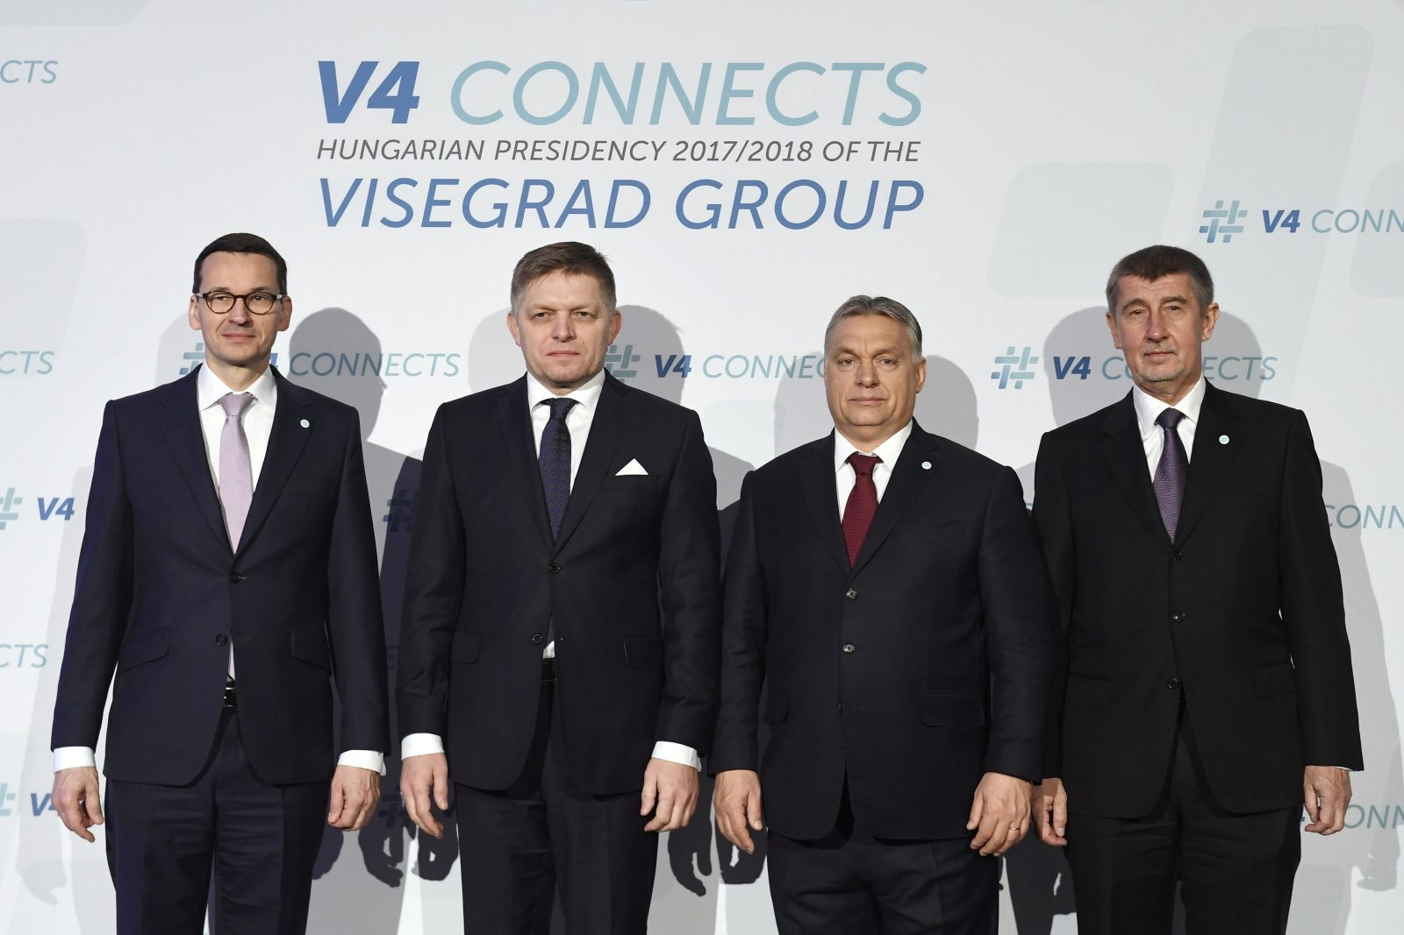
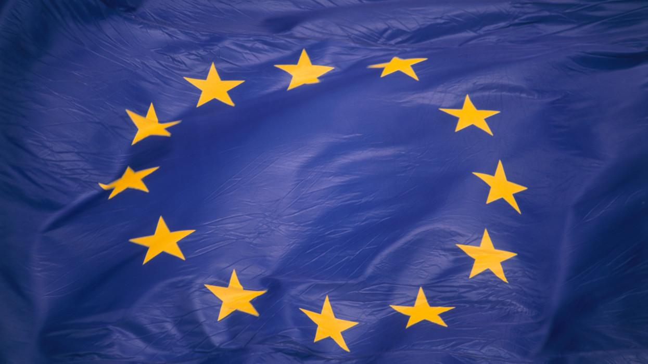
World War II and the Soviet Union
„The Polish people go shopping in Hungary and Hungarians go to Poland for a holiday and a cinema"
Polish - Bolshevik war Hungarian aid
World War II
Reception of Polish refugees
1939 Opening of the border for Polish refugees
Hungarian-Polish Refugee Committee
Revolution 56 Polish donations
First Visegrad Summit
Both countries are members of the EU and NATO

Slide 8
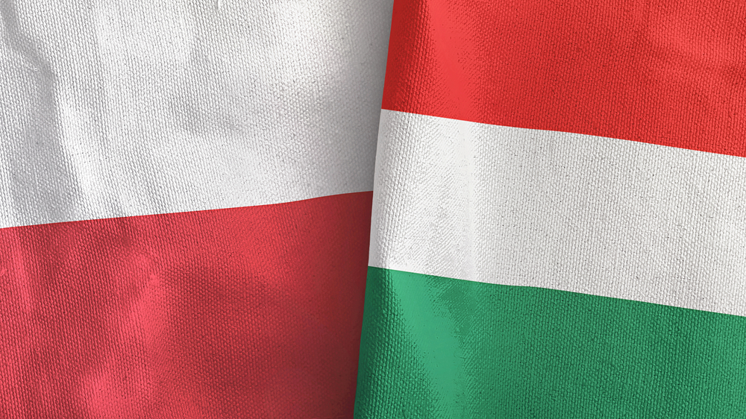
Thank you for your attention!
https://hu.wikipedia.org/wiki/Magyarorsz%C3%A1g_%C3%A9s_Lengyelorsz%C3%A1g_kapcsolatai#A_magyar_reformnemzed%C3%A9k_lengyelbar%C3%A1ts%C3%A1ga

