Slide 1
Sándor Petőfi
„Abroad, Petőfi is the best-known Hungarian poet to this day. He is the Hungarian favourite of the gods. He got everything to be a great poet: talent, history, destiny. He lived for twetny-six years, and was left with a world class oeuvre, which marked a turning point in the literature of his nation.”
- Béla G. Németh (1982)

Slide 2
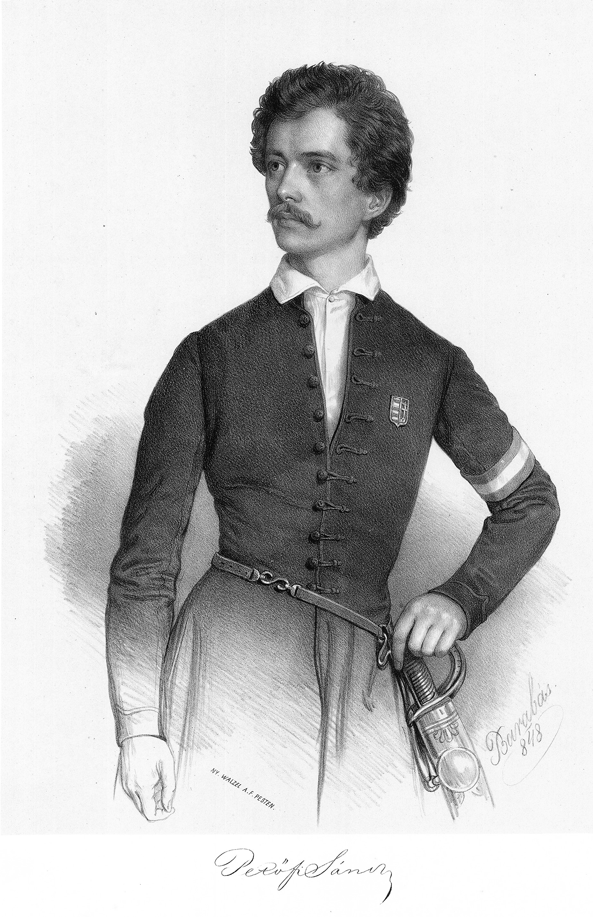
Born: as Sándor Petrovics, Kiskőrös, 1. January 1823. – Fehéregyháza, 31. July 1849.
Parents: István Petrovics, Mária Hrúz
Studies: Kiskunfélegyháza, Kecskemét, Szabadszállás, Sárszentlőrinc, Pest, Aszód, Selmecbánya, Pápa
„Aszód! You should only hear this word from me once, and you would imediately find out that I studied here for three years... I mean: I went to school.” – This is how he remembered his years in Aszód in the Úti Jegyzetek.
Spouse: Júlia Szendrey (1847-1849)
Child: Zoltán Petőfi

Slide 3
Poetry
The greatest figure in the formation of Hungarian romanticism
First poem in print: A borozó, Atheneum, 1842
Most known poem: Nemzeti dal (National song)
Themes of his poetry
The years of the Hungarian revolution
„Freedom and love my creed!
These two I need.
For love I’ll freely sacrifice
My earthly spell,
For freedom, I will sacrifice
My love as well.” - Petőfi S.

Slide 4
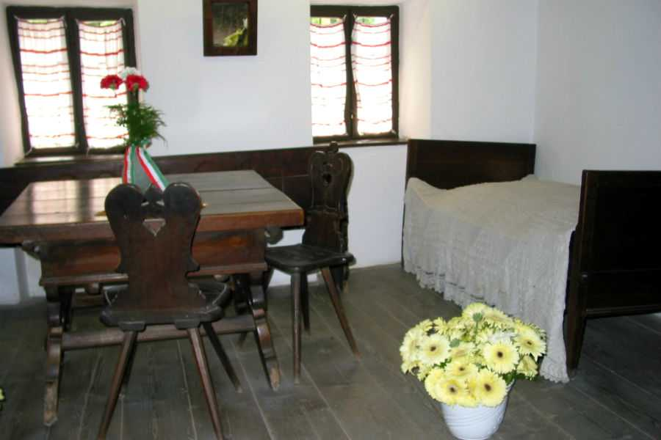
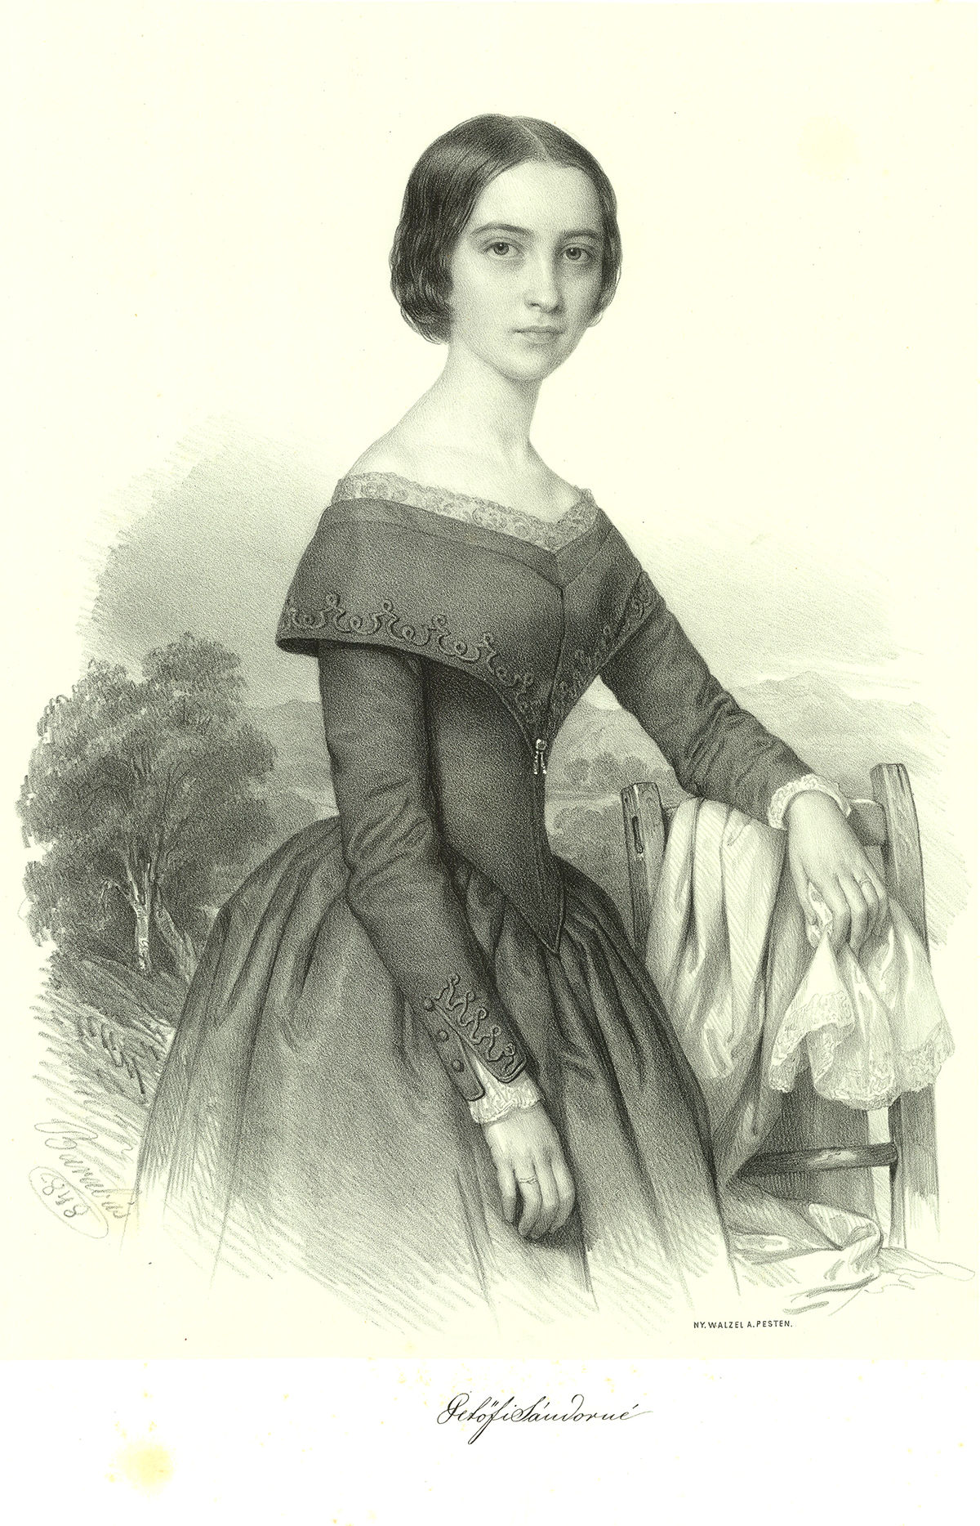
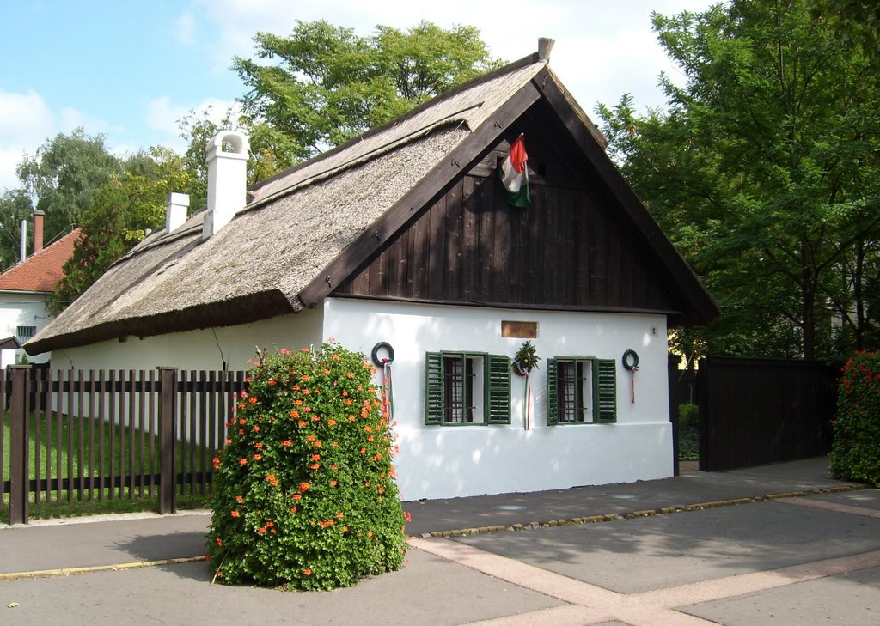
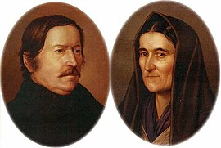
Júlia Szendrey
Birthplace of Petőfi in Kiskőrös
Parents of Petőfi

Slide 5
https://www.youtube.com/watch?v=0T723w_27IE

Slide 6
Thank you for your attention!

