Slide 1
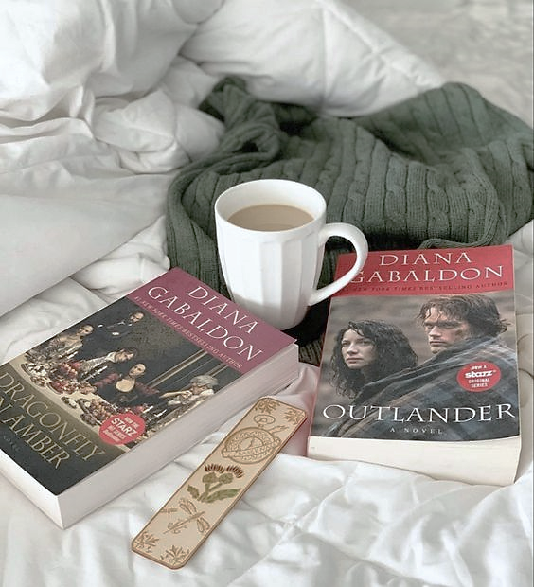
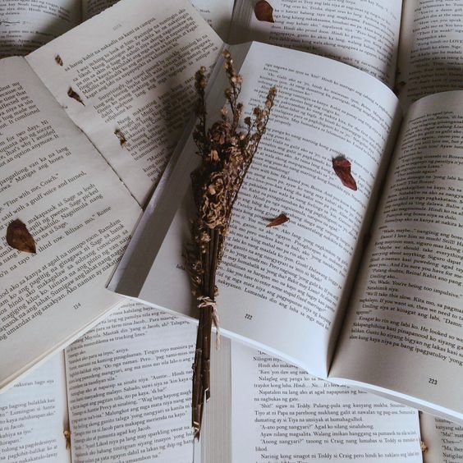
Outlander
Outlander

Slide 2
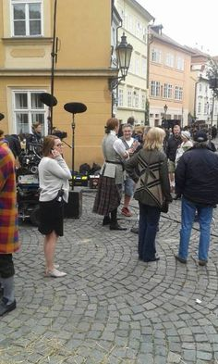
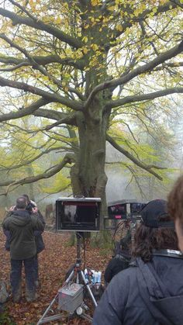
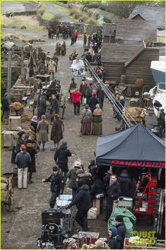
This book has been filmed as a series.

Slide 3
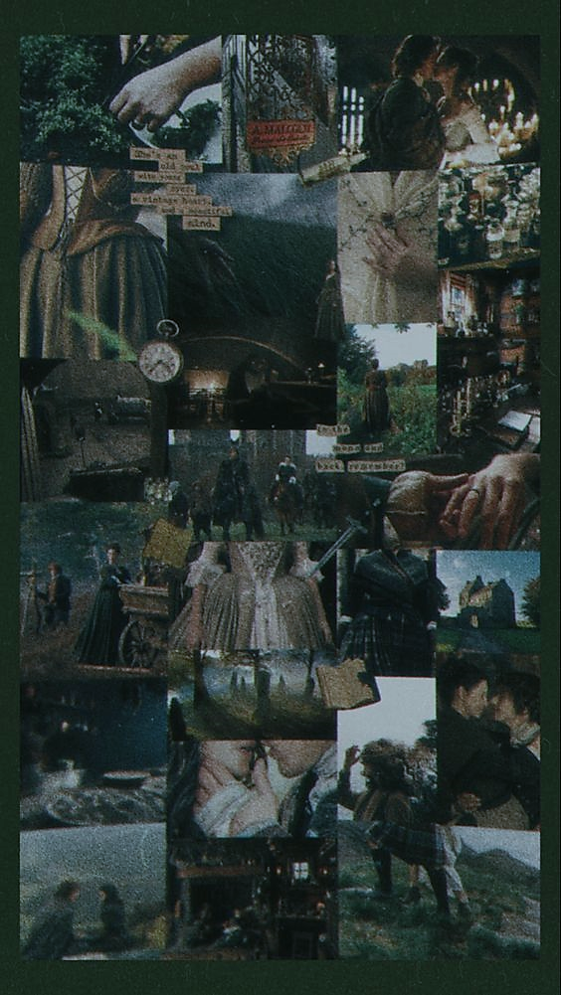
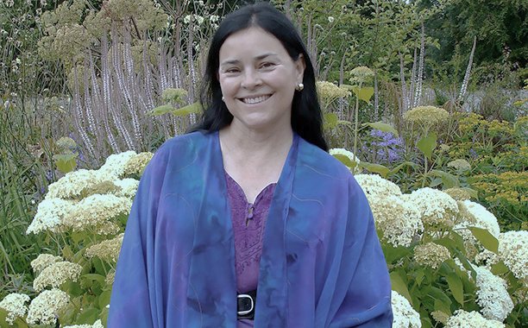
These are the hallmarks of Diana Gabaldon’s work. Her New York Times bestselling Outlander novels have earned the praise of critics and captured the hearts of millions of fans.

Slide 4
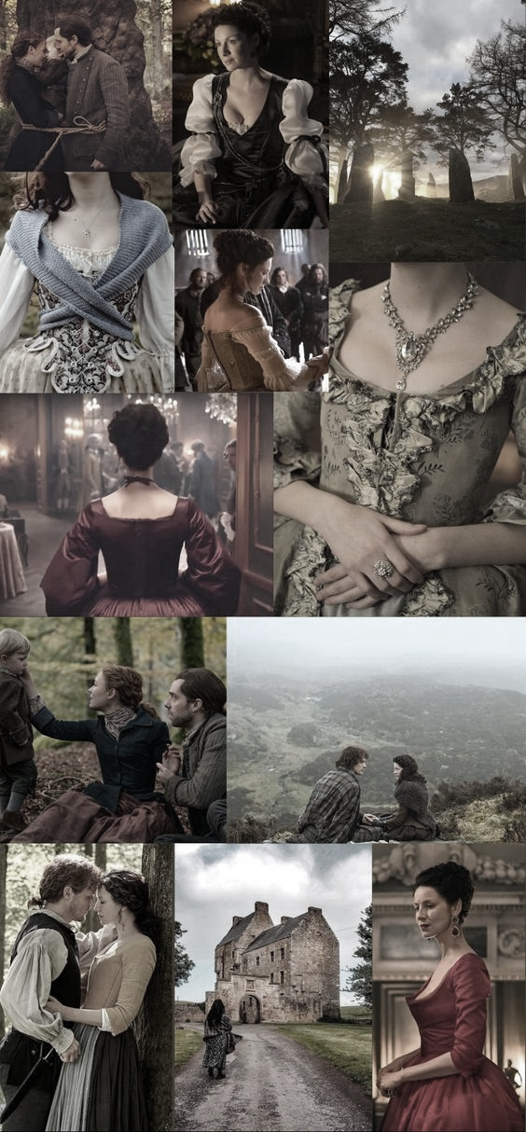
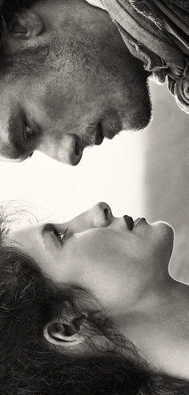
Here is the story that started it all, introducing two remarkable characters, Claire Beauchamp Randall and Jamie Fraser, in a spellbinding novel of passion and history that combines exhilarating adventure with a love story for the ages.

Slide 5
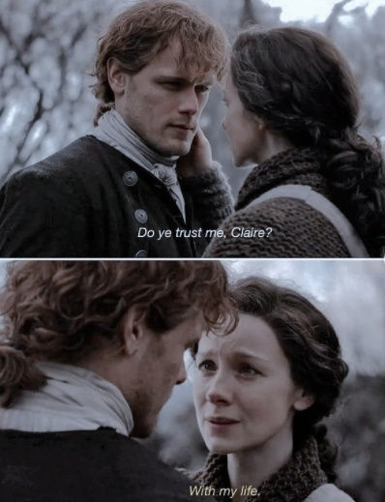
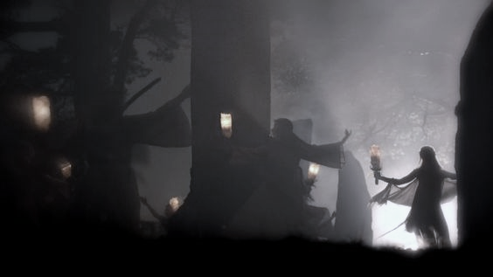
Scottish Highlands (1945) Claire suddenly disappeared and woke up in 1743.
„You are blood of my blood, and Bone of my Bone. I give you my body, than we Two might be one”

Slide 6
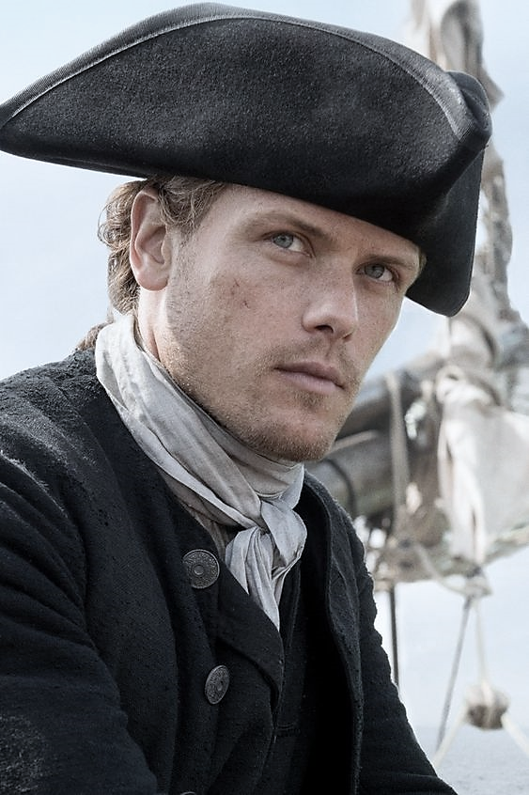
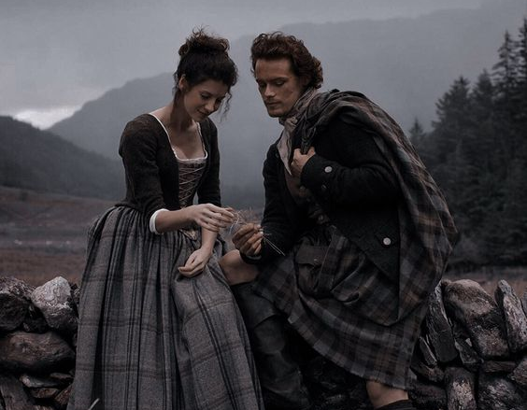
James Mackenzie Fraser
Strapping young Scottish redhead

Slide 7
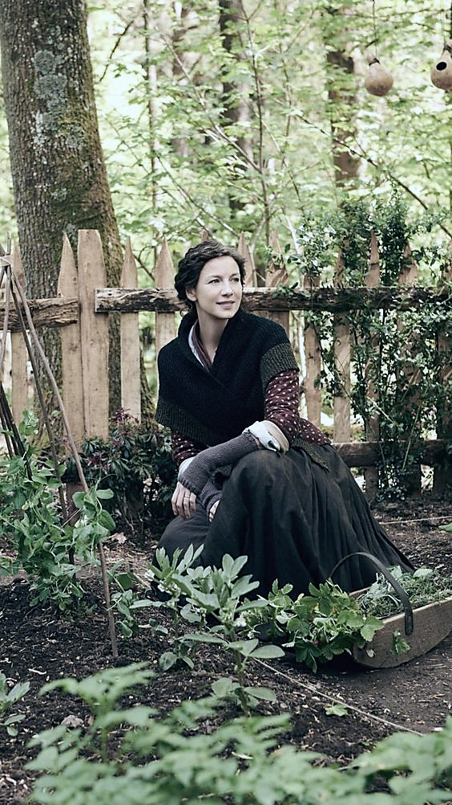
Claire Beauchamp
British nurse

Slide 8
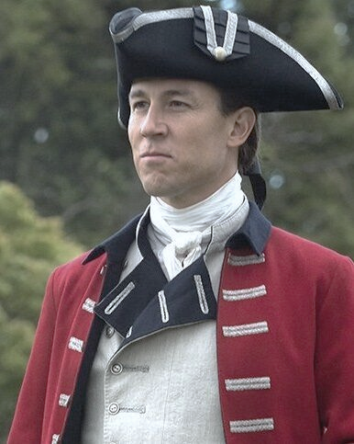
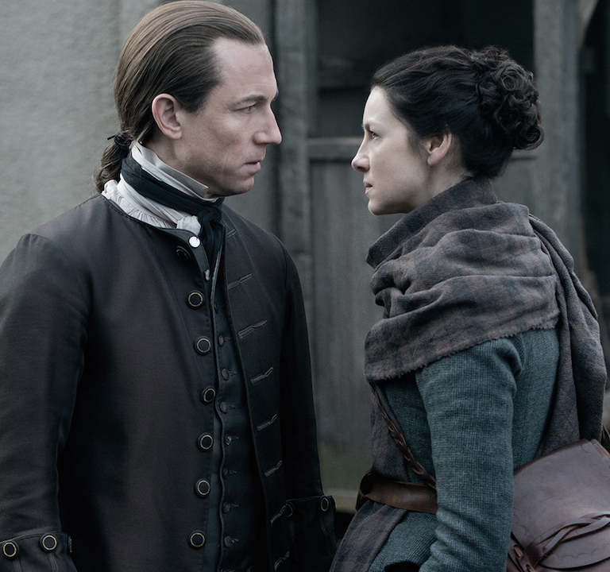
Jonathan Randall
Primary villian(„Black Jack”)

Slide 9
The story is not over yet so far 9 books are ready but there will be a sequel. I hope you like the story that caught me.
Thank you for your attention!

Slide 10
https://www.audible.co.uk/series/Outlander-Audiobooks/B075FWY5FL?source_code=M2M30DFT1Bk12109222102RZ&gclid=CjwKCAiAtouOBhA6EiwA2nLKH9R-Mip90dGzdrPQSjflhNvGLr7nGPi5uhewwZuihRorCOP-wuboqBoCNvcQAvD_BwE&gclsrc=aw.ds
https://www.amazon.com/Outlander-Novel-Book-1-ebook/dp/B000FC2L1O
https://novels80.com/2434452-outlander.html
https://hetediksor.hu/2017/09/08/outlander-az-idegen-1-2-evad-kritika/
https://nemnyilatkozom.wordpress.com/2018/02/07/outlander-az-idegen/
https://en.wikipedia.org/wiki/Outlander_(novel)#Main_characters
https://hu.pinterest.com/search/pins/?q=outlander%20aesthetic&rs=typed&term_meta[]=outlander%7Ctyped&term_meta[]=aesthetic%7Ctyped

