Slide 1
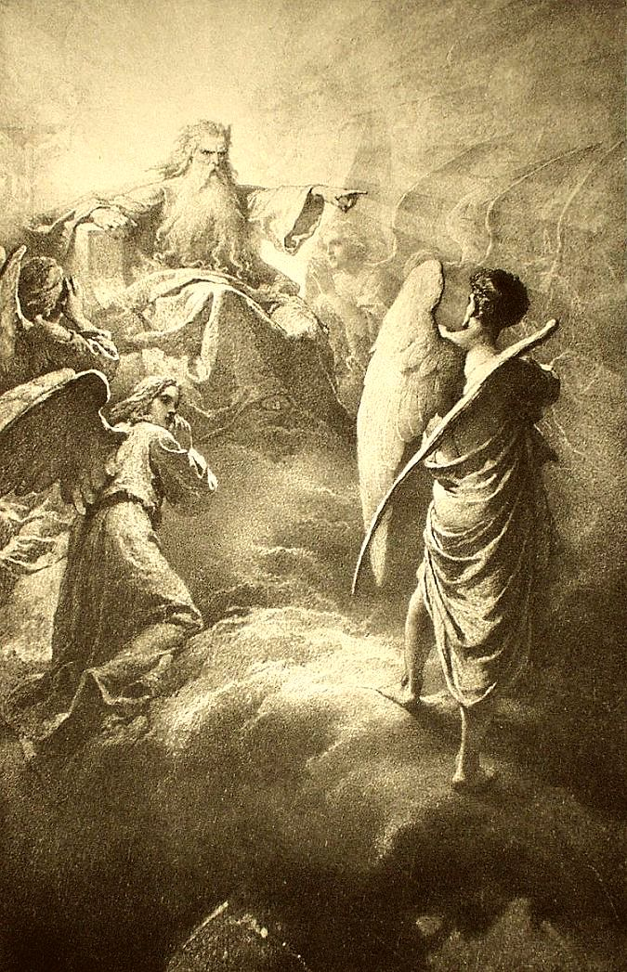
Madách Imre

Slide 2
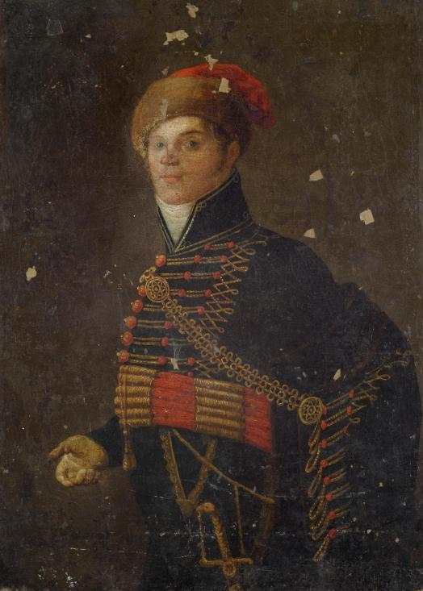
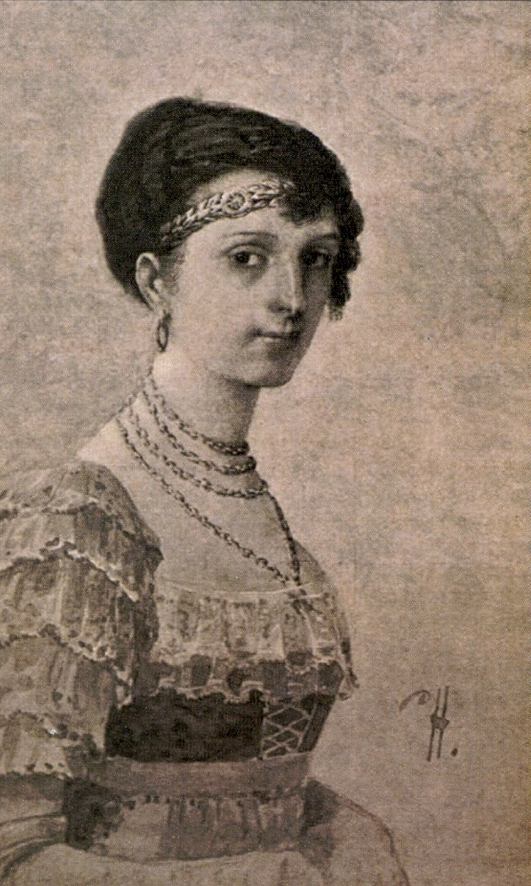
his childhood
Born: January 20, 1823 in Alsósztregova
His father was Imre Madách's mother Anna Majthényi
Landowner family
Madách Imre
Majthényi Anna

Slide 3
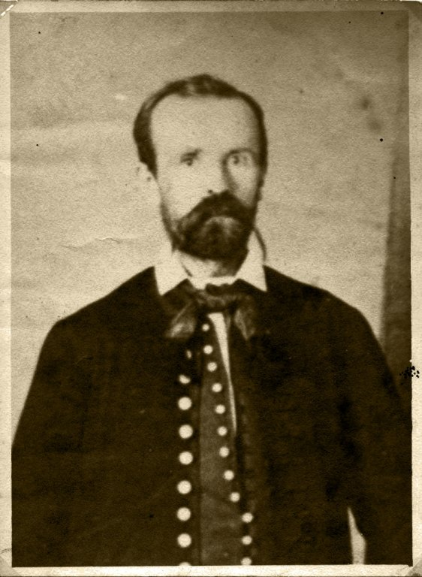
Study
Private student because of his illness
Váci Piarist High School
He was able to speak six languages
English, German, French, Slovak, Ancient Greek, Latin
He studied law at the University of Pest
graduated in 1841
Madách Imre

Slide 4
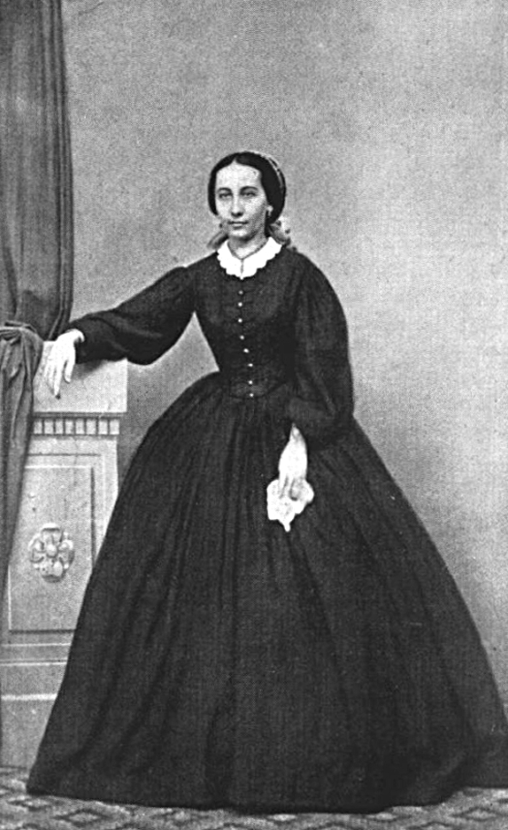
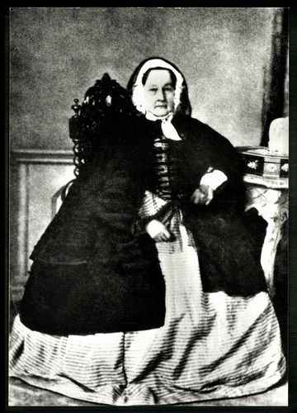
His loves
Lónay Etelka
His classmate's sister
Died in 1843
Fráter Erzsébet
His later wife
She didn't come out with her mother-in-law
VS
Majthényi Anna
Fráter Erzsébet

Slide 5
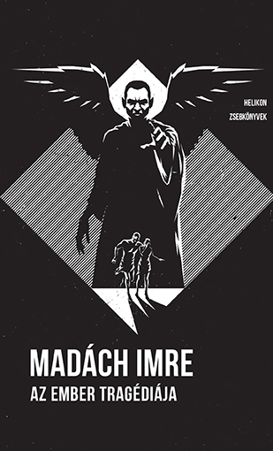
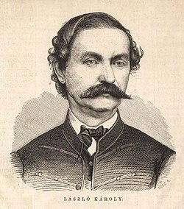
During the War of Independence
Lots of bane
Imprisonment
His wife cheated on him
The first version of The tragedy of man
The cover of The tragedy of man
László Károly (kossuth secretary)

Slide 6
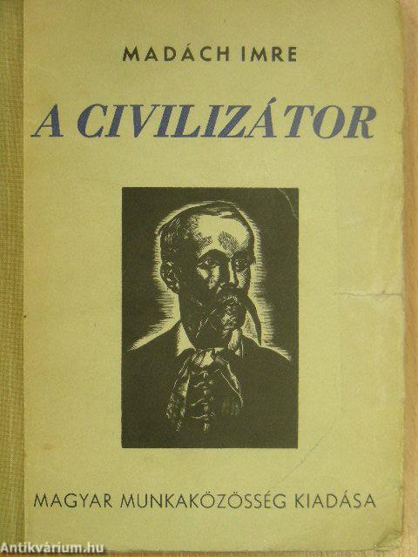
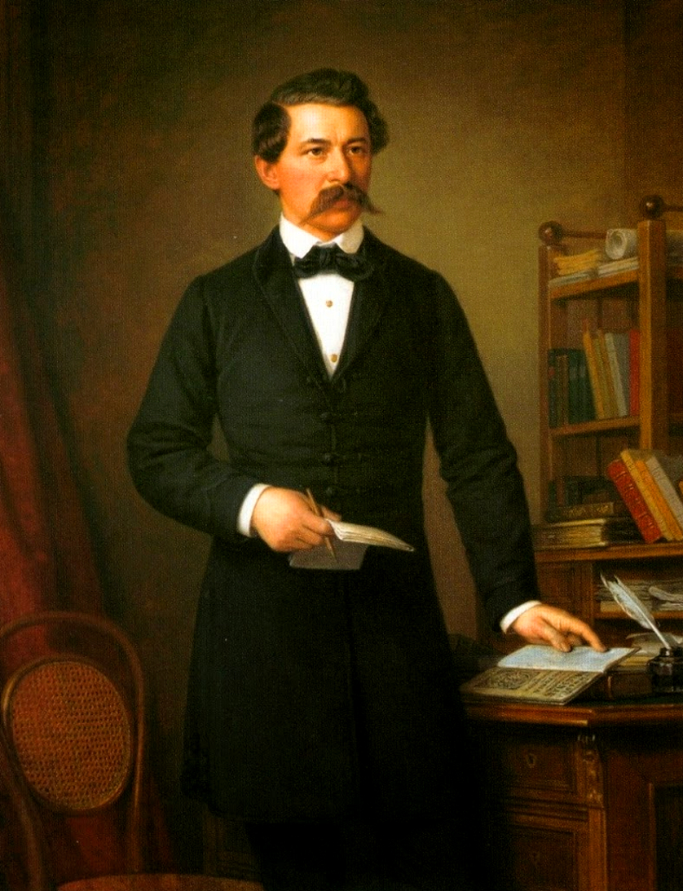
last stage of his life
Political satires
Civilizer, II. Lajos
The tragedy of man second version
Asked Arany János opinion about it
Became a member of the Kisfaludy Society
Died: October 5, 1865, Alsósztergova
The Civilizer’s book cover
Arany János

Slide 7
Thank you for your attention!

