Slide 1
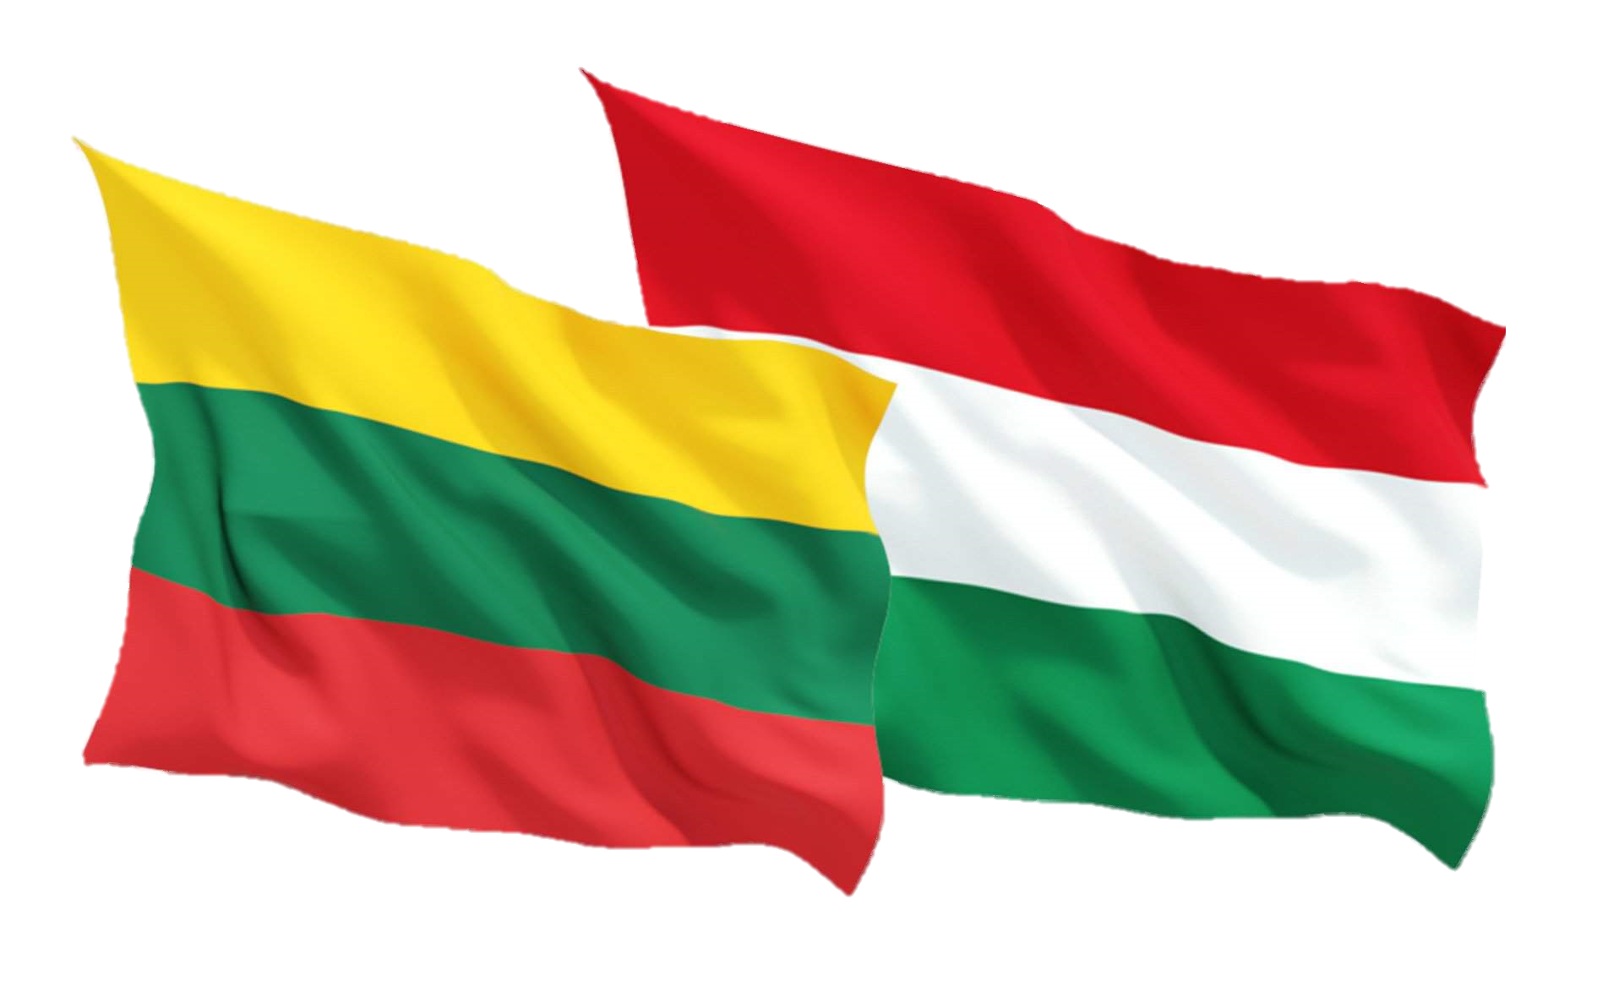
Lithuanian Hungarian relations in the past

Slide 2
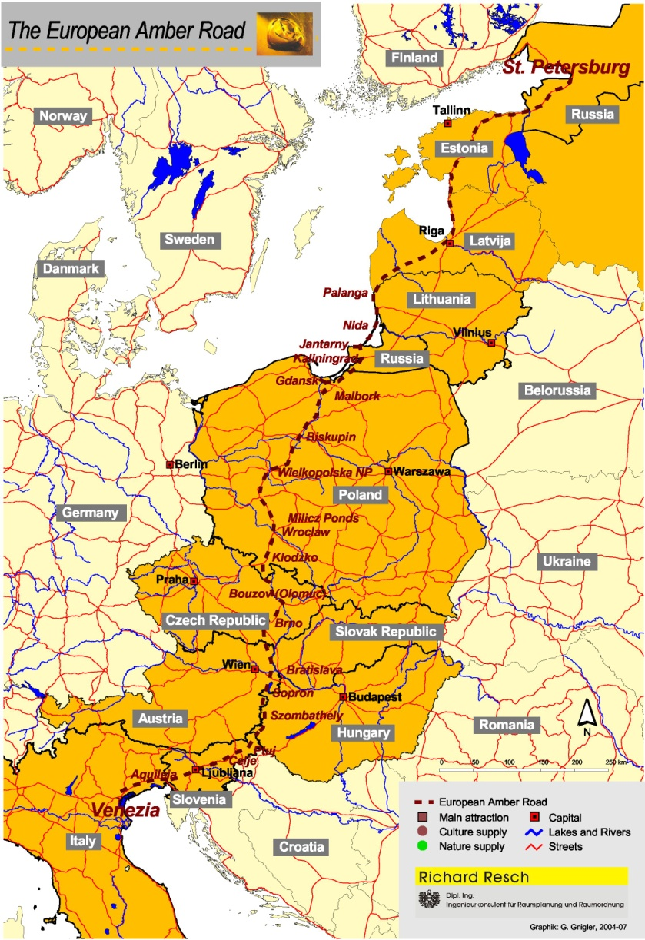
Before the real creation of the two countries
Trade relations between the two countries
Amber Road
Military alliance in the time of Charles Robert
Christian State In the time of II. Ulászló

Slide 3
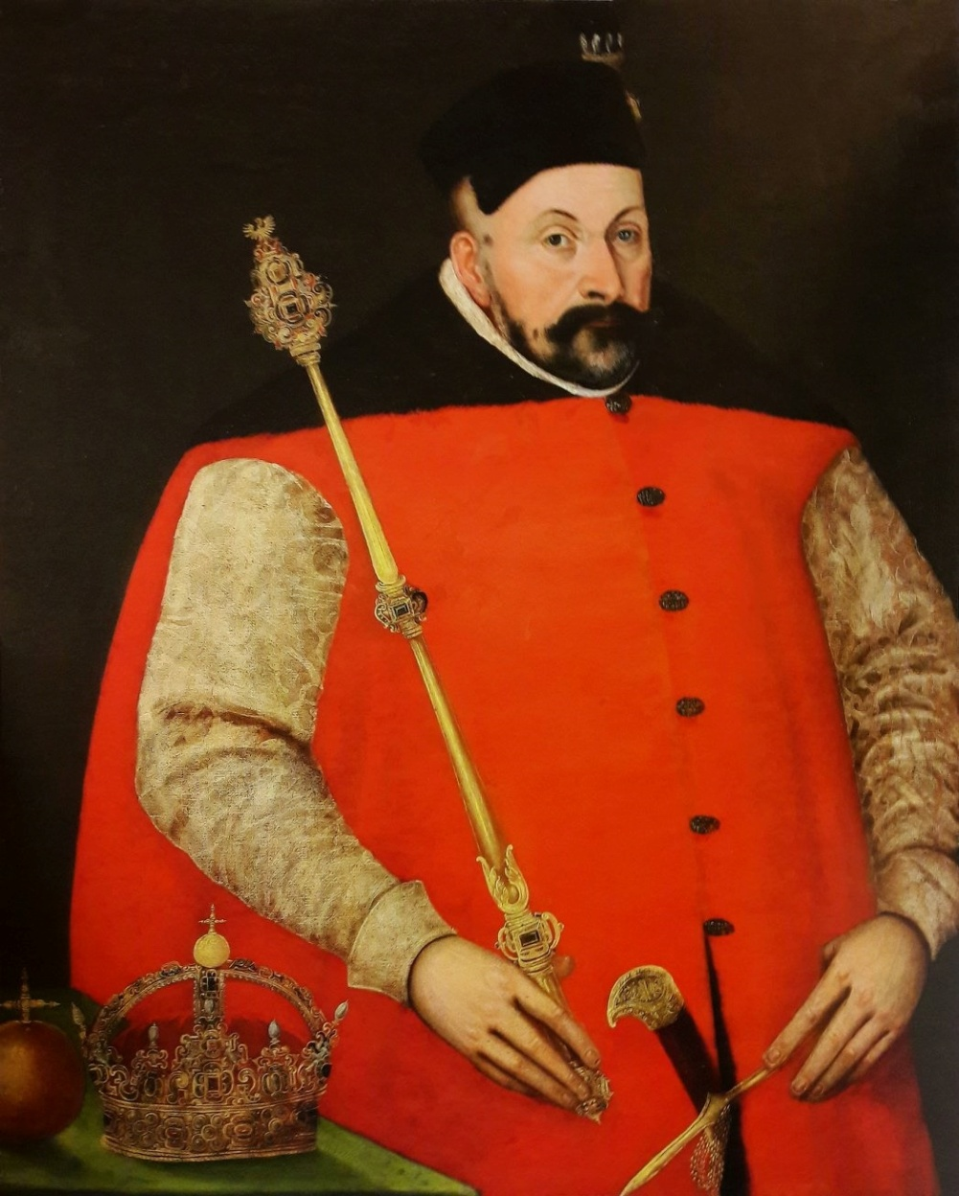
Jagiellonian dynasty
“Eternal peace and covenant” between kings
During the Turkish occupation, a mass of Hungarians emigrated
Bathory neutralizes the Grand Duchy of Moscow

Slide 4
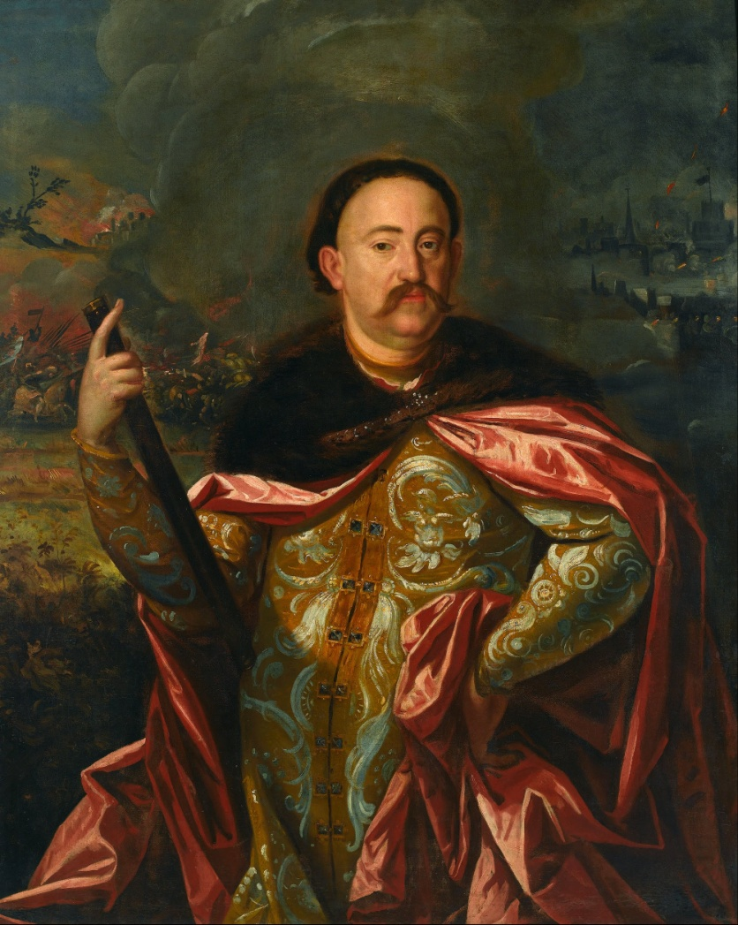
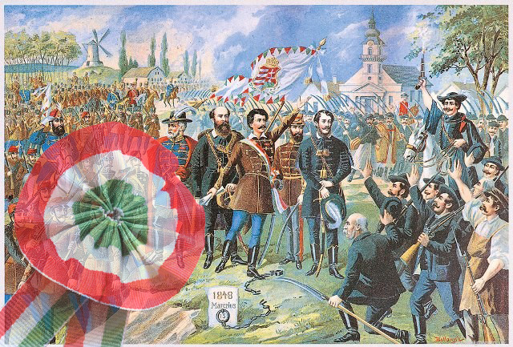
Hungarian War of Independence
Lithuanian help
Led by János Sobieski

Slide 5
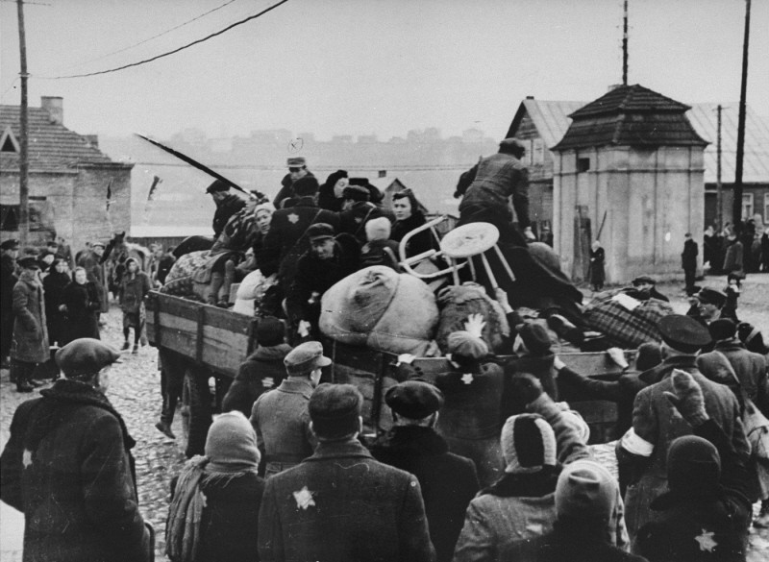
Between two world wars
Land losses
Continuous trade
Hungarian wine

Slide 6
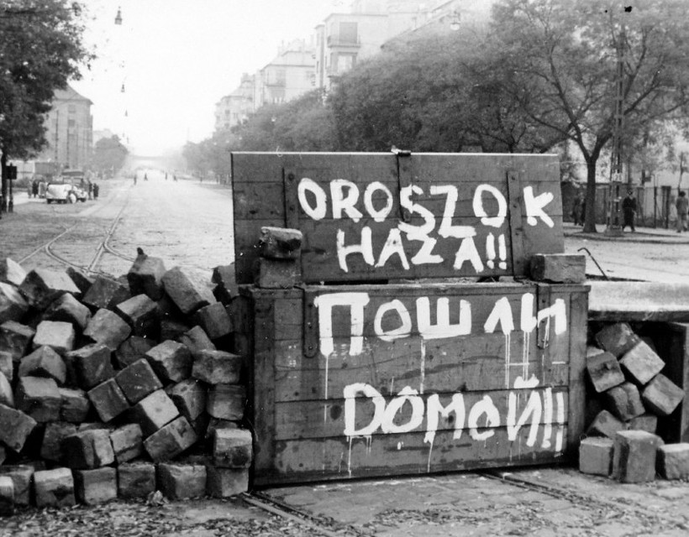
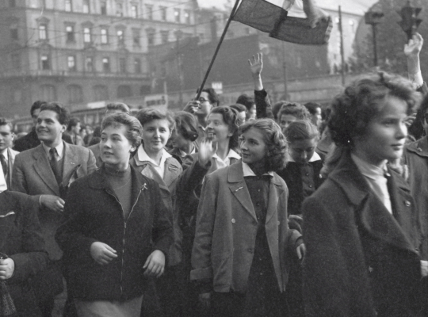
1856 revolution
Lithuanian demonstrations
Expressing their solidarity
Annual commemoration

Slide 7
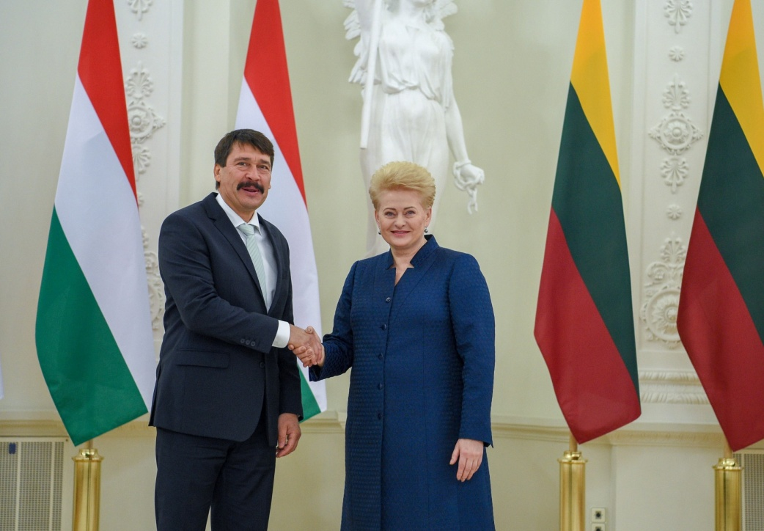
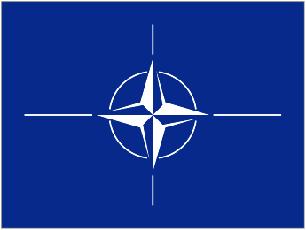
From regime change to the present
Both countries are members of the EU and NATO
István Báthory Lithuanian-Hungarian Youth Cooperation Fund
Center for Hungarian Studies
Annual scientific and cultural conference

Slide 8
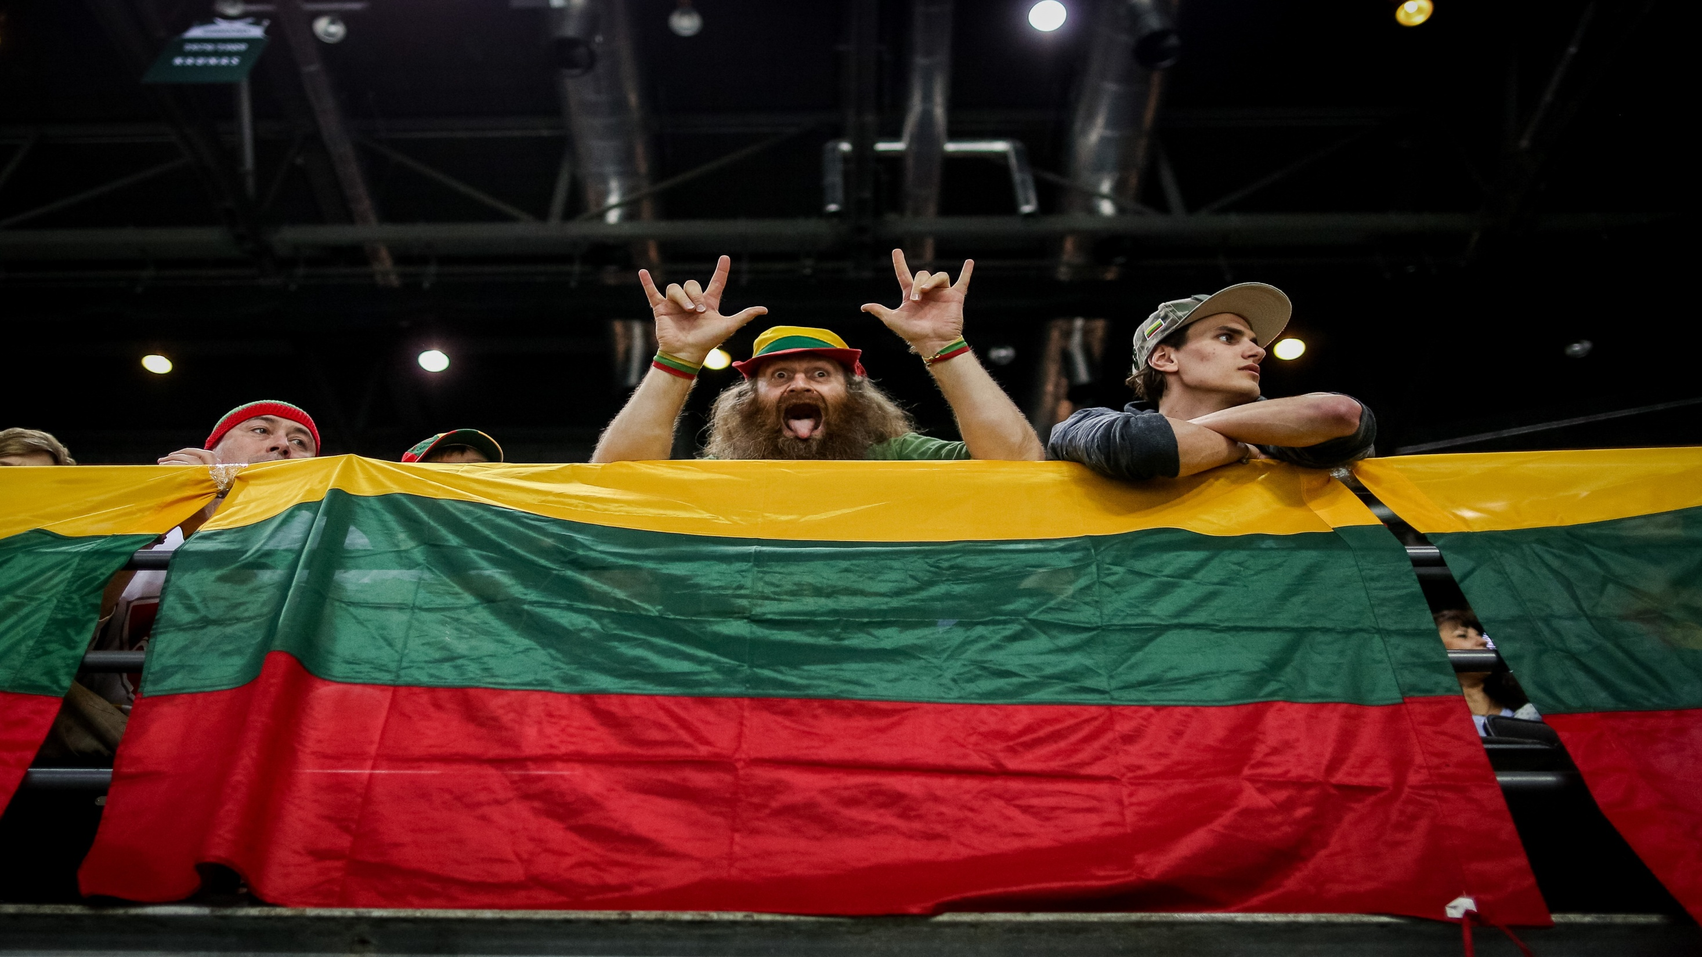
Thank you for your attention!
Távol, mégis közel: Litvánia és Magyarország történelmi kapcsolatai - Vilnius, 2018 (fordította: Tölgyesi Beatrix) (pdf)

