Slide 1
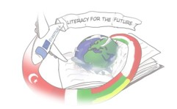
Joanne Kathleen Rowling

Slide 2
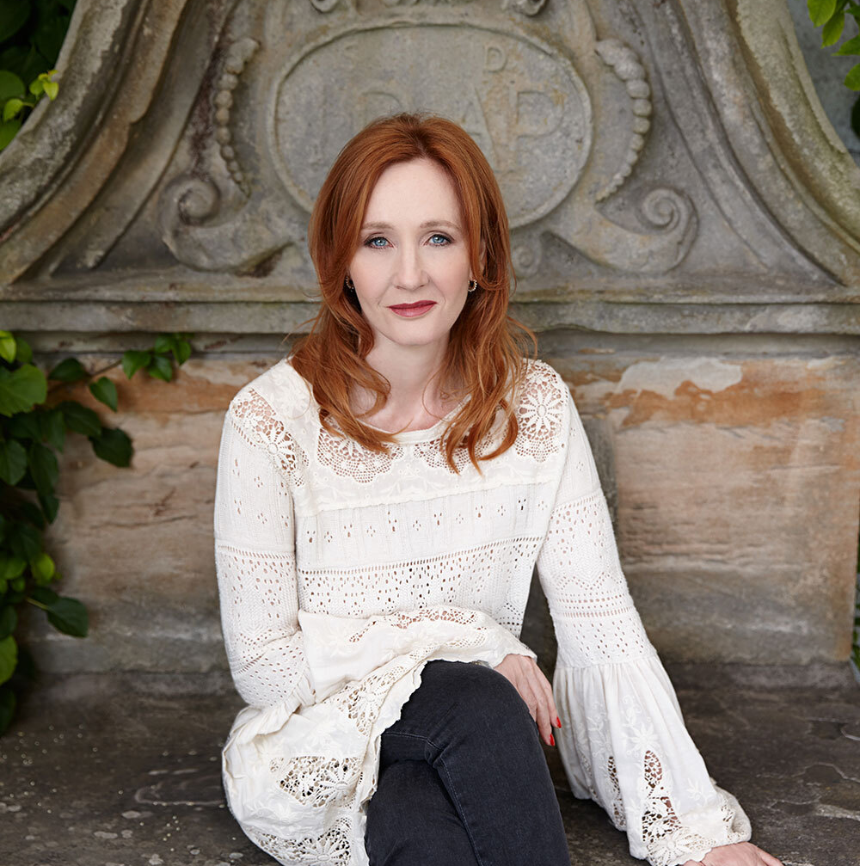
Born: 31. July 1965., Chipping Sodbury, England (One day with the character in her most famous book, Harry Potter)
Parents: Peter James Rowling, Anne Volant
Studies: Wyedean High School, University of Exeter
Children: Jessica Arantes, Mackenzie Murray, David Murray

Slide 3
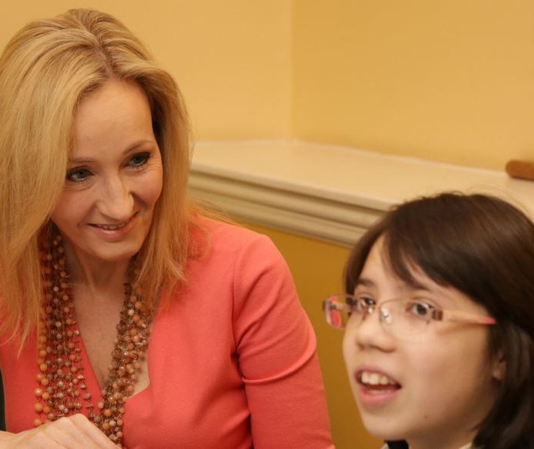
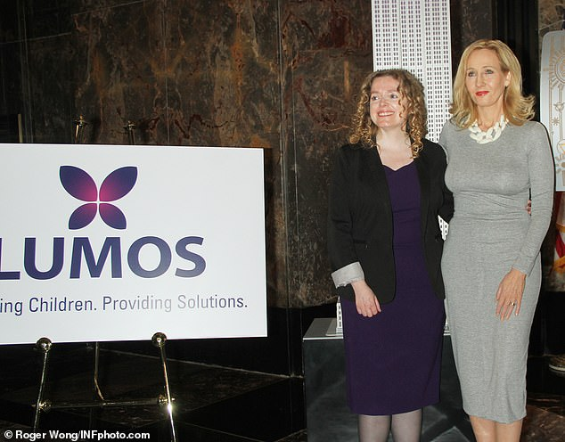
How do you know Rowling?
Her most famous book series: Harry Potter
Her other books: Cormoran Strike series, Harry Potter companion books, stb.
Charitable activities

Slide 4
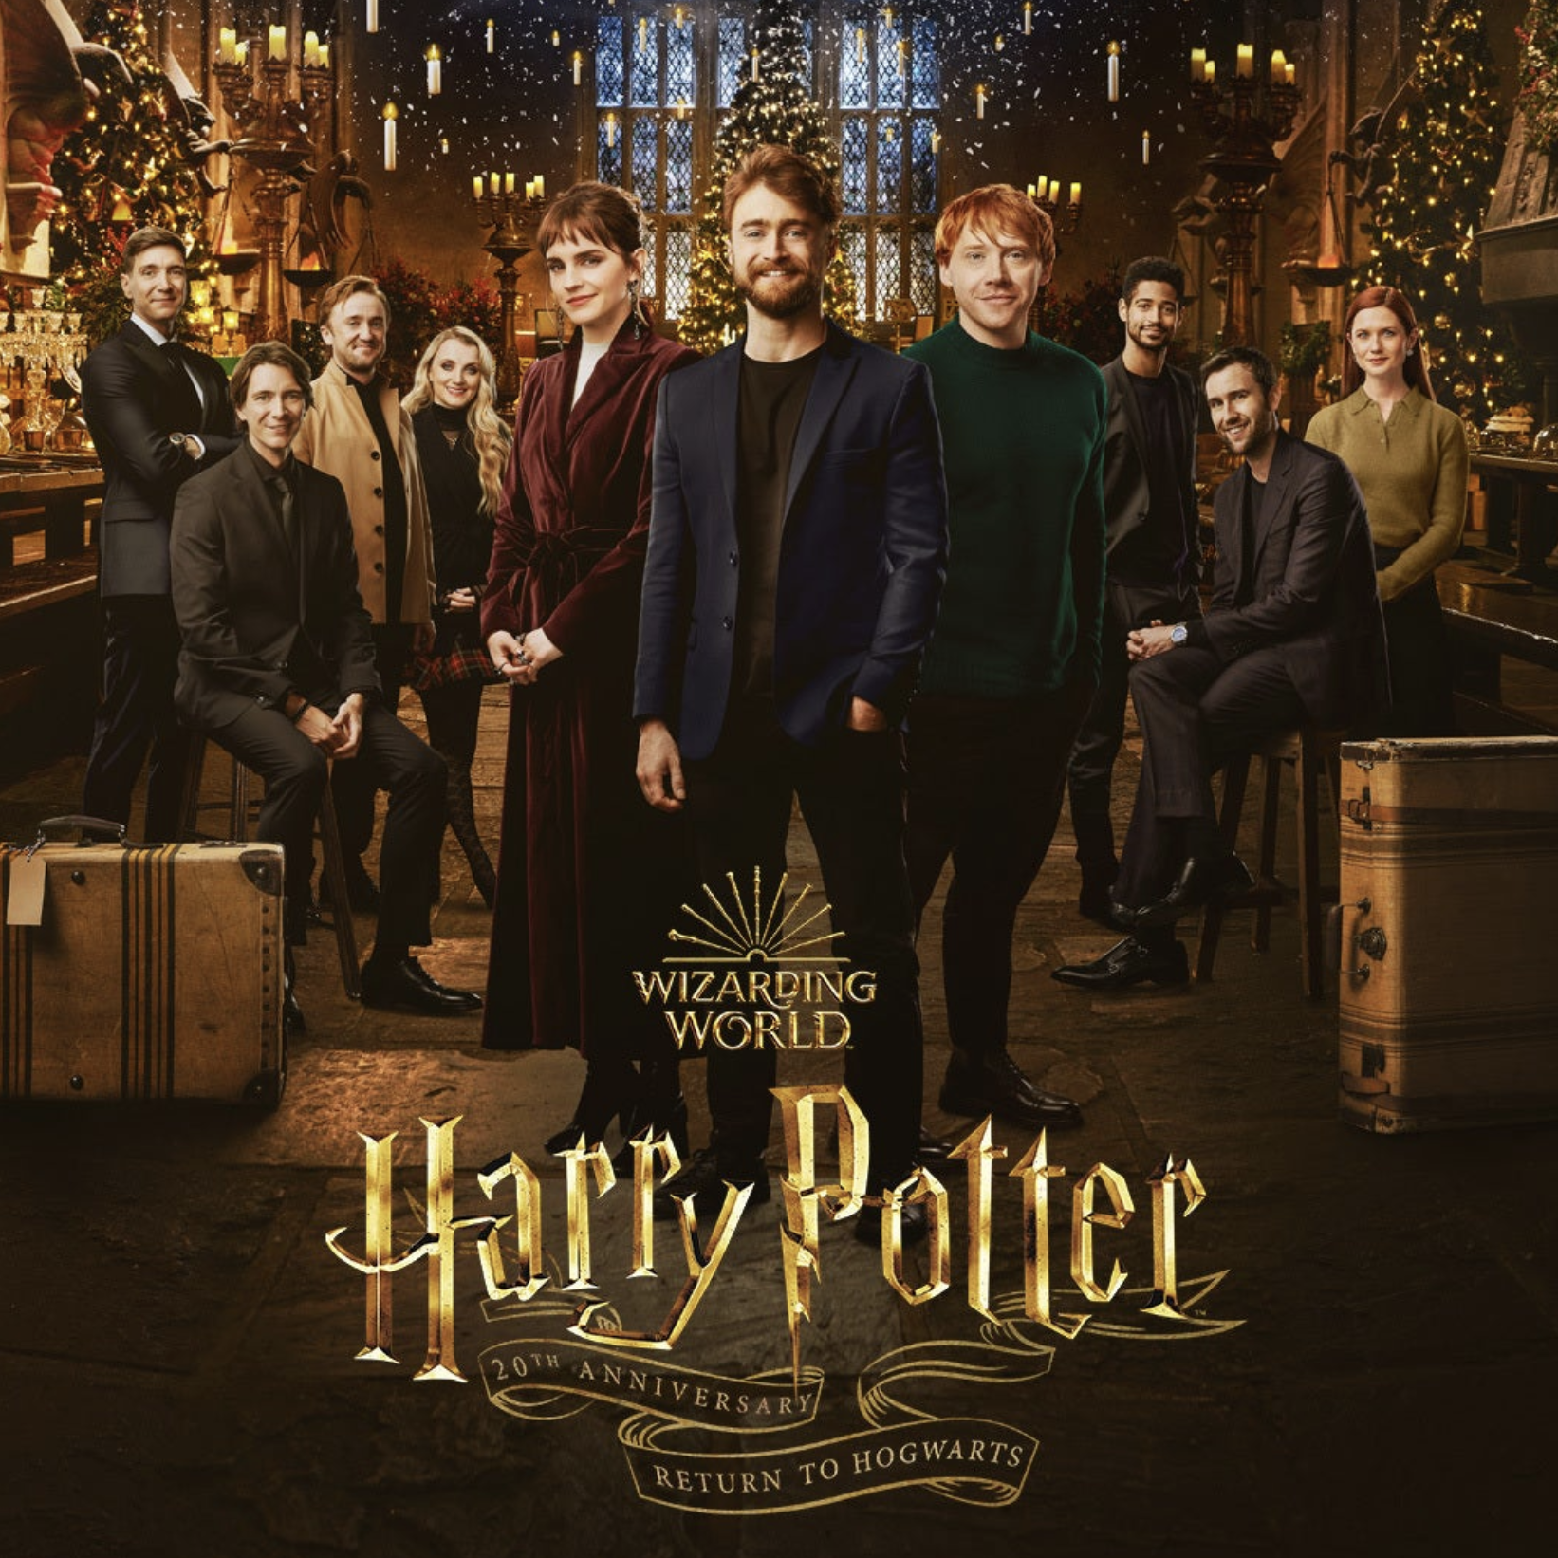
Her most famous book series
The born of the Harry Potter series
Publication
Success

Slide 5
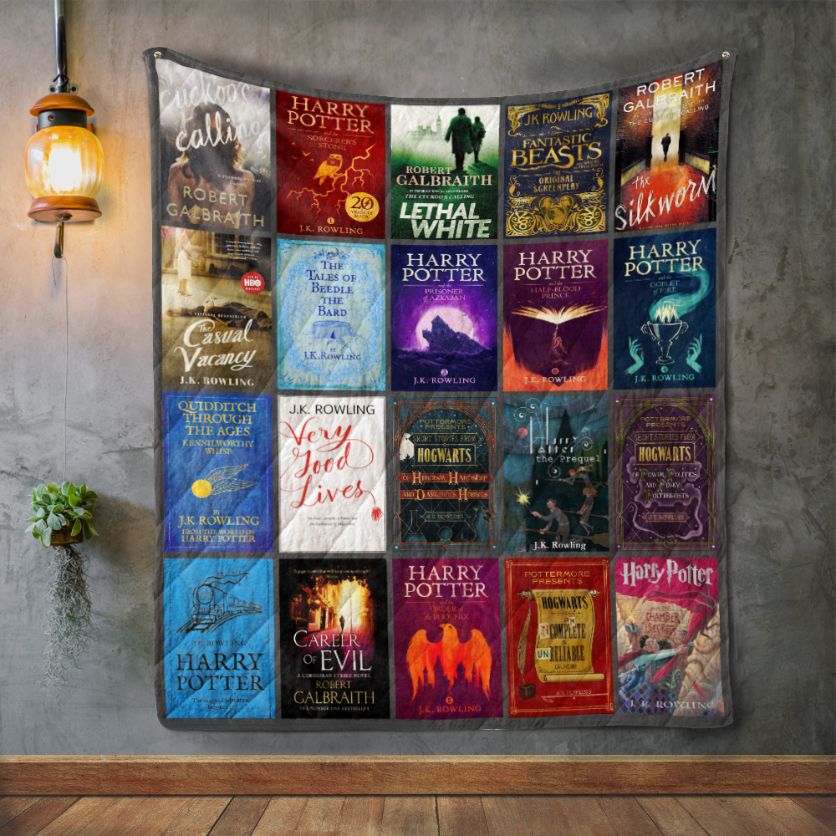
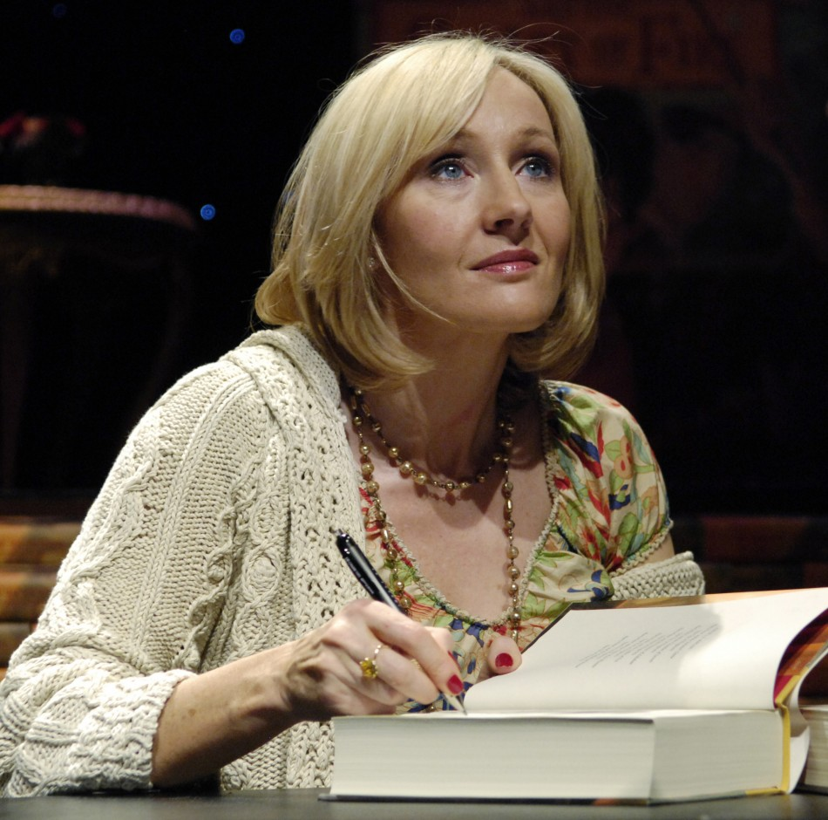

Slide 6
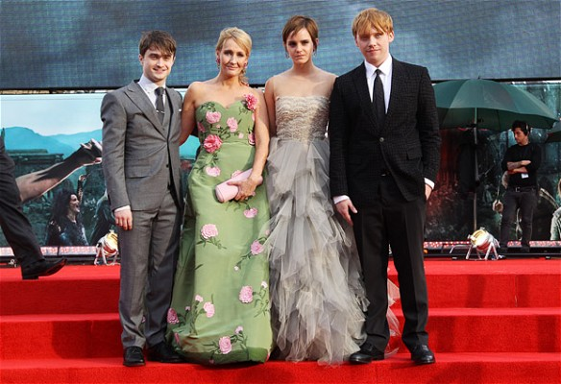
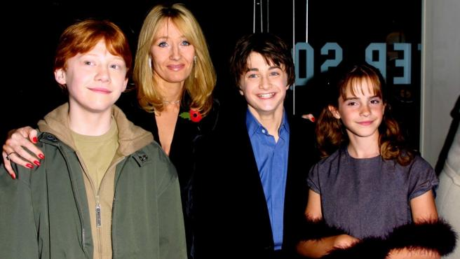

Slide 7
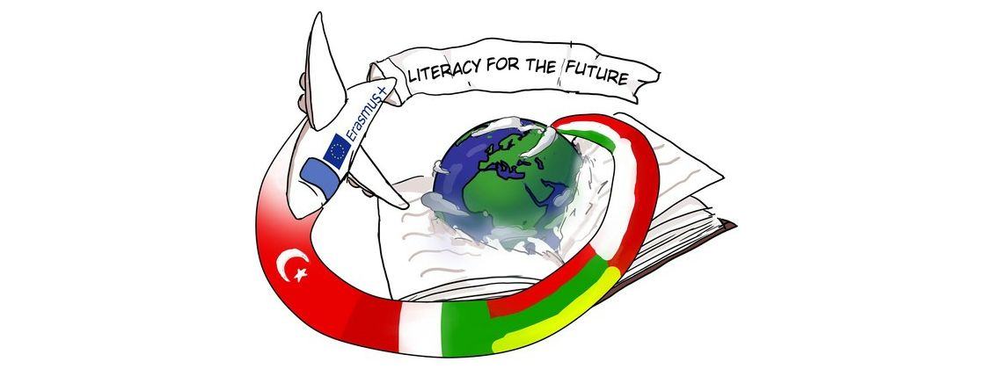
Thank you for your attention!
Happiness can be found even in the darkest times if you don’t forget to turn on the light. - Dumbledore

