Slide 1
Hungarian culture

Slide 2
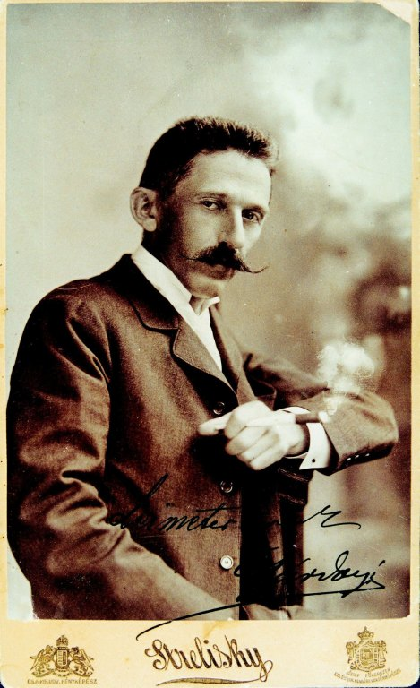
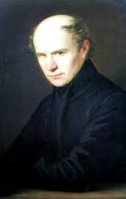
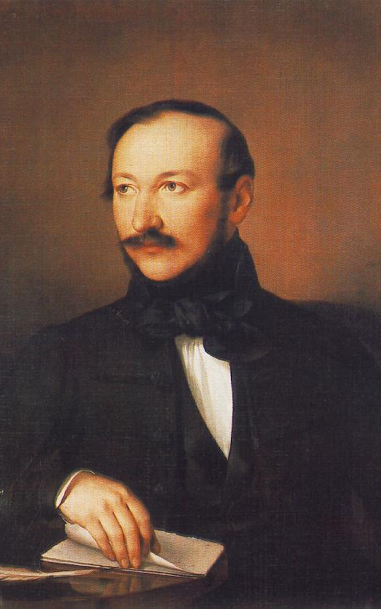
I. Well-known writers and poets
Gárdonyi Géza Kölcsey Ferenc Vörösmarty Mihály
(1863– 1922) (1790-1838) (1800 – 1855)
Notes:
Megkérdezni a magyartanárt, hogy kiket gondol a legfontosabbaknak?

Slide 3
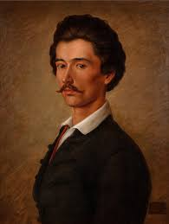
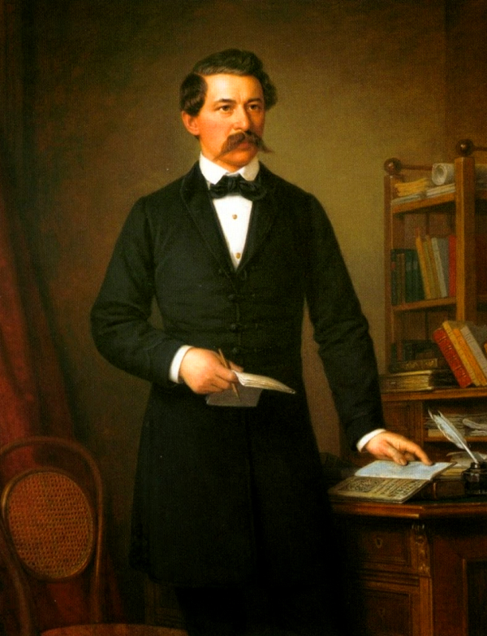
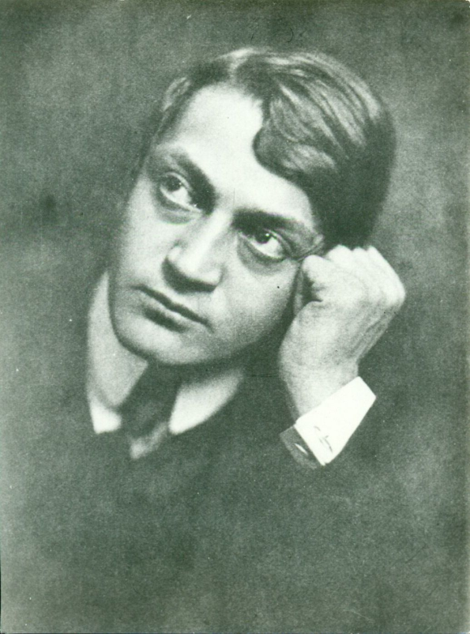
II. Well-known writers and poets
Petőfi Sándor Arany János Ady Endre
(1823-1849) (1817-1882) (1877-1919)

Slide 4
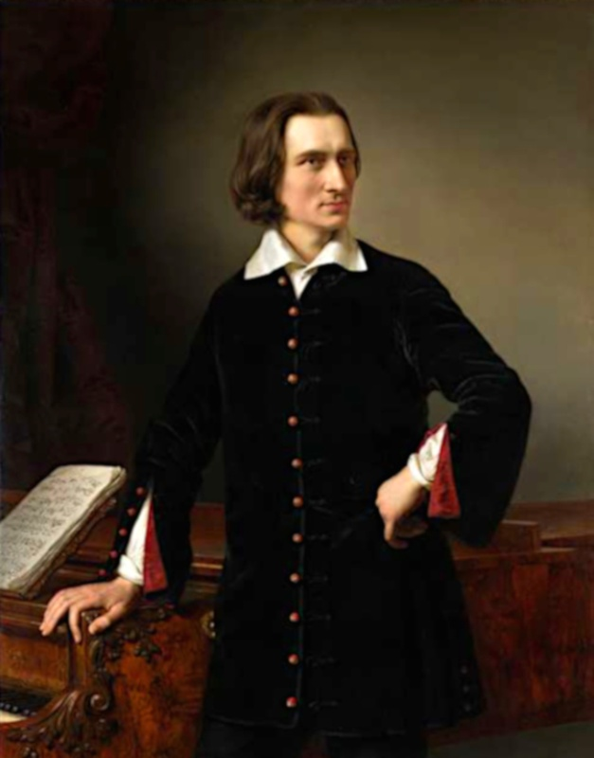
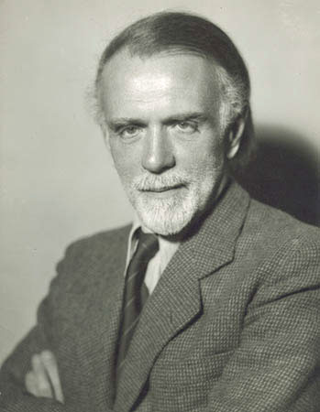
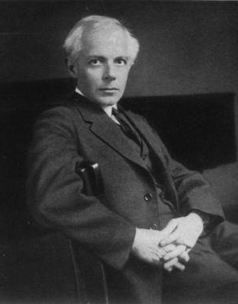
II. Famous musicans
Liszt Ferenc Kodály Zoltán Bartók Béla
(1811-1886) (1882- 1967) (1881-1945)

Slide 5
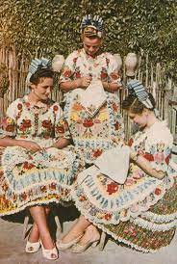
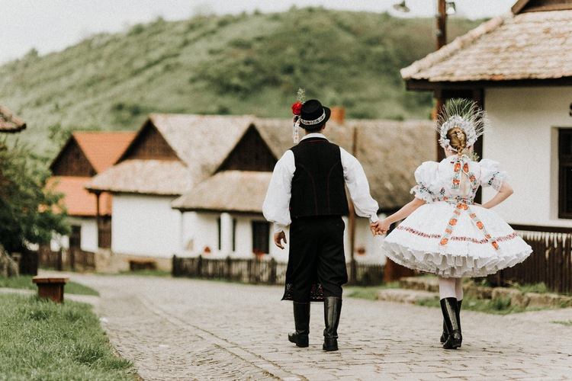
III. Traditional costumes
When we talking about Hungarian folk costumes, we distinguish four main regions:
Transdanubia,
Uplands,
Great Hungarian Plain
and Transylvania.
Some of the lands with characteristic dresses are found in Kalocsa, in Matyó Land, in Hollókő - just to mention some.
Kalocsa
Hollókő

Slide 6
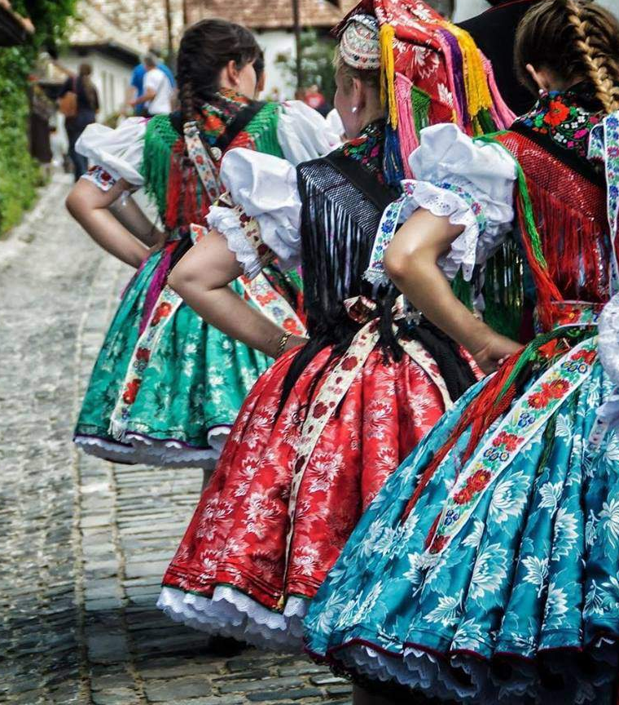
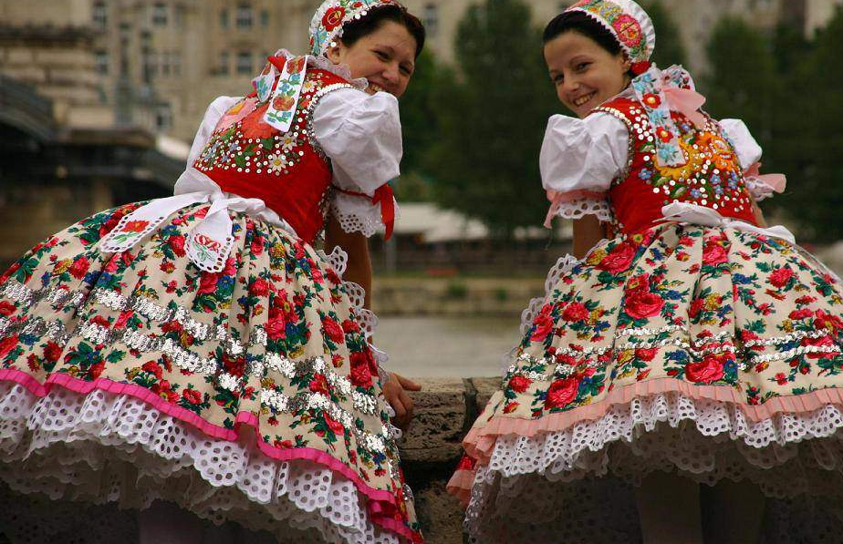
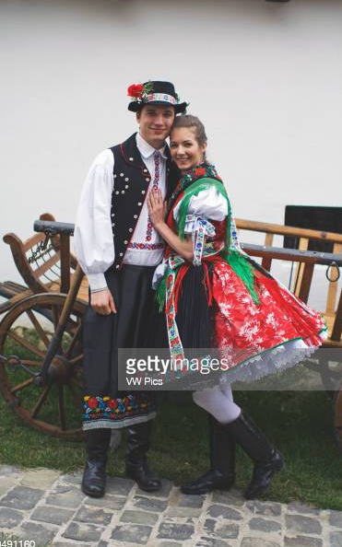
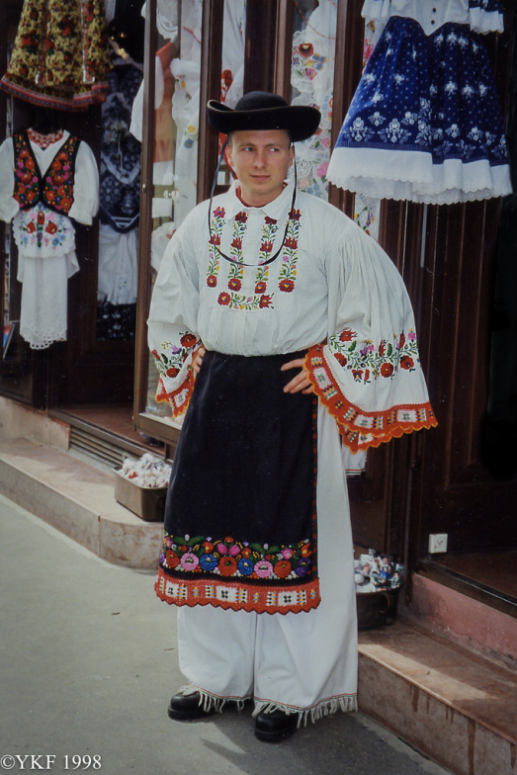
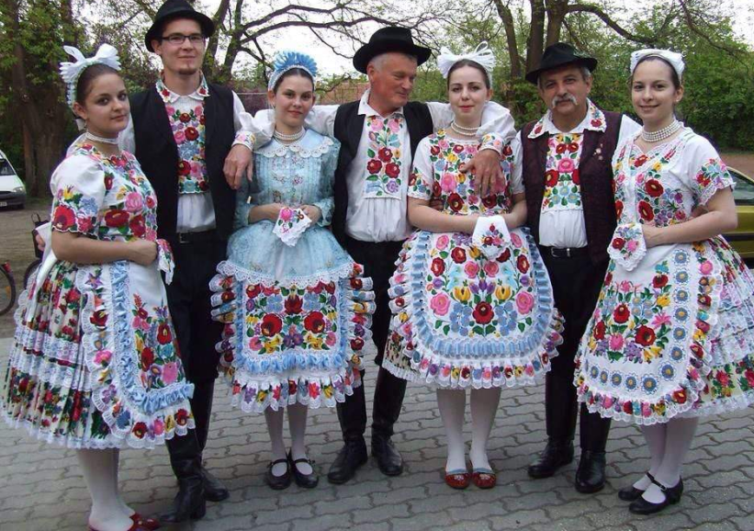
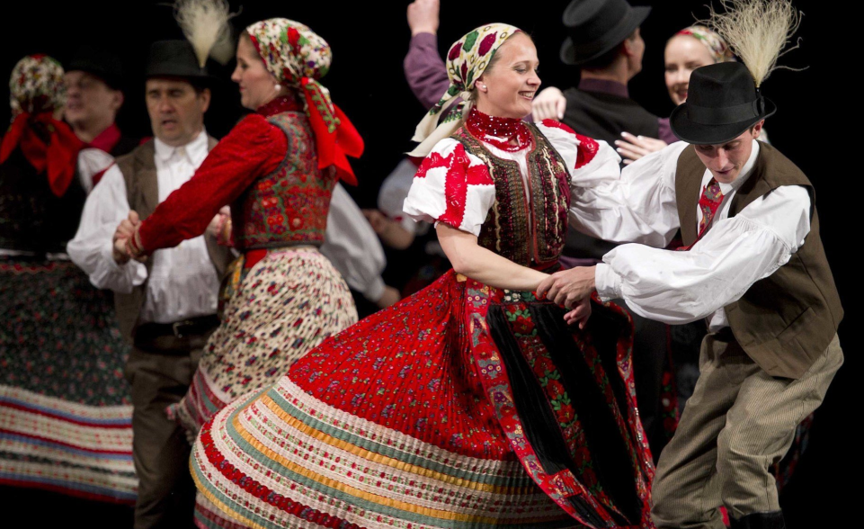
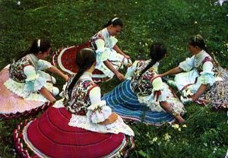
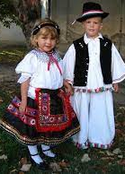
→Traditional costumes

Slide 7
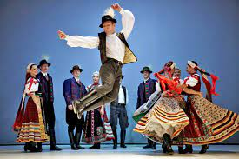
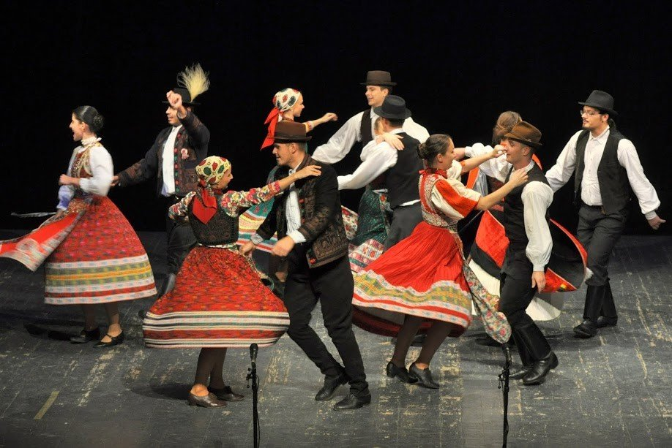
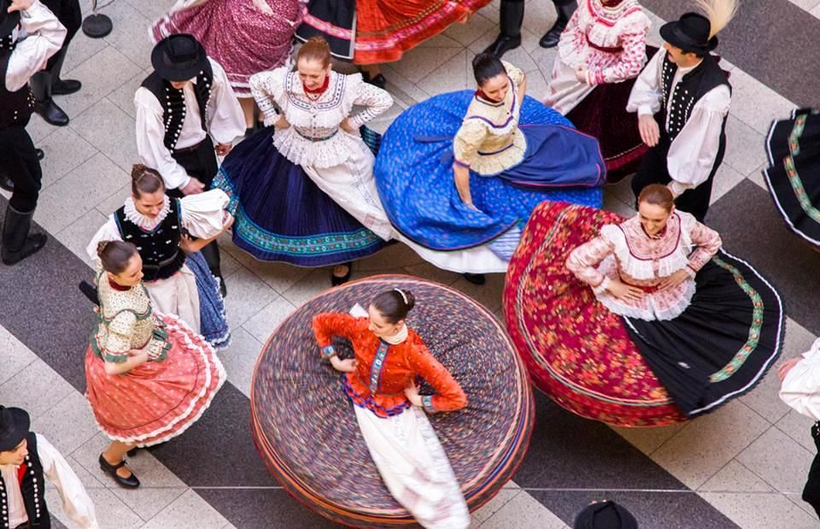
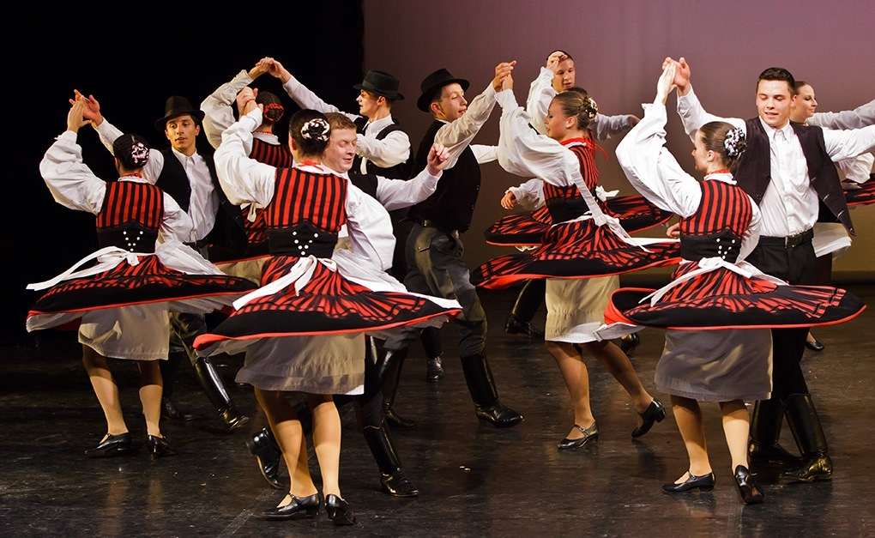
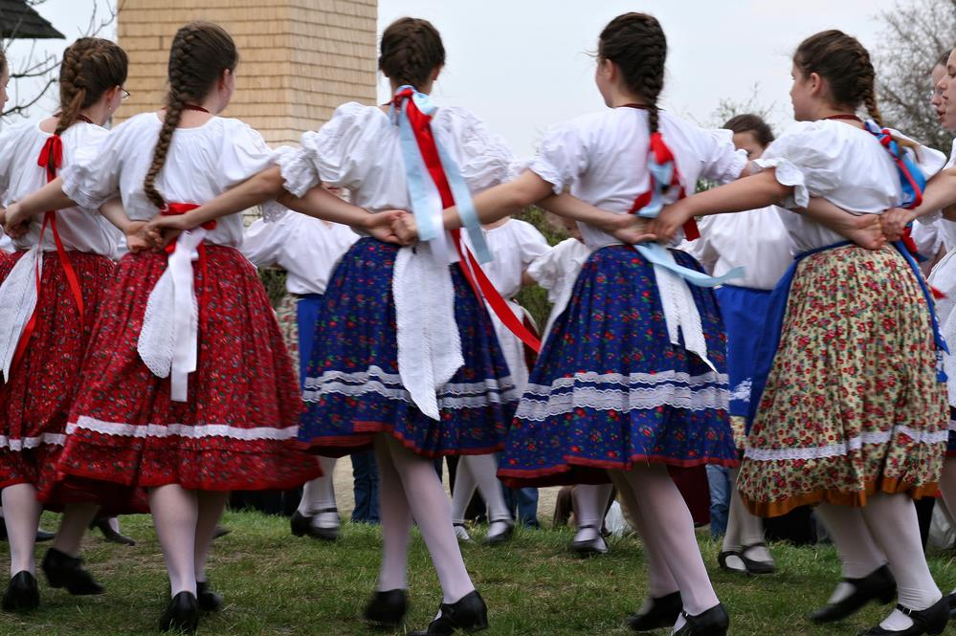
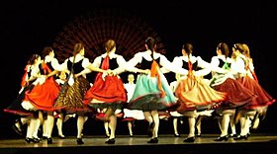
Hungarian folkdancing

Slide 8
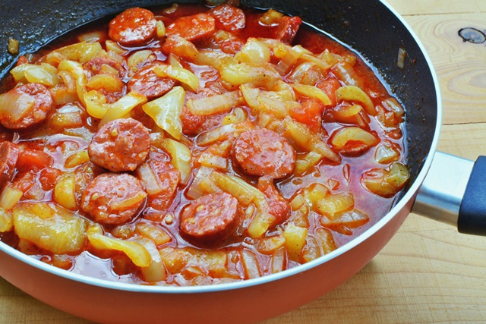
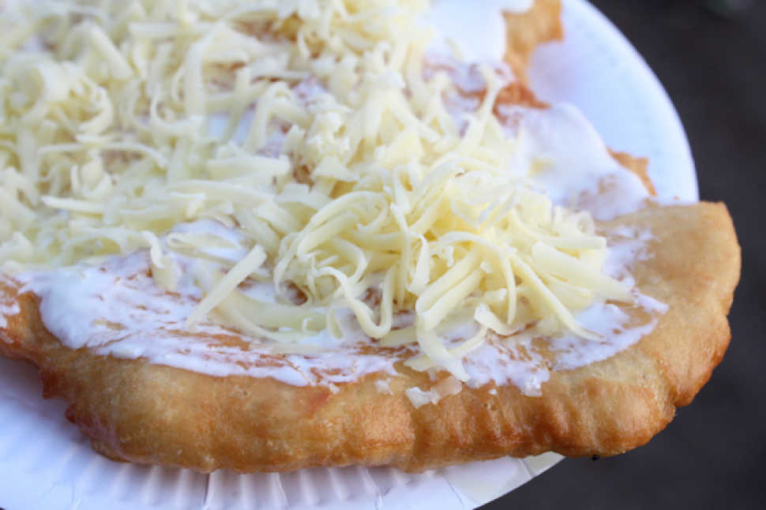
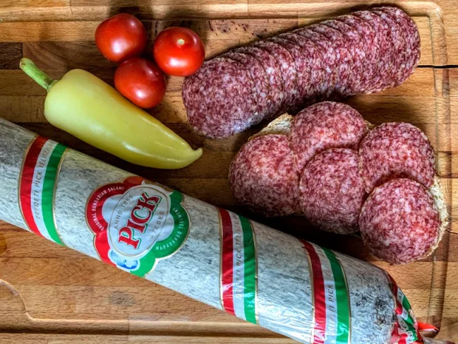
IV. Gastronomy
Hungarian cooking is actually quite difficult to define. It tends to use paprika, black pepper, several different spices and often onion. Traditional Hungarian dishes are primarily based on meats, seasonal vegetables, fresh bread, dairy products, cheeses and fruits.
lángos
Szalámi

Slide 9
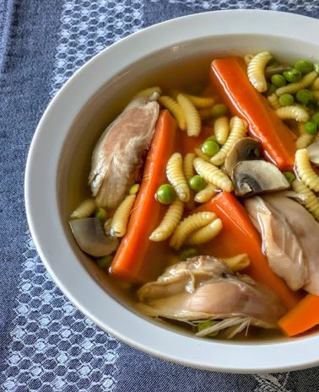
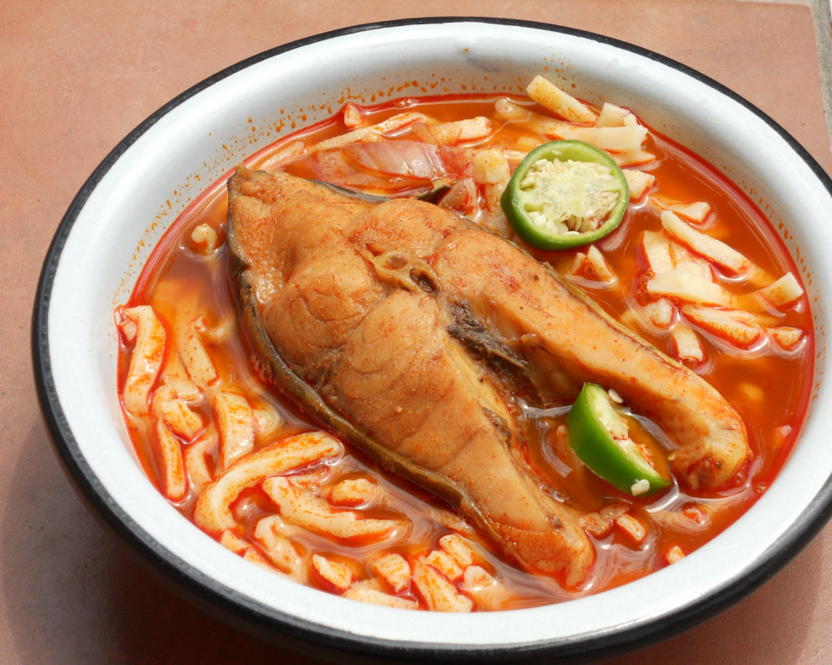
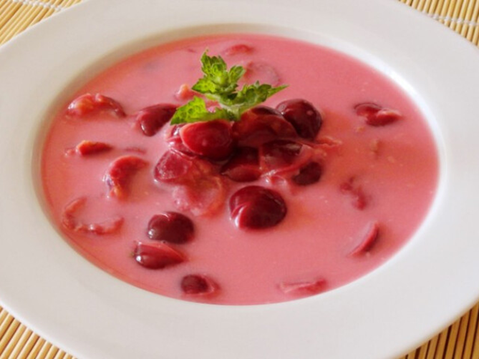
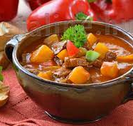
Soups
chicken soup
Fish soup
Chilled sour-cherry soup
Goulash

Slide 10
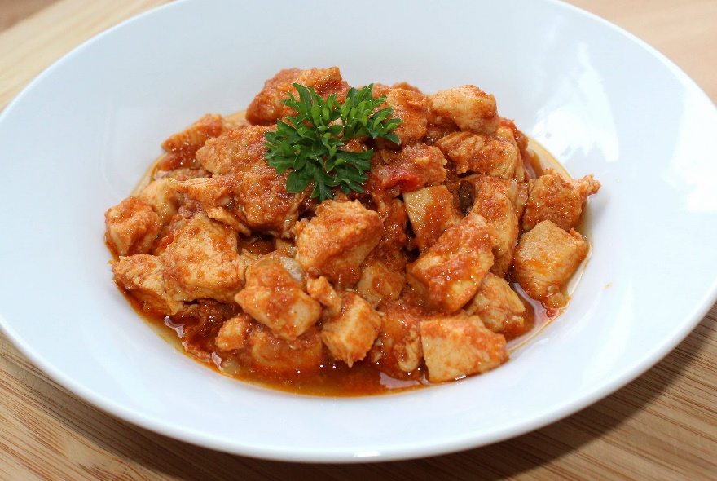
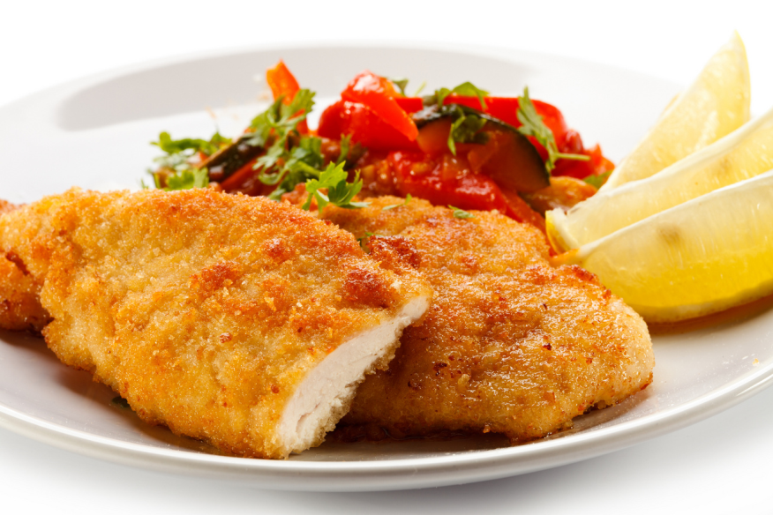
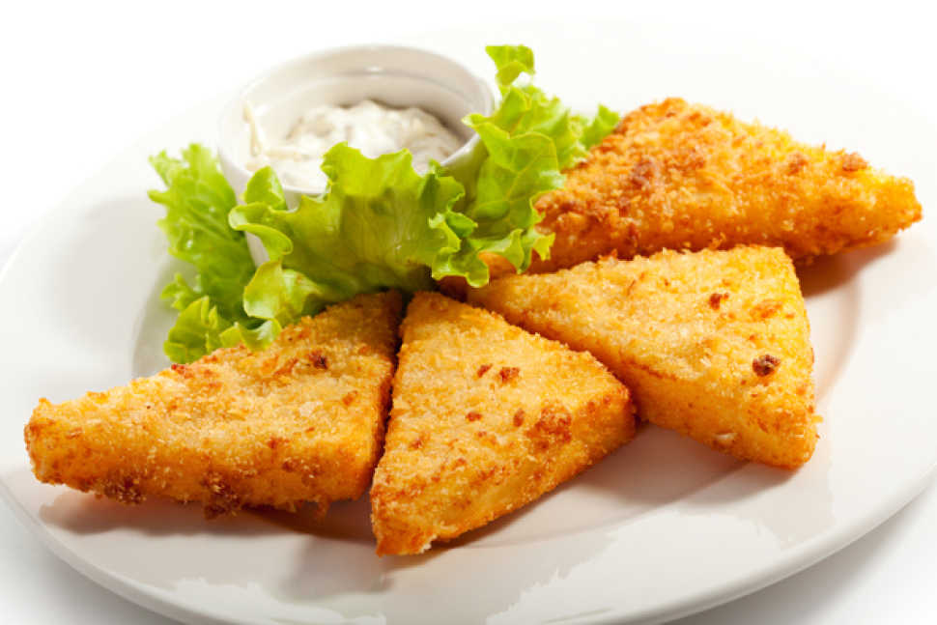
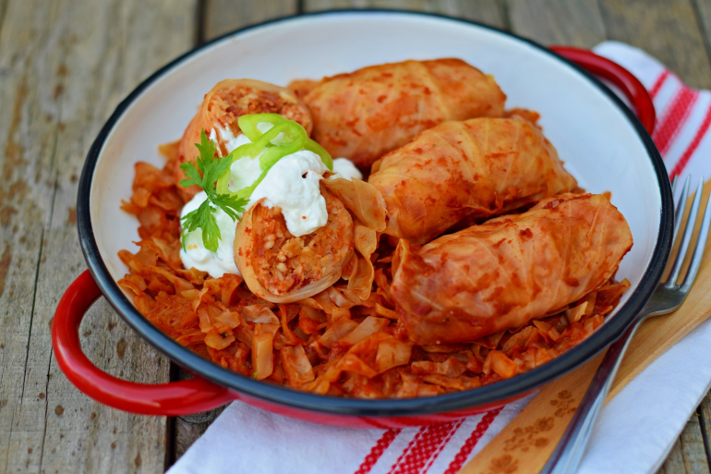
Main courses
Hungarian flat bread
Lecsó
Stew
Fried cheese
Stuffed cabbage
Fried meatl

Slide 11
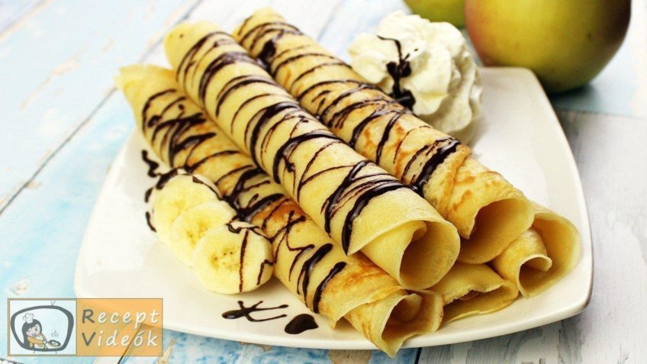
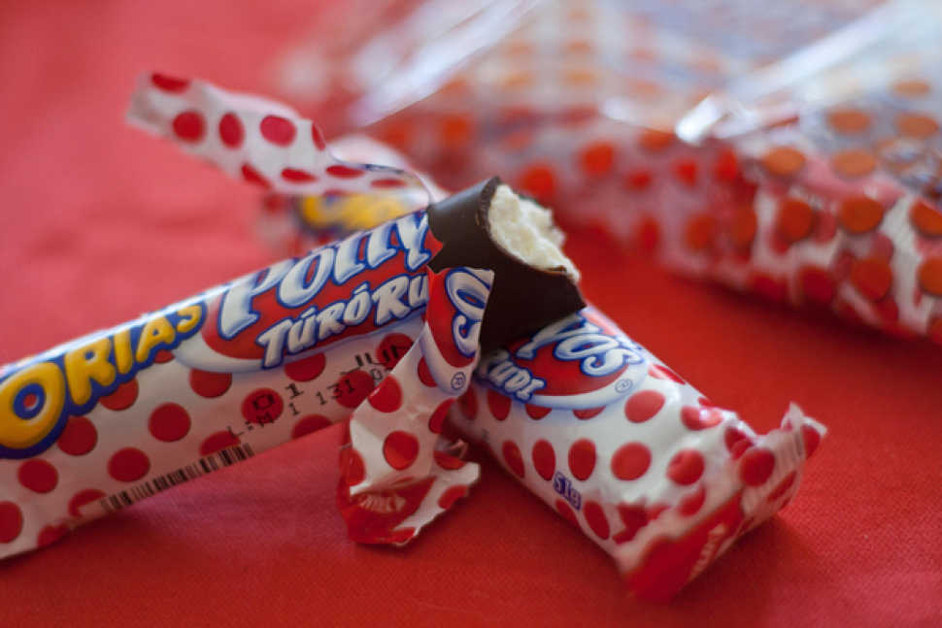
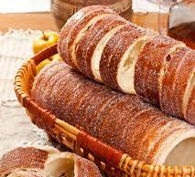
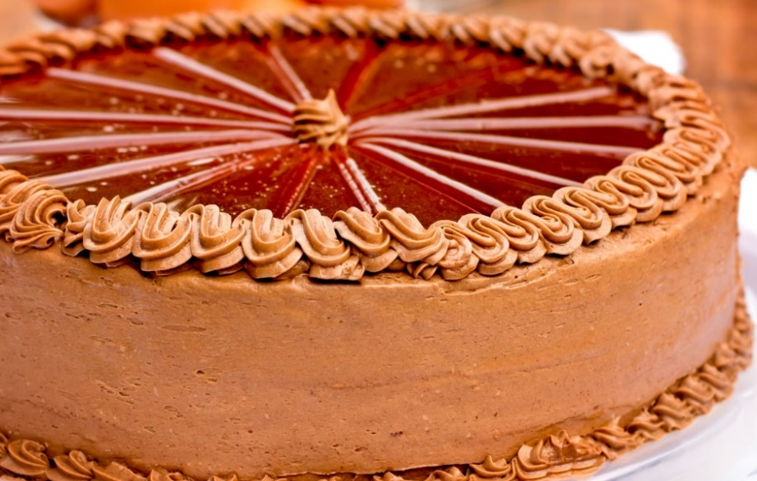
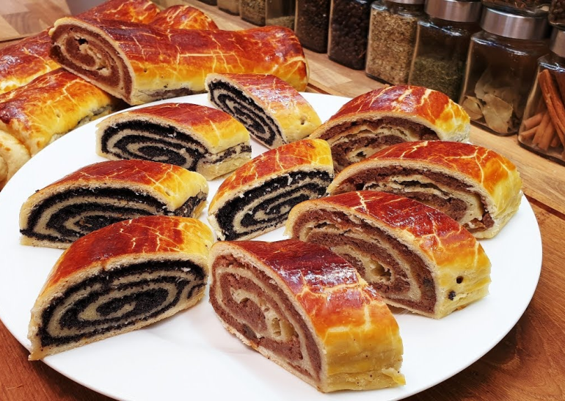
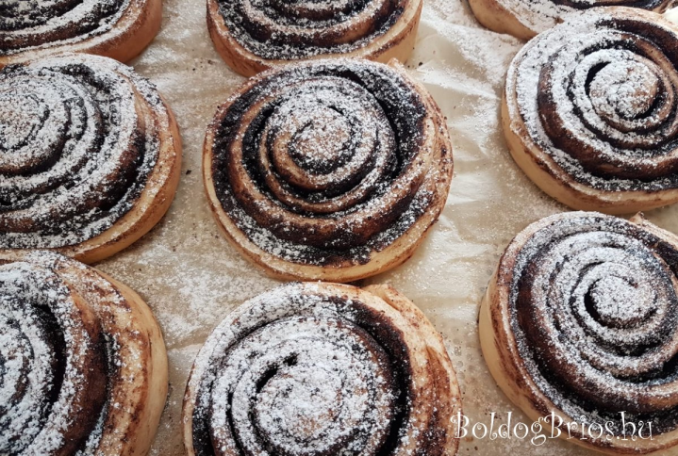
Desserts
Hungarian pancakes
Túró Rudi
Chimney cake
Dobos cake
Beigli
Chocolate bun

Slide 12
V. Places to visit

Slide 13
Budapest
parliament
Gellért statue

Slide 14
Balaton Lake

Slide 15
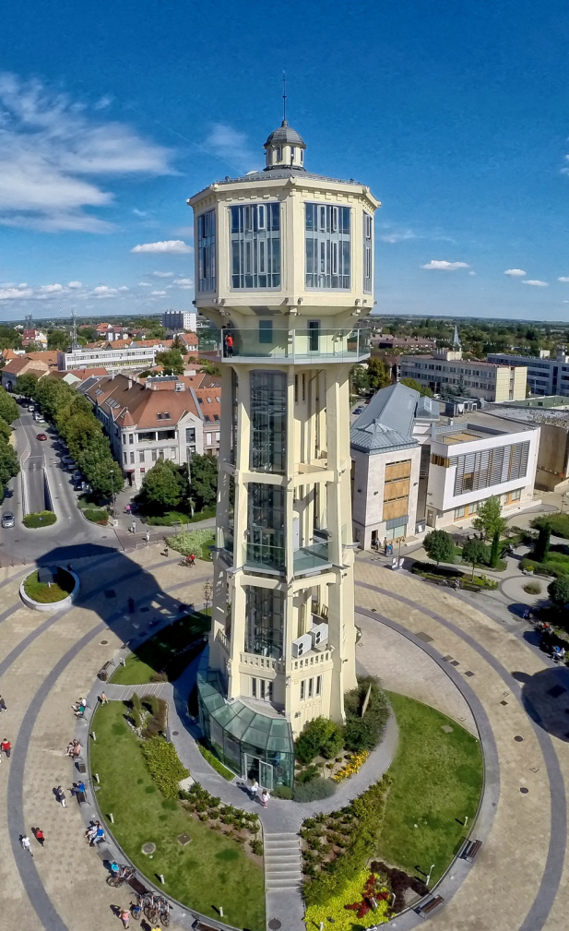
Siófok
upside down house water and lookout tower
Big Wheel

Slide 16
Eger
Cathedral Basilica
Eger Castle

Slide 17
Aggtelek Caves

Slide 18
Nyíregyháza

Slide 19
Szilvásvárad
Szalajka Valley
lake

Slide 20
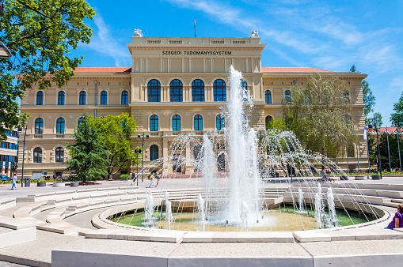
Szeged
Votive Church
Millennium Fountain

Slide 21
Thank you for your attention!
Works cited:
https://www.szeretlekmagyarorszag.hu/utazz/15-magyar-nevezetesseg-amit-latnod-kell/
https://www.magyarorszagom.hu/hires-magyar-etelek.html
https://furir.blog.hu/2012/10/30/x_hires_magyar_kolto_versei_szuletese_halala
https://www.otptravel.hu/inspiraciok/magyarorszag-kis-magyar-divattortenet-szines-nepviseletek
https://szallas.hu/programok/magyarorszag
https://www.google.com/search?q=hungary+traditional+costume&source=lmns&bih=568&biw=1366&hl=hu&sa=X&ved=2ahUKEwif4O7r7dX3AhUNgKQKHSN9CeoQ_AUoAHoECAEQAA
https://www.offbeatbudapest.com/budapest-city-guide/best-traditional-hungarian-dishes/
https://www.google.com/search?q=Hungarian+folk+music&tbm=isch&hl=hu&chips=q:hungarian+folk+music,online_chips:folk+dance:a64FdFCRfcM%3D&sa=X&ved=2ahUKEwjFtaqK7dX3AhWVgKQKHZ7cDpcQ4lYoAHoECAEQHQ&biw=1349&bih=625
http://www.hungarikum.hu/hu/k%C3%BCrt%C5%91skal%C3%A1cs
https://www.szeretlekmagyarorszag.hu/gasztro/33-tipikus-magyar-etel-ami-meghodithatja-a-vilagot/

