Slide 1

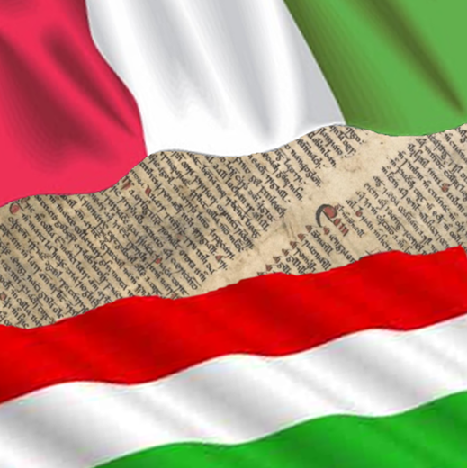
HUNGARIAN-ITALIAN RELATIONS
IN THE PAST
Created by: Damarisz Tóbi
Bianka Püspöki

Slide 2
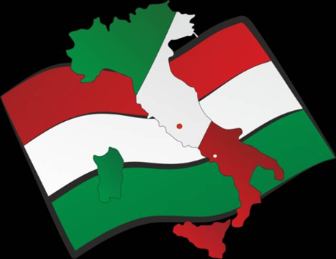
Introduction
The lands of Hungary and Italy are linked by a rich historical tradition.
The names of Lajos Kossuth, István Türr and Lajos Tüköry sound familiar to most Italian ears.

Slide 3
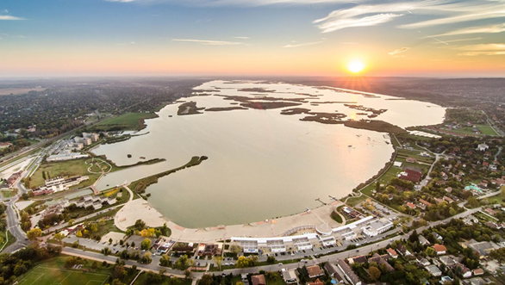
Interesting facts 1.
During the reign of András III, Venetian craftsmen arrive in the area around today's Lake Venice.

Slide 4
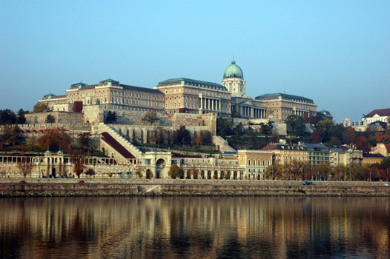
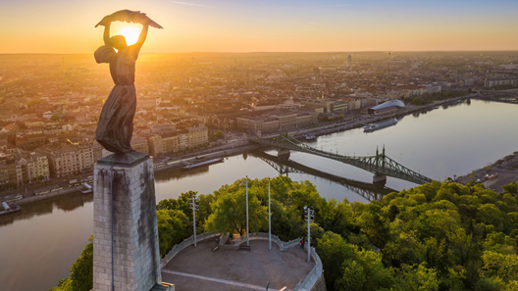
Interesting facts 2.
The Buda Castle, built by Italian and Flemish craftsmen, is based on an Italian model.
The rebuilding and fortification of the citadels in Hungary was also the work of Italian masters.

Slide 5
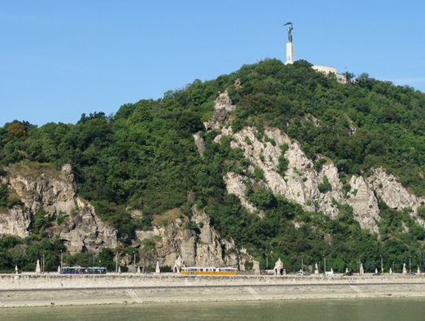
St. Gellért
Born in Venice
Patron Saint of the Diocese of Szeged-Csanád
The Gellért Hill is named after him

Slide 6
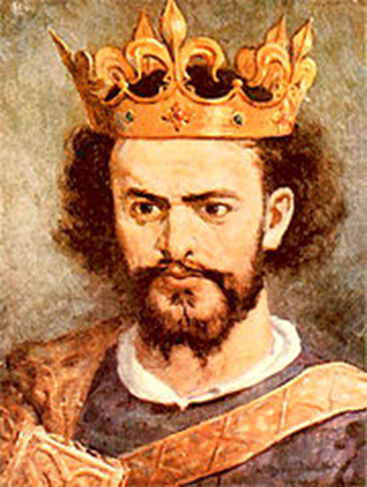
Lajos Nagy
King Lajos launched a campaign against Naples.
Lajos the Great captured Naples twice.
On 23 March 1352, a peace treaty is signed in Naples

Slide 7
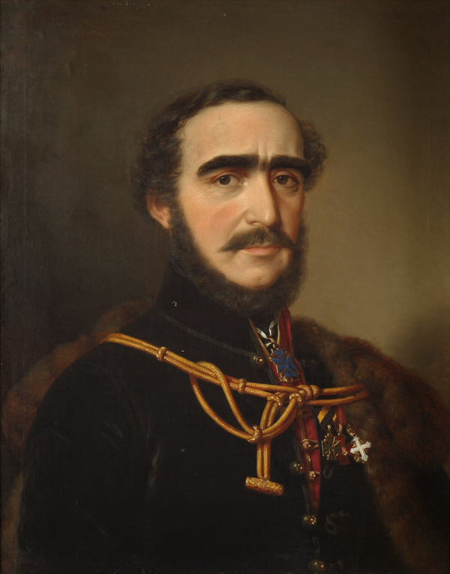
István Széchenyi
He is the person giving his name to the school,he also had links with Italy.

Slide 8
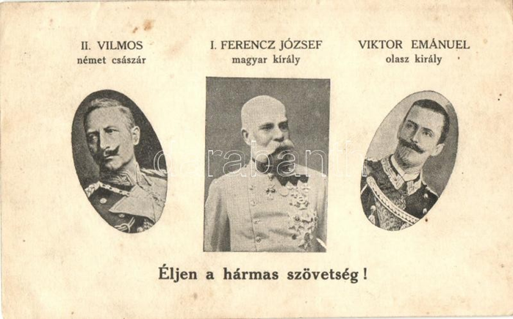
Triple Alliance
During the Austro-Hungarian Empire, Hungary shared an embassy with Austria in Rome.

Slide 9
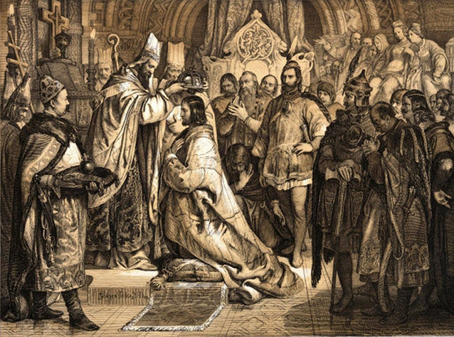
HISTORICAL REVIEW
The foundation of the Hungarian state began with the coronation of Stephen I, who received the crown from the Roman Pope (Pope Sylvester II).

Slide 10
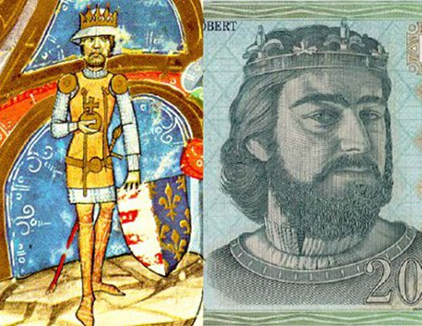
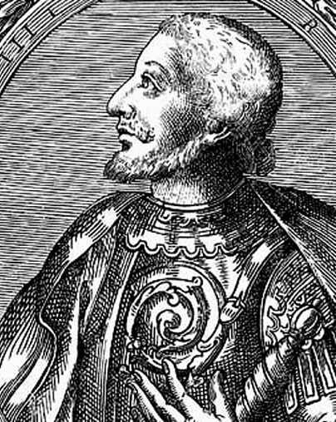
KINGS OF THE ANGEVIN ERA
Hungary also had kings of Italian nationality (between 1308-1395), for example:
Róbert Károly Károly Kis

Slide 11
Charles Road
New trade routes will be built, including to Karlovac and Rijeka.
The famous Charles Road, which brings Hungarian agricultural products and cattle to Italy, and from where Italian artisanal products can reach Hungarian soil

Slide 12
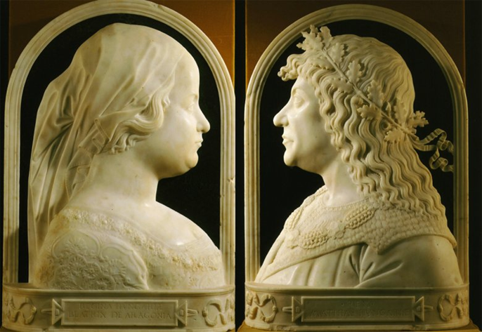
RELATIONS WITH Matthias
Matthias's wife Beatrix of Aragon, Queen of Hungary (former Royal Princess of Naples)
One can also think of King Matthias' Renaissance connections, the Hungarian students who went to Padua and Bologna.

Slide 13
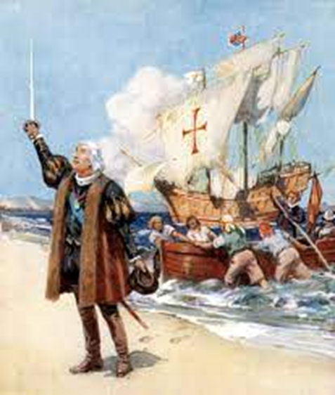
Renaissance 1.
Two years after the death of Matthias, Christopher Columbus reached the shores of Cuba and this contributed significantly to the wars in Italy.

Slide 14
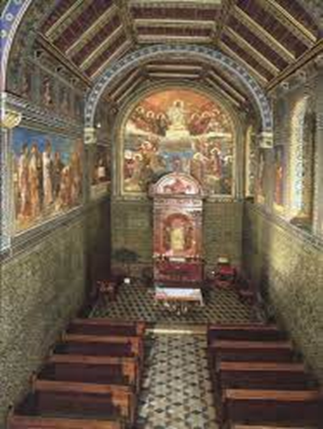
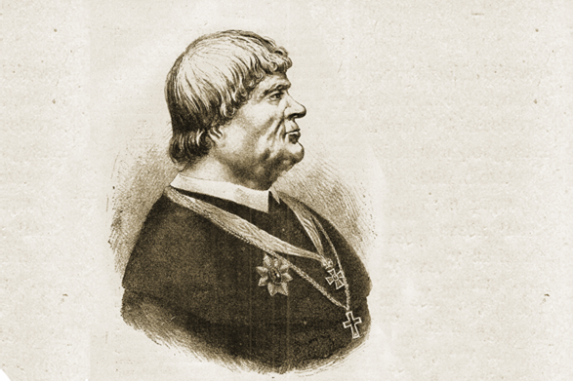
Renaissance 2.
The Archbishopric of Esztergom was justly famous throughout Italy.
Archbishop Tamás Bakócz, who later stood a chance in the papal election, was supported in his promotion not only by the papal state but also by Venice.

Slide 15
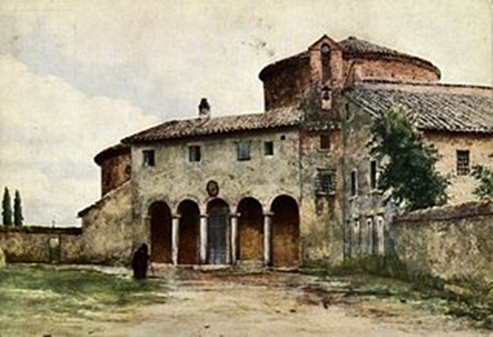
AFTER THE TURKISH OCCUPATION
The recapture of Buda was a milestone in the history of Central and Southern Europe, and renewed relations and cultural interaction between Hungary and Italy.
Christian connections are of great importance, the 5th most important church in Rome, San Stefano Rotondo, is then in the care of the Hungarian Palaians

Slide 16
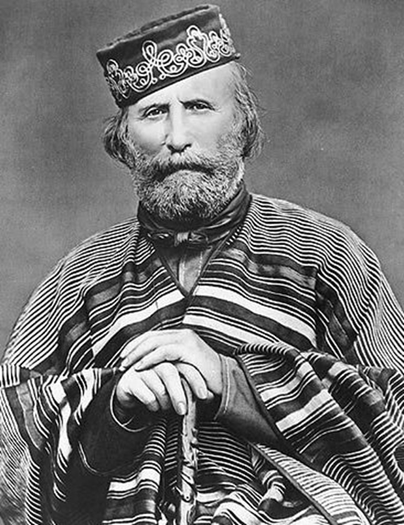
REUNIFICATION OF ITALY
Rome helped in the formation of the Hungarian state, and Hungarian soldiers helped in the reunification of Italy.
Among them was István Türr.

Slide 17
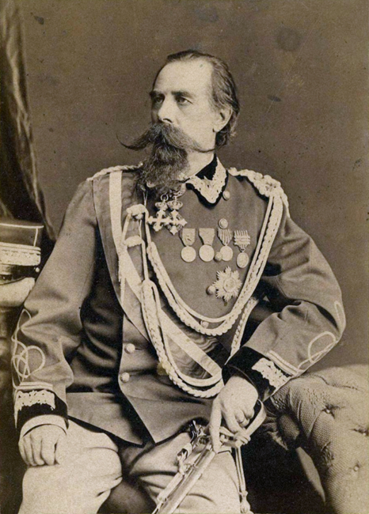
István Türr
After the armistice, he again joined Garibaldi as his aide-de-camp, who finally took Palermo. Here he was awarded the title of 'the fearless Hungarian' by his comrades for his perseverance.

Slide 18
VEGETABLES
During the Austro-Hungarian Empire, Hungary shared an embassy with Austria in Rome.
They were further strengthened by the Treaty of Friendship signed in Rome on 5 April 1927.

Slide 19
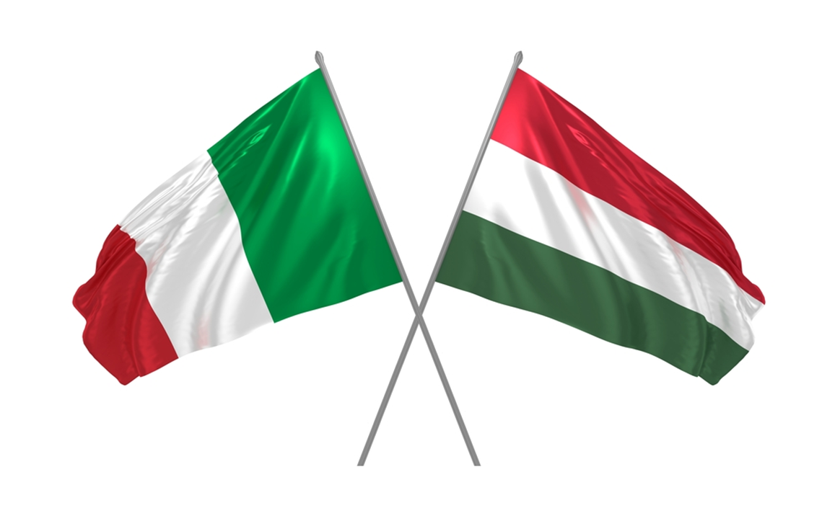
The end!
THANK YOU FOR YOUR ATTENTION!

