Slide 1
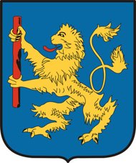
Hatvan

Slide 2
The town
Last estimated population: over 20000
2017: the most flowery town of Hungary

Slide 3
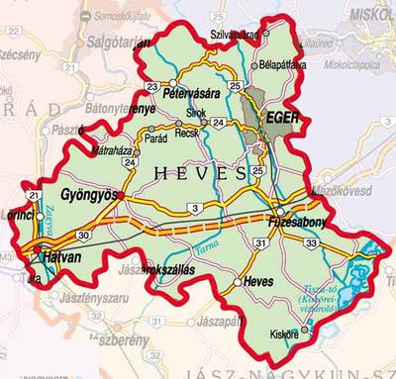
location
south-west of Heves county
the river Zagyva
territory:6630 hectares

Slide 4
Its history
Flourishing from the Bronze Age
The title of „market town” in 1406
From1544 : paid tax to the Ottoman Empire
Earl Antal Grassalkovich bought the estate in 1734
Victorious battle against the Habsburgs on 2 April 1849

Slide 5
Town hall

Slide 6
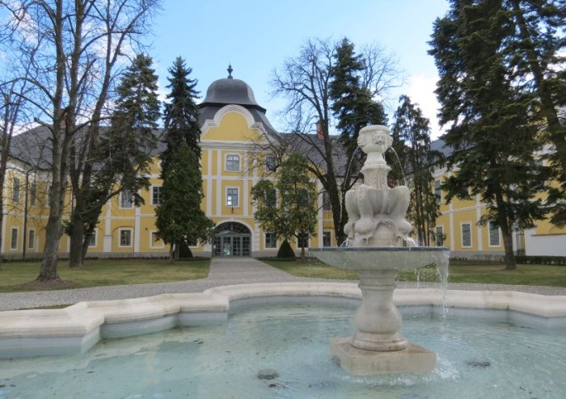
Grassalkovich castle
Built between 1754 -1763
Now: Széchenyi Zsigmond Hungarian Hunting Museum of the Capathian Basin

Slide 7
The roman catholic church in new Hatvan

Slide 8
The calvinist church

Slide 9
Saint Adalbert roman catholic churh
Antal Grassalkovich had it built (1751-1757)

Slide 10
Hatvany Lajos Museum
ethnological, archeological and visual arts exhibitions
museum of local history
brewery

Slide 11
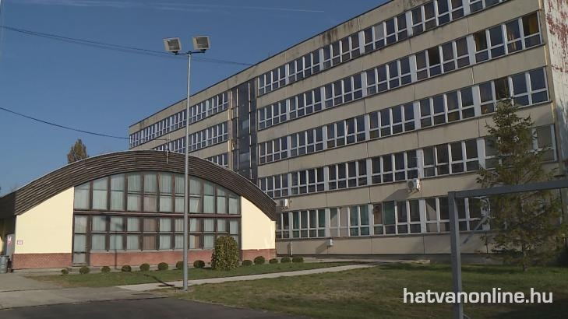
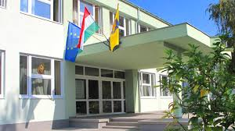
Secondary schools

Slide 12
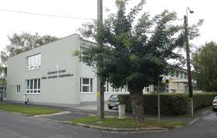
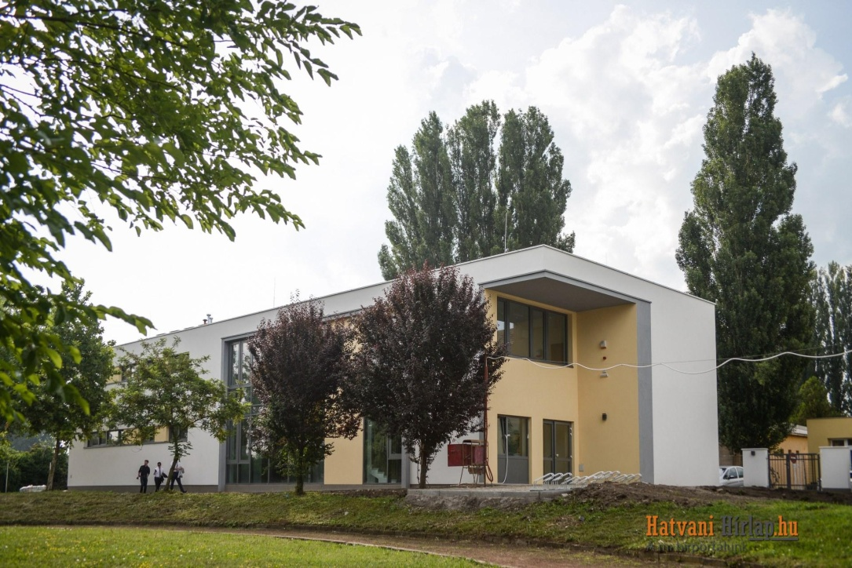
Széchenyi istván roman catholic secondary school
Two buildings

Slide 13
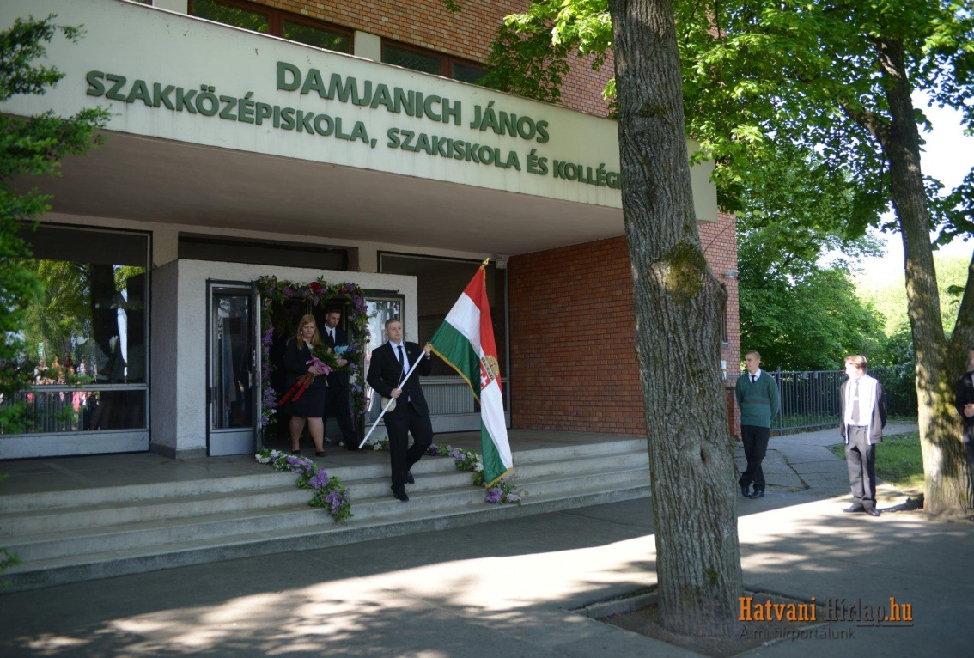
Damjanich JÁnos secondary school

Slide 14
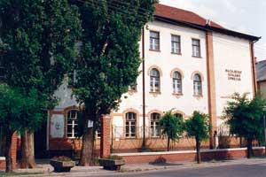
bajza józsef secondary grammar school

Slide 15
Primary schools
Kossuth Lajos Primary School
Roman Catholic Primary School
Szent István Primary School
Primary School No.5
Kodály Zoltán Primary School

Slide 16
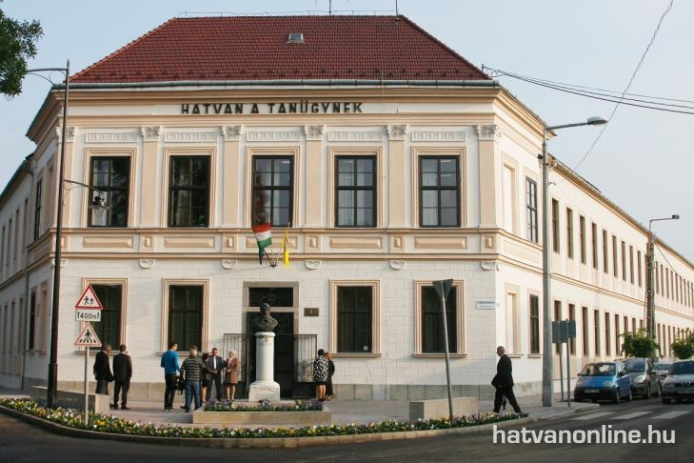

Slide 17
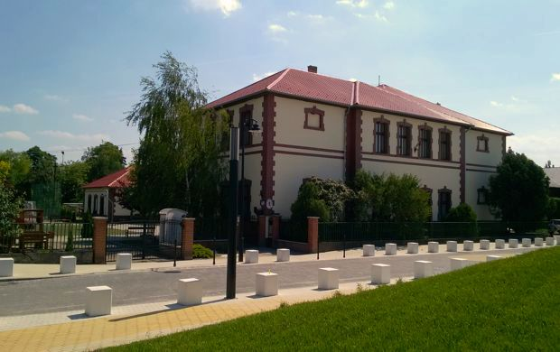
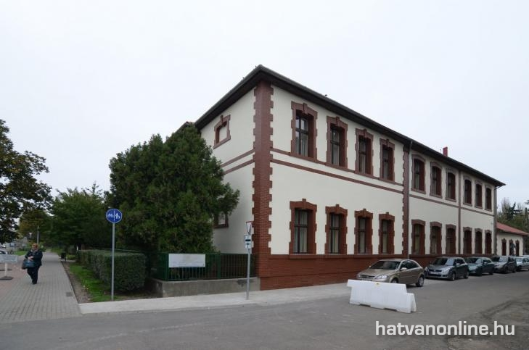
2.

Slide 18
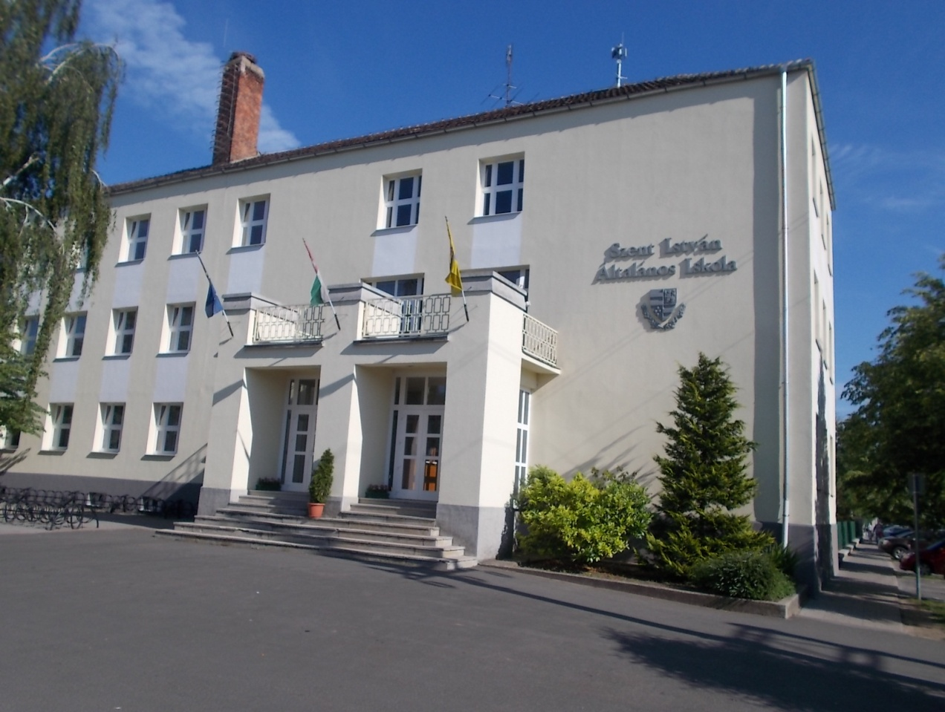
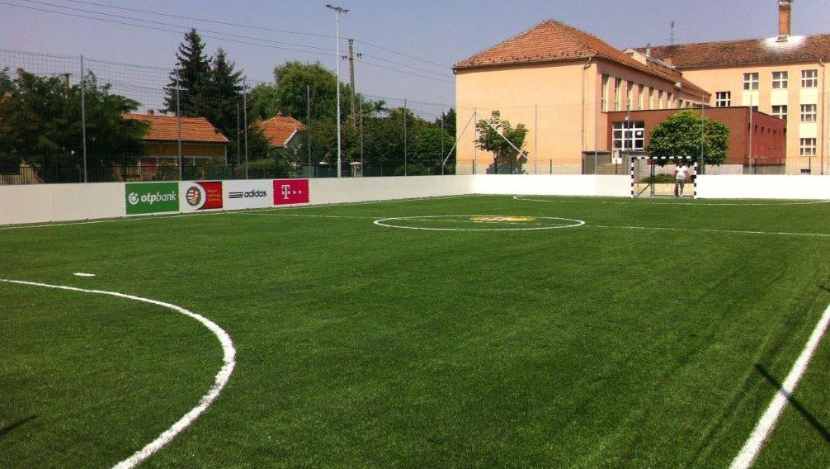
3.

Slide 19
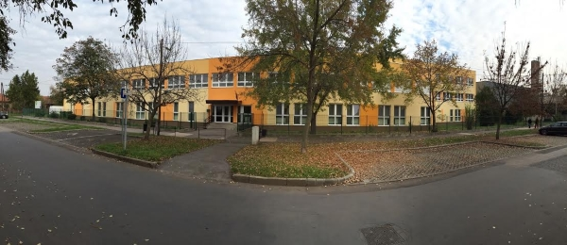
4.

Slide 20
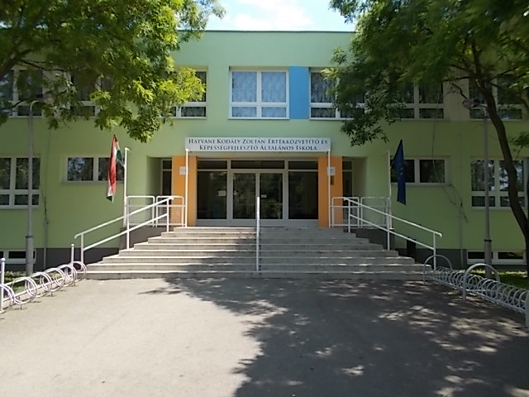
5.

Slide 21
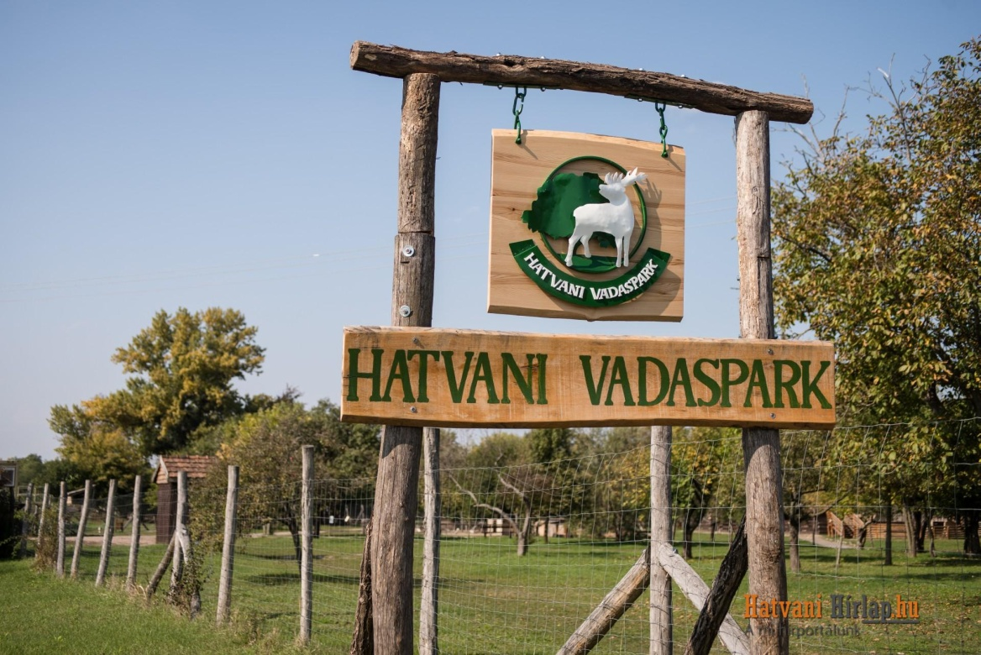
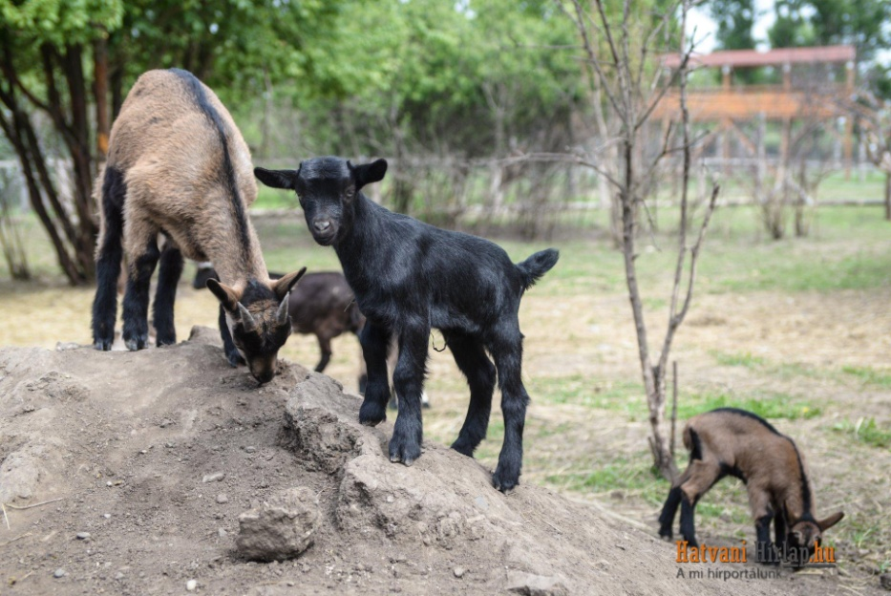
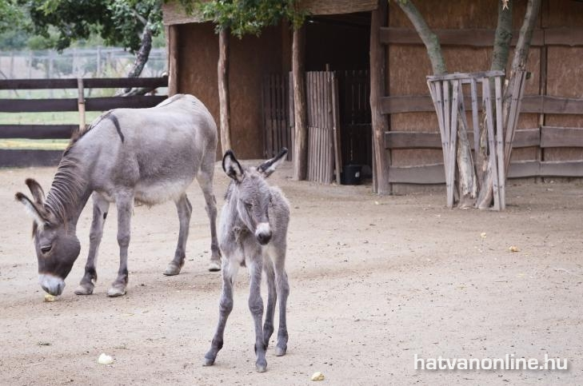
zoo

Slide 22
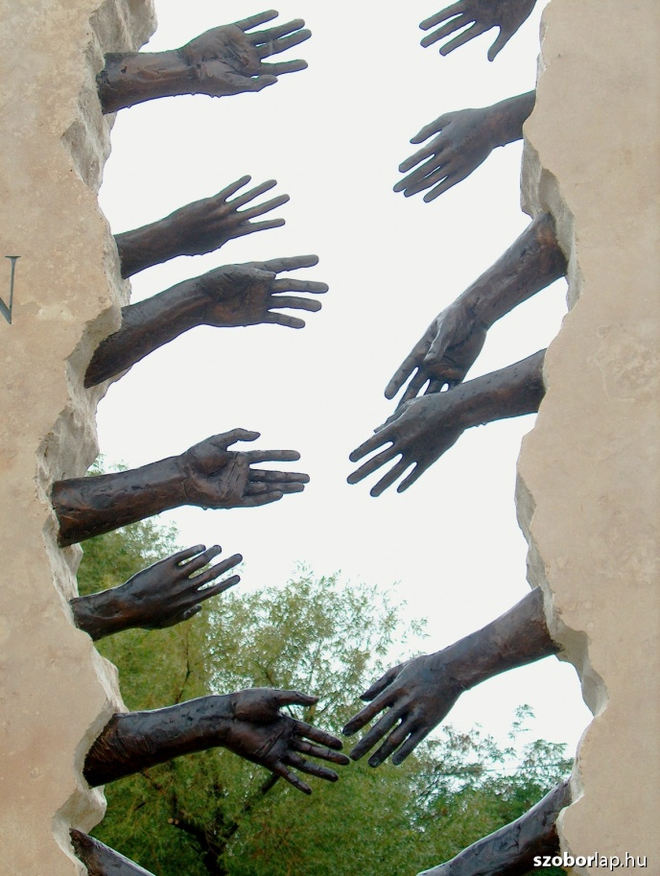
memorials
Trianon-monument

Slide 23
memorials
The memorial of the battle of 2 April 1849

Slide 24
Memorials
The Monument of Martyrs

Slide 25
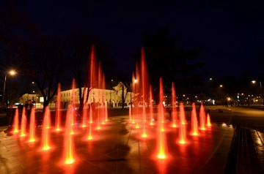
fountain

Slide 26
Thank you for your attention

