Slide 1
EXPLORE SIVAS GROUP 4 TRAVEL DIARY
ZSOFIA VIZNER ELİF SAHINER
JOSKO TOSIC BURAK KURT
GIANNIS FAKOURELIS ORHAN MEHMET KOC

Slide 2
MUSTAFA KEMAL ATATURK STATUE

Slide 3
KALE CAMİİ KALE MOSQUE

Slide 4
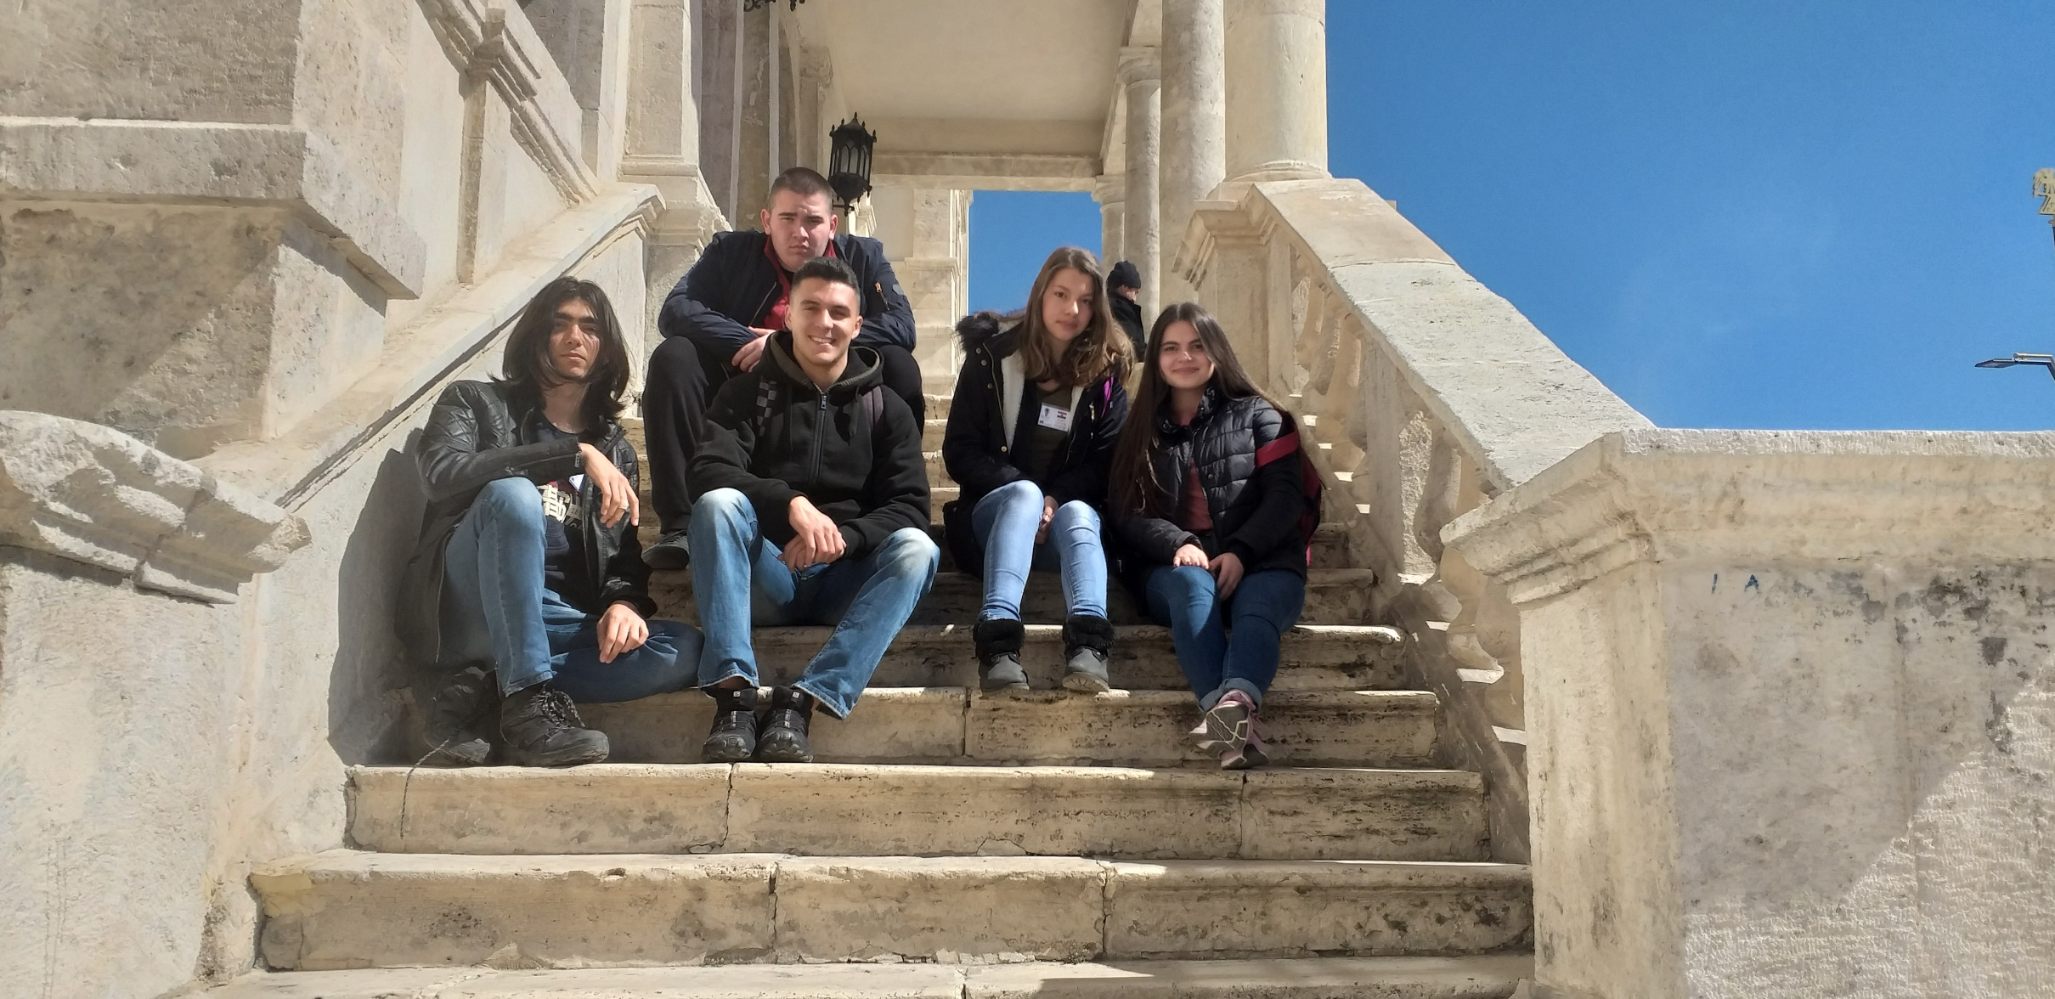
ATATÜRK CONGRESS AND ETHNOGRAPHY MUSEUM

Slide 5
ATATÜRK CONGRESS AND ETHNOGRAPHY MUSEUM

Slide 6
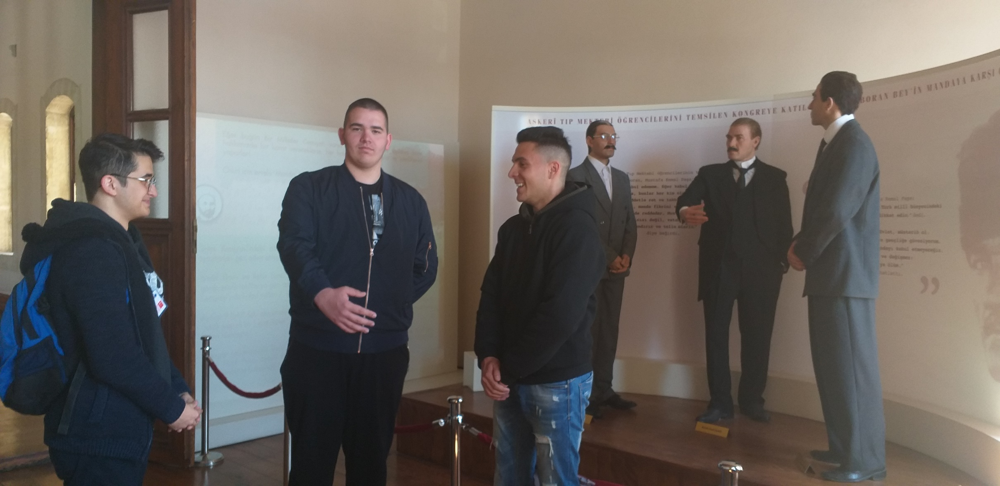
ATATÜRK CONGRESS AND ETHNOGRAPHY MUSEUM

Slide 7
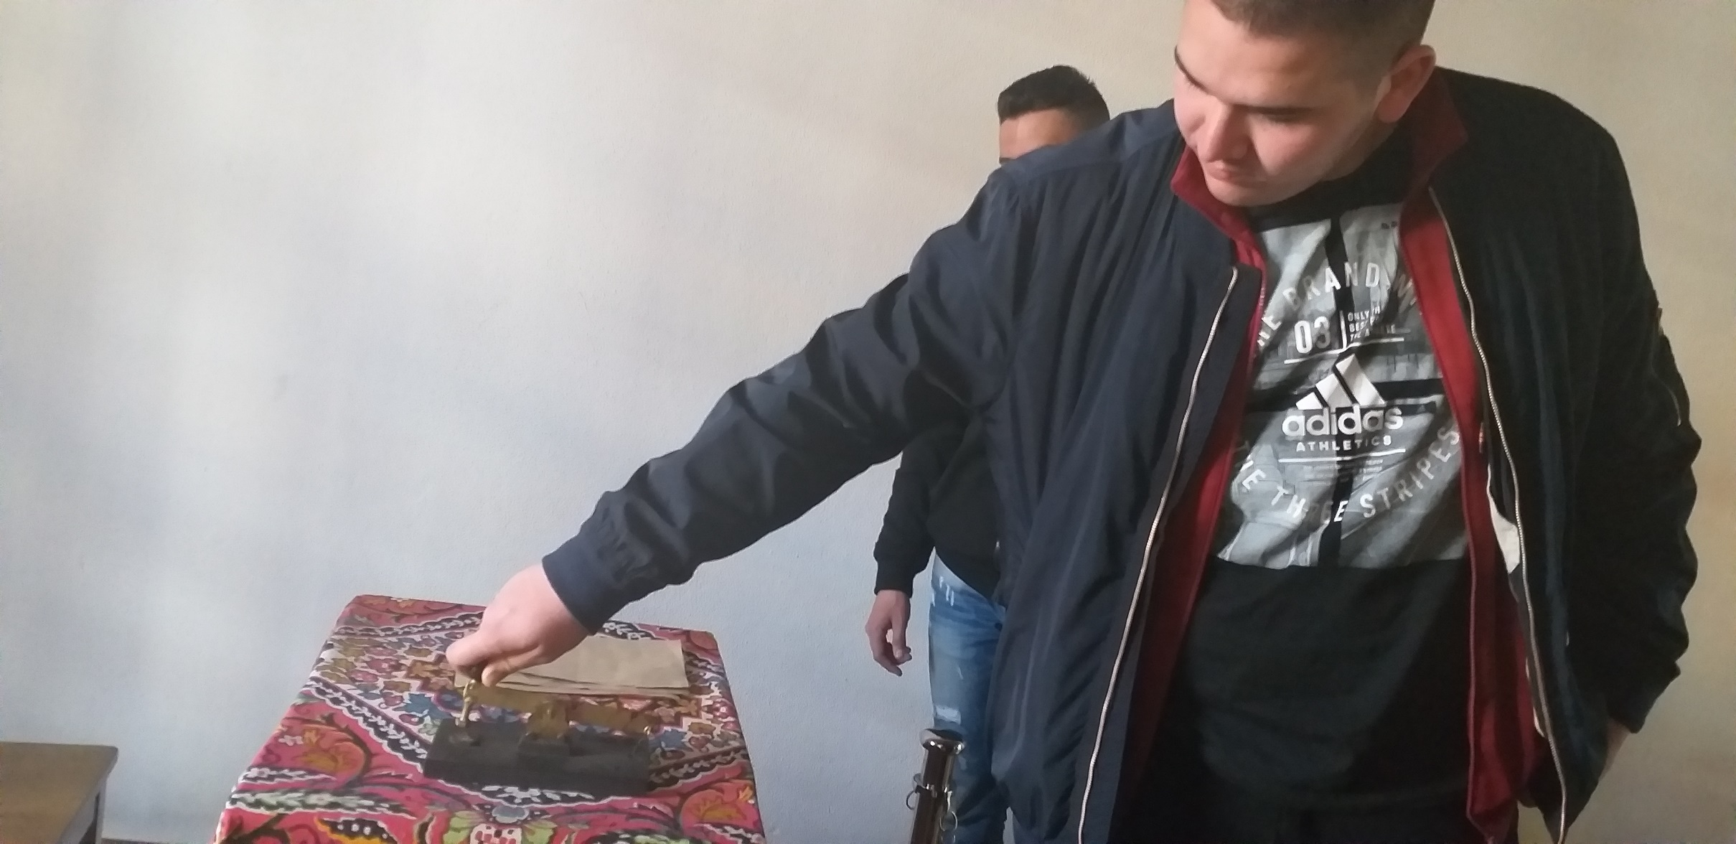
ATATÜRK CONGRESS AND ETHNOGRAPHY MUSEUM

Slide 8
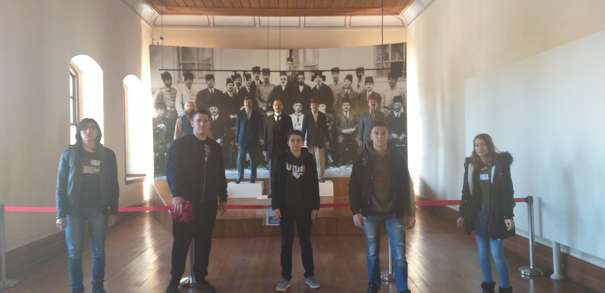
ATATÜRK CONGRESS AND ETHNOGRAPHY MUSEUM

Slide 9
REPUBLIC SQUARE

Slide 10
BURUCIYE MADRASAH

Slide 11
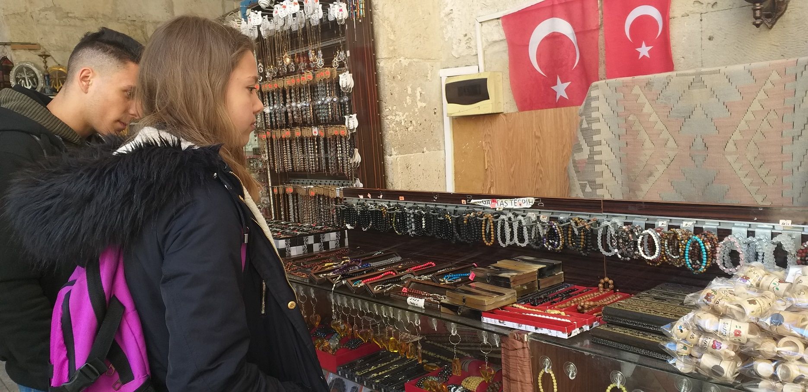
SIFAIYE MADRASAH

Slide 12
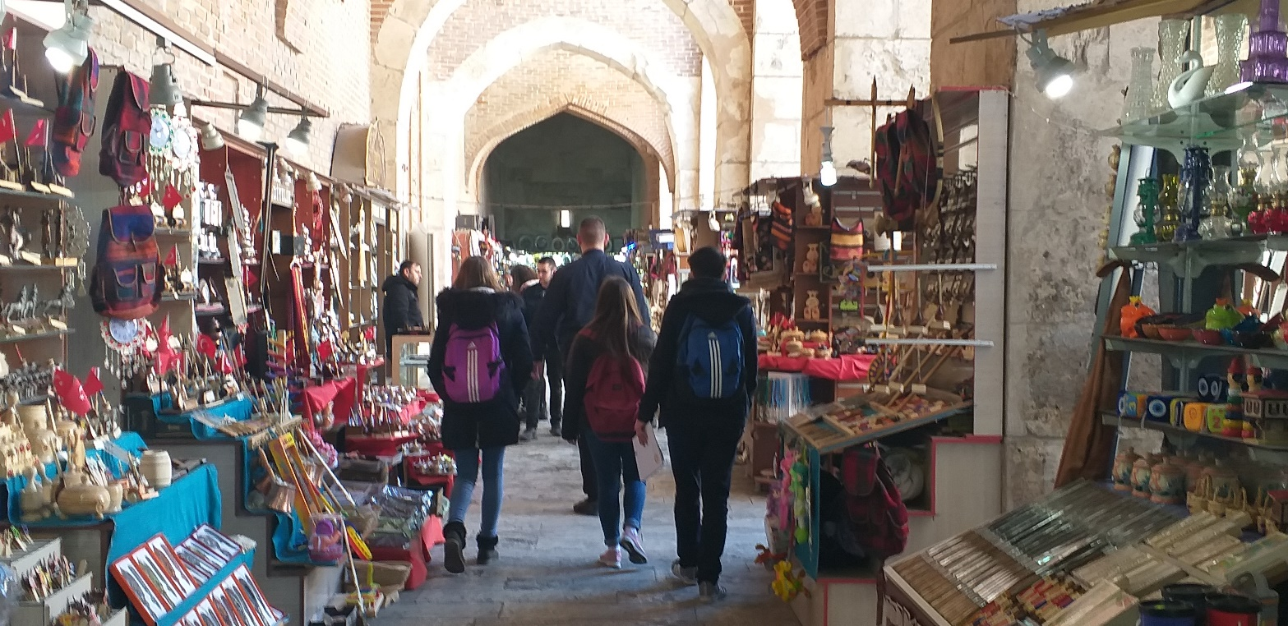
SIFAIYE MADRASAH

Slide 13
ABDI AGA MANSION

Slide 14
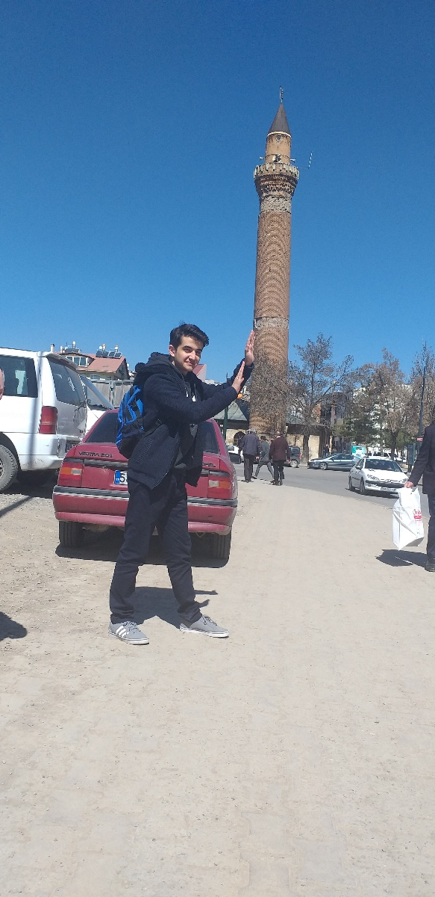
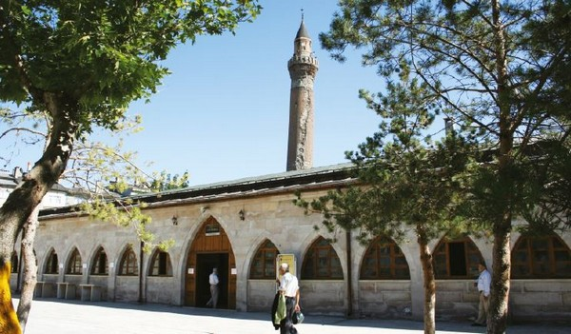
ULU CAMİİ ULU MOSQUE

Slide 15
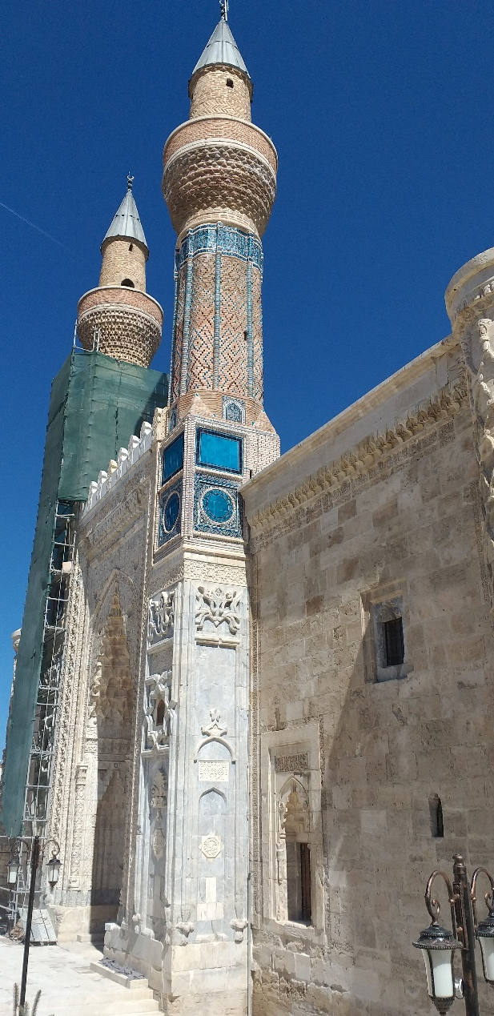
GOK MADRASAH

Slide 16
TAŞ HAN STONE INN.

