Slide 1
EXPLORE SİVAS
Tayfun Karapınar
Şafak Kılavuz
Christos Tragakis
Gabrijela Brkıc
Ebrar Sağırlar
Tobi Dorina

Slide 2
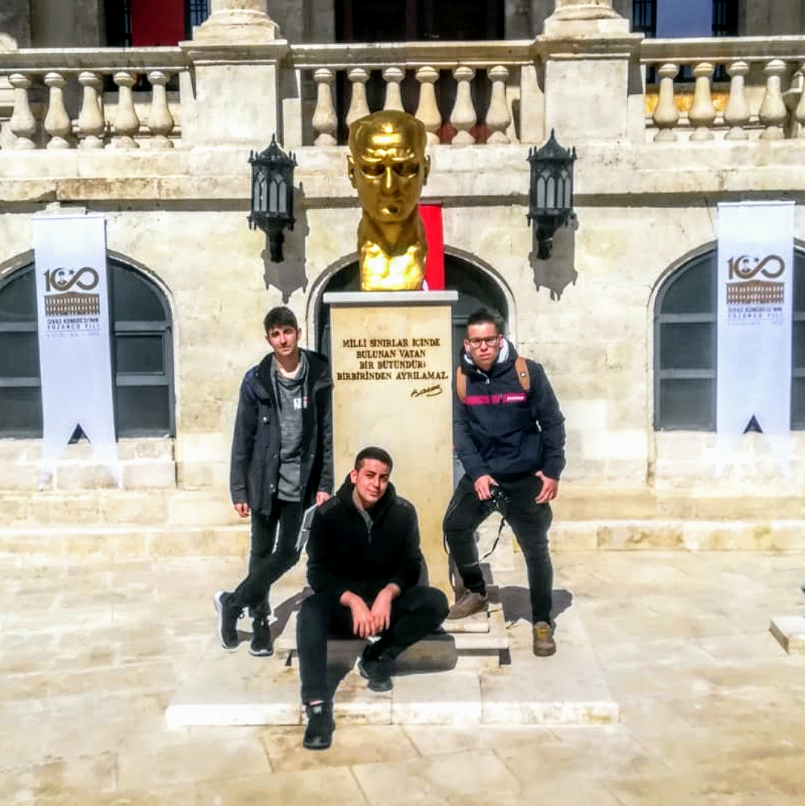
Atatürk Congress and Etnography Museum
The building, which was used by Mustafa Kemal Atatürk in 1919 as the önemli National Fight Headquarters Mustafa, has a very important and exceptional place in our history.

Slide 3
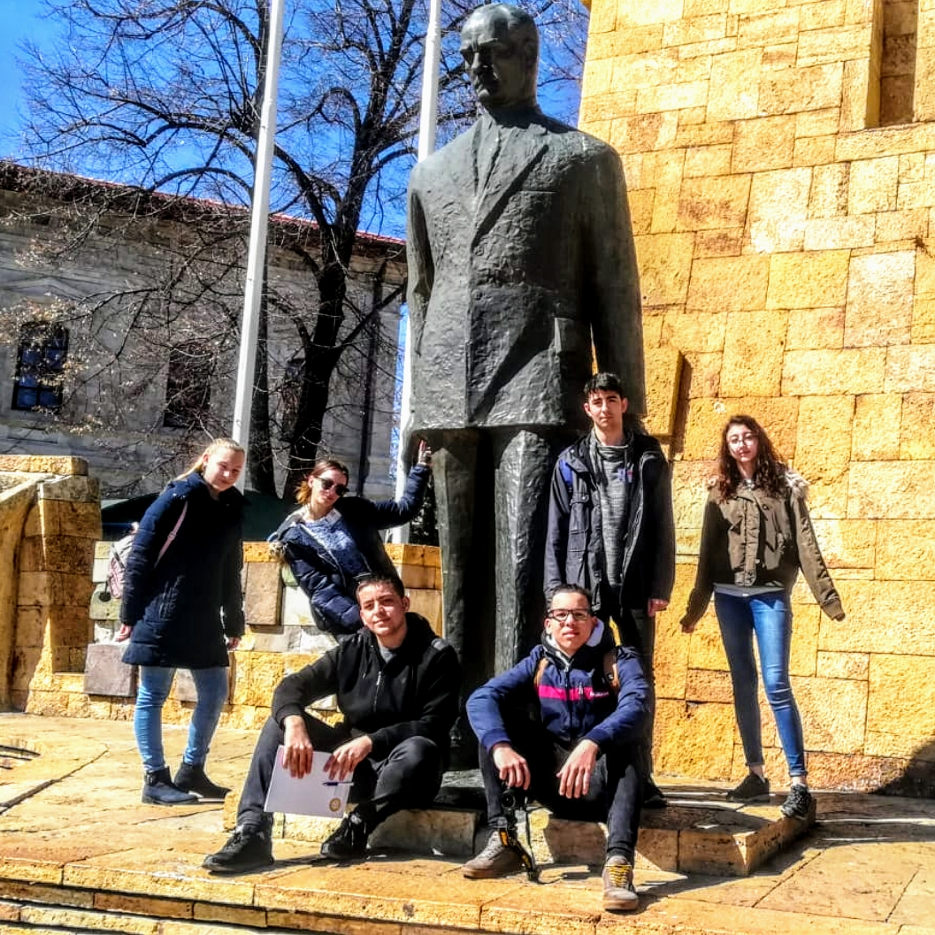
Atatürk’s Statue in Rebuplıc Square
Atatürk is the founder and first president of the republic of Turkey.

Slide 4
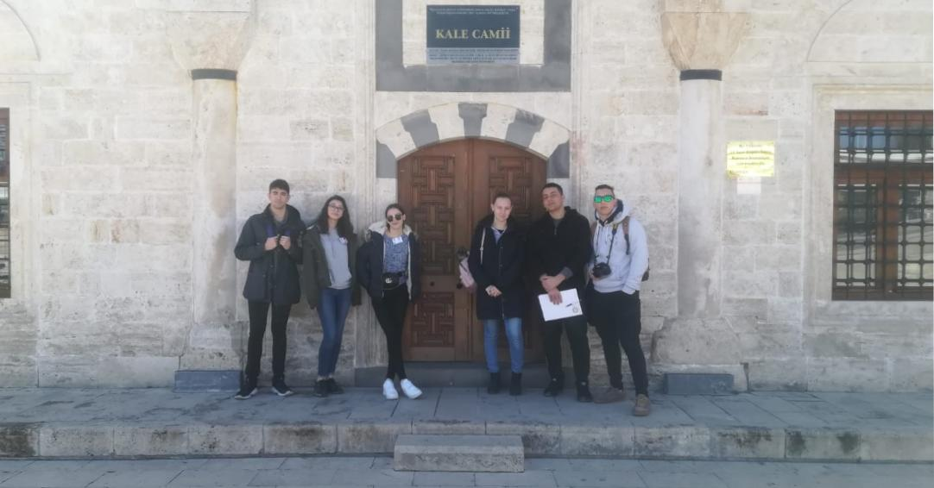
Kale Mosque
3. Murad's vizier was built in 1580 by Sivas Governor Ali Beyoğlu Mahmud Pasha.

Slide 5
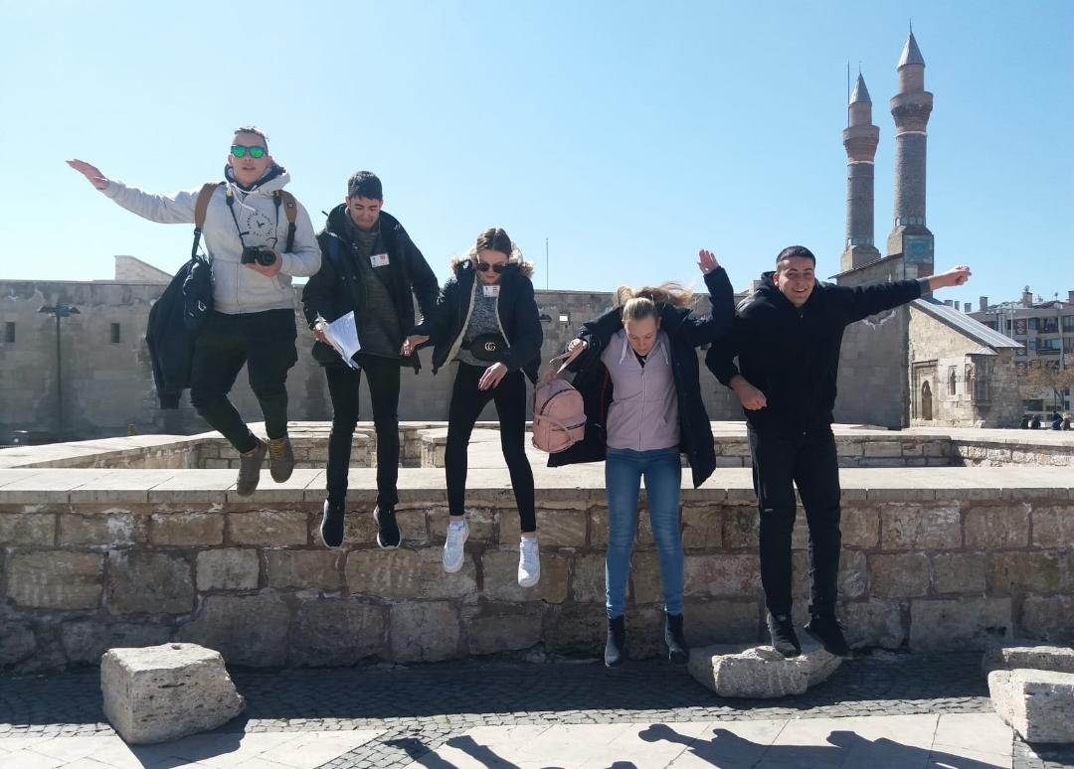
Sivas Republıc City Square
It is an old town square with many mosques and madrasah.

Slide 6
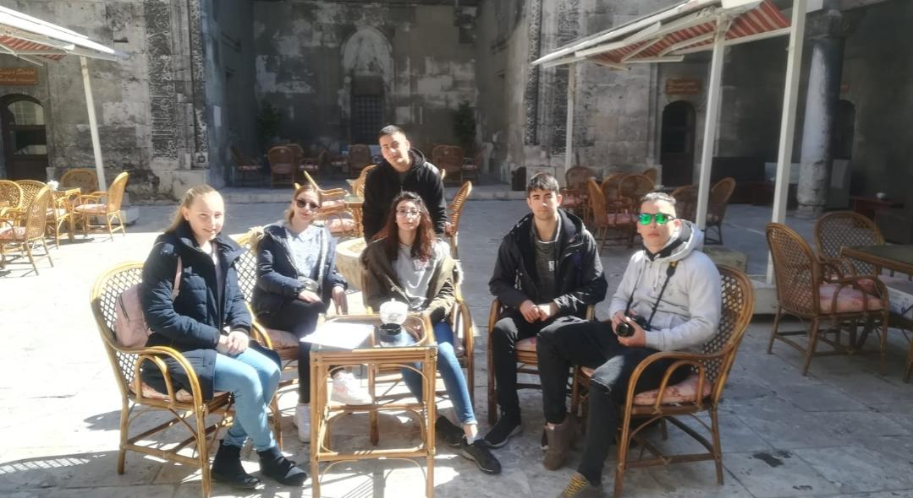
Buruciye Madrasah
Buruciye Madrasah is one of the most famous structures of Sivas and Anatolia with its magnificent crown gate.

Slide 7
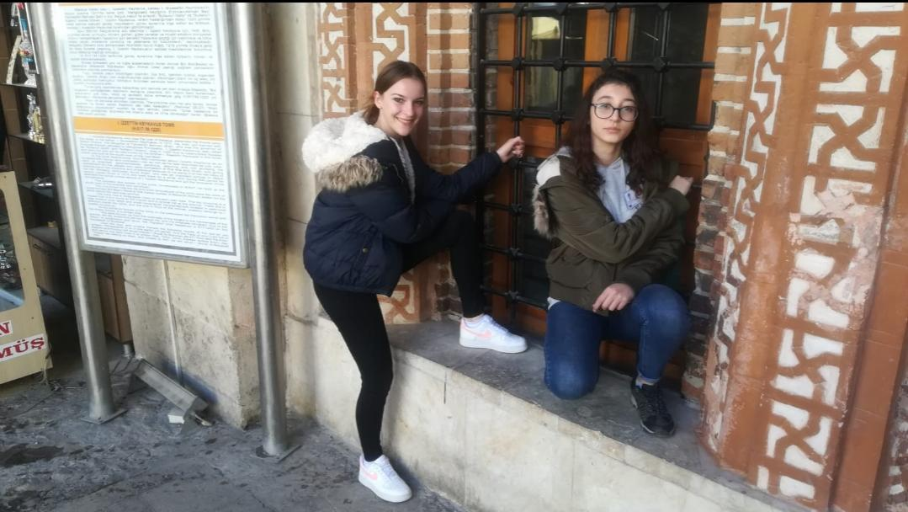
Şifaiye Madrasah
This structure is one of the most important madrasas in which Seljuk period patients are treated and at the same time, medicine is collected.

Slide 8
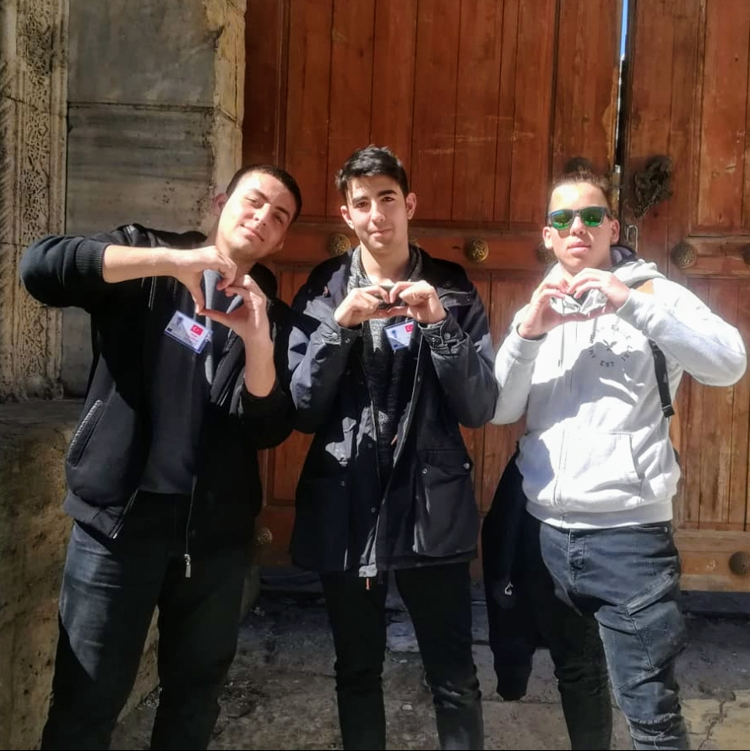
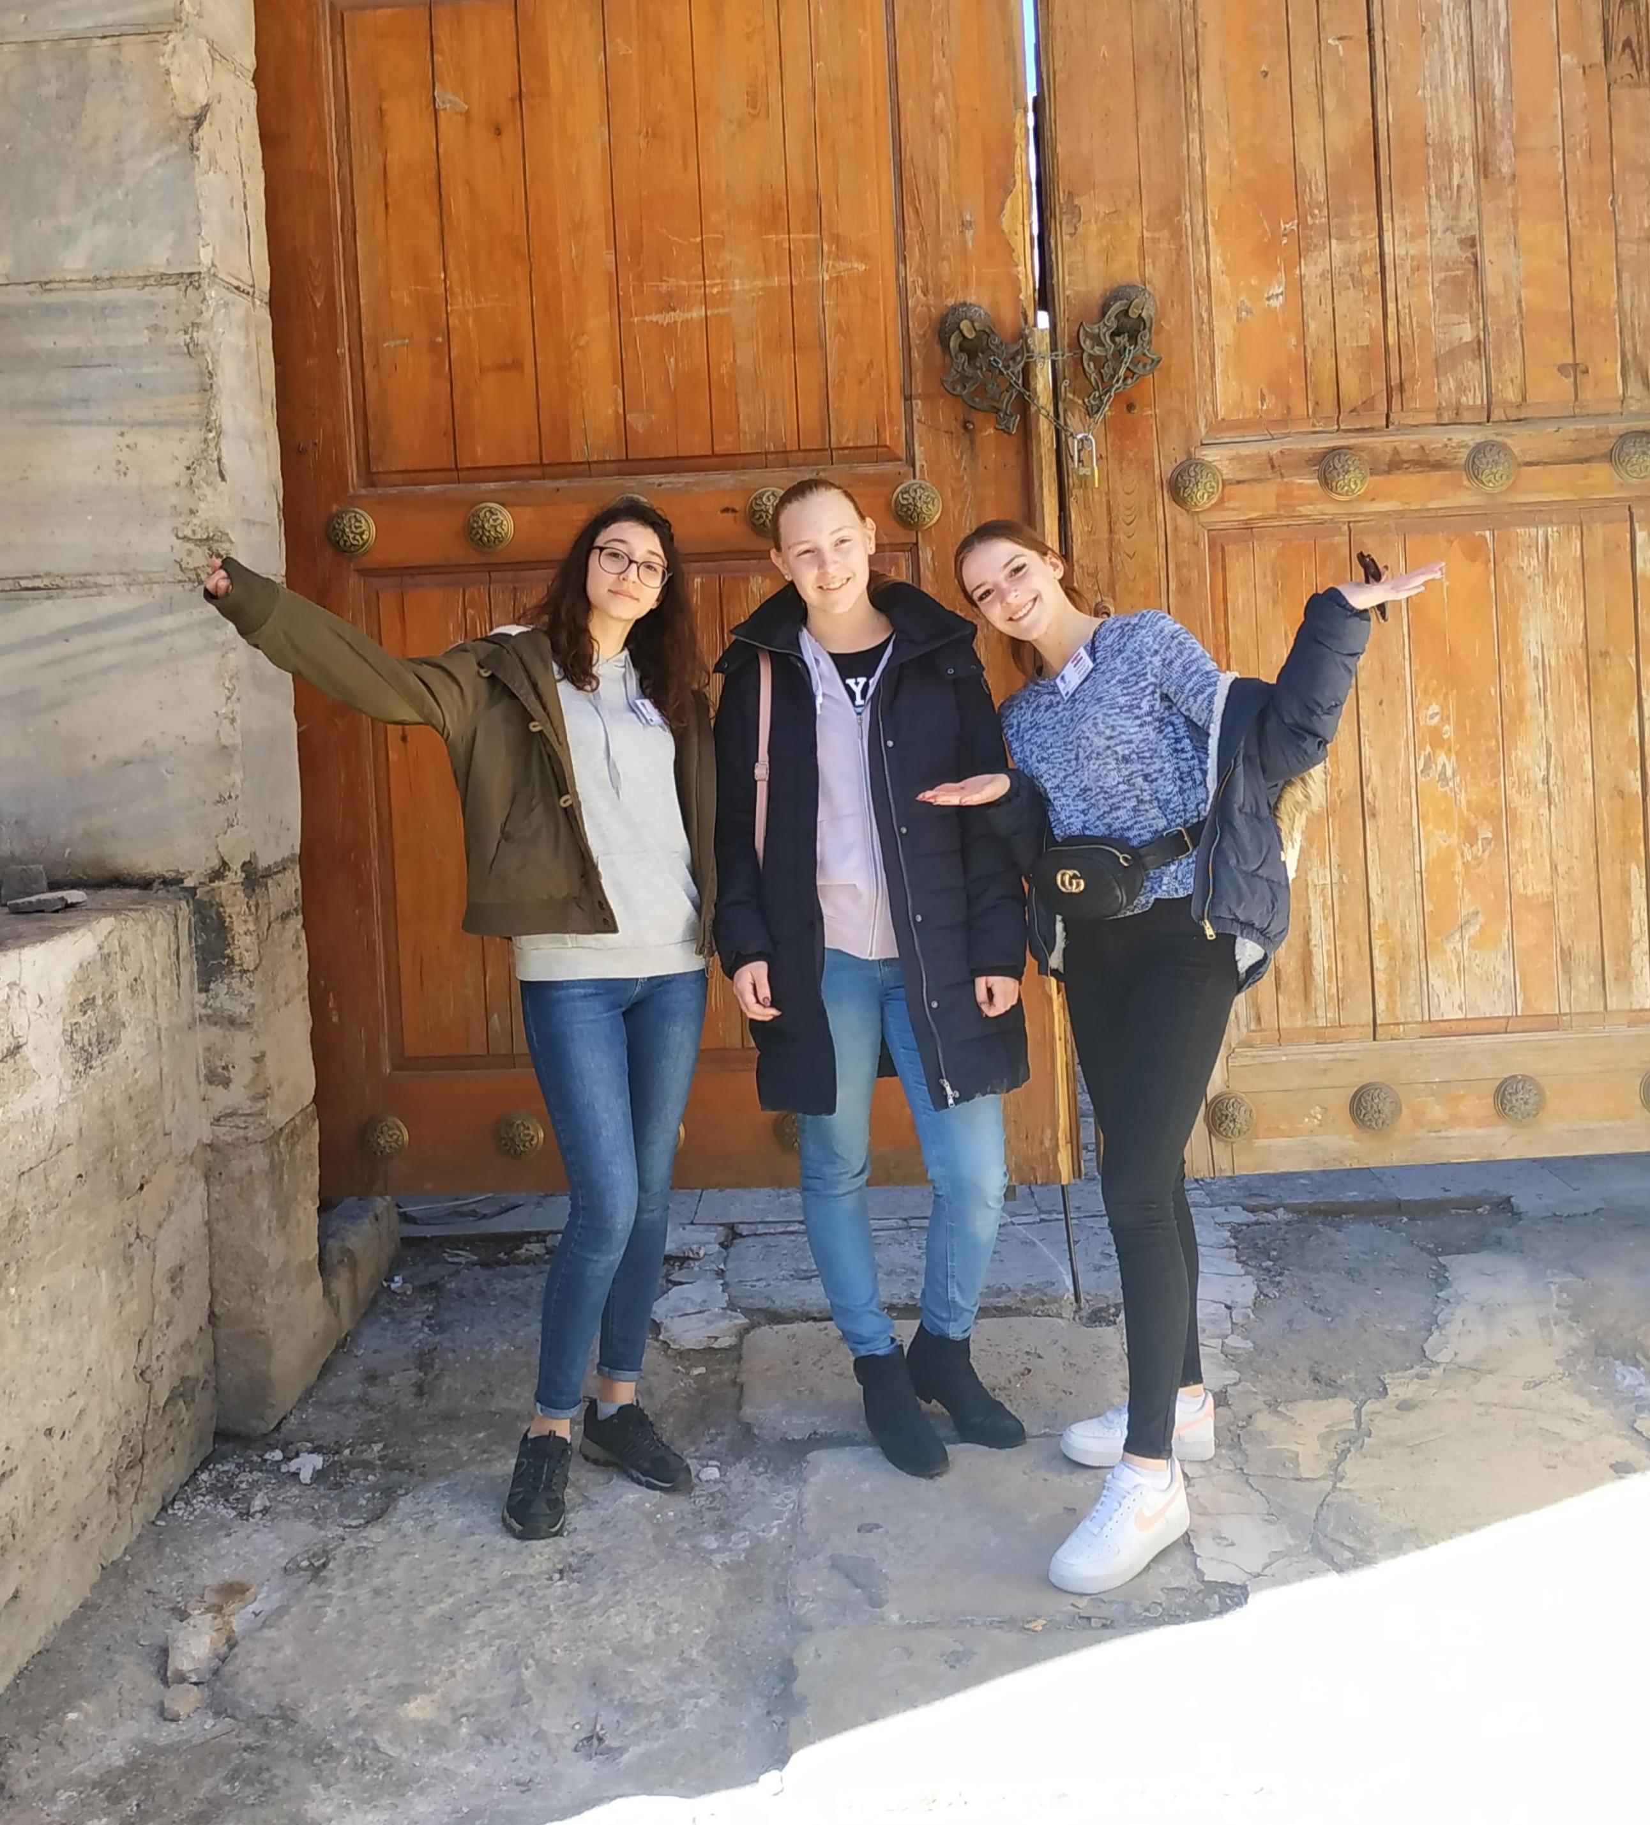
The Double Minaret Madrasah
According to the inscription on the door of the crown, it was built in 1271 by the Grand Vizier Shamseddin Cüveyni.

Slide 9
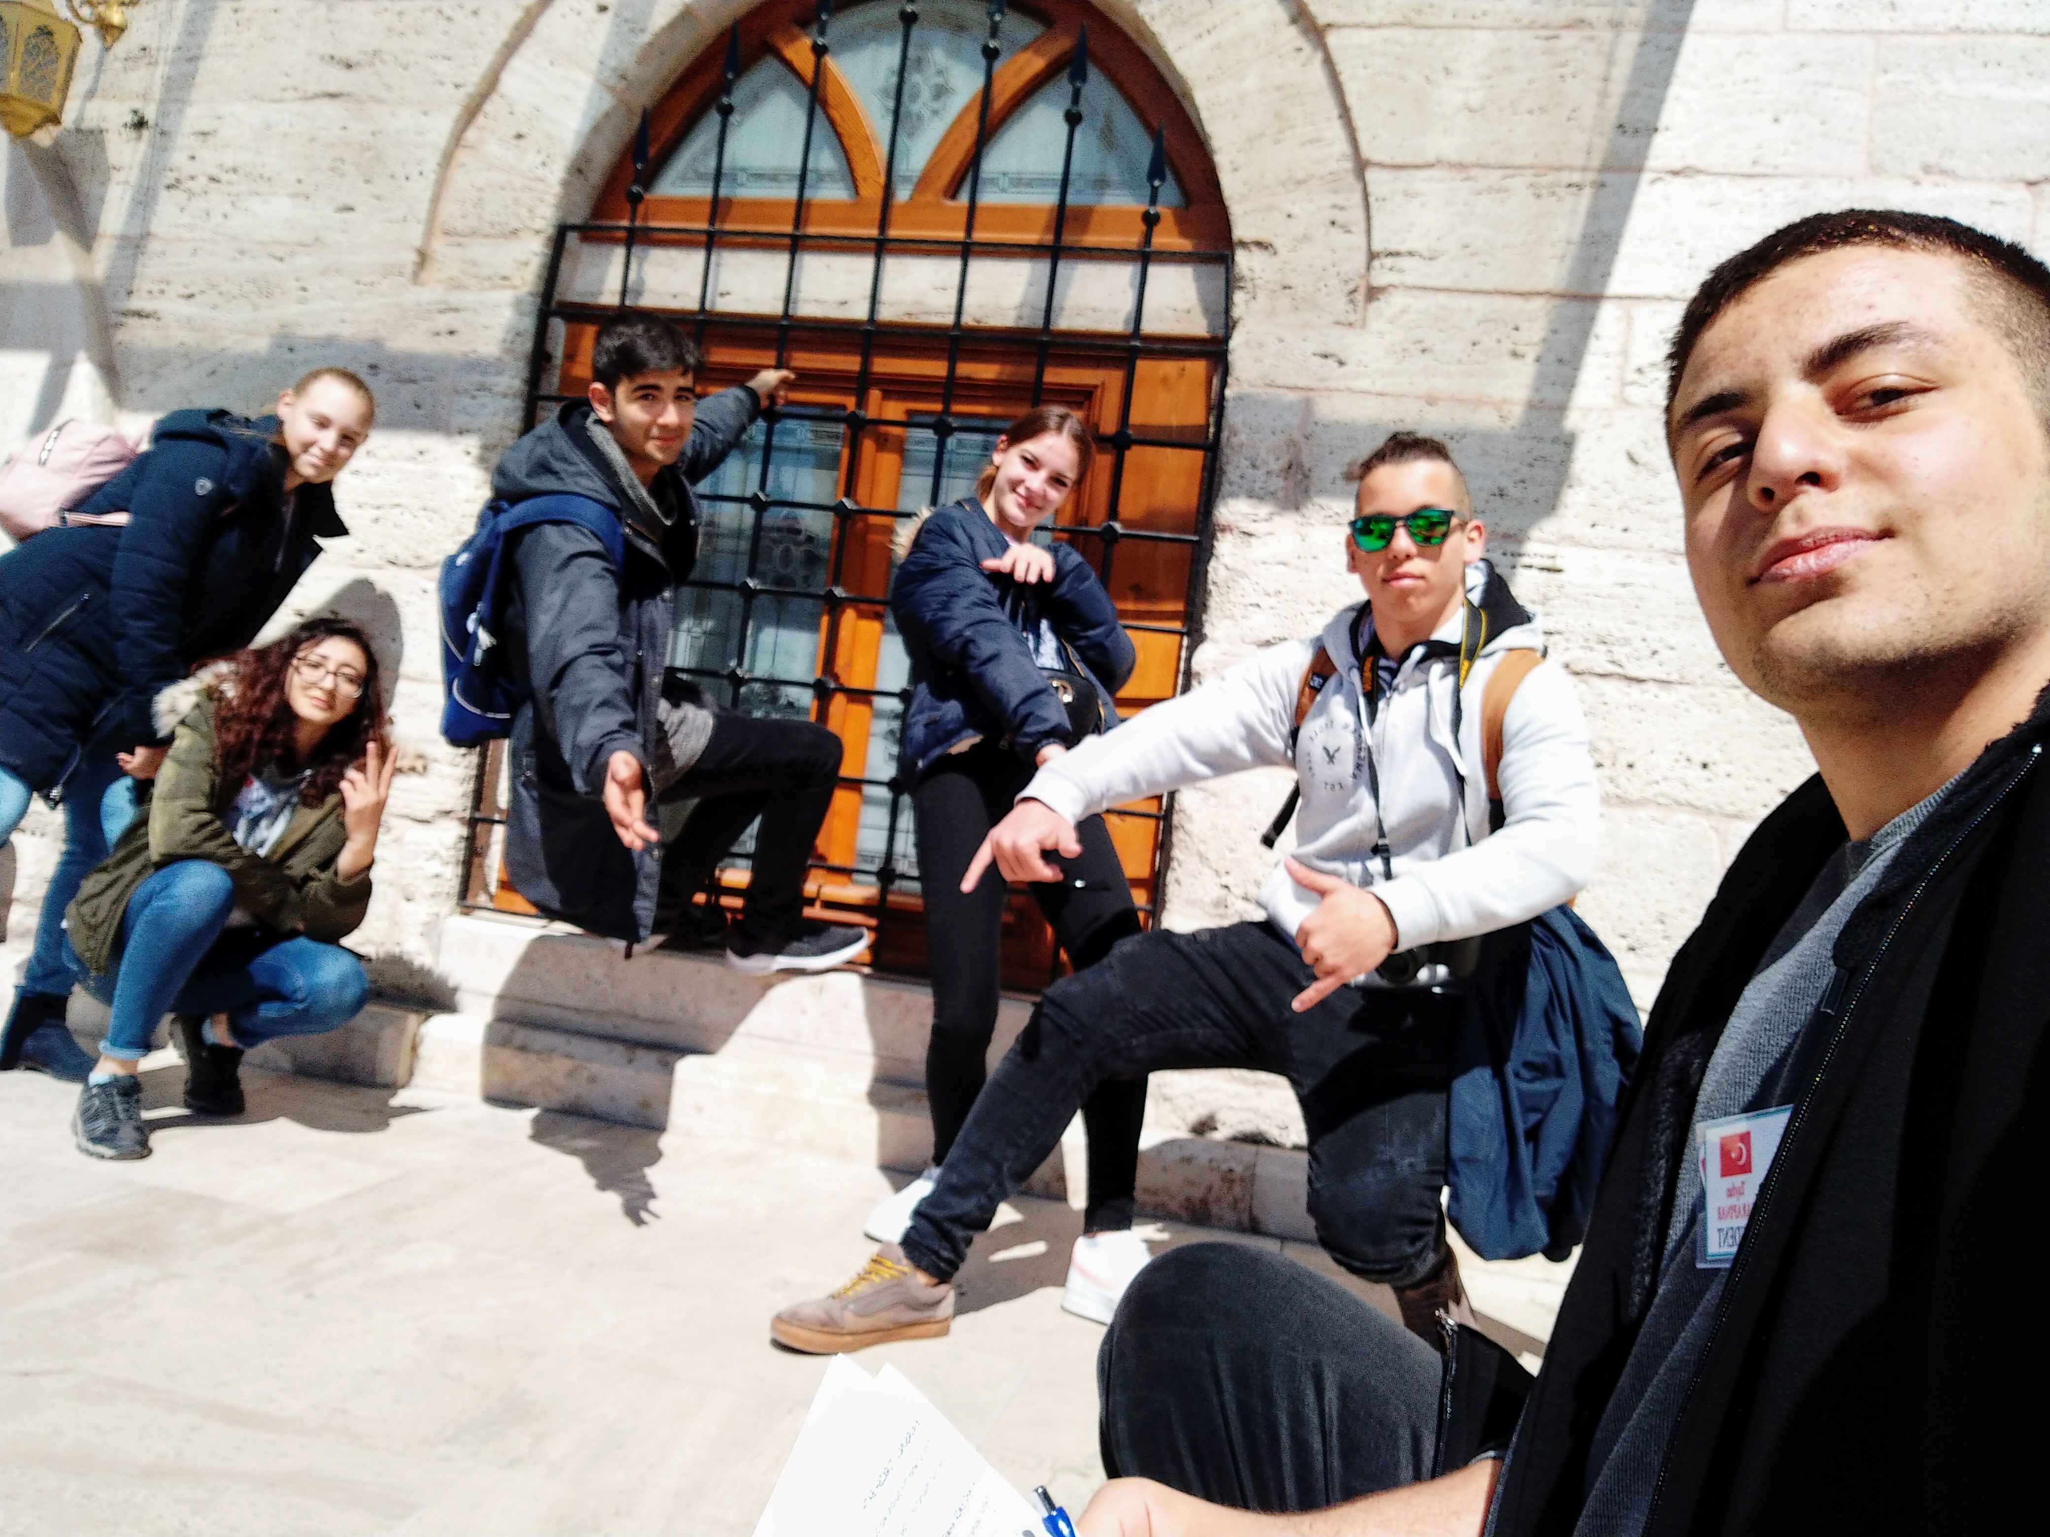
Kurşunlu Turkısh Bath
The building, called Kurşunlu Hamam, was built as a double bath in 1576 by Behram Pasha as it was built by pouring lead to iron connections on the body walls.

Slide 10
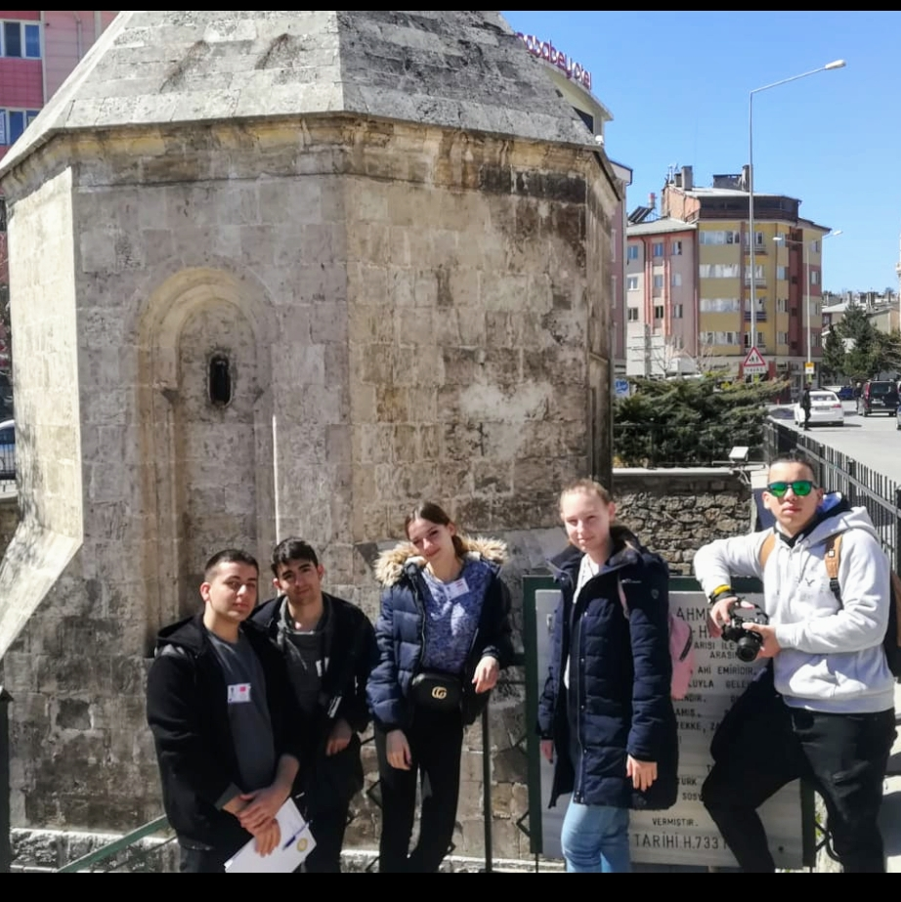
Ahi Emir Ahmet‘s Tomb
In Sivas, it is a dollhouse where families bring their sick children and wish them the opportunity for healing.

Slide 11
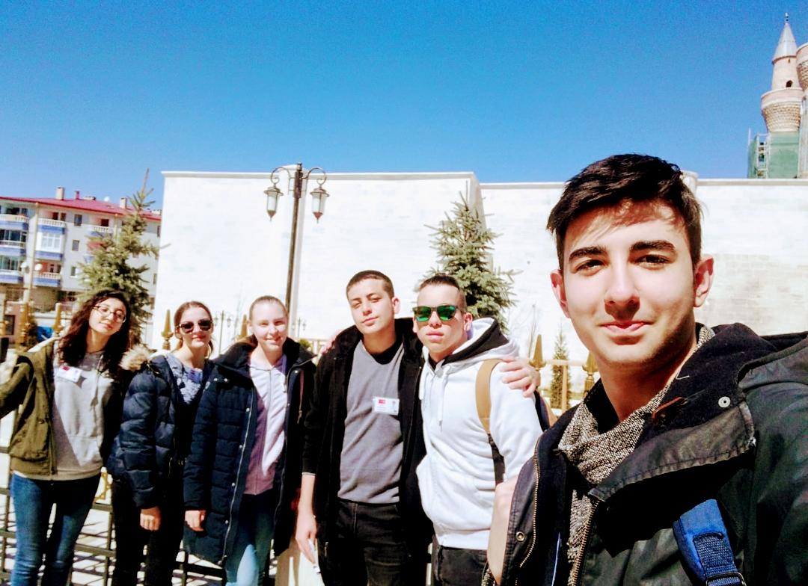
Gök Madrasah
The main name is Sahibiye Madrasa. It is one of the important works of Anatolian Seljuk State.

Slide 12
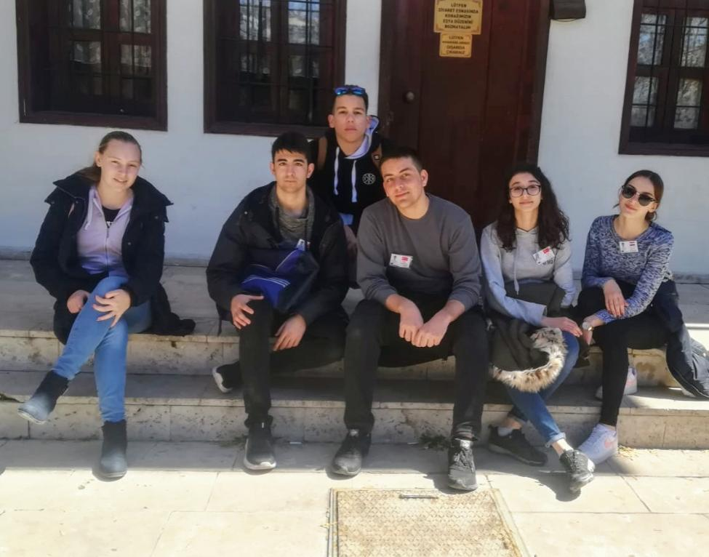
Abdi Agha Mansion
The historic mansion consists of 12 rooms and consists of 2 floors. There are two guest rooms, two large halls, 2 living rooms and one bedroom on the upper floor, while the lower floor has two living rooms, a large kitchen, a cellar and a shelter.

Slide 13
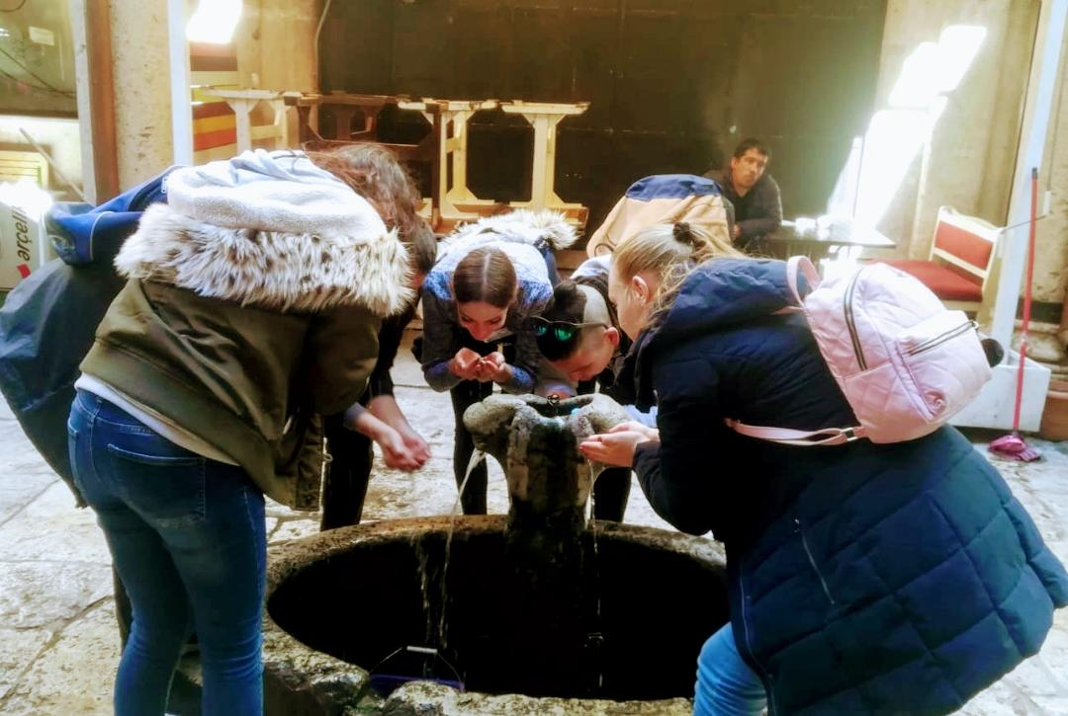
Stone Inn
It is made of cut stone in the second half of 19th century and it has two floors with open courtyard. The rectangular structure has three entrances with iron wings and round arches on the east, south and north sides.

Slide 14
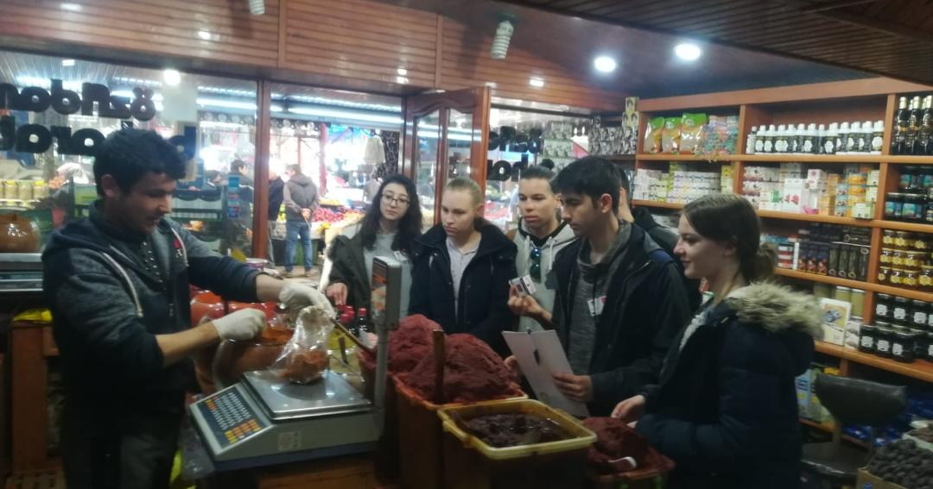
Fruıt and Vegetable Market
Where various spices and herbs are sold.

