Slide 1
OUR TEAM
Okan Aslantas
Regina Morvai
Dionysia Vilara
Julie Ralli
MARIJA FERIC

Slide 3
THE CHURCH-agios dimitrios

Slide 4
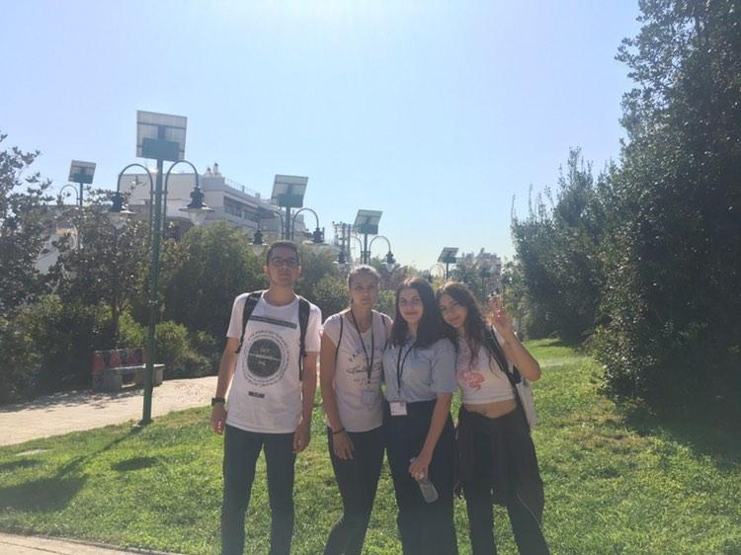
SQUARE HRW

Slide 5
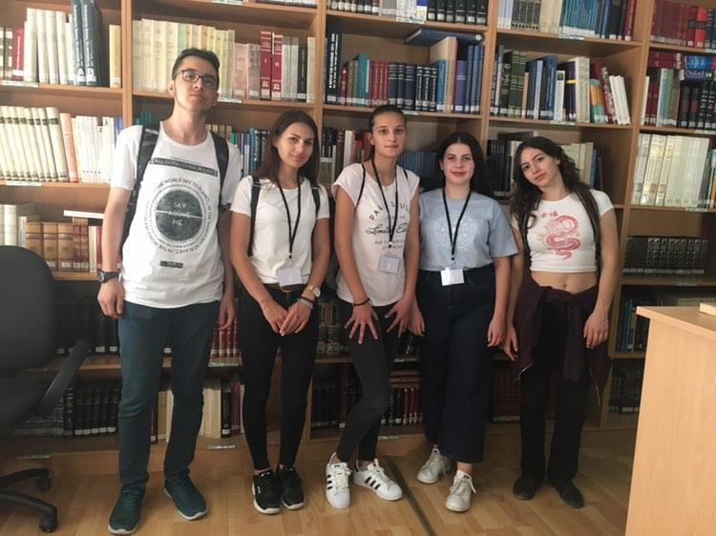
THE LIBRARY

Slide 6
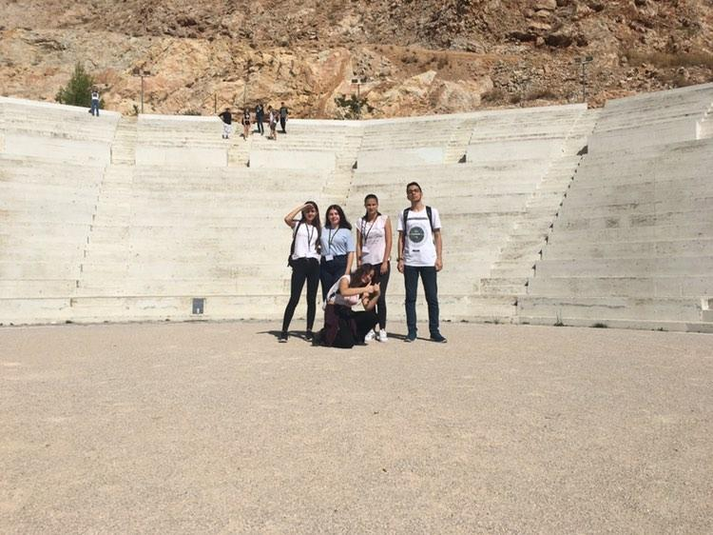
THE PETRA THEATER

Slide 7
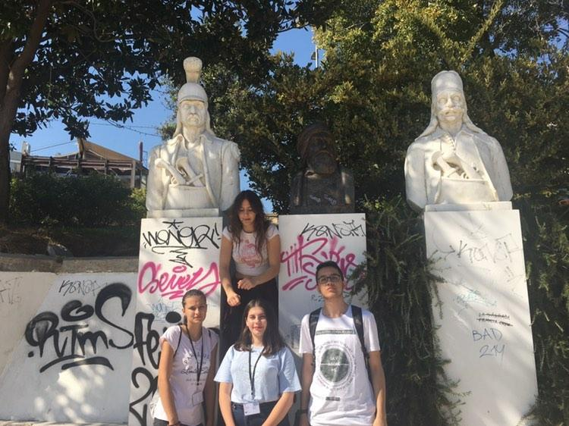
HRWWN SQUARE

Slide 8
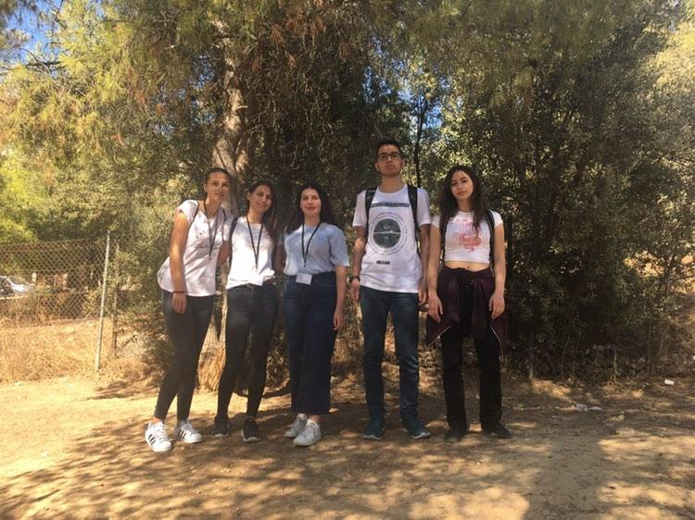
THE PARK

Slide 9
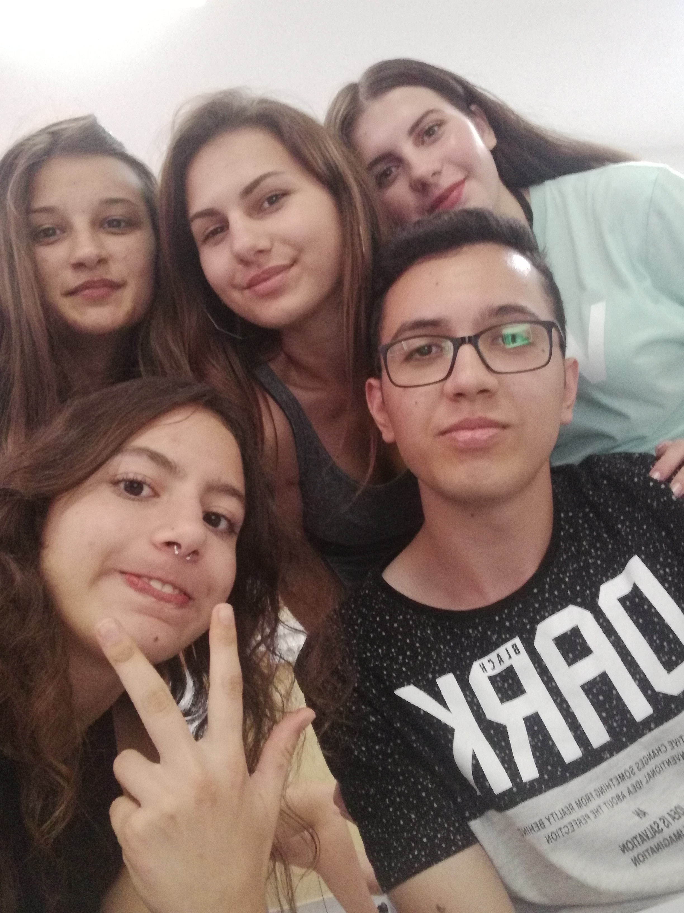
BONUS PICTURE AT THE COMPUTER LAB.<3

