Slide 1
Exploring Petroupolis
With Valentina, Melike, Dani, Konstantina and Alex

Slide 2
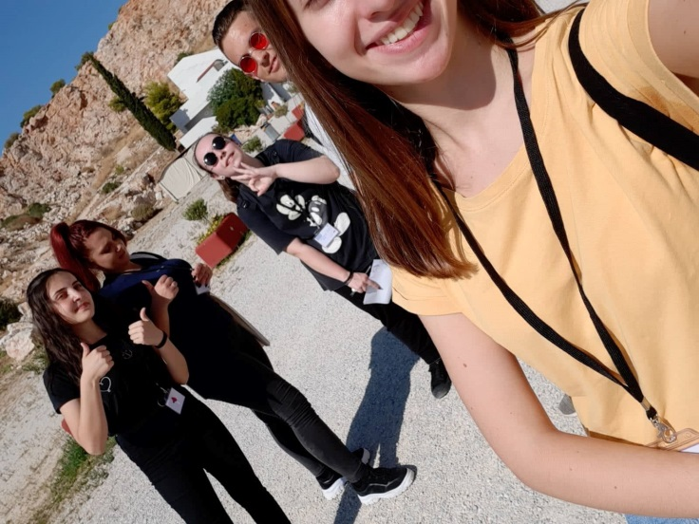
Theatro Petras

Slide 3
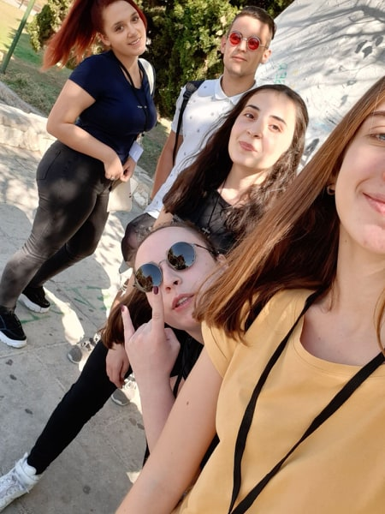
Saint Demetrios

Slide 4
Church of saint demetrios

Slide 5
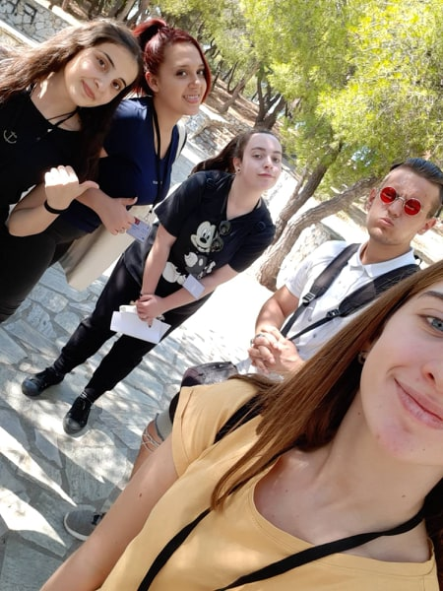
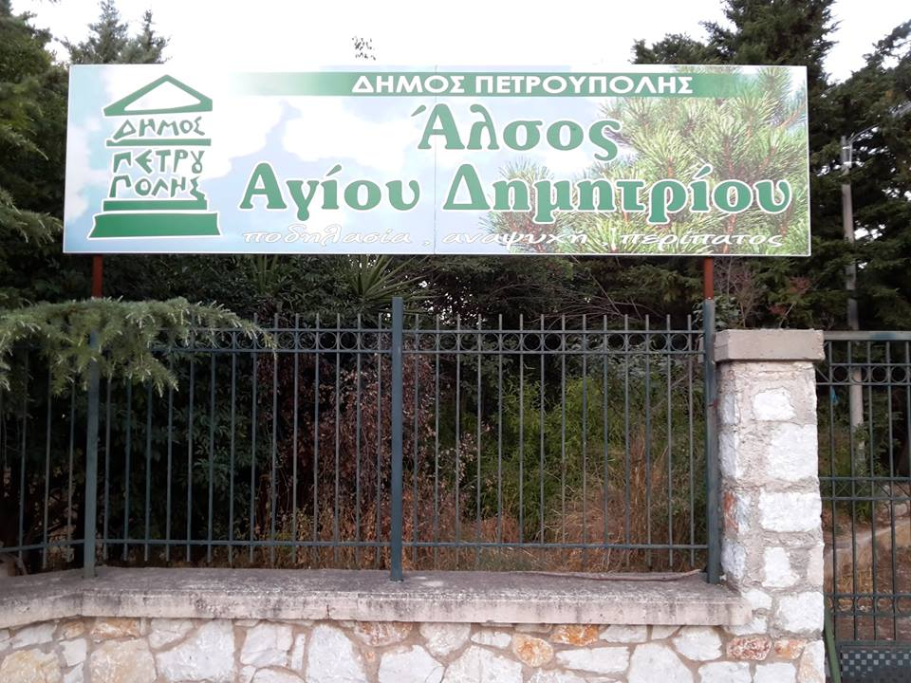
Park of Saint Demetrios

Slide 6
Drama School of Petroupolis
Οὔ τοι συνέχθειν, ἀλλὰ συμφιλεῖν ἔφυν
They think they are actors! HAHAHAHA

Slide 7
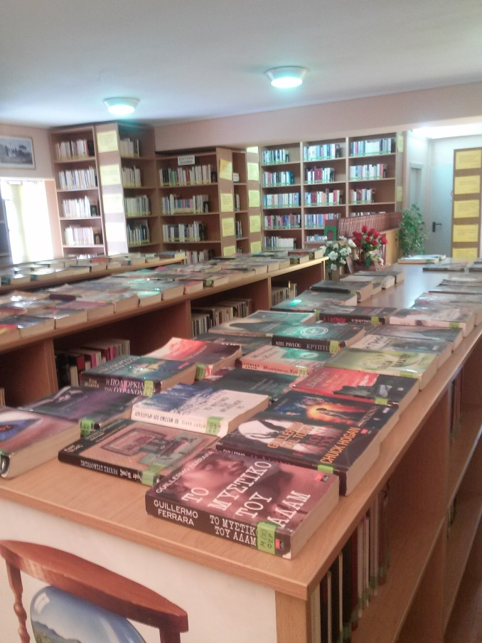
Petroupolis’ Library

Slide 8
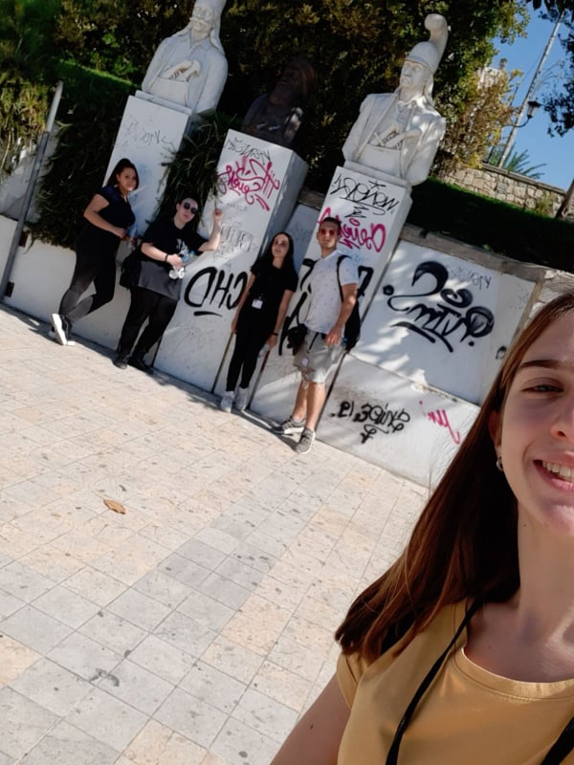
Heroes’/Round Square

Slide 9
Working out at Saint Demetrios
FML
I am soo STRONG!

Slide 10
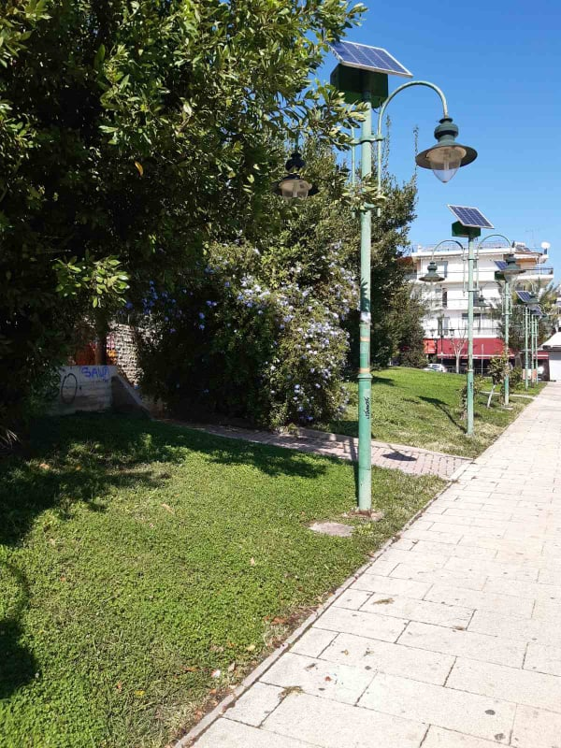
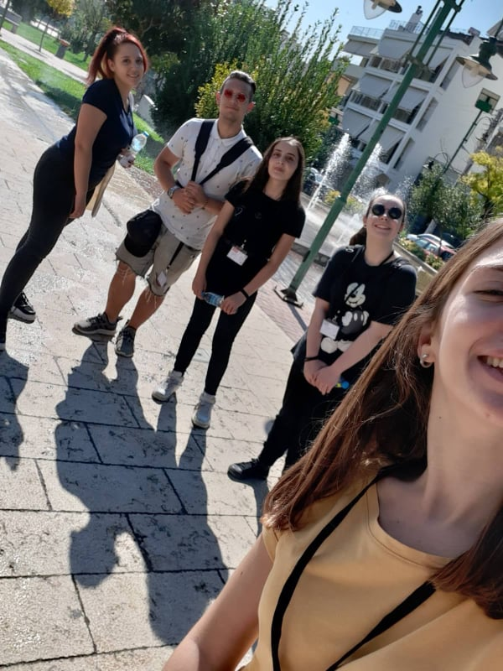
IRO SQUARE

Slide 11
thE FIFTH SENIOR HIGH SCHOOL OF PETROUPOLIS

Slide 12
THANK YOU FOR YOUR ATTENTION (Team number 2, aka “dream team”)

