Slide 1
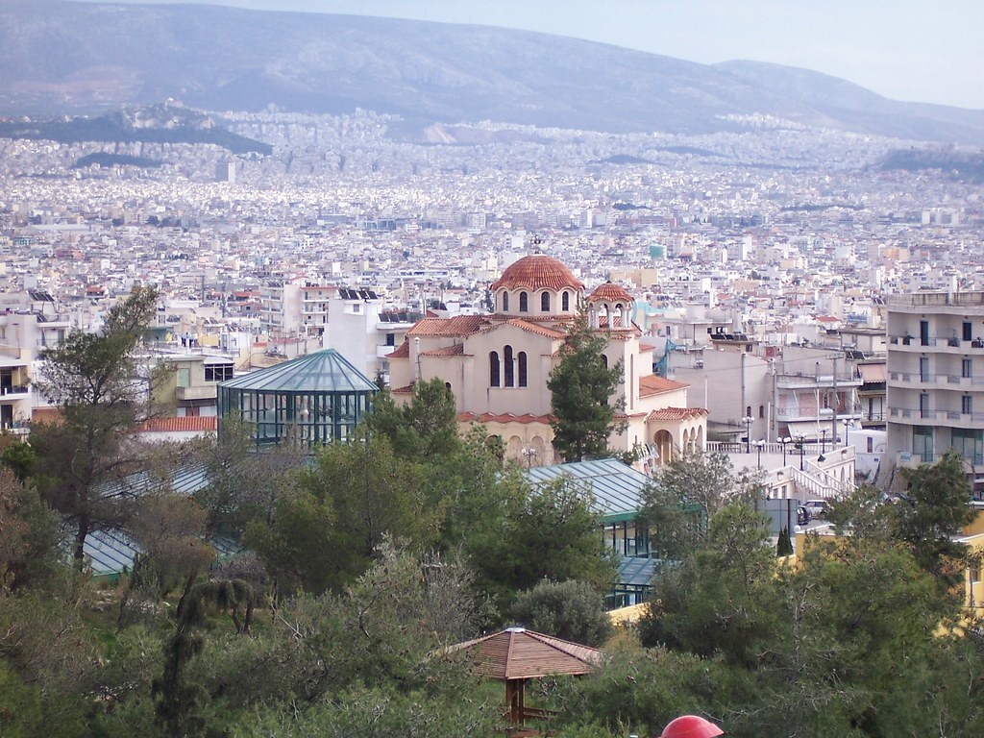
EXPLORING PETROUPOLIS team 5
Nefeli Milioni
Sapi Vivien
Nick Giannikakis
Karlo Rasic
Zeljko Cosic

Slide 2
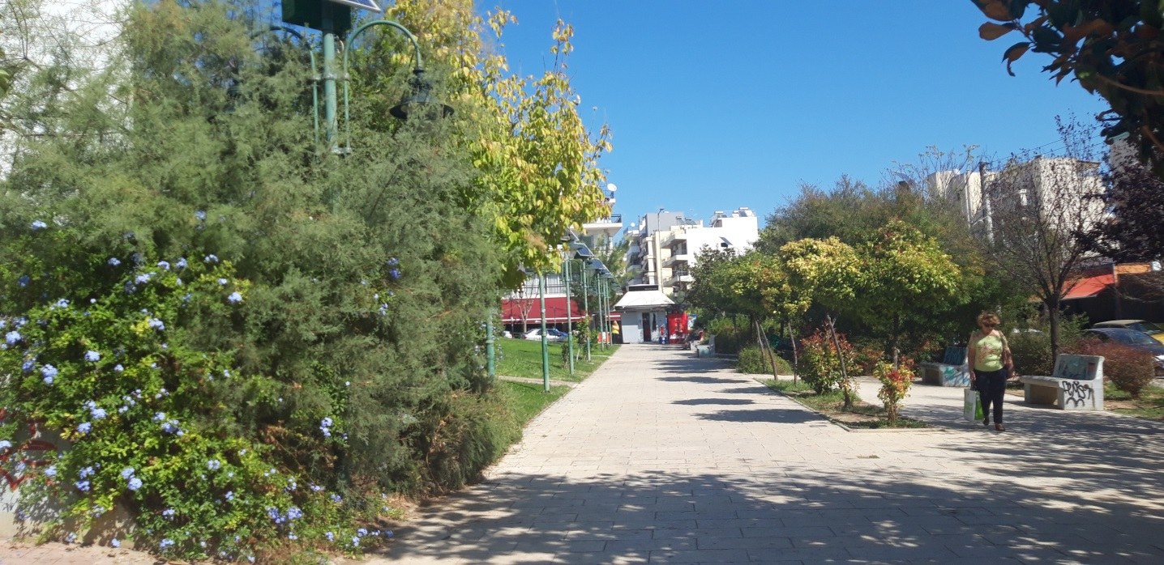
ΗΡΩ SQUARE

Slide 3
Our first stop

Slide 4
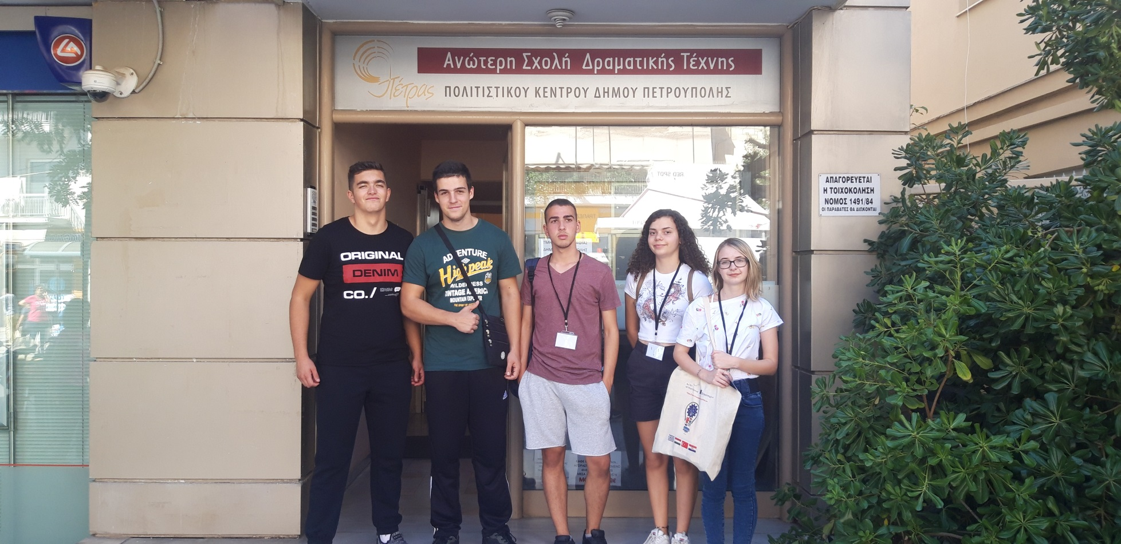
Petroupolis Drama school

Slide 5
At the view of Terra Petra

Slide 6
Petra Theatre

Slide 7
(starting to get tired)

Slide 8
TOO. MUCH. SUN.

Slide 9
But we took nice pictures

Slide 10
Library and cultural center of Petroupolis

Slide 11
Nick is getting tired and angry.

Slide 12
Inside the library

Slide 13
The “Heroes” square

Slide 14
We found the heroes. They were not very lively.

Slide 15
At the Saint Dimitrios church

Slide 16
At the Botanical Garden of Petroupolis

Slide 17
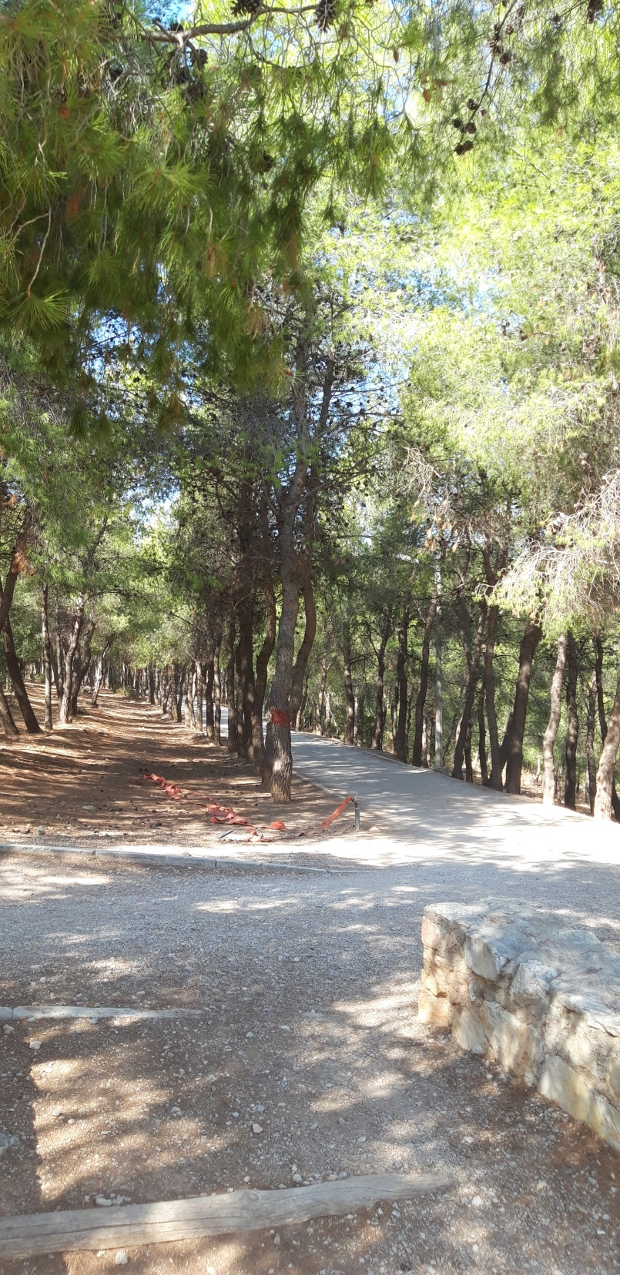
In the city’s park

Slide 18
Our last stop

Slide 19
WE.NEED.WATER.
THE END

