Slide 1
https://szolgaltat.com/wp-content/uploads/2018/11/reklam-hirdetes-marketing.jpg

Slide 2
During the 1st meeting...
We have established our enterprise.
We have started to operate our webpage.
An enterprise can be successful if it sells its products.
Our enterprise will be successful, if we use the tests and study materials effectively during lessons.
Question: How will they know that there is such a website?
Answer: IT MUST BE ADVERTISED!

Slide 3
What is an advertisement?
Influential communication about products and services.
Commercial advertising is designed to increase sales.
But there are also political and social advertisements. E.g. EU parliamentary elections, fight against global warming.
Advertisements can affect different senses:
There are auditory (what we hear, e.g. radio),
visual (what we see, e.g. posters, newspapers),
audiovisual (what we see and hear, e.g. TV), or
other sensory advertising media (e.g. in-store tasting, olfactory perfumes).
You should always choose the method that best suits your target audience!

Slide 4
What is not allowed in an advertisement?
violate the privacy rights of others,
incitement to violence, fear,
it is forbidden to state a false fact about a competitor's product,
it is forbidden to damage the reputation of the company’s name or goods of another enterprise,
advertising is not permitted for goods that cannot be produced(e.g. drugs),
advertising of tobacco products is prohibited(in Hungary),
it is forbidden to affix the packaging or marking to the product from which the competitor's product is usually identified.

Slide 5
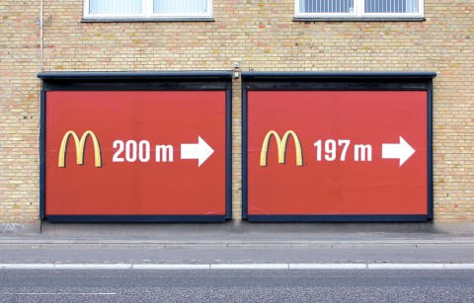
The task:
Create an advertisement to promote our website!
http://knowledgebaseltd.eu/

