Slide 1
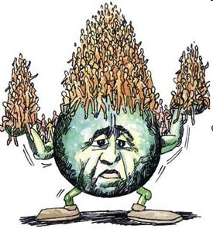
OVERPOPULATION

Slide 2
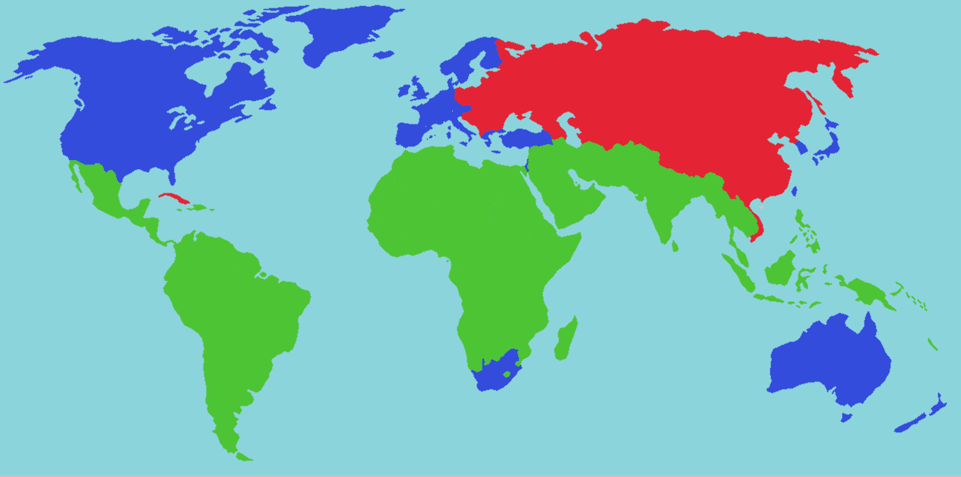
LOCATION
Biggest pressures occur in Third World (green)
aka - Developing World

Slide 3
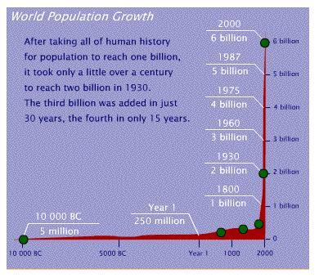

Slide 4
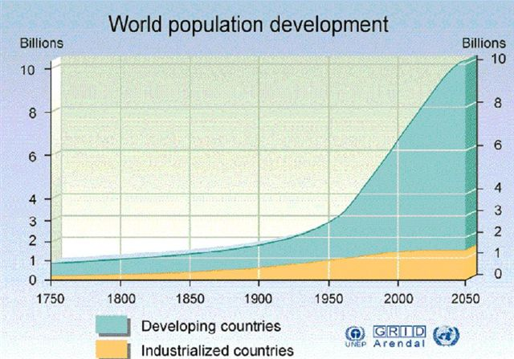

Slide 5
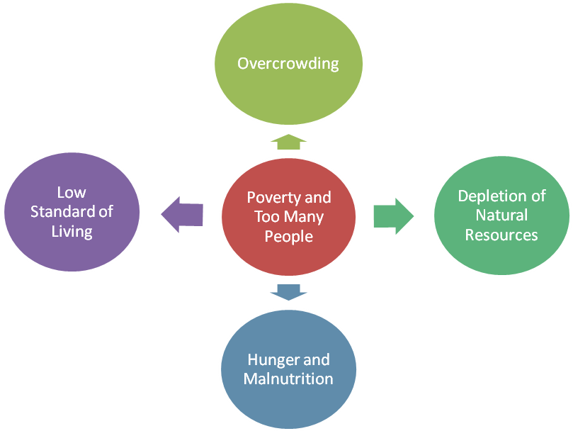
Cycle of Overpopulation

Slide 6
CAUSES

Slide 7
New Inventions in Medicine
The new inventions in medicine have improved treatments. This has resulted in an increase in the life expectancy.
Mortality rate has declined leading to an increase in population and with it, the curse of overpopulation.

Slide 8
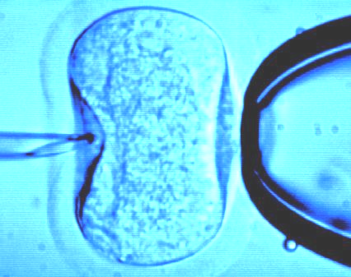
Rise in the Birth Rate
Better nutrition brings an increase in the fertility rates of human beings.
Medicines and treatments can help increase conception. This is certainly a reason to be proud and happy but advances in medicine have also become a cause of overpopulation.

Slide 9
Migration
Immigration is a problem in some parts of the world.
If the rates of emigration from a certain nation do not match the rates of immigration to that country, overpopulation results.

Slide 10
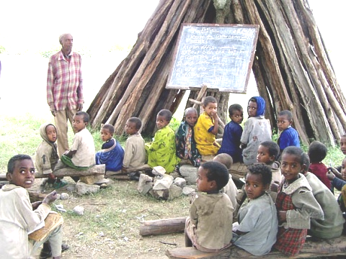
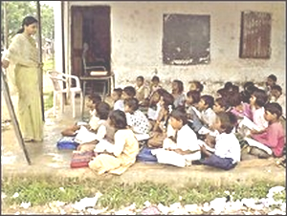
Lack of Education
Illiteracy:Those lacking education fail to understand the need to prevent excessive growth of population.
They are unaware of the ways to control population. Lack of family planning is commonly seen in the illiterate regions of the world.

Slide 11
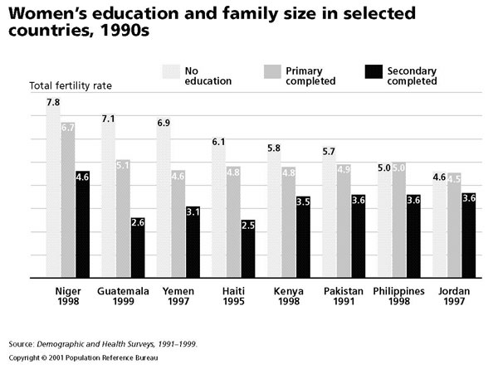
More education generally leads to smaller family size

Slide 12
Overpopulation:
A world problem

Slide 13
EFFECTS

Slide 14
More people = more resources consumed = more global warming

Slide 15
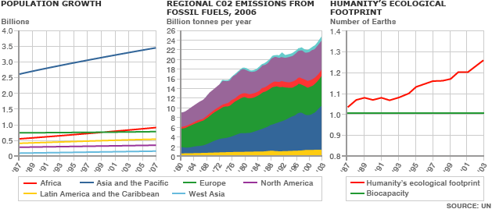

Slide 16
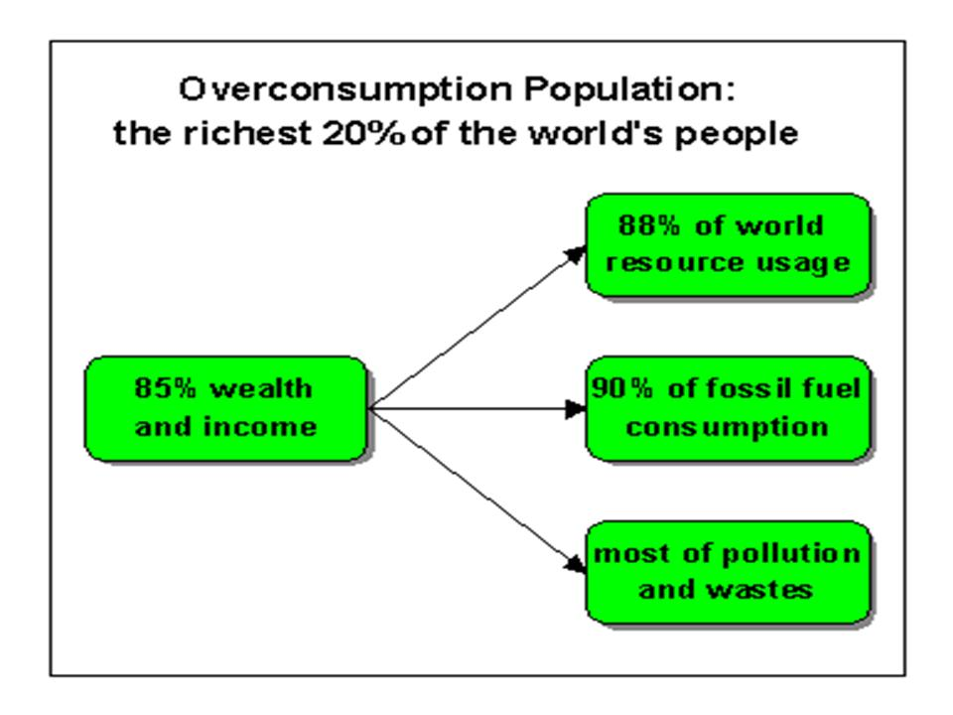

Slide 17
Overcrowded Conditions

Slide 18
CURRENT WORLD POPULATION GROWTH
In 2005, the actual global population growth rate is estimated to be 76 million additional people per year. SOURCE: Earth Policy Institute

Slide 19
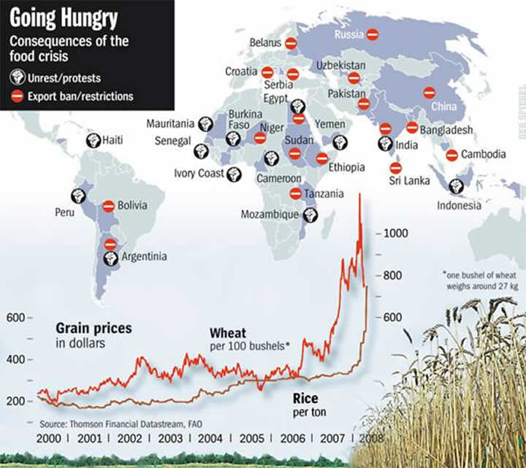

Slide 20
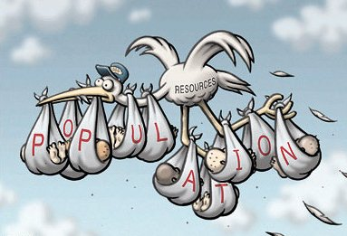

Slide 21
SOLUTIONS
We should:
continue to strive to reduce suffering by combating disease and poverty around the world;
continue to improve resource efficiency and pollution control so that standards of living can rise without negative impact; and
keep human population to numbers that are sustainable.

Slide 22
On the population front, that means:
making sure people around the world have access to family planning services
empowering women in developing countries economically, socially, and legally in a manner that results in them having an equal say (with their husbands) in reproductive decisions
modifying school curricula to include information on population levels and implications for the future;
reforming tax laws in a way that encourages couples to have no more than two children. (They would still be able to have as many kids as they want, but the tax code would no longer subsidize more than two.)

