Slide 1
Deforestation
Mateo Lebeda i Zvonko Crnac 2.F

Slide 2
Content
Why do we deforest?
How do we deforest?
Where do we deforest?

Slide 3
Why do we deforest?
Due to the sale of wood
Conversion of forests into plantations
Due to construction of settlements and roads

Slide 4
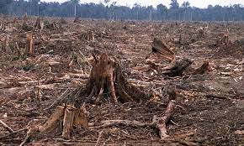
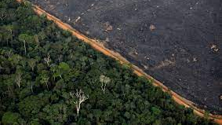
How do we deforest?
Burning and clear-cutting the land are two most common ways to deforest

Slide 5
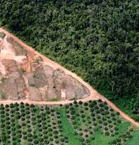
Where do we deforest?
Deforestation is most common in underdeveloped countries with many forests and rainforests, where forests are deforested to make a profit by selling timber and producing new agricultural land. The Cut-and-Burn method is used.

Slide 6
The end

