Slide 1
Organisation of the Education System and of its Structure

Slide 2
Croatian education system provides education services at pre-school, primary school, high-school and higher education levels, as well as for adult education, so as to enable every user to develop his/her potential optimally, aiming at their personal development and entry into the labour market, including their preparedness for lifelong learning.
Education in Croatia is available to all, under equal conditions, in line with their capabilities. Compulsory education is free of charge, as stipulated by law, while private schools and colleges/polytechnics can be established in accordance with the relevant legal framework. Universities are guaranteed autonomy and they can independently decide on their structure, organisation and operation (Articles 66 and 67 of the Croatian Constitution).

Slide 3
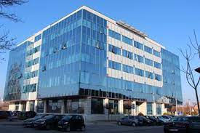
Croatian education system is centrally managed by the Ministry of Science, Education and Sports (MSES). Besides MSES, other national public bodies involved in the regulation, development and quality control of the educational sector in Croatia are Education and Teacher Training Agency, Agency for Vocational Education and Training, Agency for Science and Higher Education, Agency for Mobility and EU Programmes and National Center for External Evaluation of Education.
In line with the aforementioned, Croatian education system consists of the following levels: early childhood and pre-school education, elementary education, high school education and higher education.

Slide 4
STAGES OF EDUCATION
Pre-school education
Elementary (Single-Structure Primary and Lower Secondary) Education
High school (Upper Secondary) Education
Home education
Higher education
Adult education
Art education
Education for pupils with learning difficulties
Management of Education System in Croatia

Slide 5
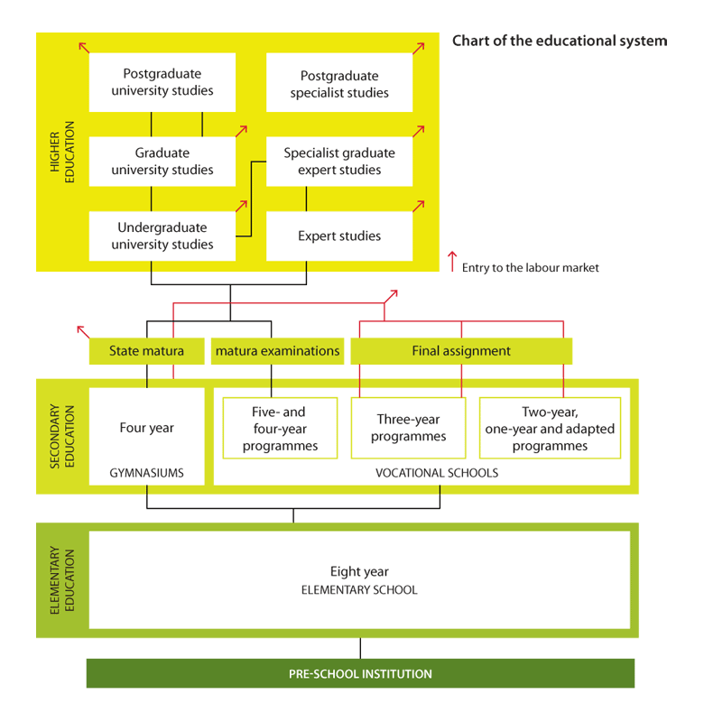

Slide 6
Pre-school education
Pre-school education in Croatia includes education and care about pre-school children. It is carried out through programmes of care, education, healthcare, meals and social care for children aged from 6 months to school age children.
Early Childhood and Pre-school Education constitutes the first level of the educational system and, except for the pre-school educational program for children in the year prior to 1st grade of primary school, it is not compulsory for all pre-school children. It is divided into three educational cycles, based on the age of children: (1) from 6 months to one year of age, (2) from 1 to 3 years, (3) from 3 years of age to the start of primary education.
Early education and child care is financed and managed by local authorities, while MSES provides central guidance, accreditation and control over the educational programmes which are implemented in organizations providing early education and child care.

Slide 7
Elementary (Single-Structure Primary and Lower Secondary) Education
Besides the regular schools which provide tuition in Croatian, a number of schools – almost fifty - provide tuition in Serbian, Italian, Czech and Hungarian languages. Just as national minority students can, according to their own decision, enroll into regular schools providing tuition in Croatian, students of Croatian nationality can – and quite a few of them indeed do – enroll into schools providing tuition in some of the minority languages.
The founders of elementary schools are: the Republic of Croatia, counties (20 counties) and the City of Zagreb, municipalities, towns, as well as legal and physical persons. Primary schools can be regular ones, with a general education program, special ones, with programs for children with developmental disabilities, art schools (dance and ballet), and schools in the language and writing of national minorities.
Elementary education includes primary and lower secondary levels organised as a single structure system, beginning at the age of 6 and consisting of eight years of compulsory schooling. In elementary education segment, special care is dedicated to the possibilities for education of students of national minorities in their mother tongue.

Slide 8
High school (Upper Secondary) Education
High school education is not compulsory in Croatia but almost all students do enroll into the general or vocational upper secondary courses upon completing elementary school. Following the completion of single structure education, secondary education (upper secondary and post-secondary non-tertiary education) enables everyone, under equal conditions and in accordance with individual capabilities, to acquire knowledge and competencies to work and/or continue education.
In vocational and art education programs, lasting a minimum of 4 years, it is completed once a final paper is completed, submitted and defended, in a procedure organized and carried out by the school. If a student of art and vocational programs, lasting a minimum of 4 years, wishes to continue education at a higher education institution, he/she is obliged to take the State Matura exam.
High schools, depending on their program, are grammar schools, vocational schools or art schools. High school education enables students to acquire knowledge and competences for work and for continuation of education. Secondary education in grammar school programs is completed by taking the State Matura exam.

Slide 9
Higher education
The higher education system is twofold and comprises of university and professional study programmes of different duration.
University study programs prepare students for scientific or professional careers in public and private sector. Professional study programs provide students with an appropriate level of knowledge and skills enabling them to work professionally and become directly involved in the working process.
Higher education is provided by the universities - most of them public - whose organizational autonomy and academic freedom in teaching and research is guaranteed by the Croatian Constitution. Great majority of funding for higher education is provided by the state, covering such items as salaries for academic staff, capital investment and running costs for academic institutions, research funds, student subsistence and tuition fees and other.

Slide 10
Adult education
Adult education system is also an integral part of the Croatian education system. Adult education practices in Croatia, in many of its integral parts and characteristics, are aligned with those of the developed countries.
Croatia has a network of institutions for adult education throughout its territory, as well as a large number of various institutions which, apart from their regular activities, carry out adult education program.
The range of the programs, especially in non-formal education, is very wide and, as a rule, was created in response to the educational needs of citizens and legal entities.

Slide 11
Art education
Croatia has a well-developed system of art education, which is carried out in accordance with the Art Education Act and Primary and Secondary Education Act. Art schools are the music, dance, visual arts schools and other schools which carry out art education programs. Art education is available to everyone under equal conditions, regardless of race, sex, language, religious, political or other orientation, national or social background, property, birth, social position, disability, sexual preference or age, according to individual capability. The children of citizens of European Union member states are entitled to access art education under the same conditions as Croatian citizens, and enroll into Croatian art education institutions under the same conditions as Croatian citizens. The children of Croatian citizens that received education in one of the EU member states but want to continue their education in Croatia are entitled to art education in Croatia under the same conditions as Croatian citizens who attend art education institutions in Croatia.

Slide 12
Education for pupils with learning difficulties
Education for pupils with learning difficulties is carried out in regular schools with complete or partial integration, depending on the type and degree of the difficulty, following regular, individualized or special programs or, exceptionally, if the pupils need additional health or social care, in special education institutions.

Slide 13
Thanks!

