Slide 1
FINANCIAL AWARENESS

Slide 2
WHAT IS FINANCIAL AWARENESS?
It is a combination of knowledge, skills, attitudes and behaviors that are required to make the right financial decisions and for the financial well-being of each individual, and therefore of society.

Slide 3
Financial awareness goals
acquiring knowledge and skills for responsible money management
developing a long-term and sustainable financial plan in accordance with the wishes and capabilities of the students
differentiating between different financial products
developing the ability to think critically about ours finances
ability to hedge against financial risks
the use of digital literacy tools

Slide 4
FINANCE, as a science, deals with the problems of money management.
MONEY is a specific commodity that has the function of expressing the value of all other commodities and serves as a means of payment.

Slide 5
Without financial awareness, the path to financial independence is more difficult and costs higher.

Slide 6
BUDGET - a true picture of personal consumption
Where does your money go?
How much money do you spend per month spending time with friends?
How much do you spend on a snack?
How much do you spend on clothes?
Can you know the correct answers if you do not track and record your personal consumption?.

Slide 7
What is a BUDGET?
car
Sport activity
travels
clothes
hobby
A financial plan that shows what you will use your money for
It shows the true picture of our CONSUMPTION

Slide 8
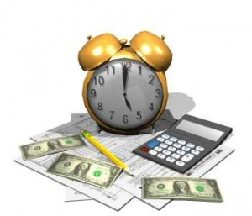
Excersize 1.
YOU CONTROL YOUR MONEY (DOES NOT CONTROL ON YOU)
List five reasons why it's a good idea to use a budget (personal)
KEEP TRACK OF YOUR RECEIPTS AND EXPENSES
YOU ARE AVOIDING DEBT
EASY TO NOTICE UNUSUAL COSTS
ARE YOU READY FOR UNEXPECTED SITUATIONS AND UNUSUAL COSTS
SLEEP PEACEFULLY, LIVE MORE HARMONIOUSLY

Slide 9
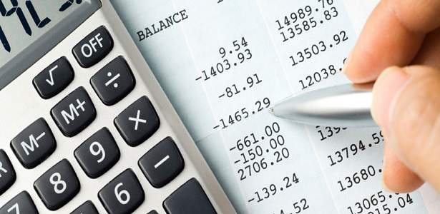
CREATE A BUDGET
RECEIPT / INCOME / INCOME
OUTLAY
All costs and
financial obligations
(debts) that we are
obliged to pay
All the money we made and got

Slide 10
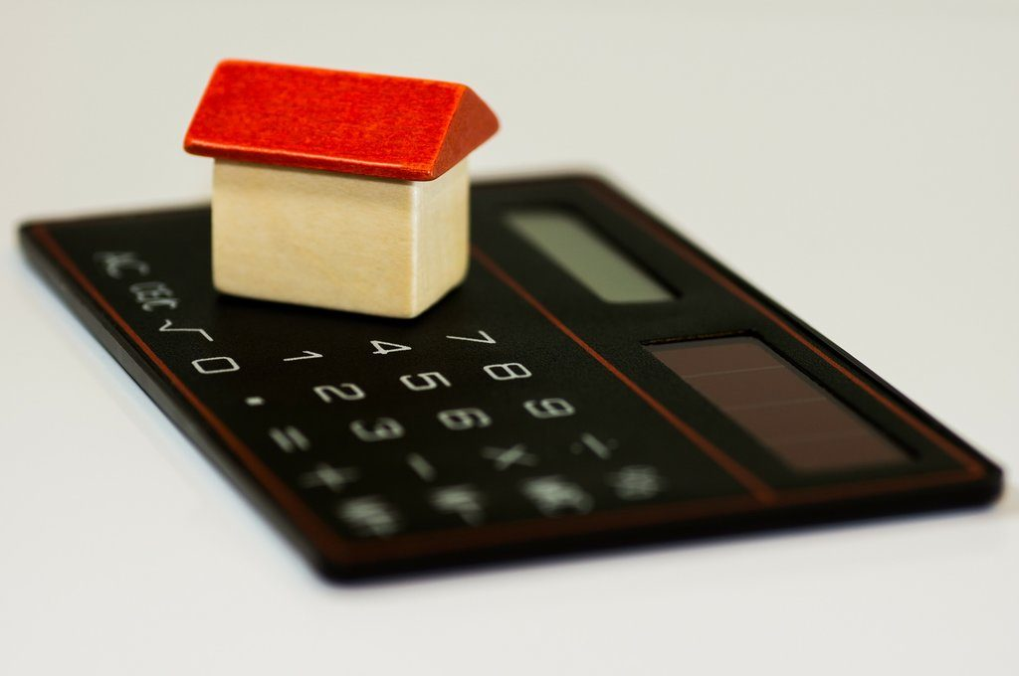
BUDGET CREATION PROCESS
1. RECORD YOUR RECEIPTS AND EXPENDITURE
DETERMINE MONITORING PERIOD (MAIN MONTHLY MONITORING)
or WEEKLY (if your pocket money is weekly)
How much money I make / get)
Tracking period?
What do I use my money for? How much do I spend?
INCOME
EXPENSES

Slide 11
2. CREATE RECEIPTS AND EXPENDITURE
3. ALLOW THE BUDGET ITEMS TO ALLOW THE AMOUNT OF MONEY
DISTRIBUTION OF EXPENDITURE BY ITEM
EXPENDITURE ITEM | Expenditure on housing | Transport expenditure | Food costs | Insurance expenditure | Savings and investments | Other costs
Daily |  | 15 | 50
Per month | 2000 | 450 | 1500 | 300
30 % arrival
households
(rent, overhead,
home insurance,
household taxes,
home maintenance
10 – 20 %
income
(carloan,
Registration,
Fuel,
Maintenance
Public transport
25-35 % income
(buying food,
Dining in restaurants,
Dinner (bakeries, pastry shops ..)
Kitchen utensils (detergents…)
7 % income
(life insurance,
Property insurance,
Auto insurance,
health insurance
preferably set aside 10%
Total income
IF WE COST LESS CARE
WHAT WE MAKE

Slide 12
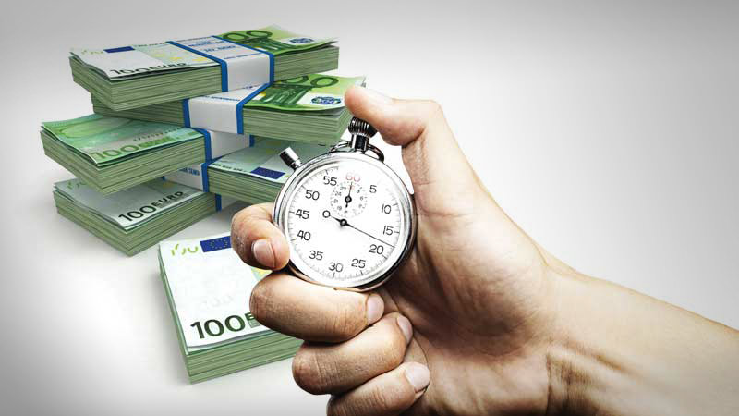
Considering how successfully we manage our money,
THREE BUDGET RESULTS ARE POSSIBLE
Desirable management result
budget
INCOME
EXPENDITURE
CASH SURPLUS/
MONEY LACK
OR DEFICIT is the result of bad
Budget management

Slide 13
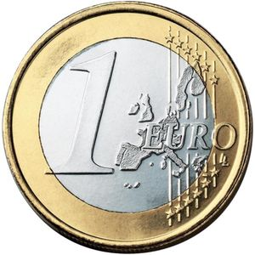
4. CONSUMPTION CONTROL
BE CAREFUL "LOW COSTS"
………..

Slide 14
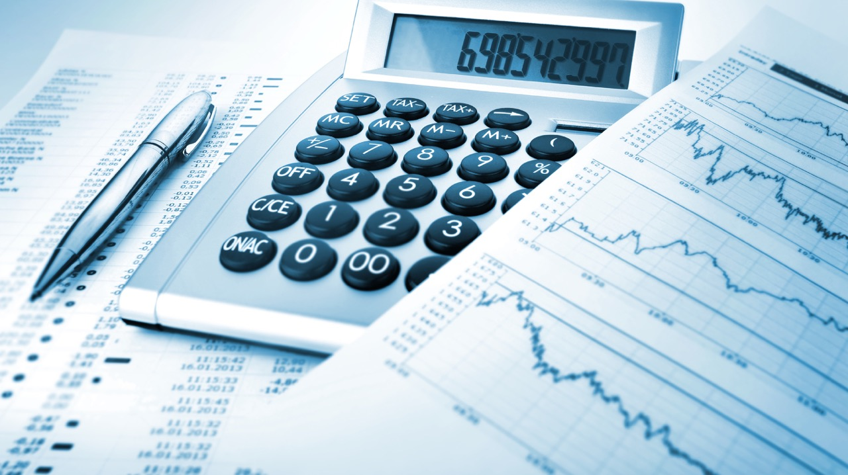
5. ASSESS AND ADJUST
BRING MONTHLY BUDGET
FOLLOWS ITS WEAKNESSES AND ACHIEVEMENTS
STRENGTHEN YOUR FINANCIAL PLANNING AND GOALS

