Slide 1
Waste management
Created by Zsófia Iglai, Dorina Tóbi, Martin Madarász

Slide 2
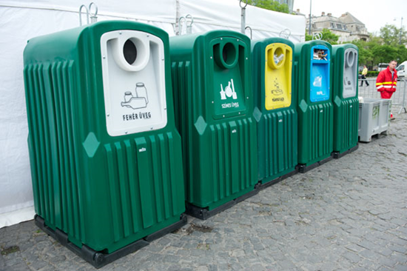
Recycling
A product is made from waste
Waste is transformed
We can save primary raw materials
Waste is also generated during recycling
A total of approx. 17% of the waste is sorted

Slide 3
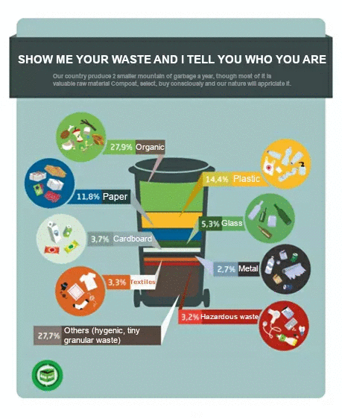

Slide 4
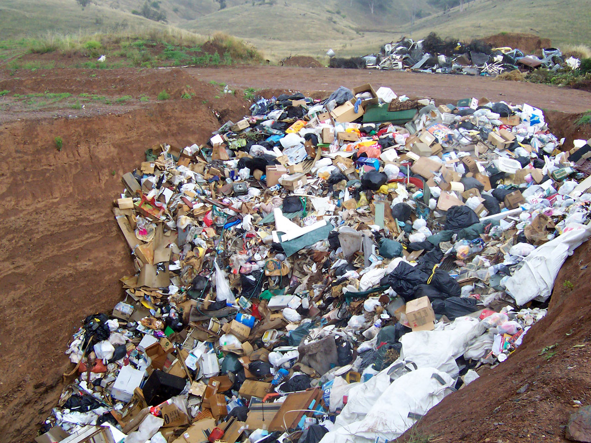
Non - degradable waste
How long does it take for various wastes to decompose?
Paper towel: 2-4 weeks Banana peel: 3-4 weeks Paper bag (paper bag): 1 month Newsprint: 1.5 months Apple seed: 2 months Cardboard paper: 2 months Cotton gloves: 3 months Orange peel: 6 months Veneer sheet: 1-3 years Wool socks : 1-5 years
Milk box: 5 years Cigarette butts: 10-12 years Leather shoes: 25-40 years Tin-plated steel tin can: 50 years Foamed plastic cup: 50 years Rubber boots: 50-80 years Aluminum tin can: 200-500 years (however, with recycling approx. It can be made into a new box in 6 weeks!) Plastic bottle: 450 years Disposable diapers: 550 years (currently not recycled) Fishing line, fishing line: 600 years Plastic bags: 200-1000 years

Slide 5
Radioactive waste
Consequence of nuclear power generation
The disposal of nuclear waste is regulated by strict safety requirements
It accounts for less than 1% of all hazardous waste in industry
Waste processing process: Collection, storage transport processing transport, placement

Slide 6
Radioactive waste processing
For solid waste:
compression, firing, fixing (conditioning)
For liquid waste:
evaporation, incineration, precipitation, filtration, extraction, ion exchange of radioactive components can be used

Slide 7
Thank you for your attention!

