Slide 1
The useage of the media and the internet
Made by: Pandák Petra, Zsíros Kitti és Morvai Regina

Slide 2
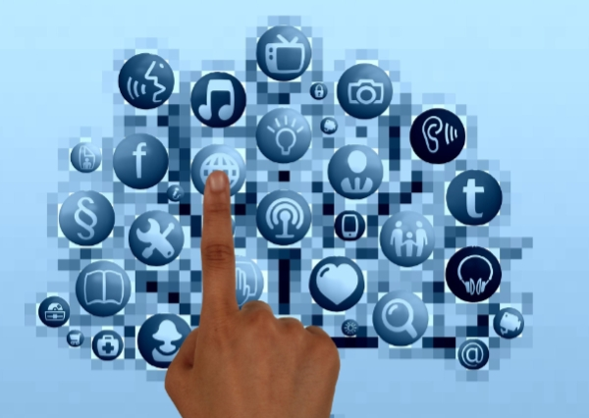
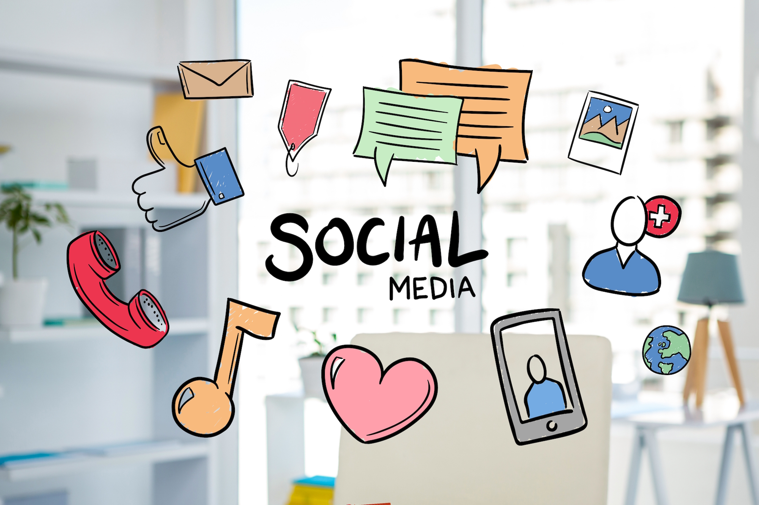
The internet is a global computer network which communicate with the help of (IP) . The internet is part of our daily lives in the households.

Slide 3
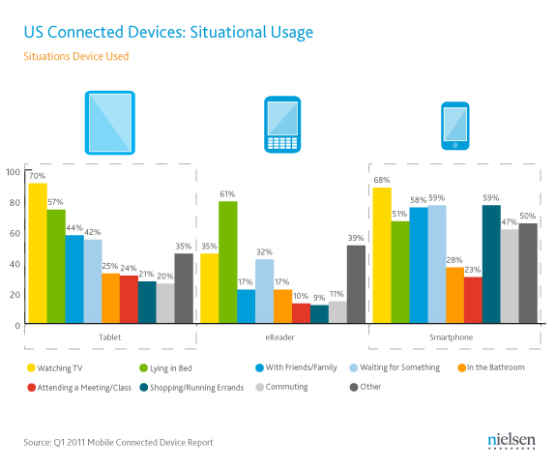
According to a data from 2019, in Hungary 5,3 million people use smart phone. The internet and smart phones are basic needs among teenagers.

Slide 4
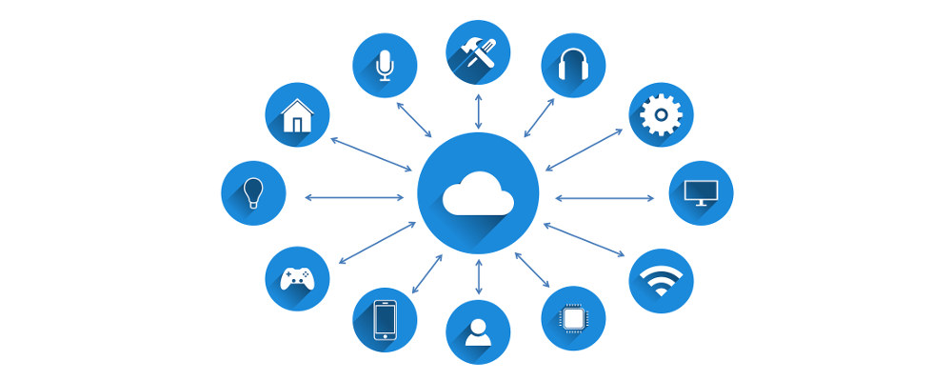
The benefit of networks and internet useage are that we can share resources, cost savings in the communication and parallel access for example data bases.

Slide 5
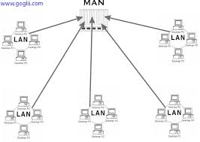
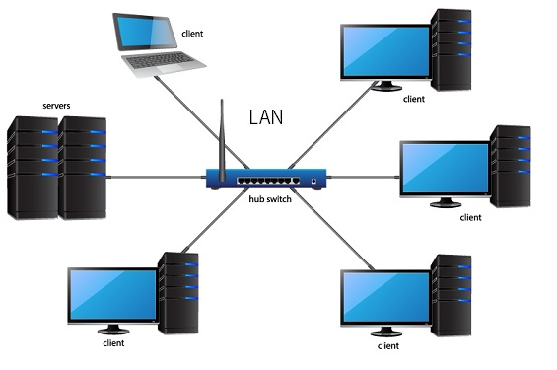
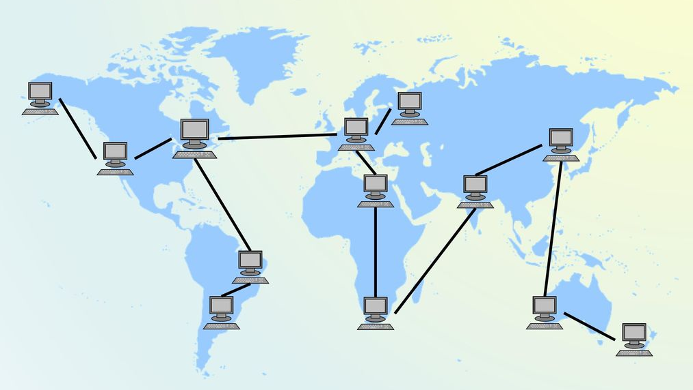
The drawbacks of the networks: claim to safety, complex softwares.
We can deal the networks into three groups:
MAN- urban networks
WAN- big dimensional networks
LAN- local networks

Slide 6
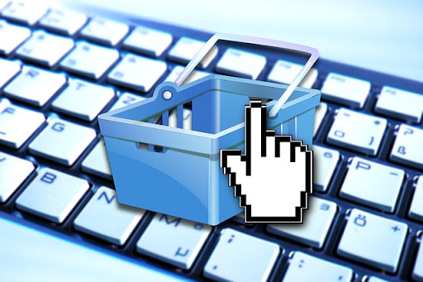
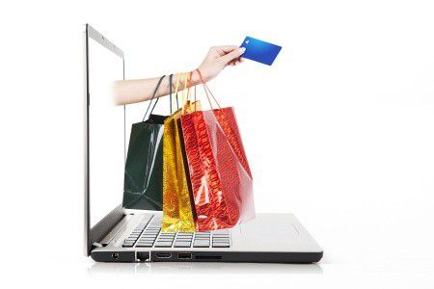
Internet that we use everyday has got opportunities and dangers.
We can enjoy a lot of opportunities of the internet for example, - we can do the shopping online - bills are easily paid in - everyday communication - spread of the news - we can find what we want in seconds

Slide 7
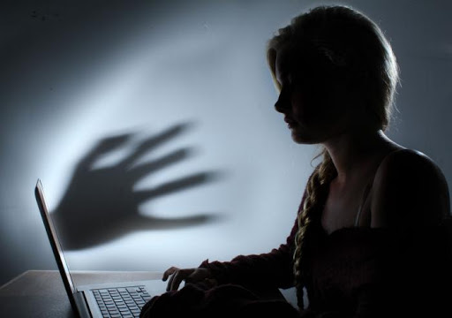
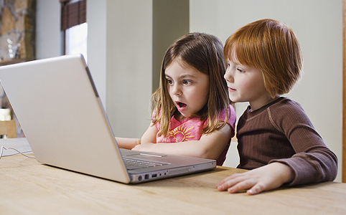
Dangers of the internet: - you can’t turst in every website - they misuse with the personal data of users - viruses and appearance of unwanted contents on computer

Slide 8
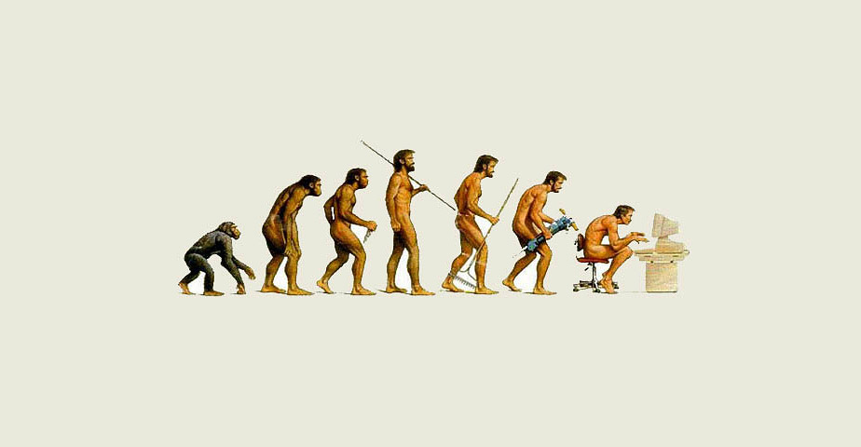
Unfortunately among the opportunities of the internet there are dangers too. Nowadays lots of people are in interenet dependece. A good many rather choose the life of internet, than doing sports or something else. Lots of relationship breaks because people choose messenger instead of face to face communication.

Slide 9
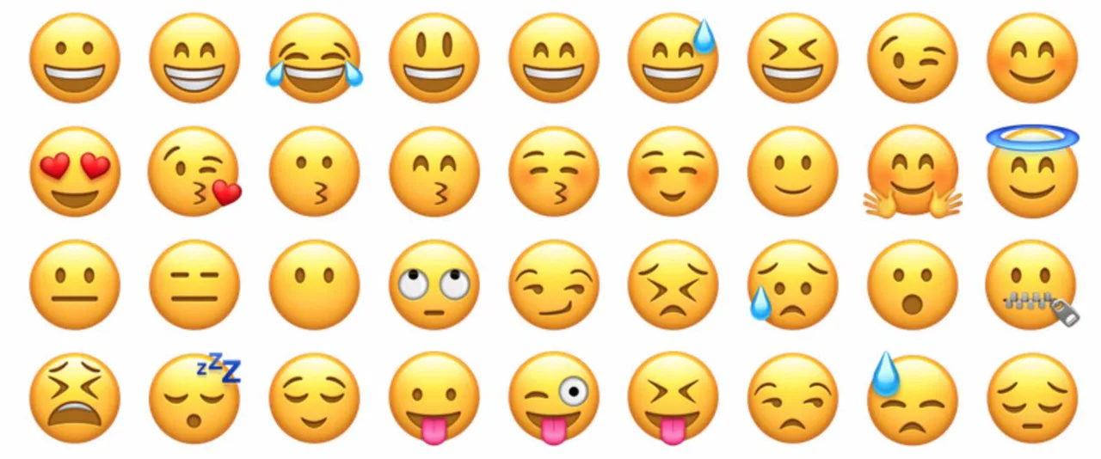
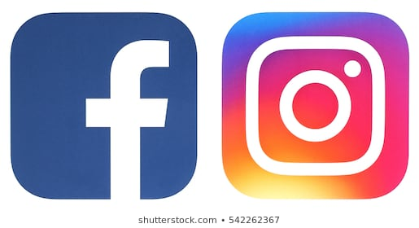
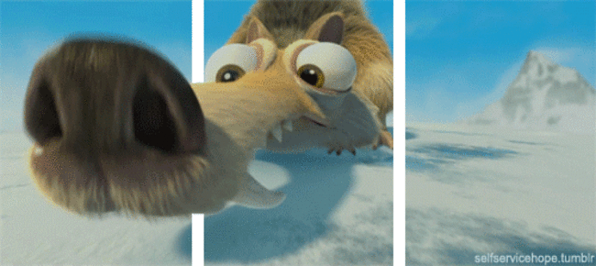
Keeping in contact in different pages belongs to the opportunities, for example Facebook, Instagram, Messenger, etc.
It is possible to exchange message, that we can make colourful with emojis and giffes.

Slide 10
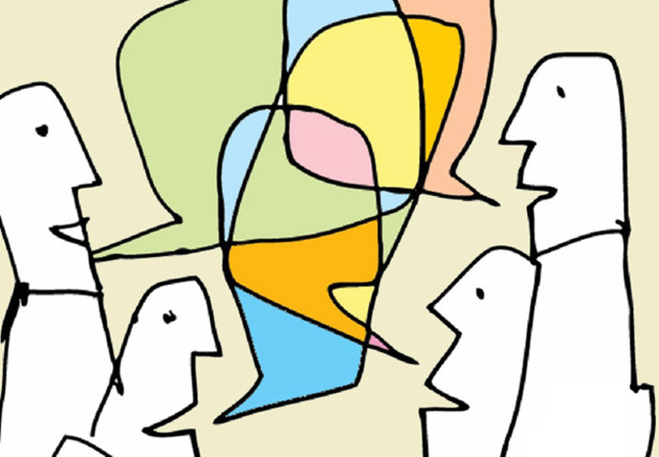
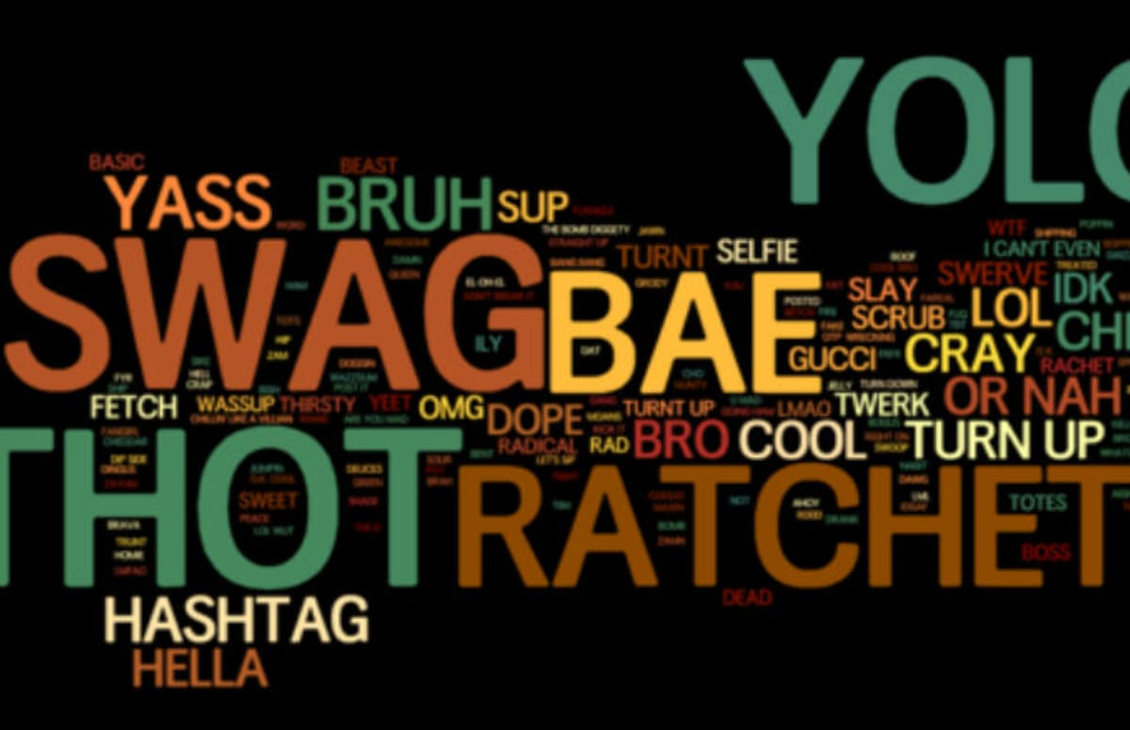
These sites has dangers too. Your personality can deform because who are in these community websites, most of them shows the world beauty and good. By this, everybody strives to not to hang out from present-day trend.

Slide 11
Thank you for your attention!

