Slide 1
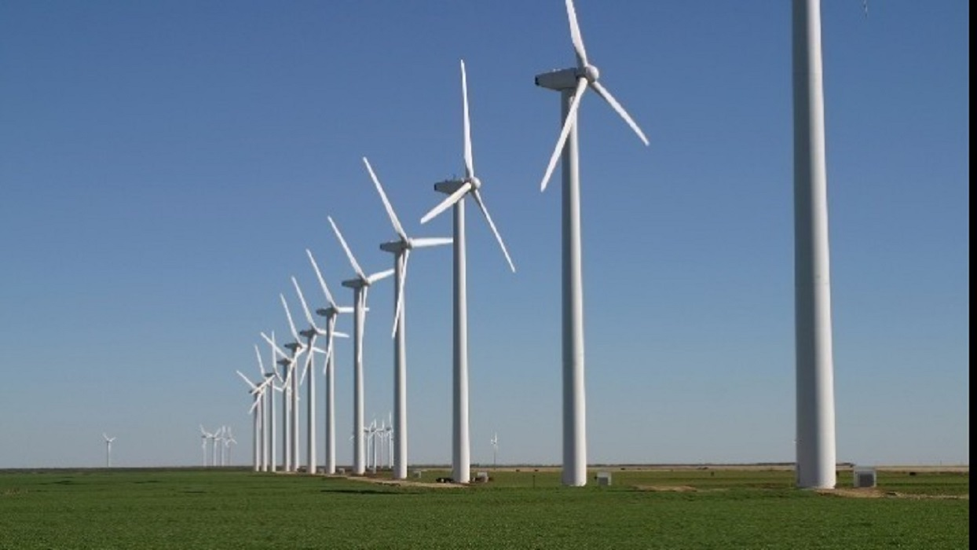
Greek energy crisis
KONSTANTINA
TSOUTSIA
ELISABETH
SIMOU

Slide 2
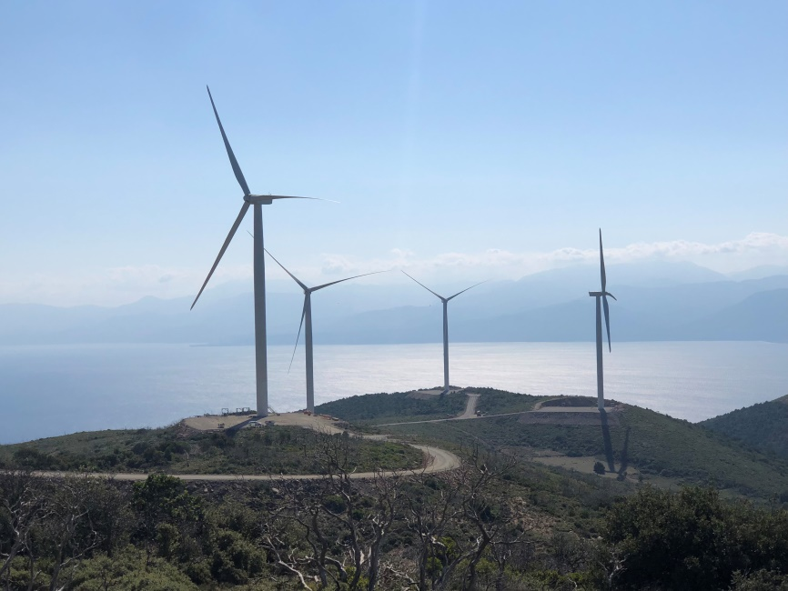
Greece's National Electricity Company warns of the possibility of the country falling into an energy crisis, as in December last year, when large consumption has triggered a sharp shortage of electricity, Greek electronic publications reported.

Slide 3
In order not to have surprises this winter, the company has planned measures to avoid a new energy crisis, News reported. The cold three years before in Europe in December and January 2017 led to increased electricity consumption by hydroelectric power plants and caused a serious shortage of electricity.

Slide 4
In 2018, the water in the Greek dams is estimated to be a record low, with experts fearing that if electricity consumption increases that winter, as in 2017, it will not be compensated by hydroelectric power plants. At a power forum in Athens, the energy operator chief Nikos Bulaxis warned that similar problems with water scarcity currently exist in the neighboring countries and that, if necessary, their hopes of supplying electricity are low.

Slide 5
He explains that, in view of a possible crisis, the electricity company is planning to deliver LNG liquefied gas to feed the Revitus terminal for the January and December critical months when cold days are expected. Ta Nea informs about how best to save energy and heat the different homes in view of the coming winter. The newspaper notes that the new national energy market plan in Greece will be ready in April.

Slide 6
Thanks for your attention

