Slide 1
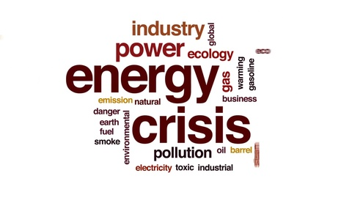
Global energy crisis
ELISABET SIMOU
KONSTANTINA TSOUTSIA
GEORGIA SKREPETOU
DIONISIA VILARA

Slide 2
DEFINITION OF ENERGY CRISIS
An energy crisis is any significant bottleneck in the supply of energy resources to an economy.
In literature, it often refers to one of the energy sources used at a certain time and place, in particular those that supply national electricity grids or those used as fuel in Industrial development and population growth have led to a surge in the global demand for energy in recent years.

Slide 3
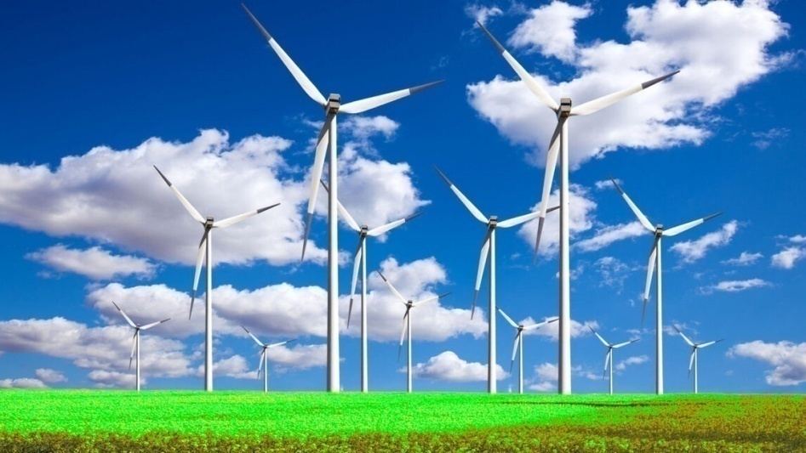
DEFINITION OF ENERGY CRISIS
In the 2000s, this new demand together with Middle East tension, the falling value of the U.S. dollar, dwindling oil reserves, concerns over peak oil, and oil price speculation — triggered the 2000s energy crisis, which saw the price of oil reach an all-time high of
$147.30 a barrel
in 2008.

Slide 4
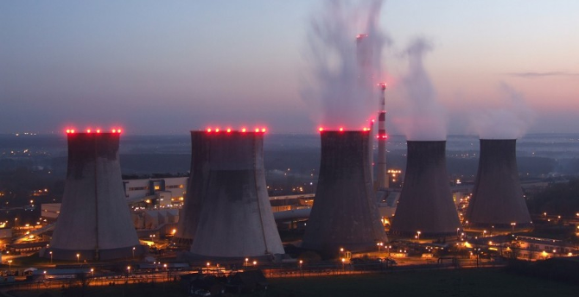
CAUSES OF ENERGY CRISIS
Most energy crisis have been caused by localized shortages, wars and market manipulation. Some have argued that government actions like tax hikes, nationalization of energy companies, and regulation of the energy sector, shift supply and demand of energy away from its economic equilibrium.

Slide 5
CAUSES OF ENERGY CRISIS
However, the recent historical energy crisis listed below were not caused by such factors. Market failure is possible when monopoly manipulation of markets occurs. A crisis can develop due to industrial actions like union organized strikes and government embargoes. The cause may be over-consumption, aging infrastructure, strangle point disruption or bottlenecks at oil refineries and port facilities that restrict fuel supply. An emergency may emerge during very cold winters due to increased consumption of energy.

Slide 6
Social and economic effects
The macroeconomic implications of a supply shock-induced energy crisis are large, because energy is the resource used to exploit all other resources. Oil price shocks can affect the rest of the economy through delayed business investment, sectoral shifts in the labor market,[ or monetary policy responses. When energy markets fail, an energy shortage develops. Electricity consumers may experience intentionally engineered rolling blackouts during periods of insufficient supply or unexpected power outages, regardless of the cause.

Slide 7
Social and economic effects
Industrialized nations are dependent on oil, and efforts to restrict the supply of oil would have an adverse effect on the economies of oil producers. For the consumer, the price of natural gas, gasoline (petrol) and diesel for cars and other vehicles rises. An early response from stakeholders is the call for reports, investigations and commissions into the price of fuels. There are also movements towards the development of more sustainable urban infrastructure.

Slide 8
Social and economic effects
In 2006, survey respondents in the United States were willing to pay more for a plug-in hybrid car
Global New Investments in Renewable Energy
In the market, new technology and energy efficiency measures become desirable for consumers seeking to decrease transport costs. January 30, 2008 Planet Ark.

Slide 9
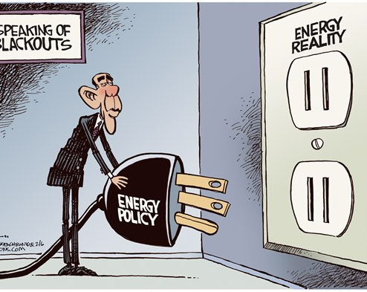

Slide 10
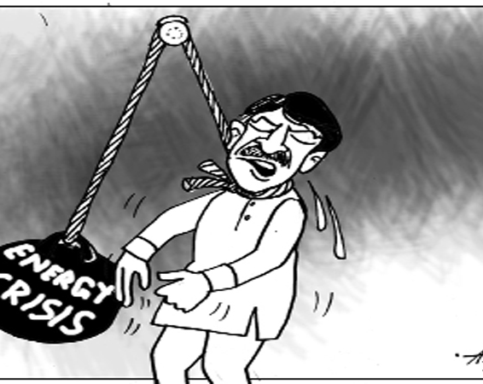
ENERGY CRISIS AFFECT HUMANITY

