Slide 1
Energy
Created by: Vivien Mádi
Márton Gergely
Luca Nagy

Slide 2
What is Energy?
There are renewable and non-renewable energy sources
Non-renewable energy sources shall not be manufactured, grown or reused, for example: fuel, oil
Renewable energy sources are a group of energy sources that can renew on a human time scale, for example: solar power, wind power

Slide 3
Use of renewable energy
Many countries around the world are currently working on renewable energy
By 2014, a total of 138 countries had declared the use of hydropower
Country | 2004 | 2016 | Goal :2020
Croatia | ? | 23,5% | 28,3%
Greece | 6,9% | 15,2% | 18,0%
Turkey
Hungary | 4,4% | 14,2% | 13,0%

Slide 4
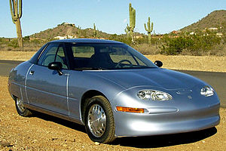
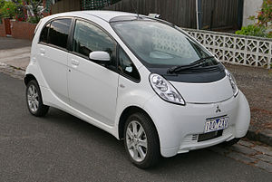
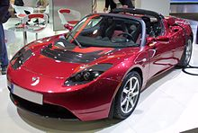
Electric Cars
The electric car is a electro-motor powered car. The electrical energy is most often obtained from the battery.
One of the frist series-produced electris cars of the 2000s was the REVAI, an indian electric moped car, which was manufactured between 2001 and 2012.
For longer trips, when the energy charged at home not enough for the trip, the battery can charged on fast charger within 20-40 minutes.

Slide 5
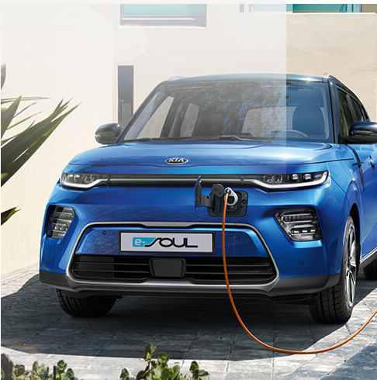
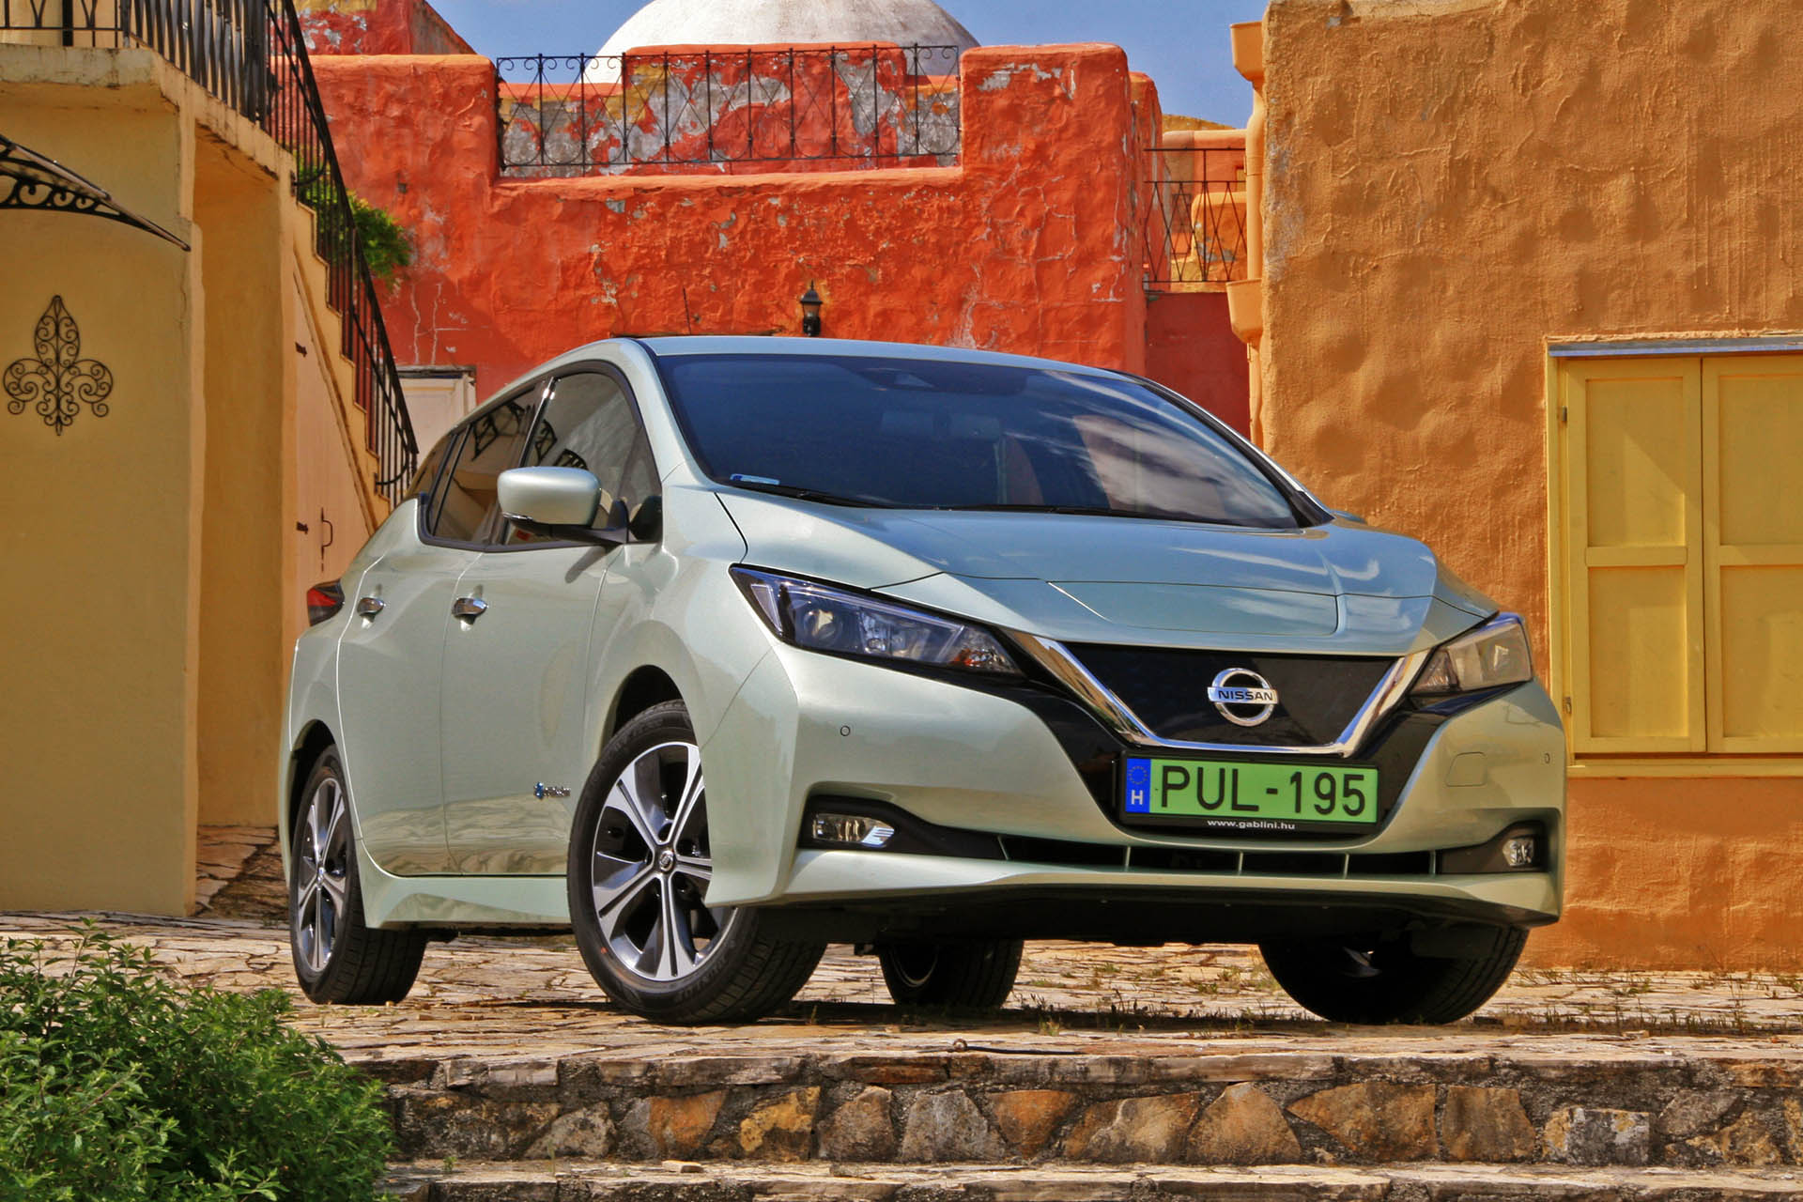
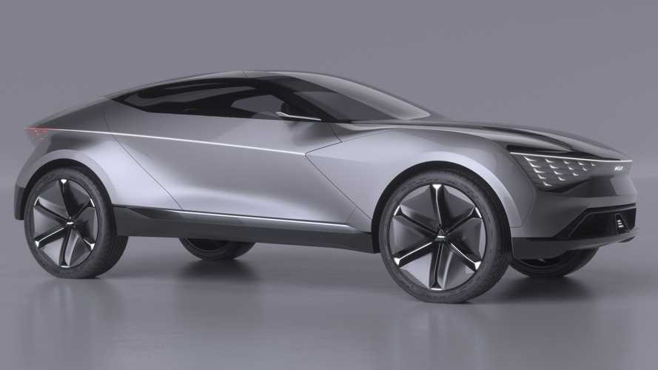
Hybrid Cars
Cars that both use electric motors and other types of motors are called hybrid cars and are not considered fully electric vehicles, because they only operate in charge storage mode.
The hybrid car consumes less fuel (and therefore emits less CO2) than the same conventional car.
The lower fuel consumption causes less air pollution.

Slide 6
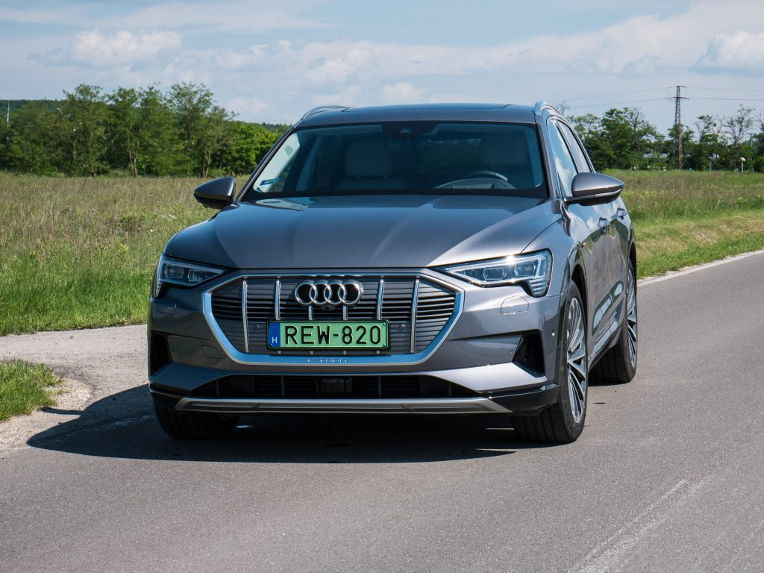
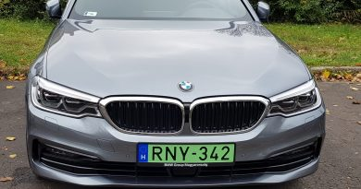
What is the green license plate good for?
The green license plate is a distinguishing sign for environmentally friendly vehicles
Cars with green license plates can park for free
Cars with green plates can use the bus lane

