Slide 1
Task – True or False

Slide 2
1. The population of Hungary is
9 772 706 people.

Slide 3
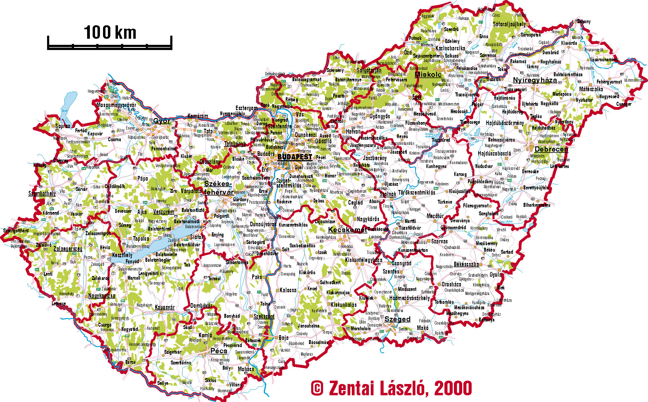
70.5% of Hungary’s population
is living in cities.

Slide 4
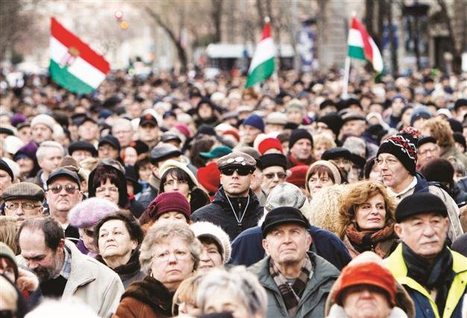
More than 97% of the Hungarian
population is Hungarian.

Slide 5
There are 276 registered
religion in Hungary.

Slide 6
74% of the Hungarian
population is Catholic.

Slide 7
Results :
1. False
2. True
3. True
4. False
5. True

