Slide 1
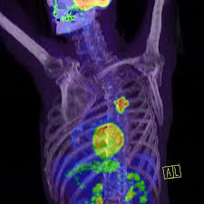
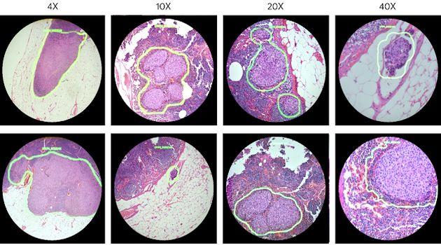
Civilizational diseases

Slide 2
Basics
What is health?
Health is not only a lack of disease and disability, but a state of complete physical, mental and social well-being. (WHO, 1946)
Health Behaviour:
The condition of a healthy lifestyle is health-conscious behavior.
Who is health-conscious, pays more attention to themselves, pays attention to their lifestyle, moves regularly, and does not consume excessive amounts of pleasure drugs…. , but the opposite of this, who does not deal with themselves, unfortunately. There are many people, so the diseases of civilization could develop.

Slide 3
What do we call civilised diseases?
It is a collective name for diseases that afflict the people of the modern age.
Development: They can be traced back to the last century, but their prevalence has increased in the last few decades.
Nowadays, it is present in every community with a modern and advanced lifestyle.

Slide 4
Why are the diseases of civilization conquering?
The man of today does a sedentary work, barely moving.
Many times people don’t even have time to eat during the day.
The lack of exercise, and sedentary lifestyle is completely unnatural and therefore it poses great dangers.
This can result in obesity, some metabolic and musculoskeletal disorders.

Slide 5
What are the most common civilizational deseases?
High blood pressure
Neoplastic deseases
Cardiovascular diseases
Heart attack
Seizure

Slide 6
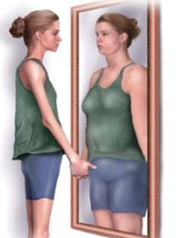
What are the most common civilizational deseases?
Over weight
Anorexia
Depression
Alcohol and drug addiction
Diabetes

Slide 7
What can you do to avoid these diseases?
Exercise more
Eat foods full of fibers, vitamins and minerals (oat, orange, pickled cabbage)
Quit smoking and using drugs
Dring alcohol within bounds
Eat less food full of grease and carbohydrate.

Slide 8
Thank you for your attention!

