Slide 1
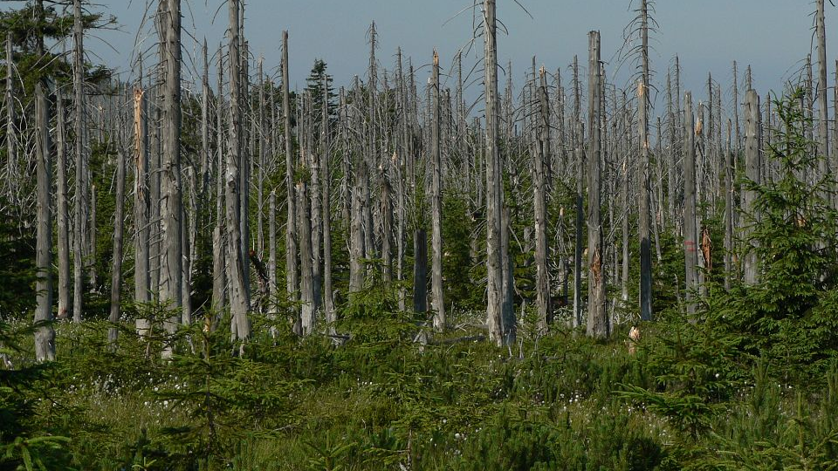
Acid rains

Slide 2
Acid rain is any precipitation that has a higher acidity (lower pH value) than that expected from natural sources (pH around 5).
As a contemporary, critical problem, it was recognized in the 1970s first in the Scandinavian countries and then in Central Europe.
The causes of acid rain are not entirely clear.

Slide 3
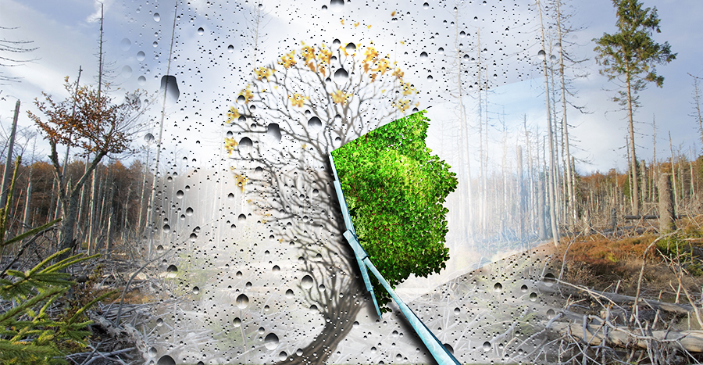

Slide 4
In some areas the cause is nitrogen oxides, in others sulfur oxides, which are formed by burning coal or petroleum products, for example in thermal power plants, automobile engines and in plants for obtaining and purifying metals, and with water vapor from the air create nitric or sulfuric acid.
By acidifying the soil and water, acid rain harms forests (forest dying), agricultural crops, life in soil and water, and human health.

Slide 5
Impact on plants
By increasing the acidity of the soil, that is, by increasing the amount of H + ions, important minerals such as magnesium, potassium, calcium and so on are leached from the soil.
This leads to a drastic reduction in pH. Based on the decrease in pH as a result of chemical processes, ions are formed that have a detrimental effect on plant roots and soil.
The same is true for iron ions released at pH less than 3.8. The degree of harmfulness ultimately depends on the type of. soil type.

Slide 6
Coniferous trees are more affected by the damage caused by acid rain, and they ate more than spruce. In deciduous trees, oak is the hardest hit.
First of all, forests are damaged in places with frequent and abundant rainfall and which also have relatively low average annual temperatures.
This applies to forests at higher altitudes. The characteristics of the diseases that occur are very different.

Slide 7
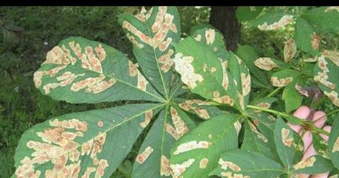

Slide 8
Individual symptoms of the disease occur independently of each other and can be very different depending on the region in which they occur. The following damage was found in coniferous trees:
Needle damage (yellowed needles, falling needles),
Damage to buds and young sprouts,
Bark damage,
Wood damage,
Growth anomalies,
Root damage,
Weakening of resistance to frost, infections, pests and so on.

Slide 9
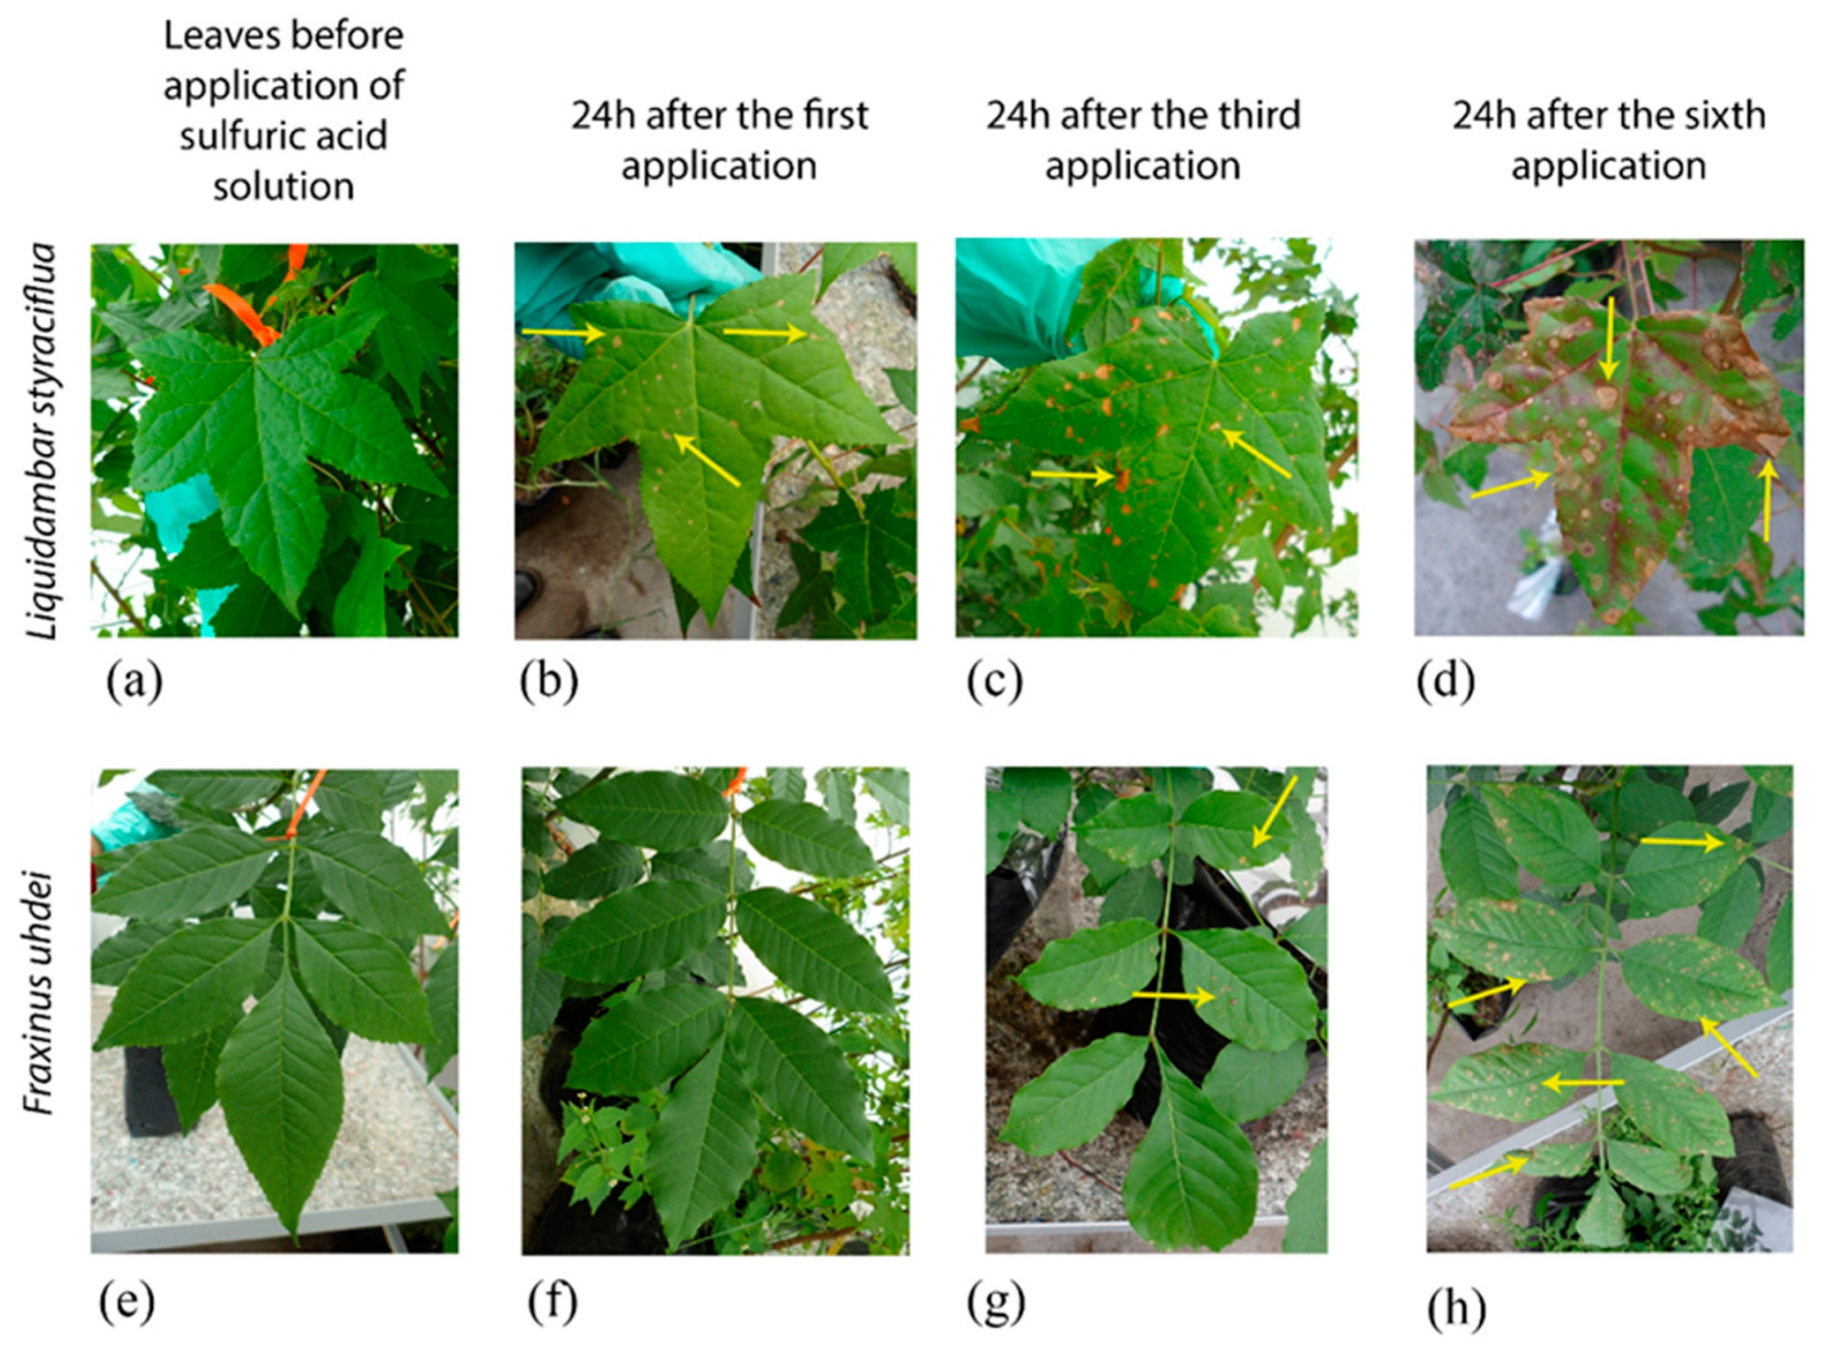

Slide 10
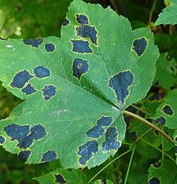
The reason why the leaves turn yellow is often a lack of nutrients. The yellowed leaves die off and fall off.
With better environmental conditions there is the possibility of regeneration and re-greening of trees.
If forests become extinct, it will result in a change in the entire ecosystem.
This means that lower plants that are better adaptable to acidic soil can settle again.
However, the situation in Central Europe is not yet such that forest damage is irreparable

Slide 11
Extinction of forests
The term forest extinction means damage to large areas of forest that causes the extinction of needles and leaves.
It is a disturbance in the whole wood - soil - air relationship, that is, a disease of the whole ecosystem.
The main cause is acid rain, and other possible causes are harmful substances such as nitrogen oxides and heavy metals generated in transport, households and industry.

Slide 12
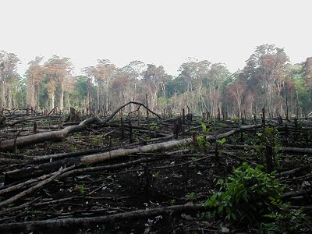
Also extreme weather and climate changes, errors in afforestation, fungi, bacteria, viruses, harmful insects can be considered the causes of forest extinction.
Intensive deforestation, especially of tropical forests in South America, the so-called "lungs of the planet Earth", destroys the only source of oxygen needed for life processes.

Slide 13
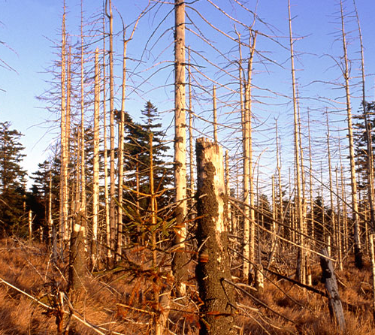
Also extreme weather and climate changes, errors in afforestation, fungi, bacteria, viruses, harmful insects can be considered the causes of forest extinction.
Intensive deforestation, especially of tropical forests in South America, the so-called "lungs of the planet Earth", destroys the only source of oxygen needed for life processes.

Slide 14
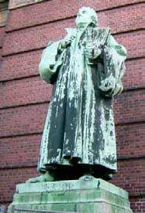
Impact on buildings
Excess protons in the rainwater cause increased rock decay, which means that decay accelerates.
Thus, for example, limestone reacts with sulfuric acid in gypsum. This crushes the stones.
In a similar way, sand decomposes. In that way, numerous cultural monuments and old churches are irreversibly destroyed.

Slide 15
The formation of acid rain
Combustion processes produce sulfur dioxide, nitrogen oxides and other gases that promote the formation of acids.
Such free non-metallic oxides oxidize in a humid atmosphere with water vapor to sulfuric and nitric acid.
These substances are dissolved in the air so that they then fall to the ground with precipitation.
Since these combustion products are produced in increased quantities in cities and industrial zones, the pH value is mostly lower there than in the countryside.

Slide 16
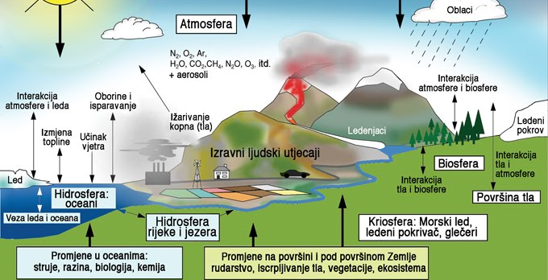

Slide 17
Carbon dioxide is one of the gases that pollutes the atmosphere and thus affects climate change.
It belongs to the so-called greenhouse gases, ie gases that cause the appearance of greenhouses.
The effect of the action of greenhouse gases in the layers of the atmosphere is that the Earth's surface is unnaturally heated.

Slide 18
We all feel the changes, in every part of the planet.
How to reduce the amount of carbon dioxide in the atmosphere caused by the combustion of fossil fuels (coal and oil) is a question that has long been posed to science and politics, but also to all the inhabitants of the Earth.
International conventions also limit the emission of carbon dioxide into the atmosphere.

Slide 19
The end Thanks for attention

