Slide 1
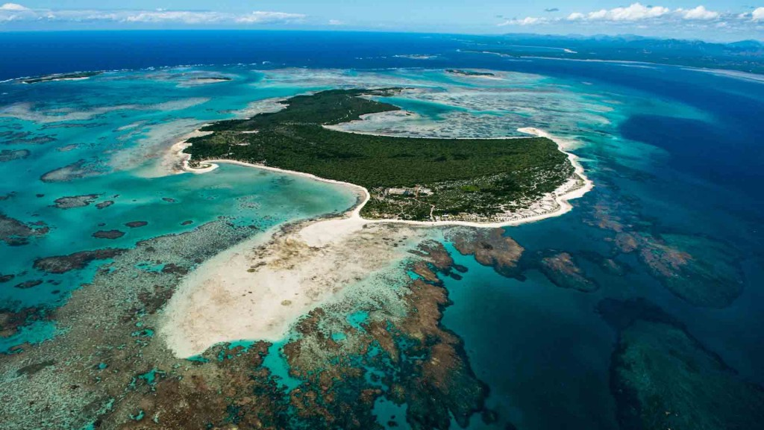
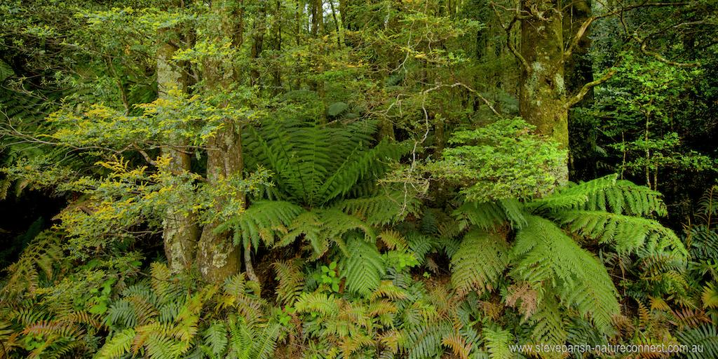
Global
problems- the destruction of rainforests

Slide 2
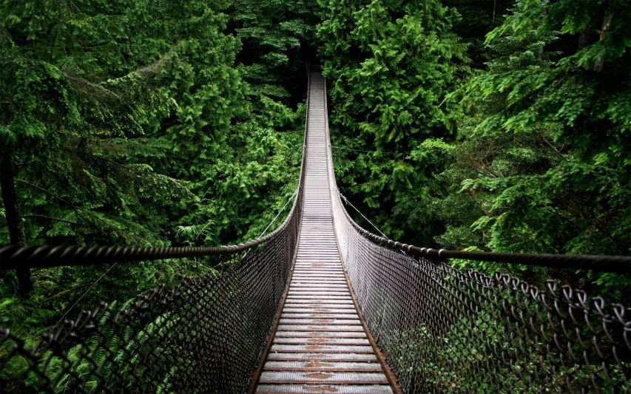
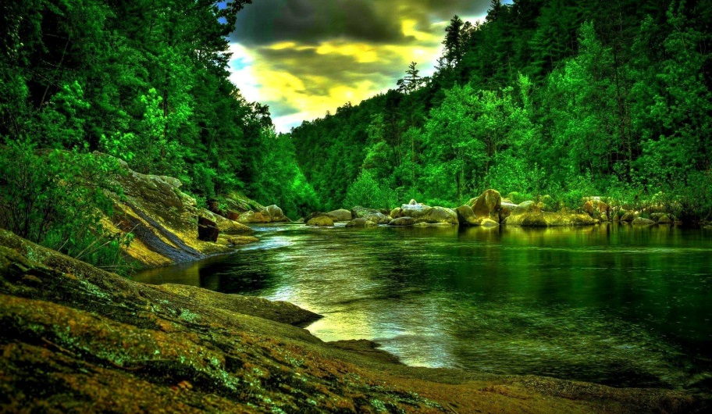
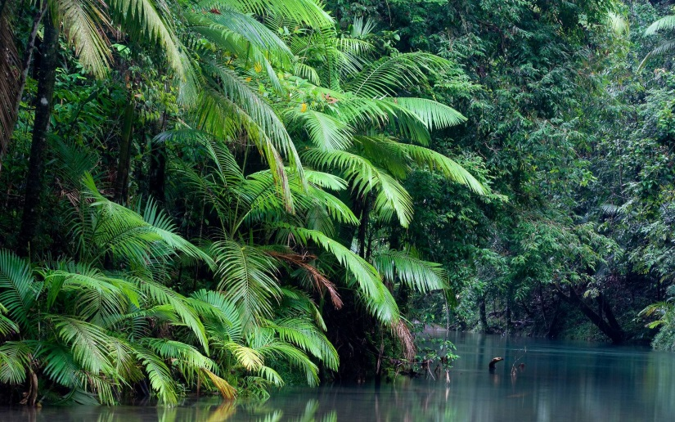
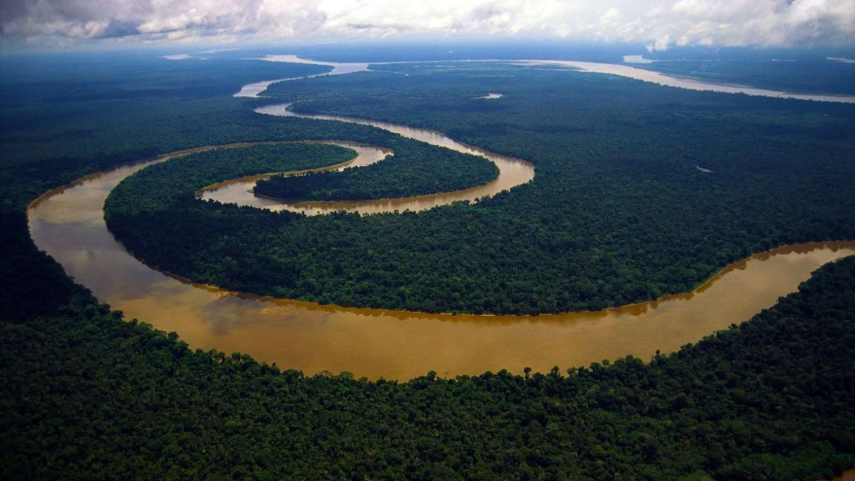
The tropical rainforest is one of the oldest and richest natural habitats in the world. It covers only about 6 percent of the Earth’s surface, yet is home to more than half of the animal and plant species.

Slide 3
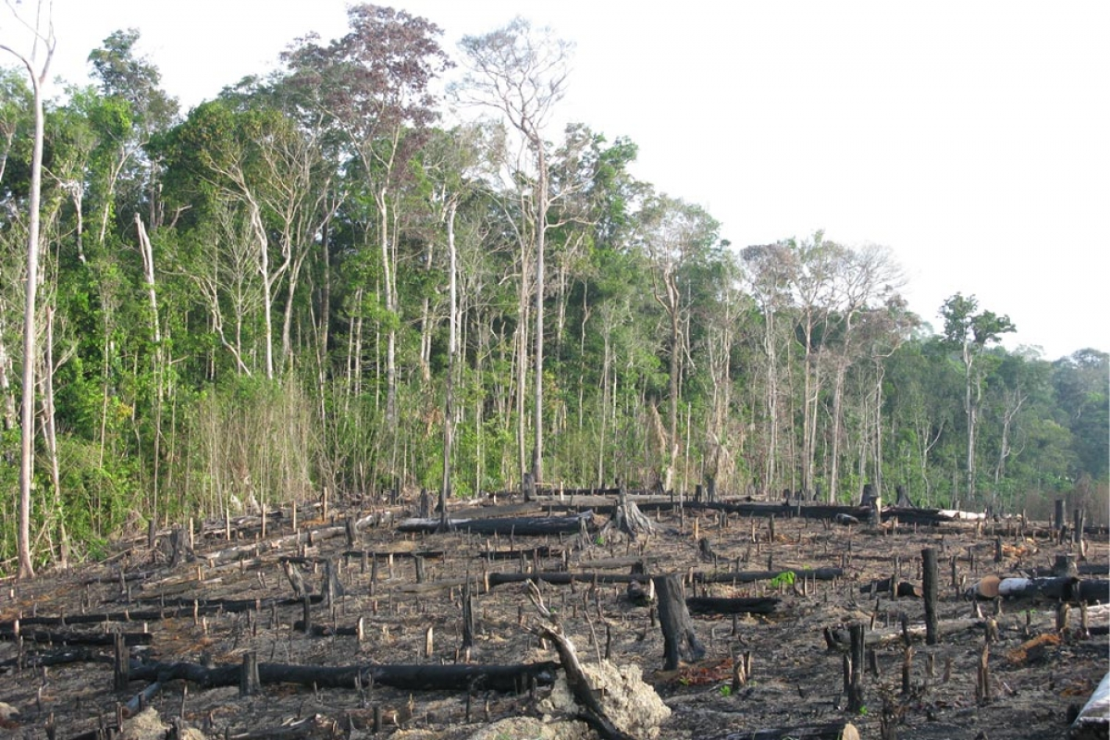
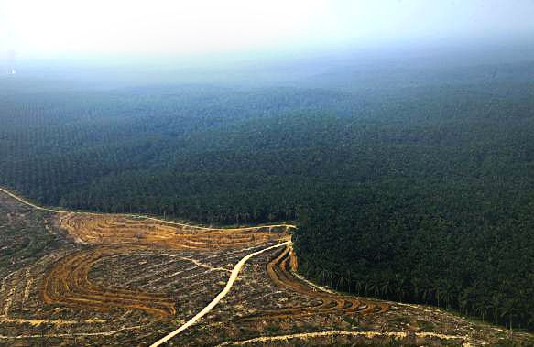
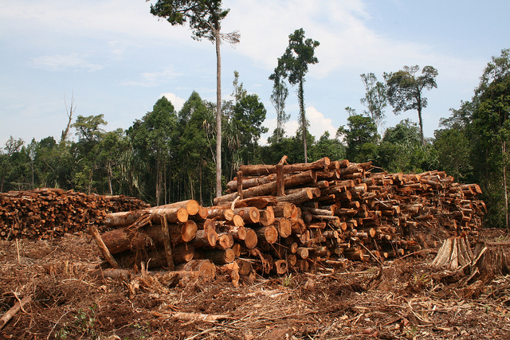
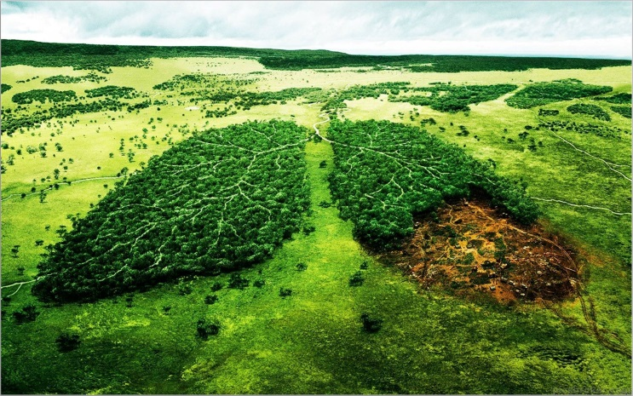
Destruction of rainforests
A few thousand years ago, until humanity began to transform the landscape,
40% of the Earth’s land area was forested, green, which has halved to date
Tropical rainforests once covered more than twice the size of the present. Their destruction has accelerated and become alarming, especially over the last 40 years. In 1976, experts estimated the size of the rainforest that disappears each year at 57,000 km2. By 1990, this process had become such that the annual depletion already reached 142,000 km2.

Slide 4
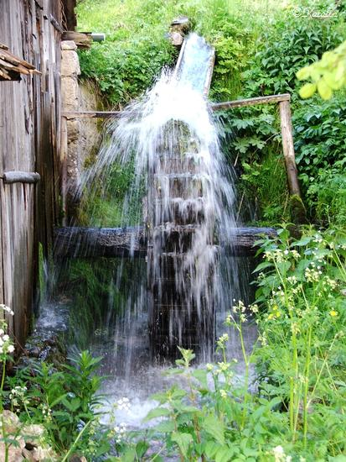
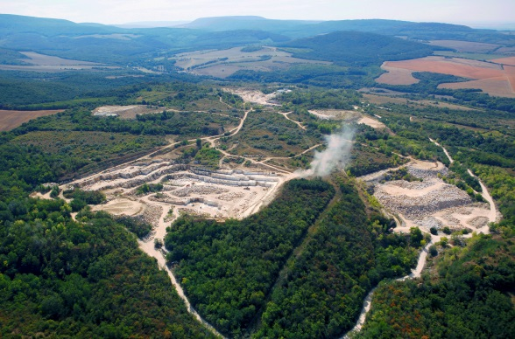
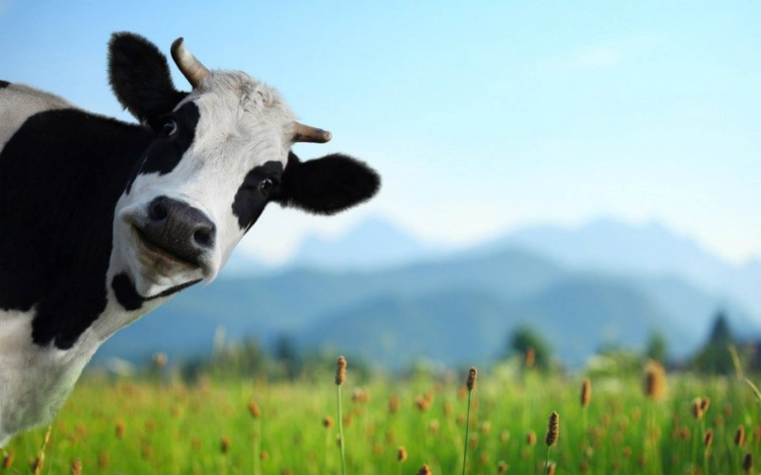
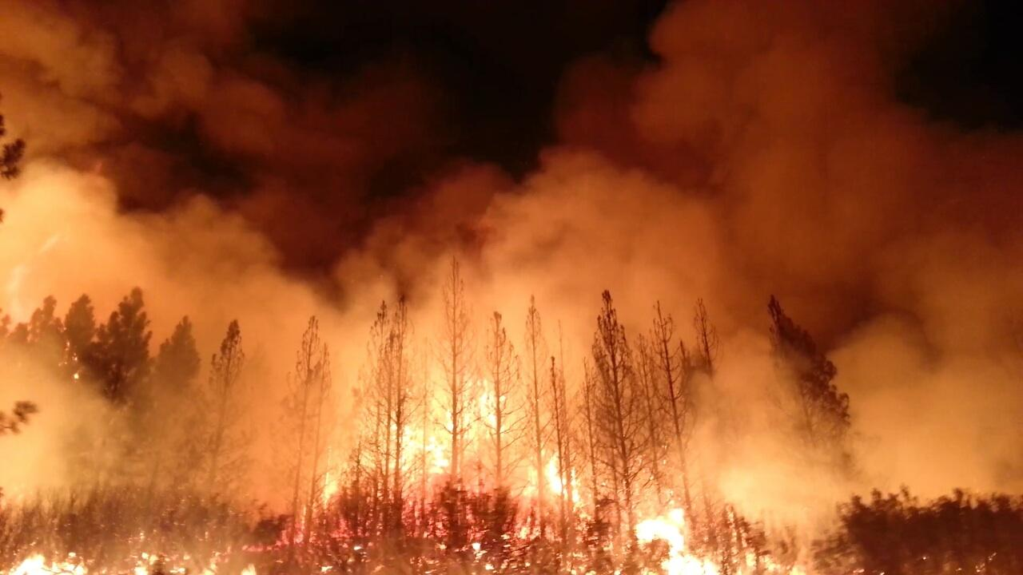
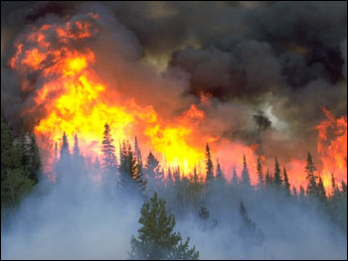
Causes of rainforest destruction:
Large-scale logging (mahogany, teak)
Burning of forest areas
Open-cast mining
Construction of dams, reservoirs
Areas for grazing

Slide 5
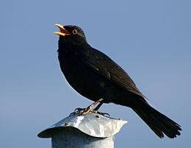
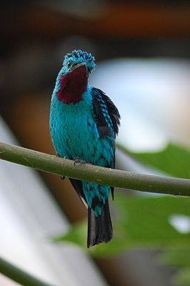
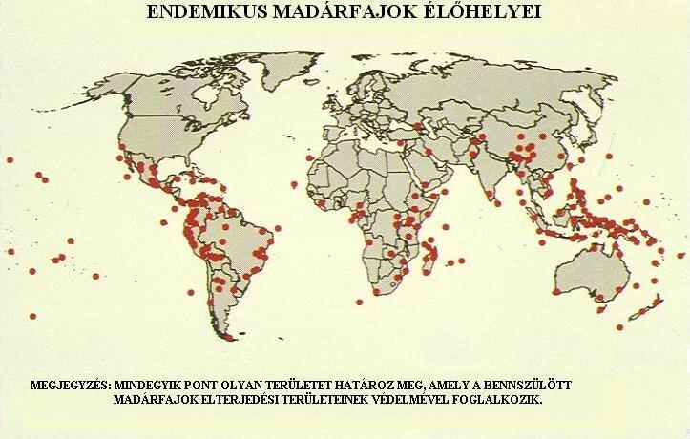
Evolutionary effects of rainforest deforestation:
As a result of deforestation of 15 million hectares per year, about 6-14% of the species living in closed tropical forests will disappear by 2015 and 17-35% by 2040. If deforestation were reduced to 10 million hectares per year, 9-19% of species living in rainforests would disappear by 2040.
There has been a decline in the number of large birds in the forests that feed on the fruits of the trees and help the seeds to disperse. Fruit-eating toucans and kotings played a major role in this process. But as the area of ​​the rainforest decreased, these birds also disappeared and remained only as small as the thrushes.

Slide 6
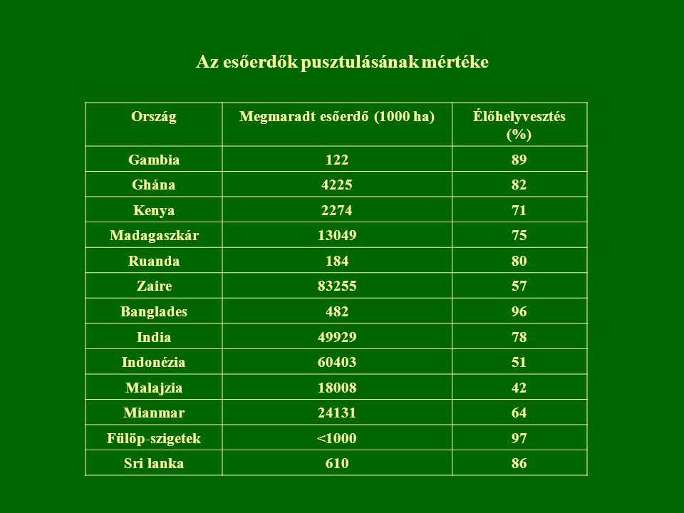
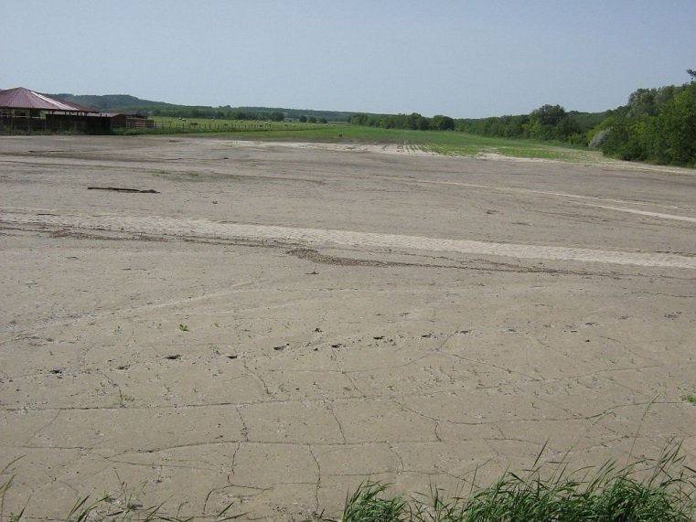
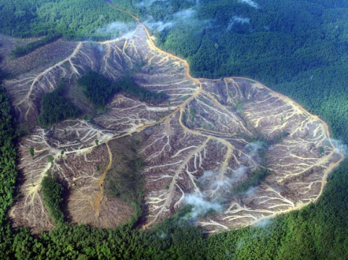
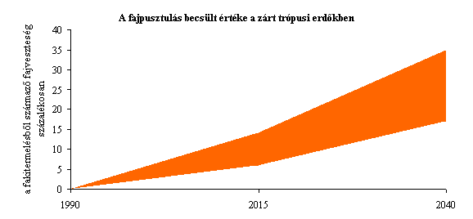
Consequences of deforestation:
As the forest is an extremely complex ecological system, many animal and plant species become extinct with its extinction. Excessive, irresponsible rainforest clearing has several serious consequences.
Heavy rain washes away nutrients from the soil left uncovered after removing the natural vegetation cover, making it soon infertile. Heavy rainfall also causes severe soil erosion. Rainwater, which is no longer absorbed by plants, floods the surface, causing floods and landslides.

Slide 7
Protection of rainforests:
Education is an essential part of saving rainforests. For people to want to save rainforests, they need to see their beauty and understand its importance.
To date, 145,000 square kilometers have been declared a national park, ecological station or biological reserve, bringing them under strict protection.

Slide 8
Thank you for your attention

