Slide 1
Renewable and non-renewable energy sources

Slide 2
Renewable energy sources
Solar energy
Bioenergy
Water Energy
Wind energy
Geothermal Energy

Slide 3
Advantages
Eternal stock
Environmentally friendly operation
Energy Independence

Slide 4
Disadvantages
Their use is determined by local conditions.
They cannot be used anywhere and in any quantity
Uneven production (difficult storage of energy)
Large space requirements so it destroys the environment

Slide 5
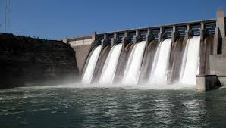
The most commonly used power plants
Wind Power
Hydropower
Solar Power
Geothermal Power Plant
Biomass

Slide 6
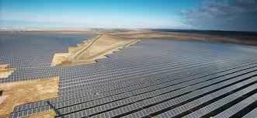
Solar Power in Hungary
Paks Solar Power Plant :
20,6 MW (2019)
Largest in Hungary
74 000 panel
Peak solar power in Hungary 2010 - 2018 (MW)
2010 | 2011 | 2012 | 2013 | 2014 | 2015 | 2016 | 2017 | 2018
2 | 4 | 12 | 35 | 77 | 168 | 225 | 300 | 640

Slide 7
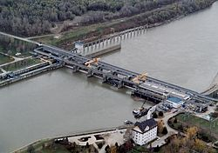
Hydropower in Hungary
Kiskörei Hydropower:
28 MW
4 turbines
Largest in Hungary

Slide 8
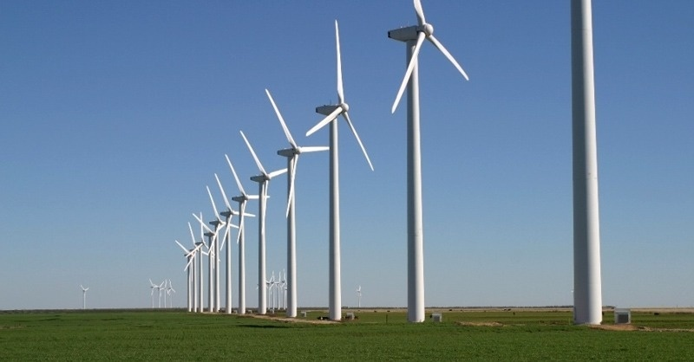
Wind energy in Hungary
Kisigmánd
38 000 kW (2009)
25 windmills
Largest in Hungary

Slide 9
Non-renewable energy sources

Slide 10
Advantages
Getting a lot of energy
Enough for mankind's use of energy

Slide 11
Disadvantages
Limited
Costly
Polluting
Change the composition of the earth's atmosphere
Radioactive

Slide 12
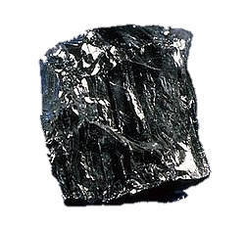
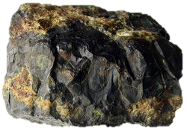
Commodity
Coal
Crude Oil
Natural Gas
Uranium

Slide 13
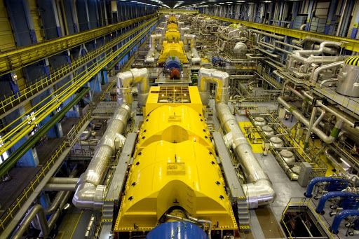
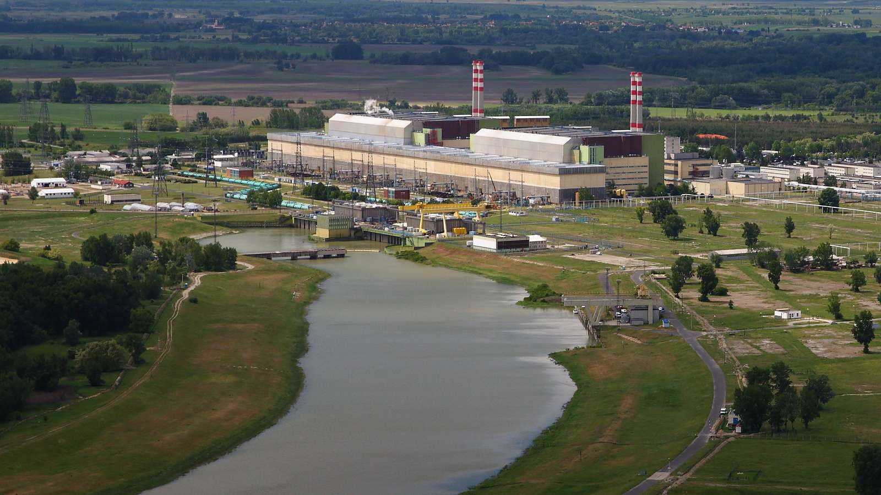
Paks Nuclear Power Plant
Provides Hungary’s 53.6% of its energy
4 reactor units

Slide 14
Thank you for your attention!

