Slide 1
Mihaela Oroz 4.b
High school Matija Antun Reljković (Slavonski Brod)
18y
Topic: science and technology

Slide 2
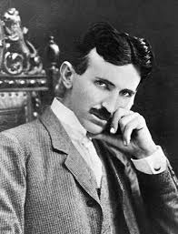
Nikola tesla

Slide 3
80% of the technology we use today is based on Nikola Tesla patents
we will watch the video ( watch carefully)
we will split into groups
groups will answer questions
Which means we will have quiz!

Slide 4
https://www.youtube.com/watch?v=cDxi6ozDwhc

