Slide 1
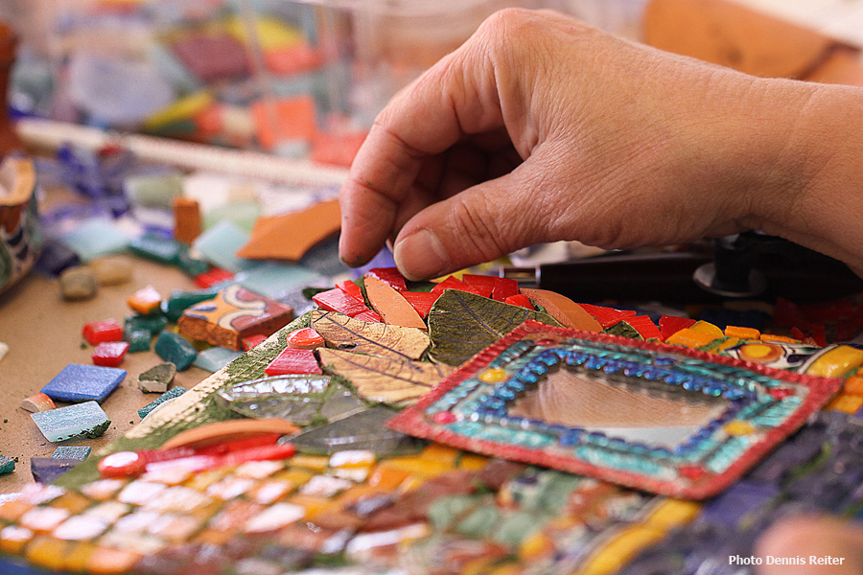
5° GENIKO LYKEIO PETROUPOLIS
ΜOSAIC WORKSHOP

Slide 4
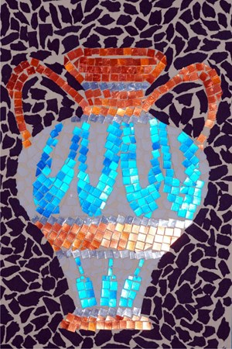
Who made mosaics
Greeks
Assyrians
Egyptians
Romans
Byzantines
Persians

Slide 5
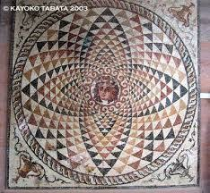
Origin
The earliest mosaics can be traced back to ancient Mesopotamia
They were used to enhance the appearance of Hellenic Villas

Slide 6
Greek mosaic

Slide 7
Assyrians mosaic

Slide 8
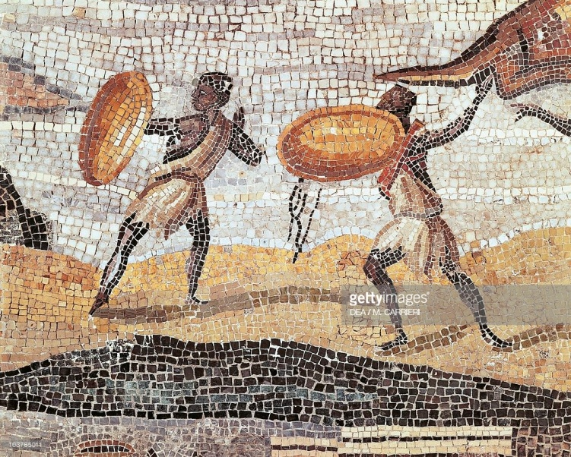
Egyptians mosaics

Slide 9
Persians mosaic

Slide 10
Roman mosaic

Slide 11
Byzantines mosaic

Slide 12
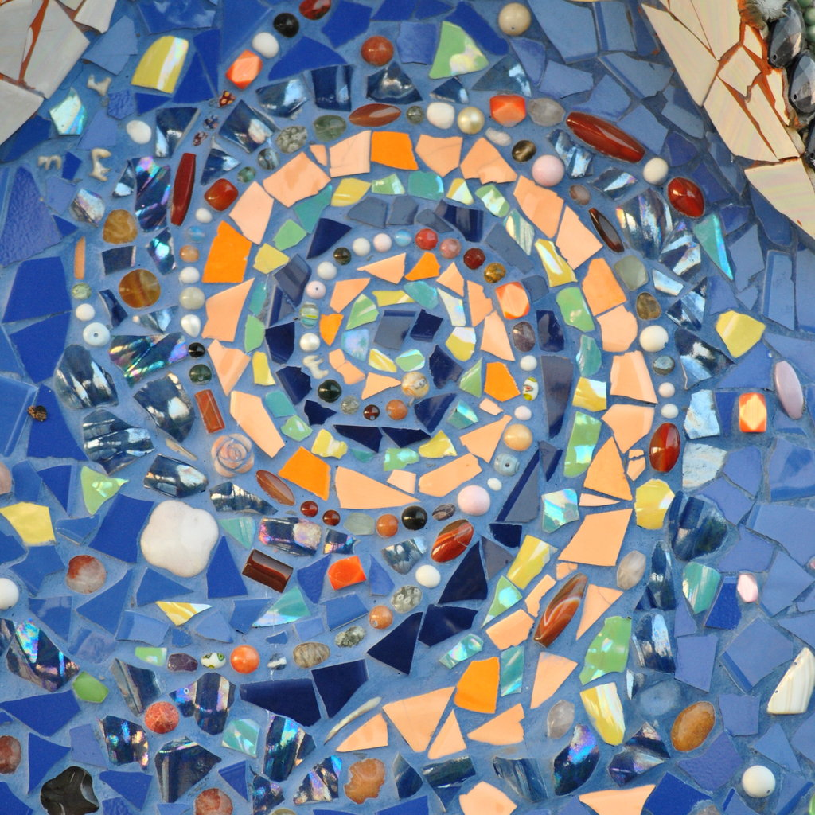
Modern mosaics

Slide 13
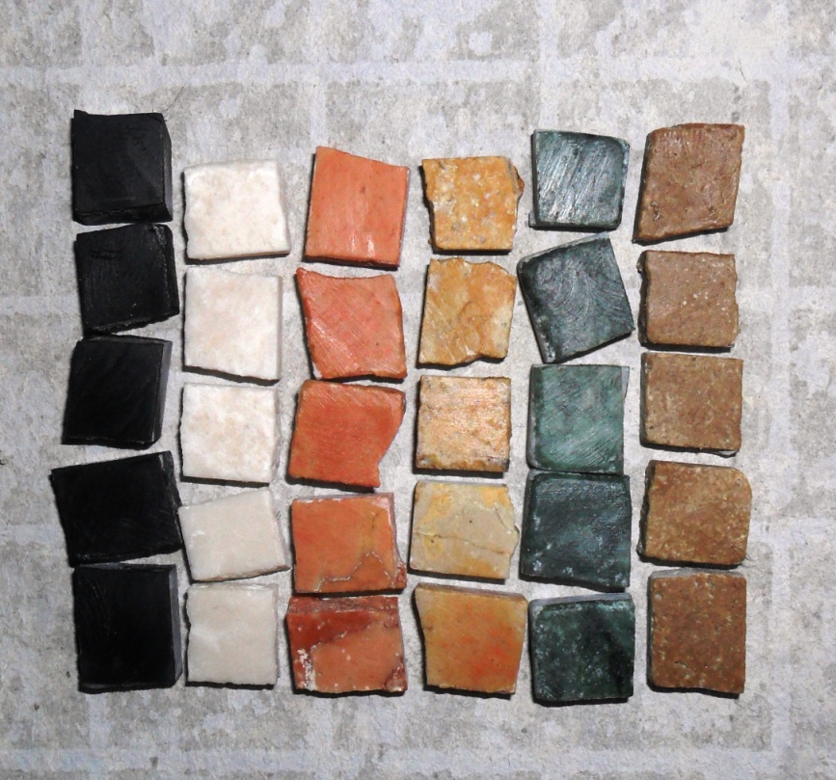
How to create a mosaic
1. Select the material you wish to use. Pieces of material used in a mosaic art are called tesserae. They can be glass, stones, porcelain, seashells, or anything else you can find.

Slide 14
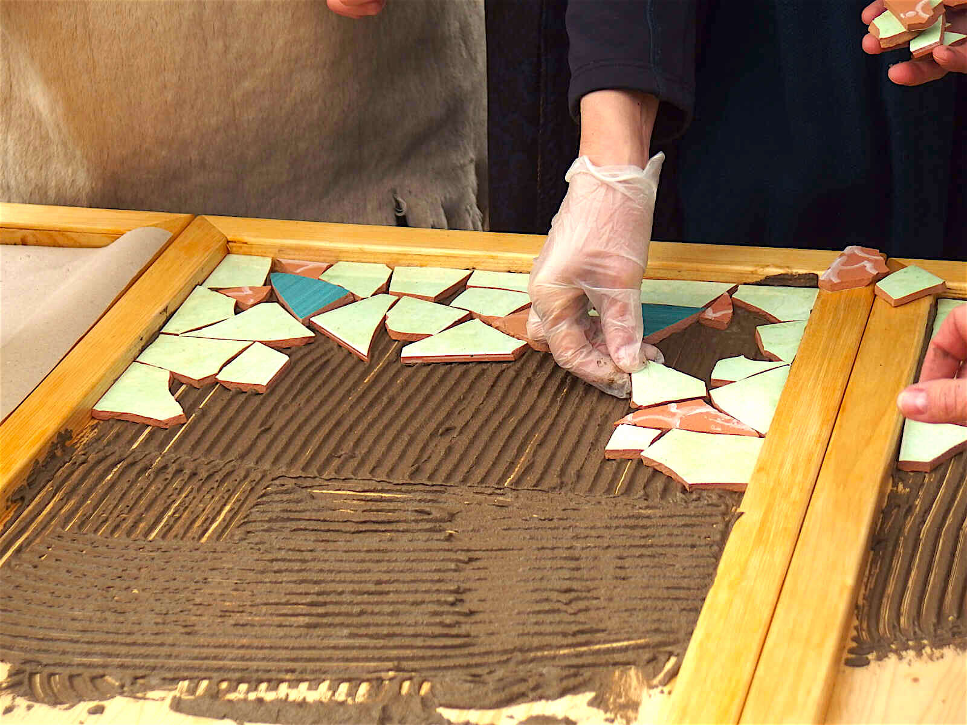
2. Pick the foundation to adhere the mosaic tiles on. Tables, planters, birdbaths, or walking stones are just a few ideas to use.

Slide 15
5. Mix mortar. Apply it to the foundation using a trowel or spatula
6. Prepare the grout mixture.
8. Apply the grout using a spatula
9. Let the grout set for 20 minutes
10. Seal the mosaic with varnish
https://www.youtube.com/watch?v=EWVluZxYiYQ

